Slide 1
Reinforcement Learning

Slide 2
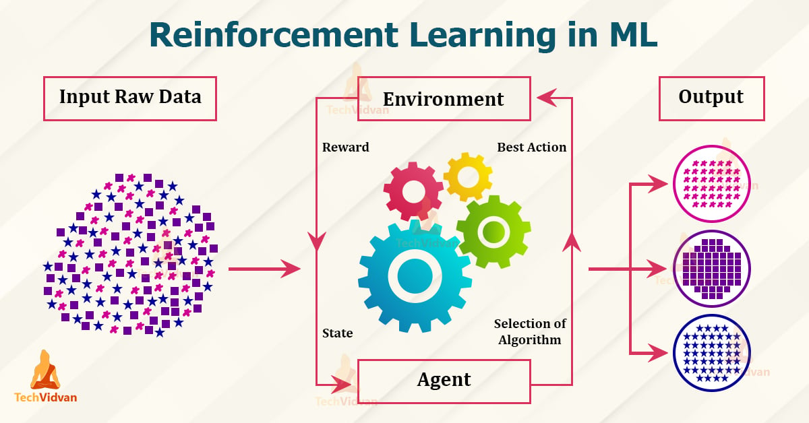
Reinforcement Learning (RL)
Reinforcement Learning brings us closer to what many people traditionally imagine as “Artificial Intelligence”
Not classifying images or predicting numbers
RL help programs learn chess and robots learn to walk
RL is a field of machine learning that tackles problems where an agent learns by interacting with an environment

Slide 3
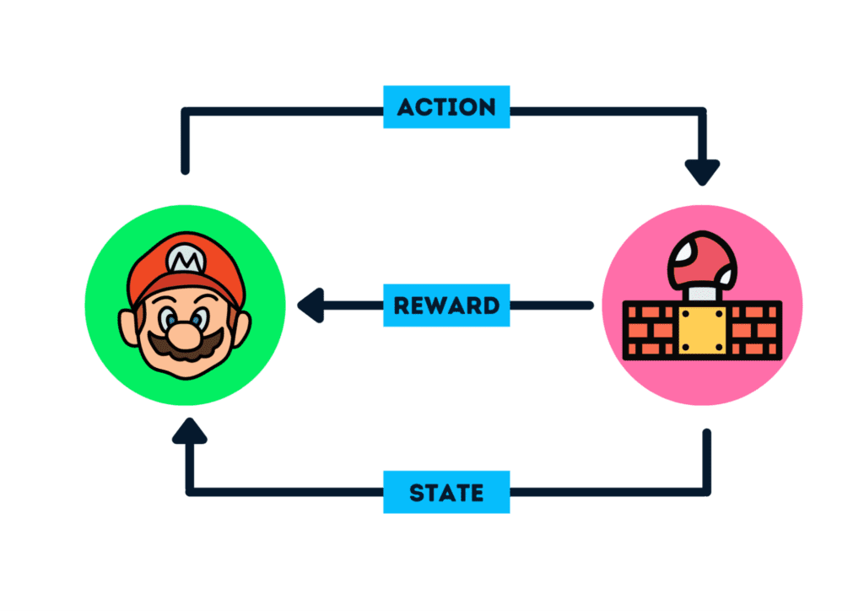

The agent-environment loop
An agent explores an environment
It perceives a state $s∈S$
It chooses an action $a∈A$
The environment transitions to a new state and returns a reward $r_{t}$
Think: Teaching a dog to sit

Slide 4
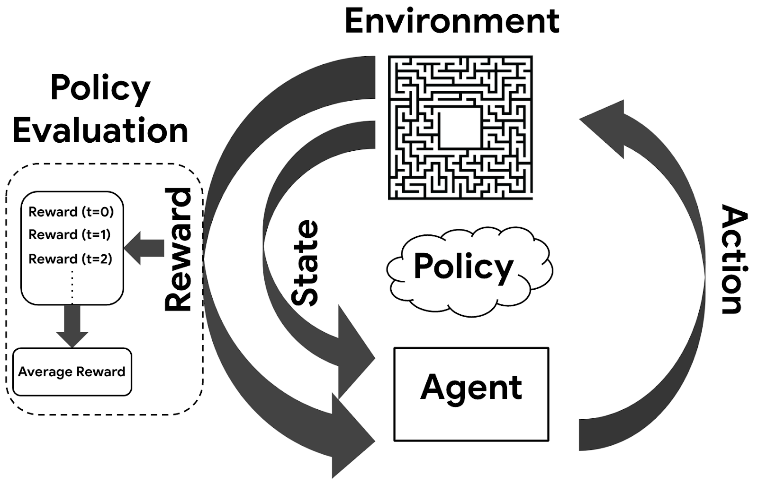
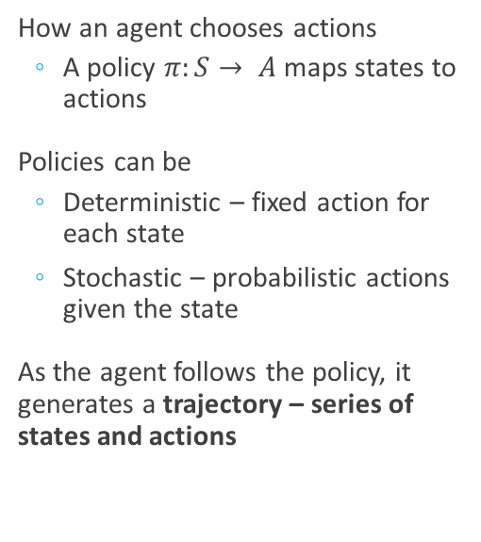
Policy Functions
How an agent chooses actions
A policy $π:S→ A$maps states to actions
Policies can be
Deterministic – fixed action for each state
Stochastic – probabilistic actions given the state
As the agent follows the policy, it generates a trajectory – series of states and actions

Slide 5


Rewards and Return
The agent gets a reward at each time step
Rewards accumulate into a return
$G_{t}=Σ_{0}^{∞}γ^{k} r_{t+k+1}$
$γ$is a discount factor [0,1]
$γ =0$looking for short-term gains
$γ≈ 1$planning for future

Slide 6
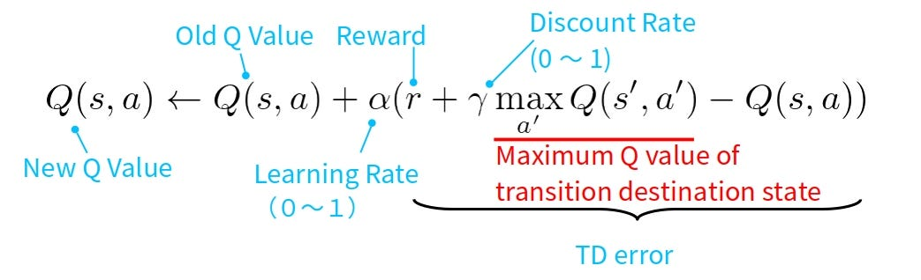

Value Functions
We estimate how good it is to be in a state $s$ with
State Value Function: $v_{π}\left(s\right)=E_{π}\left[G_{t} | S_{t}=s\right]$
Action Value Function: $q_{π}\left(s,a\right)=E_{π}\left[G_{t} | S_{t}=s,A_{t}=a \right]$
Guides agent toward better decisions

Slide 7
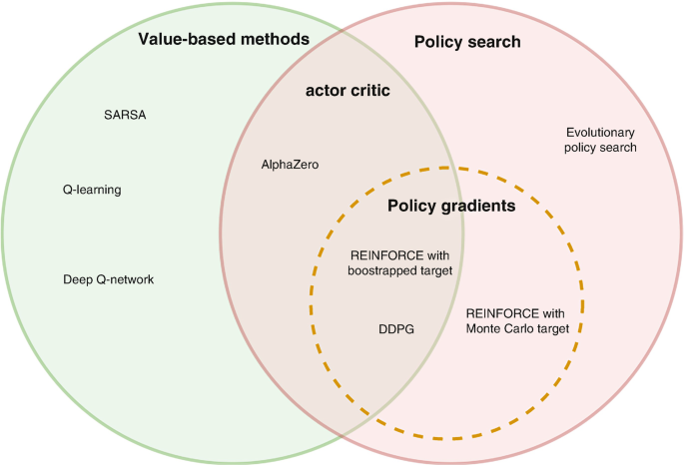
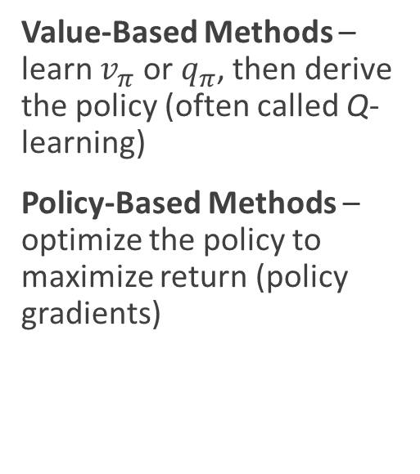
Types of RL Algorithms
Value-Based Methods – learn $v_{π}$ or $q_{π}$, then derive the policy (often called Q-learning)
Policy-Based Methods – optimize the policy to maximize return (policy gradients)

Slide 8
Using Reinforcement Learning
When answering yes to the following questions, RL may be the method to use
Can the problem be conceptualized as an agent interacting with an environment?
Can the agent take actions that affect the outcomes?
Is there a clear notion of reward?
RL is best when the environment is too large to explore exhaustively (Deep-Q learning)

Slide 9
Take home message
Supervised Learning is interpolation over a known dataset
requires someone to have solved the problem already (to label the data)
Reinforcement Learning is optimization via self-generated experience.
can, in principle, discover solutions to problems no human has solved

Slide 10
AlphaZero
CASE STUDY
Reinforcement learning in practice · DeepMind, 2017
AlphaZero is a general-purpose RL agent that mastered Go, Chess, and Shogi from scratch through self-play alone — no human games, no hand-crafted evaluation functions. A single neural network learns both a policy π(a|s) and a value function v(s), guided by Monte Carlo tree search. Within hours it surpassed the best domain-specific engines ever built.
Policy π(a|s)
State s
Value v(s)
Reward r
Move probabilities
action a
Board position
evaluate
Position evaluation
outcome
Game outcome
Network outputs
distribution over
legal board moves
Current piece layout
encoded as
tensor input
Win probability
estimate from
current board state
+1 win
0 draw
−1 loss
← policy updated after each self-play game →
10¹⁷⁰
possible Go positions — brute force is impossible; RL learns to navigate
Silver et al., Nature 2017 · arXiv:1712.01815

Slide 11
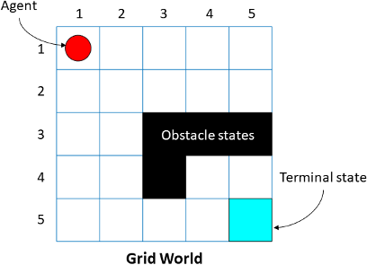
Gridworld
Simple RL environment to explore these concepts
Grid-based world
Agent moves up/down/left/right
Goal is to reach a designated target square
Rewards: +1 for reaching goal, -1 for invalid moves
We should be looking for
Agent Behavior
Different policy effects
How value functions evolve during training

