Slide 1

Numerical Integration
Simpson to Quadrature

Slide 2
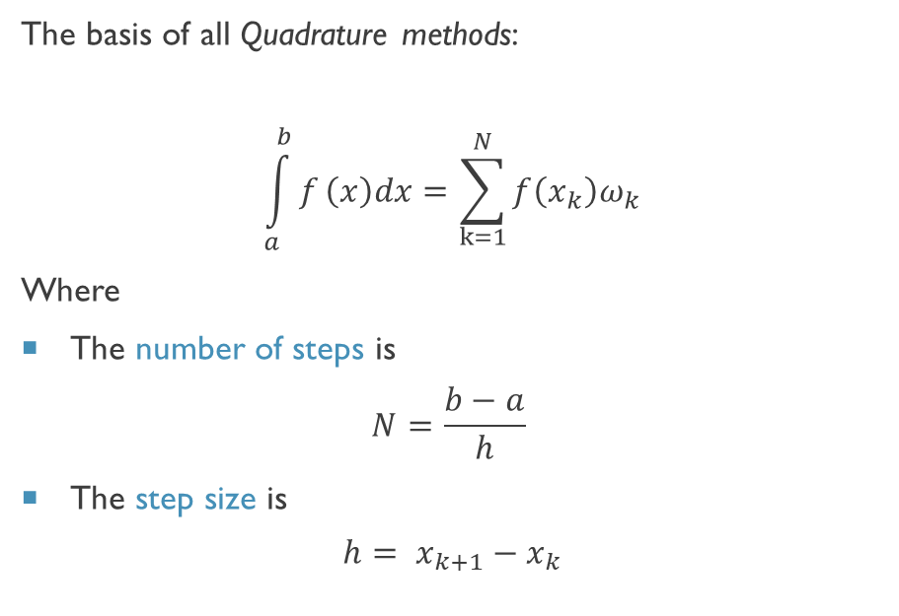
Quadrature
Quadrature –the process of finding a square equal in area to a given area
Many methods for finding these areas, we’ll concentrate on three:
Trapezoid Rule
Simpson Rule
Romberg Integration
The basis of all Quadrature methods:
$$\int_{a}^{b}{f}\left(x\right)dx=\sum_{k=1}^{N}{f\left(x_{k}\right)ω_{k}}$$
Where
The number of steps is
$$N=\frac{b−a}{h}$$
The step size is
$$h= x_{k+1}−x_{k}$$

Slide 3
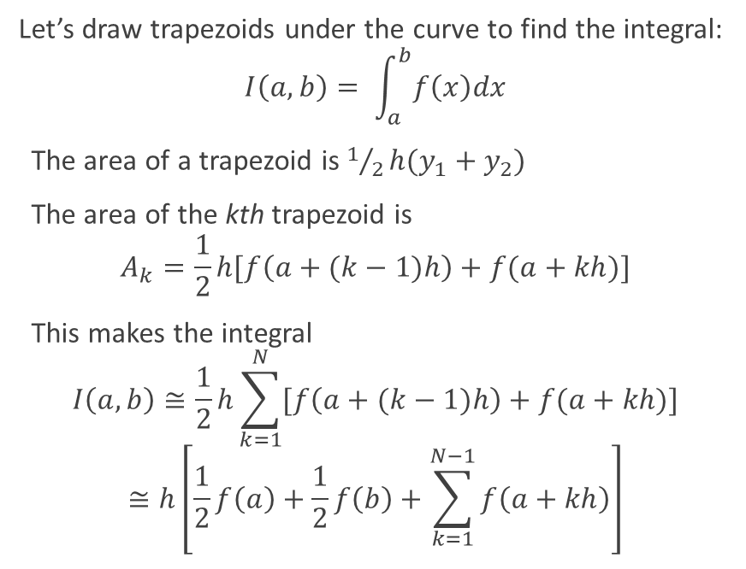
Trapezoid Rule
Let’s draw trapezoids under the curve to find the integral:
$$I\left(a,b\right)= \int_{a}^{b}{f\left(x\right)dx}$$
The area of a trapezoid is $1/2h(y_{1}+y_{2})$
The area of the kth trapezoid is
$$A_{k}=\frac{1}{2}h[f\left(a+(k−1)h\right)+f(a+kh)]$$
This makes the integral
$$I\left(a,b\right)≅\frac{1}{2}h\sum_{k=1}^{N}{[f\left(a+(k−1)h\right)+f(a+kh)]}$$
$$≅h\left[\frac{1}{2}f\left(a\right)+\frac{1}{2}f\left(b\right)+\sum_{k=1}^{N−1}{f\left(a+kh\right)}\right]$$

Slide 4
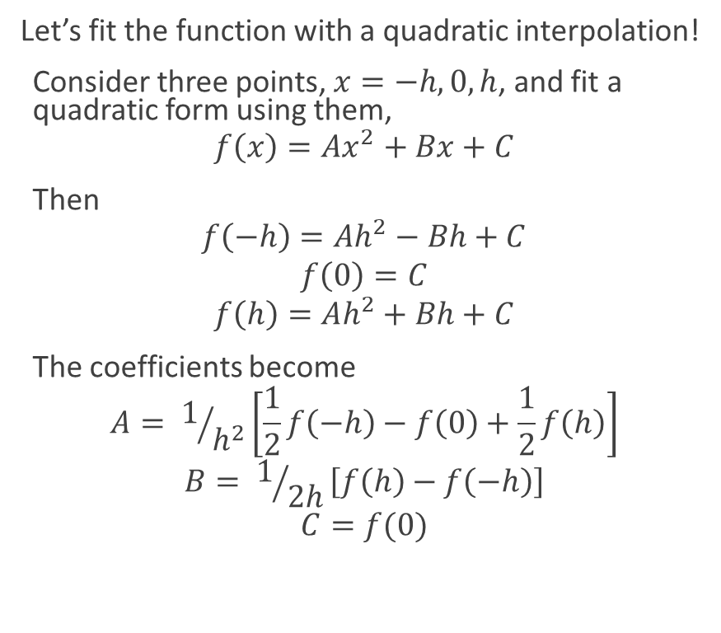
Simpson Rule
Let’s fit the function with a quadratic interpolation!
Consider three points, $x=−h,0,h$, and fit a quadratic form using them,
$$f\left(x\right)=Ax^{2}+Bx+C$$
Then
$$f\left(−h\right)=Ah^{2}−Bh+C$$
$$f\left(0\right)=C$$
$$f\left(h\right)=Ah^{2}+Bh+C$$
The coefficients become
$$A= 1/{h^{2}}\left[\frac{1}{2}f\left(−h\right)−f\left(0\right)+\frac{1}{2}f\left(h\right)\right]$$
$$B= 1/{2h}\left[f\left(h\right)−f\left(−h\right)\right]$$
$$C=f(0)$$

Slide 5
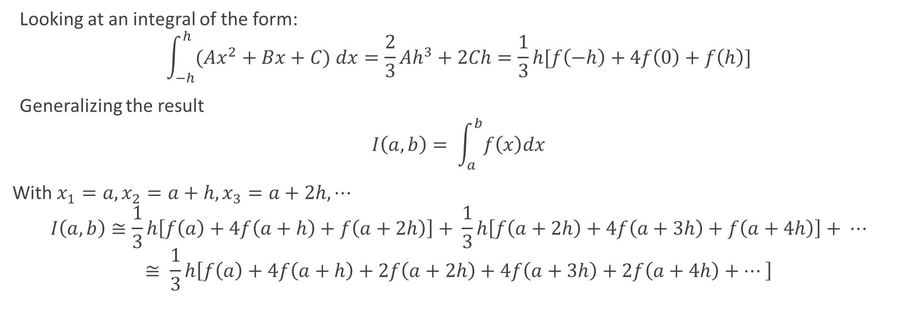
Simpson Rule (In the Weeds)
Looking at an integral of the form:
$$\int_{−h}^{h}{(Ax^{2}+Bx+C) dx}=\frac{2}{3}Ah^{3}+2Ch=\frac{1}{3}h[f\left(−h\right)+4f\left(0\right)+f\left(h\right)]$$
Generalizing the result
$$I\left(a,b\right)= \int_{a}^{b}{f\left(x\right)dx}$$
With $x_{1}=a,x_{2}=a+h,x_{3}=a+2h,⋯$
$$I\left(a,b\right)≅\frac{1}{3}h\left[f\left(a\right)+4f\left(a+h\right)+f\left(a+2h\right)\right]+ \frac{1}{3}h\left[f\left(a+2h\right)+4f\left(a+3h\right)+f\left(a+4h\right)\right]+ ⋯$$
$$≅ \frac{1}{3}h\left[f\left(a\right)+4f\left(a+h\right)+2f\left(a+2h\right)+4f\left(a+3h\right)+2f\left(a+4h\right)+⋯ \right]$$

Slide 6
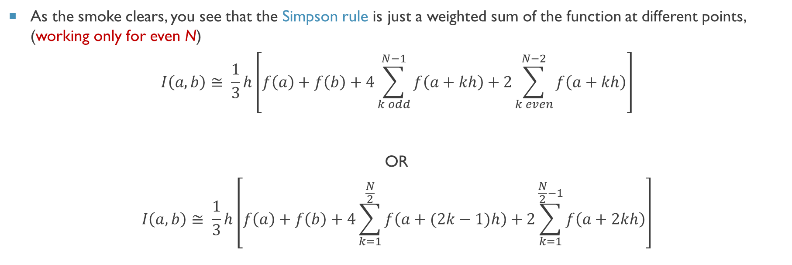
Simpson Rule (Last of the math)
As the smoke clears, you see that the Simpson rule is just a weighted sum of the function at different points, (working only for even N)
$$I\left(a,b\right)≅ \frac{1}{3}h\left[f\left(a\right)+f\left(b\right)+4\sum_{k odd}^{N−1}{f\left(a+kh\right)}+2\sum_{k even}^{N−2}{f\left(a+kh\right)}\right]$$
OR
$$I\left(a,b\right)≅ \frac{1}{3}h\left[f\left(a\right)+f\left(b\right)+4\sum_{k=1}^{\frac{N}{2}}{f\left(a+(2k−1)h\right)}+2\sum_{k=1}^{\frac{N}{2}−1}{f\left(a+2kh\right)}\right]$$
Simpson Rule

Slide 7
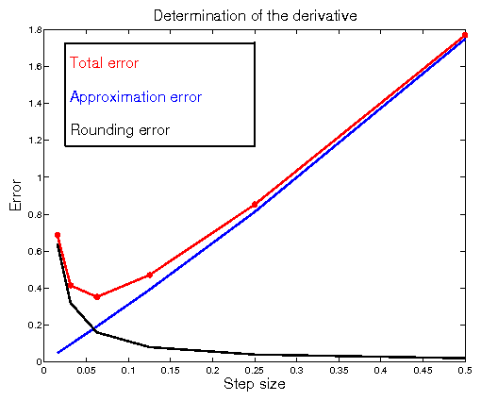
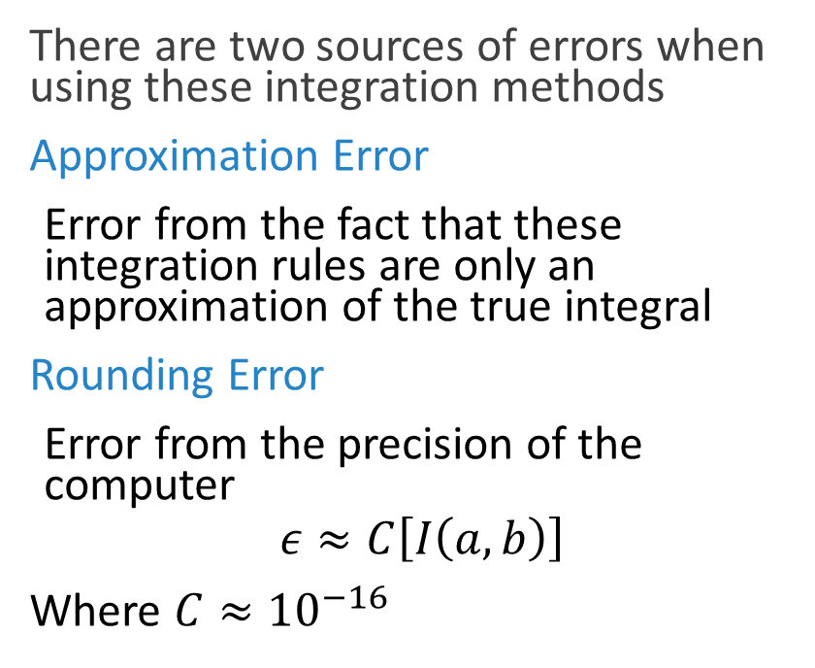
How Accurate are These Methods?
There are two sources of errors when using these integration methods
Approximation Error
Error from the fact that these integration rules are only an approximation of the true integral
Rounding Error
Error from the precision of the computer
$$ε≈C\left[I\left(a,b\right)\right]$$
Where $C≈{10}^{−16}$

Slide 8
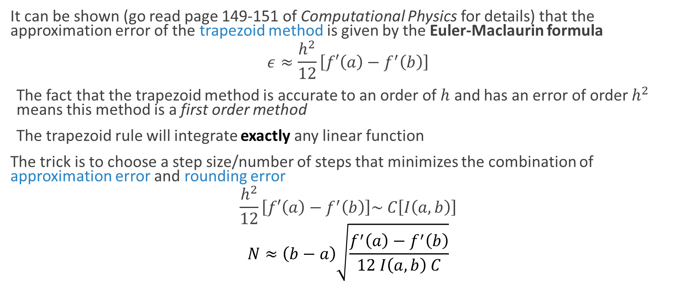
Errors in the Trapezoid Rule
It can be shown (go read page 149-151 of Computational Physics for details) that the approximation error of the trapezoid method is given by the Euler-Maclaurin formula
$$ε≈\frac{h^{2}}{12}\left[f′\left(a\right)−f^{′}\left(b\right)\right]$$
The fact that the trapezoid method is accurate to an order of $h$ and has an error of order $h^{2}$ means this method is a first order method
The trapezoid rule will integrate exactly any linear function
The trick is to choose a step size/number of steps that minimizes the combination of approximation error and rounding error
$$\frac{h^{2}}{12}\left[f′\left(a\right)−f^{′}\left(b\right)\right]\sim C\left[I\left(a,b\right)\right]$$
$$N≈\left(b−a\right)\sqrt{\frac{f^{′}\left(a\right)−f^{′}\left(b\right)}{12 I\left(a,b\right) C}}$$

Slide 9
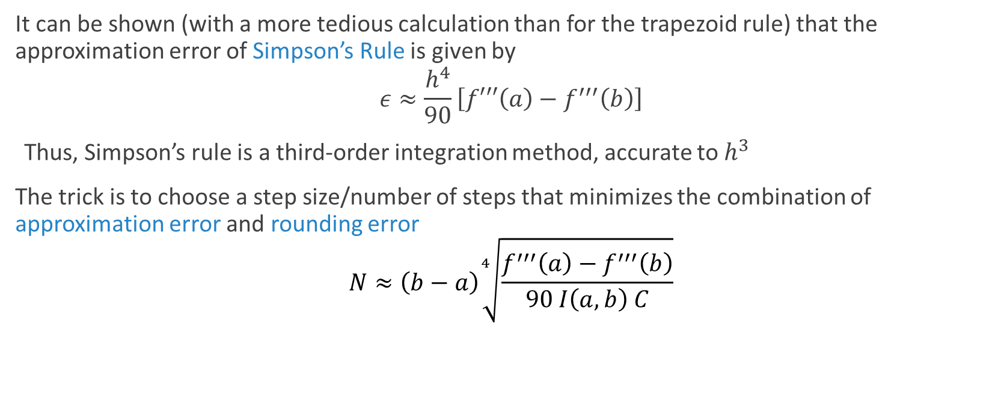
Errors in Simpson’s Rule
It can be shown (with a more tedious calculation than for the trapezoid rule) that the approximation error of Simpson’s Rule is given by
$$ε≈\frac{h^{4}}{90}\left[f′′′\left(a\right)−f^{′′′}\left(b\right)\right]$$
Thus, Simpson’s rule is a third-order integration method, accurate to $h^{3}$
The trick is to choose a step size/number of steps that minimizes the combination of approximation error and rounding error
$$N≈\left(b−a\right)\sqrt[4]{\frac{f^{′′′}\left(a\right)−f^{′′′}\left(b\right)}{90 I\left(a,b\right) C}}$$

Slide 10
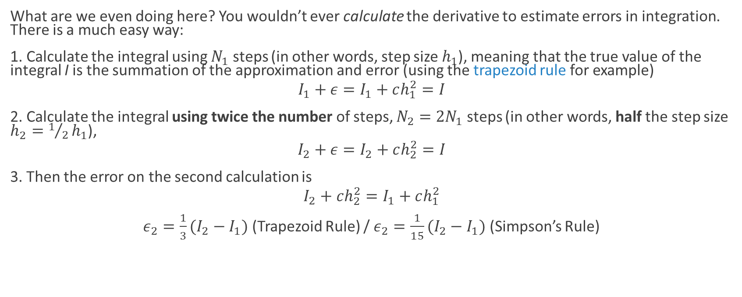
That’s all great, IF we knew the function!!
What are we even doing here? You wouldn’t ever calculate the derivative to estimate errors in integration. There is a much easy way:
1. Calculate the integral using $N_{1}$ steps (in other words, step size $h_{1}$), meaning that the true value of the integral I is the summation of the approximation and error (using the trapezoid rule for example)
$${I_{1}+ε=I}_{1}+ch_{1}^{2}=I$$
2. Calculate the integral using twice the number of steps, $N_{2}=2N_{1}$ steps (in other words, half the step size $h_{2}=1/2h_{1}$),
$${I_{2}+ε=I}_{2}+ch_{2}^{2}=I$$
3. Then the error on the second calculation is
$$I_{2}+ch_{2}^{2}=I_{1}+ch_{1}^{2}$$
$ε_{2}=\frac{1}{3}(I_{2}−I_{1})$(Trapezoid Rule) / $ε_{2}=\frac{1}{15}(I_{2}−I_{1})$(Simpson’s Rule)

Slide 11
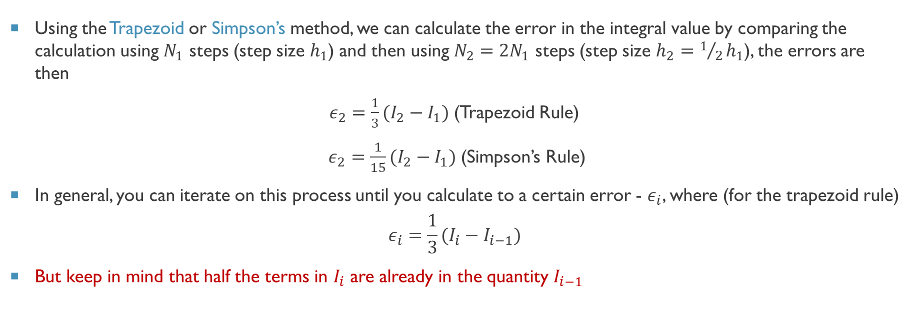
Using the error estimates to our advantage
Using the Trapezoid or Simpson’s method, we can calculate the error in the integral value by comparing the calculation using $N_{1}$ steps (step size $h_{1}$) and then using $N_{2}=2N_{1}$ steps (step size $h_{2}=1/2h_{1}$), the errors are then
$ε_{2}=\frac{1}{3}(I_{2}−I_{1})$(Trapezoid Rule)
$ε_{2}=\frac{1}{15}(I_{2}−I_{1})$(Simpson’s Rule)
In general, you can iterate on this process until you calculate to a certain error - $ε_{i}$, where (for the trapezoid rule)
$$ε_{i}=\frac{1}{3}(I_{i}−I_{i−1})$$
But keep in mind that half the terms in $I_{i}$ are already in the quantity $I_{i−1}$

Slide 12
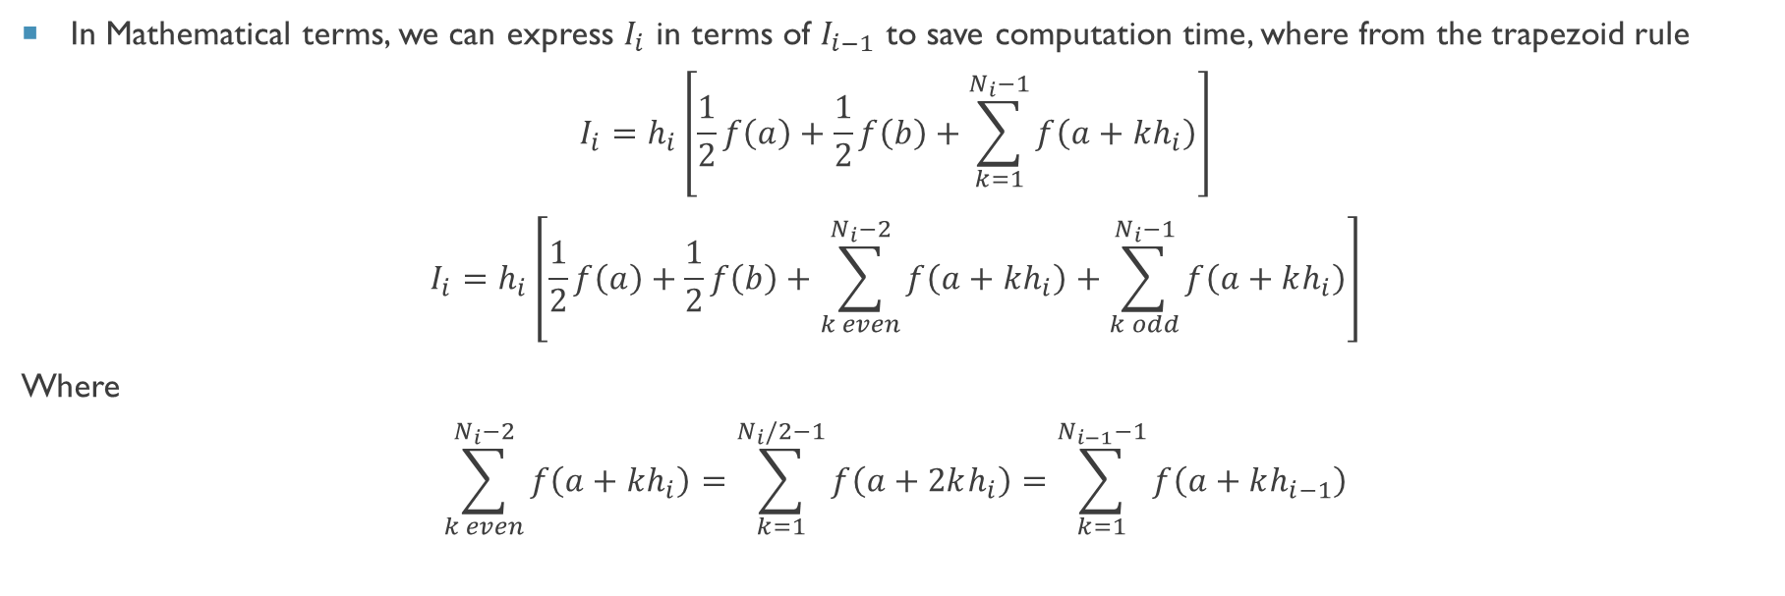
Adaptive Integration Techiniques
In Mathematical terms, we can express $I_{i}$ in terms of $I_{i−1}$ to save computation time, where from the trapezoid rule
$$I_{i}=h_{i}\left[\frac{1}{2}f\left(a\right)+\frac{1}{2}f\left(b\right)+\sum_{k=1}^{N_{i}−1}{f\left(a+kh_{i}\right)}\right]$$
$$I_{i}=h_{i}\left[\frac{1}{2}f\left(a\right)+\frac{1}{2}f\left(b\right)+\sum_{k even}^{N_{i}−2}{f\left(a+kh_{i}\right)}+\sum_{k odd}^{N_{i}−1}{f\left(a+kh_{i}\right)}\right]$$
Where
$$\sum_{k even}^{N_{i}−2}{f\left(a+kh_{i}\right)=\sum_{k=1}^{N_{i}/2−1}{f\left(a+2kh_{i}\right)}=\sum_{k=1}^{N_{i−1}−1}{f\left(a+kh_{i−1}\right)}}$$

Slide 13
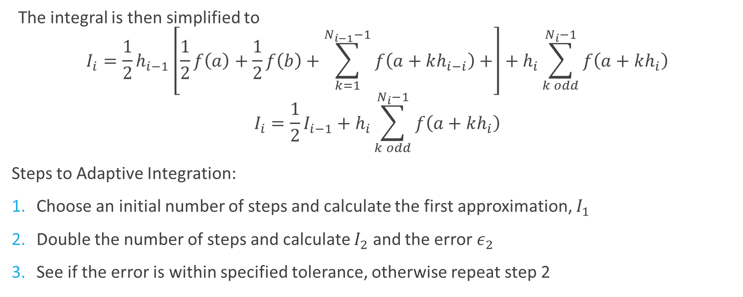
Adaptive Integration Techiniques
The integral is then simplified to
$$I_{i}={\frac{1}{2}h}_{i−1}\left[\frac{1}{2}f\left(a\right)+\frac{1}{2}f\left(b\right)+\sum_{k=1}^{N_{i−1}−1}{f\left(a+kh_{i−i}\right)}+\right]+h_{i}\sum_{k odd}^{N_{i}−1}{f\left(a+kh_{i}\right)}$$
$$I_{i}=\frac{1}{2}I_{i−1}+h_{i}\sum_{k odd}^{N_{i}−1}{f\left(a+kh_{i}\right)}$$
Steps to Adaptive Integration:
Choose an initial number of steps and calculate the first approximation, $I_{1}$
Double the number of steps and calculate $I_{2}$ and the error $ε_{2}$
See if the error is within specified tolerance, otherwise repeat step 2

Slide 14
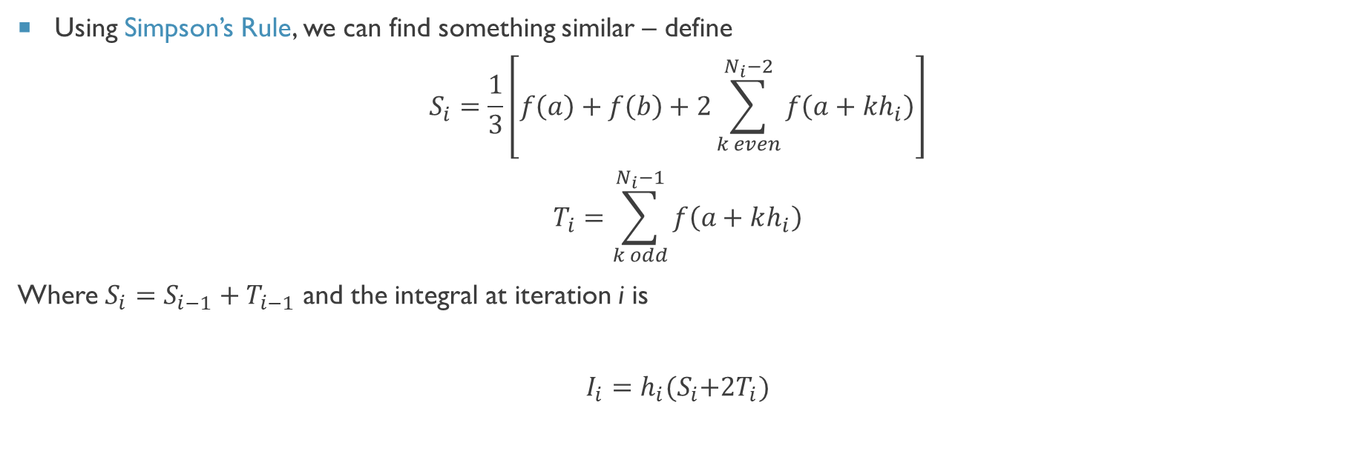
Adaptive Integration methods
Using Simpson’s Rule, we can find something similar – define
$$S_{i}=\frac{1}{3}\left[f\left(a\right)+f\left(b\right)+2\sum_{k even}^{N_{i}−2}{f\left(a+kh_{i}\right)}\right]$$
$$T_{i}=\sum_{k odd}^{N_{i}−1}{f\left(a+kh_{i}\right)}$$
Where $S_{i}=S_{i−1}+T_{i−1}$ and the integral at iteration i is
$$I_{i}=h_{i}{(S}_{i}+{2T}_{i})$$

Slide 15
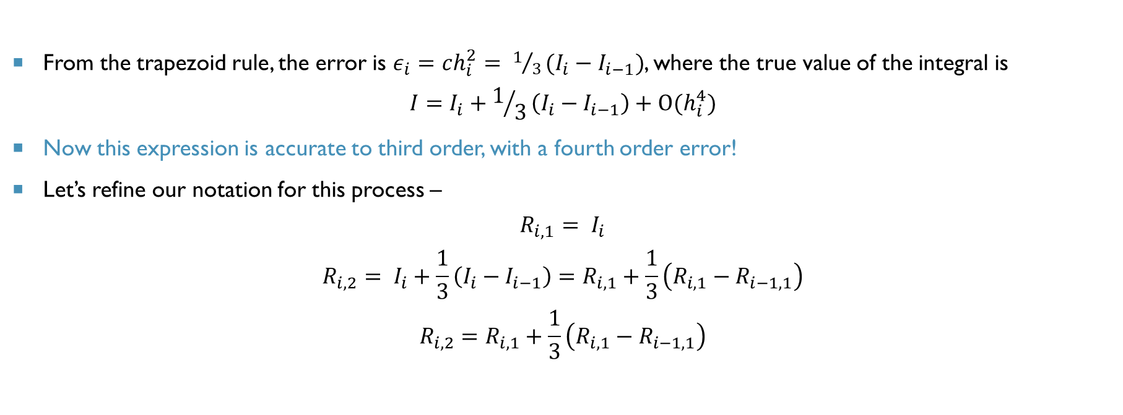
Romberg Integration - We can do even better!
From the trapezoid rule, the error is $ε_{i}=ch_{i}^{2}= 1/3(I_{i}−I_{i−1})$, where the true value of the integral is
$$I=I_{i}+1/3\left(I_{i}−I_{i−1}\right)+O(h_{i}^{4})$$
Now this expression is accurate to third order, with a fourth order error!
Let’s refine our notation for this process –
$$R_{i,1}= I_{i}$$
$$R_{i,2}= I_{i}+\frac{1}{3}\left(I_{i}−I_{i−1}\right)=R_{i,1}+\frac{1}{3}\left(R_{i,1}−R_{i−1,1}\right)$$
$$R_{i,2}=R_{i,1}+\frac{1}{3}\left(R_{i,1}−R_{i−1,1}\right)$$
Relates iterations

Slide 16
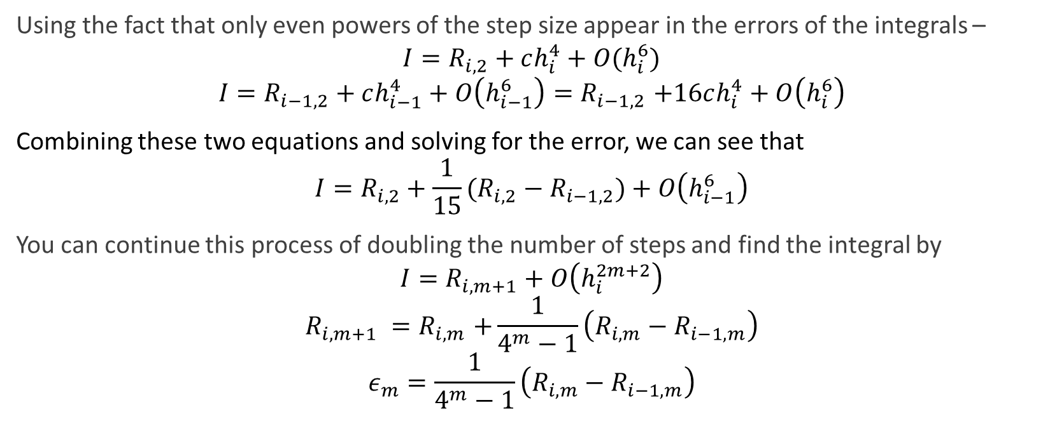
Romberg Integration – The process
Using the fact that only even powers of the step size appear in the errors of the integrals –
$${I=R}_{i,2}+ch_{i}^{4}+O(h_{i}^{6})$$
$${I=R}_{i−1,2}+ch_{i−1}^{4}+O\left(h_{i−1}^{6}\right){=R}_{i−1,2}+16ch_{i}^{4}+O\left(h_{i}^{6}\right)$$
Combining these two equations and solving for the error, we can see that
$${I=R}_{i,2}+\frac{1}{15}(R_{i,2}−R_{i−1,2})+O\left(h_{i−1}^{6}\right)$$
You can continue this process of doubling the number of steps and find the integral by
$${I=R}_{i,m+1}+O\left(h_{i}^{2m+2}\right)$$
$$R_{i,m+1} {=R}_{i,m}+\frac{1}{4^{m}−1}\left(R_{i,m}−R_{i−1,m}\right)$$
$$ε_{m}=\frac{1}{4^{m}−1}\left(R_{i,m}−R_{i−1,m}\right)$$
Relates iterations
Best error estimate

Slide 17

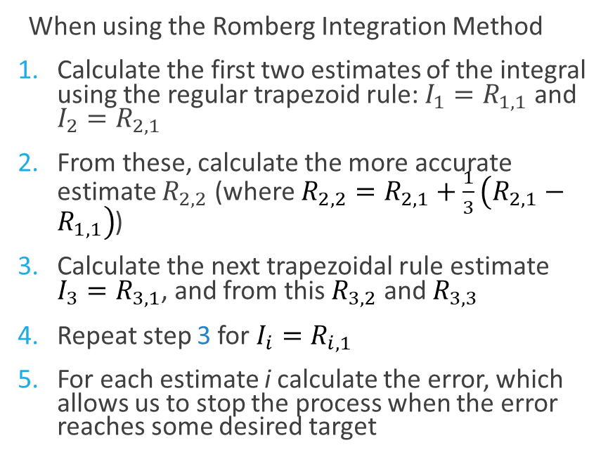
Romberg Integration Algorithm
When using the Romberg Integration Method
Calculate the first two estimates of the integral using the regular trapezoid rule: $I_{1}=R_{1,1}$ and $I_{2}=R_{2,1}$
From these, calculate the more accurate estimate $R_{2,2}$ (where $R_{2,2}=R_{2,1}+\frac{1}{3}\left(R_{2,1}−R_{1,1}\right)$)
Calculate the next trapezoidal rule estimate $I_{3}=R_{3,1}$, and from this $R_{3,2}$ and $R_{3,3}$
Repeat step 3 for $I_{i}=R_{i,1}$
For each estimate i calculate the error, which allows us to stop the process when the error reaches some desired target
$I_{1}≡R_{1,1}$
$I_{2}≡R_{2,1}→R_{2,2}$
$I_{3}≡R_{3,1}$ $→R_{3,2}$ $→R_{3,3}$
$I_{4}≡R_{4,1}$ $→R_{4,2}$ $→R_{4,3}$ $→R_{4,4}$

Slide 18
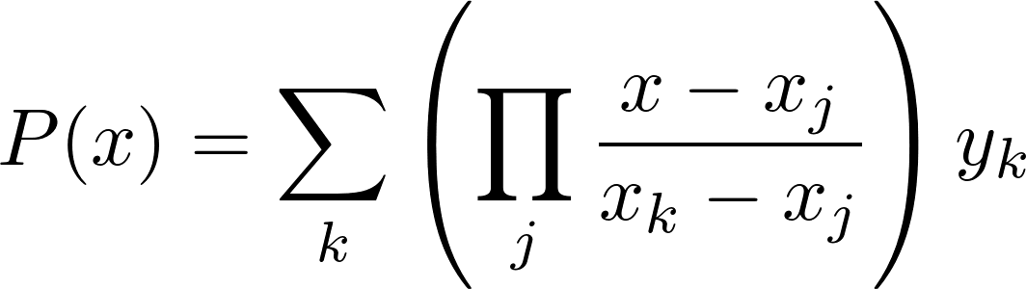
Higher order integration techniques
Given N points we can fit a (N-1)th degree polynomial
Why don’t we just do that and then integrate that polynomial?
Good question! Such methods exist and are called Newton-Cotes formulas – the weightings for cubic and quartic curve fittings is on pg 164 of Computational Physics by Newman
There is also a method that allows you to vary the weights and evaluation positions to integrate a (2N-1)th-degree polynomial with just N evaluations called Gaussian Quadrature
Lagrange Interpolating Polynomial

