Slide 1
Orbital Mechanics
planetary motion, satellite trajectories, and space exploration

Slide 2
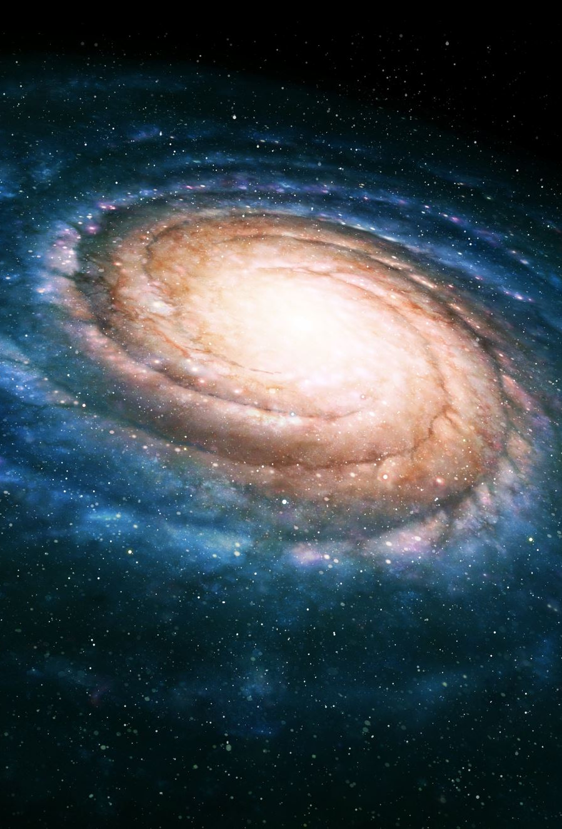

Orbital Mechanics
Orbital mechanics (or celestial mechanics) studies the motion of objects in space under gravitational influence.
Universal Law of Gravitation:
$\vec{F}=−\frac{GMm}{r^{2}} \hat{r}$
The two-body problem can be reduced to a 1-body problem using the reduced mass,
$μ=\frac{Mm}{M+m}$
But for must planetary systems we are concerned with, we don’t need this.

Slide 3
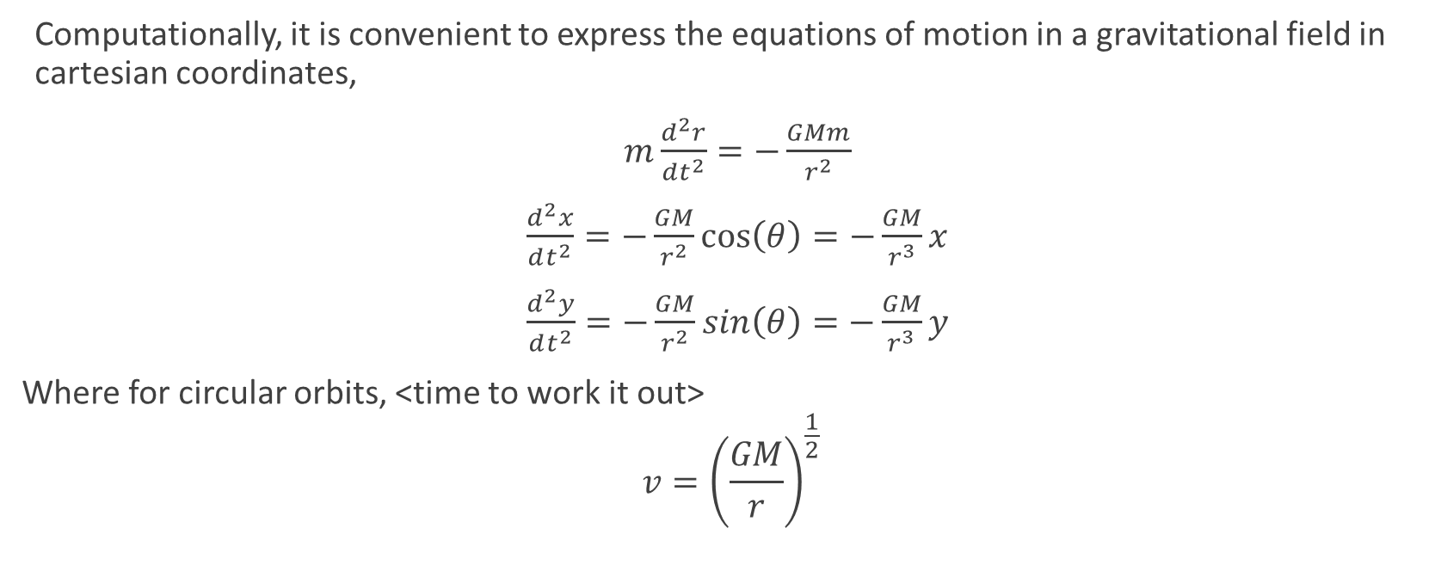
Equations of motion
Computationally, it is convenient to express the equations of motion in a gravitational field in cartesian coordinates,
$m\frac{d^{2}r}{dt^{2}}=−\frac{GMm}{r^{2}}$
$\frac{d^{2}x}{dt^{2}}=−\frac{GM}{r^{2}}cos\left(θ\right)=−\frac{GM}{r^{3}}x$
$\frac{d^{2}y}{dt^{2}}=−\frac{GM}{r^{2}}sin\left(θ\right)=−\frac{GM}{r^{3}}y$
Where for circular orbits, <time to work it out>
$$v={\left(\frac{GM}{r}\right)}^{\frac{1}{2}}$$

Slide 4
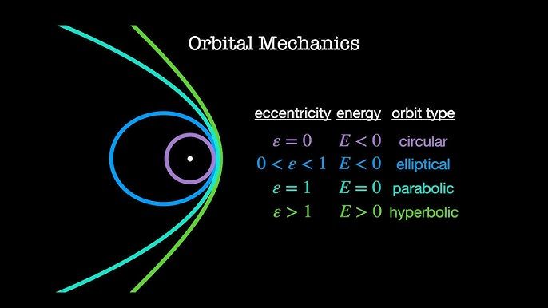
Types of Orbits
The type of orbits are characterized by eccentricity and the energy
Kepler’s First Law: planets orbit stars in elliptical orbits

Slide 5
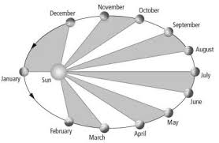

Conserved Quantities In Orbits
Energy
Since gravitation is a conservative force, the total energy of the orbiting system is conserved
$E=\frac{1}{2}mv^{2} −\frac{GMm}{r}$
Using the Virial theorem, this can be simplified even more
Angular Momentum
Since gravitation is a central force, the angular momentum of the system should also be conserved,
$$\vec{L}=m \vec{r}×\vec{v}=constant$$
How do we know that?
How does it relate to Kepler’s 2nd Law?

Slide 6
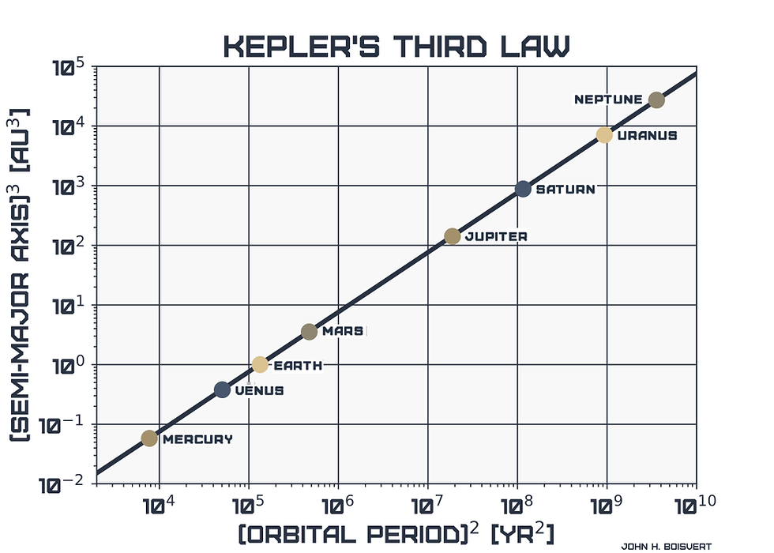
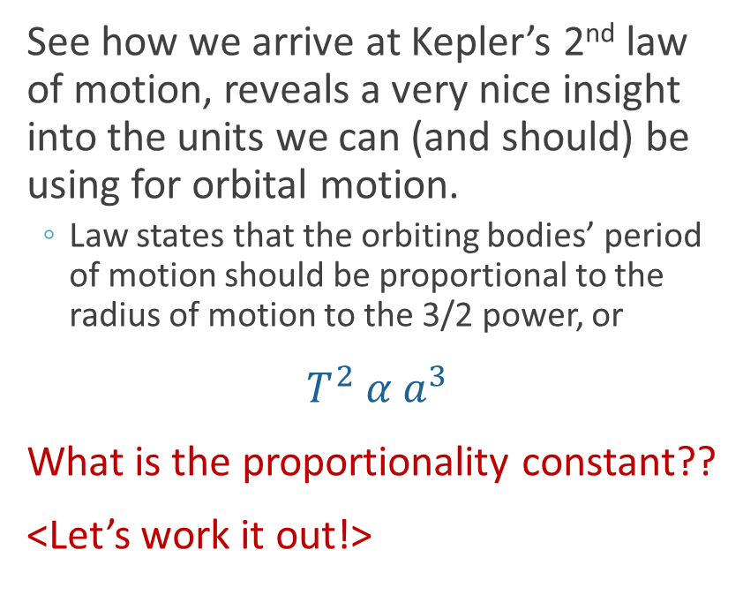
Kepler’s 3rd Law of Motion
See how we arrive at Kepler’s 2nd law of motion, reveals a very nice insight into the units we can (and should) be using for orbital motion.
Law states that the orbiting bodies’ period of motion should be proportional to the radius of motion to the 3/2 power, or
$T^{2} α a^{3}$
What is the proportionality constant??
<Let’s work it out!>

Slide 7
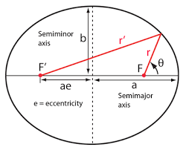

Elliptical Orbit Parameters
Elliptical orbits can be mathematically described by relating their distance from the focal points and an angle measured from the aphelion.
a = semi-major axis
b =semi-minor axis
You can derive many of the basic relations from the fact that
$r+r^{′}=2a$

