Slide 1
Parallel Processing
Phys 3211

Slide 2

Three types of Parallelism
Multi-Threading
Multi-Processing
Asynchronous Programming

Slide 3
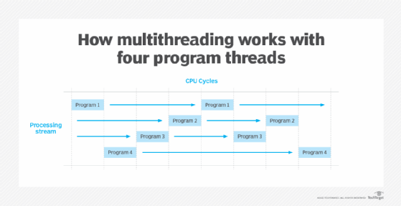
Multi-Threading
Multi-threading is a form of parallelism that allows programs to execute multiple commands concurrently
Great for I/O bound tasks (where waiting periods may exist)

Slide 4
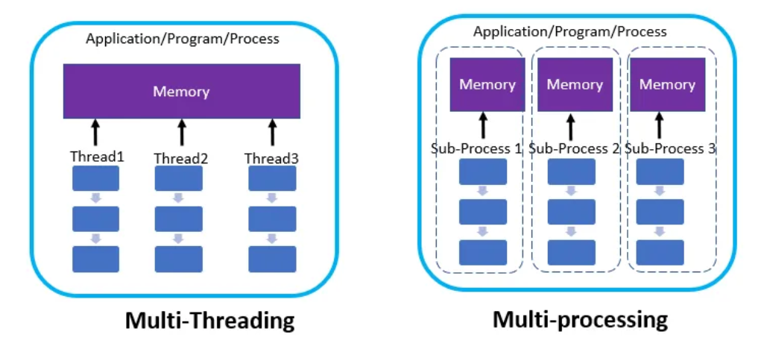
Multiprocessing
Multiprocessing is another form of parallelism that allows multiple processes to run simultaneously.
Each process has own memory with copies of necessary data
Can be hard to reintegrate results

Slide 5
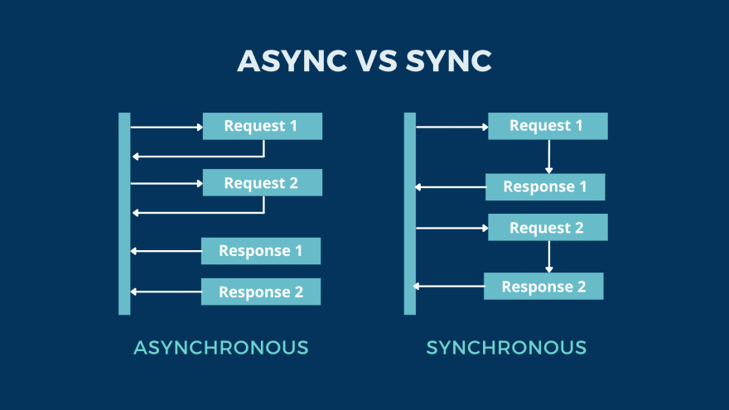
Asynchronous Programming
Asynchronous programming is a form of concurrent programming that involves executing tasks in a non-blocking manner
It requires a different way of thinking about the program's flow

Slide 6

Python Reality
Python’s Global Interpreter Lock (GIL) allows only 1 thread to execute Python bytecode at a time. Multi-threading isn’t really a thing
Asynchronous programming is not true parallelism, just efficient multi-tasking
NumPy is already parallel. Linear algebra operations us multi-threaded BLAS libraries underneath

