Slide 1
Quantum Mechanics and Schoedinger’s Equation

Slide 2
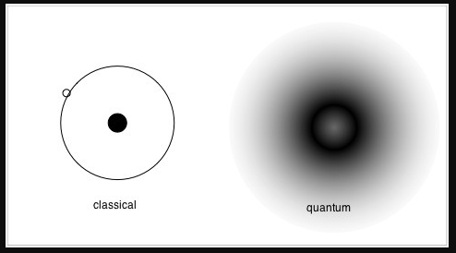
Quantum World
Classical mechanics are deterministic
Quantum Mechanics describes the microscopic world in a probabilistic way
Wavefunctions describe the state of quantum systems, such as particles

Slide 3
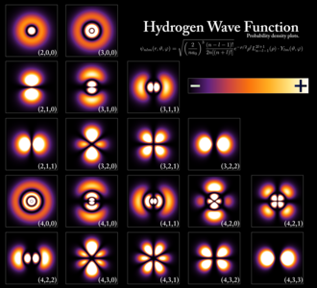
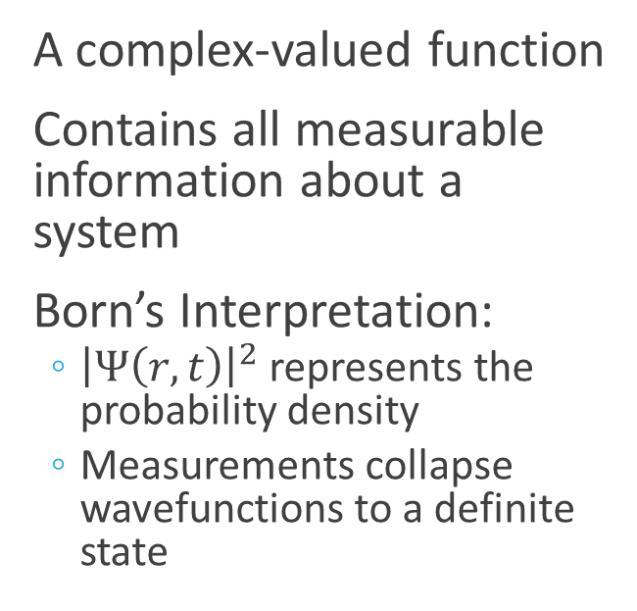
The Wavefunction
A complex-valued function
Contains all measurable information about a system
Born’s Interpretation:
${\left|Ψ\left(r,t\right)\right|}^{2}$ represents the probability density
Measurements collapse wavefunctions to a definite state

Slide 4
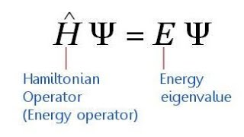

Schrödinger's Equation
Schrödinger's Equation is expressed as
$iℏ\frac{∂Ψ}{∂t}=\left(−\frac{ℏ^{2}}{2m}∇^{2}+V\left(\vec{r},t\right)\right)Ψ(\vec{r},t)$
Which can put in operator terms
$\hat{H}Ψ=iℏ\frac{∂Ψ}{∂t}$
Where the Hamiltonian is
$\hat{H}=−\frac{ℏ^{2}}{2m}∇^{2}+V(r)$
Which other equation looks like this one?

Slide 5
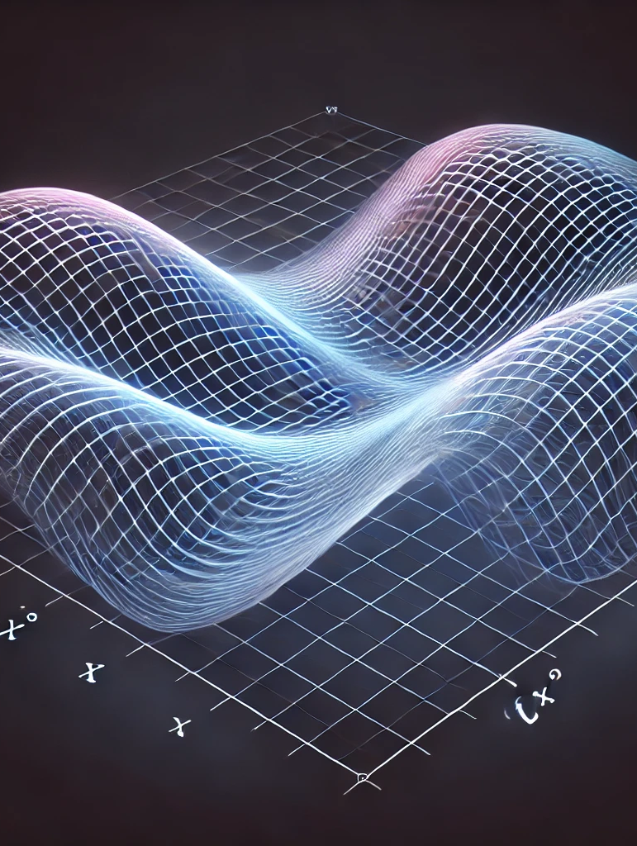

The Free Particle Case (1D)
For the V(x) = 0 case gives plane wave solutions
$Ψ\left(x,t\right)=Ae^{i\left(kx−ωt\right)}$
Is this Normalizable?
With momentum and energy relations
$p=ℏk$
$E=\frac{ℏ^{2}{ k}^{2}}{2m}$

Slide 6
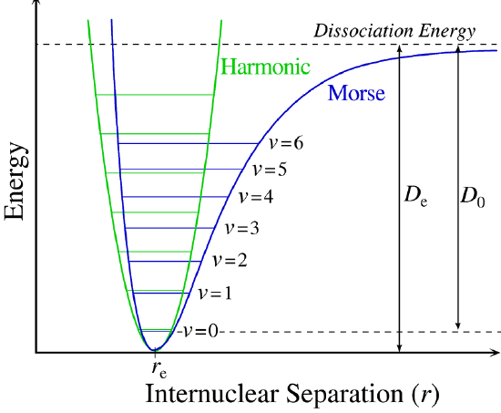
More Complicated V(x)
For complicated problems, we need to solve Schoedinger’s equation with numerical methods
What makes this different from the heat equation?

Slide 7
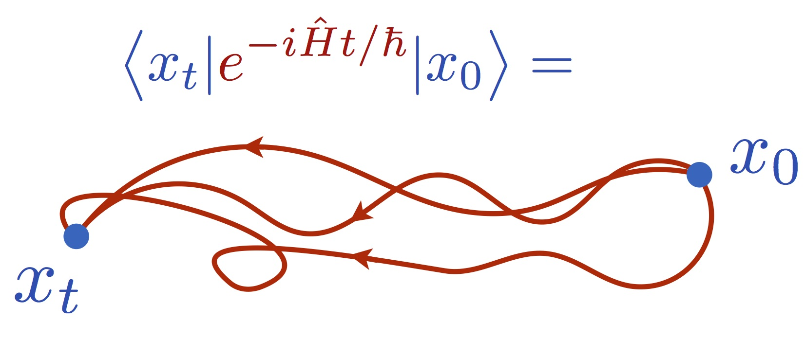

Evolution of the Wavefunction
We know that the wavefunction evolves according to the Schoedinger Equation, but we can express this with operators,
$Ψ\left(x,t\right)=U\left(t\right)Ψ\left(x,t=0\right)$
Where the time-evolution propagator is defined
$U\left(t\right)=e^{−i\hat{H}t}$
$U{\left(t\right)}^{−1}=U(−t)$

Slide 8


Discretizing the Equation
We can directly discretize Schoedinger’s equation
We can also step through with the operator expansion
$U\left(t\right)≈e^{−iHt}=e^{−iHΔt}e^{−iHΔt}…$
$≈U\left(Δt\right)U\left(Δt\right)…$
$=\left(1−iHΔt\right)\left(1−iHΔt\right)\left(…\right)…$

Slide 9

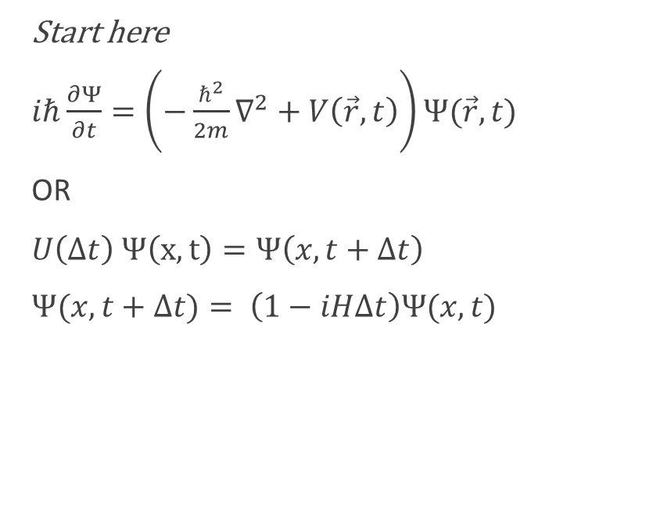
What do we get?
Start here
$iℏ\frac{∂Ψ}{∂t}=\left(−\frac{ℏ^{2}}{2m}∇^{2}+V\left(\vec{r},t\right)\right)Ψ(\vec{r},t)$
OR
$U\left(Δt\right) Ψ\left(x,t\right)=Ψ\left(x,t+Δt\right)$
$Ψ(x,t+Δt)= \left(1−iHΔt\right)Ψ(x,t)$

Slide 10
How do we calculate Energy?

Slide 11
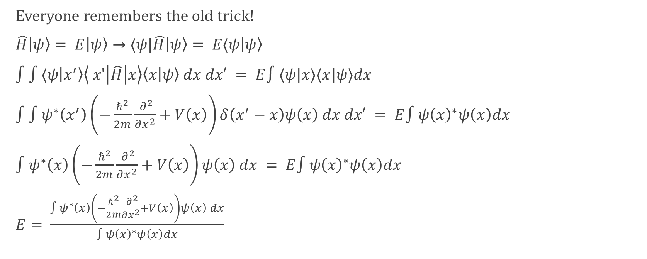
Energy Calculation
Everyone remembers the old trick!
$\hat{H}\left|ψ\right\rangle = E\left|ψ\right\rangle →⟨ψ|\hat{H}\left|ψ\right\rangle = E⟨ψ\left|ψ\right\rangle$
$∫∫⟨ψ\left|x^{′}\right\rangle \left\langle x'\left|\hat{H}\right|x\right\rangle \left\langle x | ψ\right\rangle dx dx′ = E∫⟨ψ|x⟩⟨x|ψ⟩dx$
$∫∫ψ^{∗}\left(x^{′}\right)\left(−\frac{ℏ^{2}}{2m}\frac{{ ∂}^{2}}{∂x^{2}}+V\left(x\right)\right)δ\left(x^{′}−x\right)ψ\left(x\right) dx dx′ = E∫ψ{\left(x\right)}^{∗}ψ\left(x\right)dx$
$∫ψ^{∗}\left(x\right)\left(−\frac{ℏ^{2}}{2m}\frac{{ ∂}^{2}}{∂x^{2}}+V\left(x\right)\right)ψ\left(x\right) dx = E∫ψ{\left(x\right)}^{∗}ψ\left(x\right)dx$
$E=$ $\frac{∫ψ^{∗}\left(x\right)\left(−\frac{ℏ^{2}}{2m}\frac{{ ∂}^{2}}{∂x^{2}}+V\left(x\right)\right)ψ\left(x\right) dx}{∫ψ{\left(x\right)}^{∗}ψ\left(x\right)dx}$
Integration? How do we do that numerically?

