Slide 1
Equations of Motion
A super topic

Slide 2

Learning Objectives
Main Topic
Solving Systems of Differential Equations
To express 2nd order differential equations as a system of 1st order equations
Numerical solve this system using python
Visualize the results
Side quests
Classes
Animation
Events in solve_ivp

Slide 3
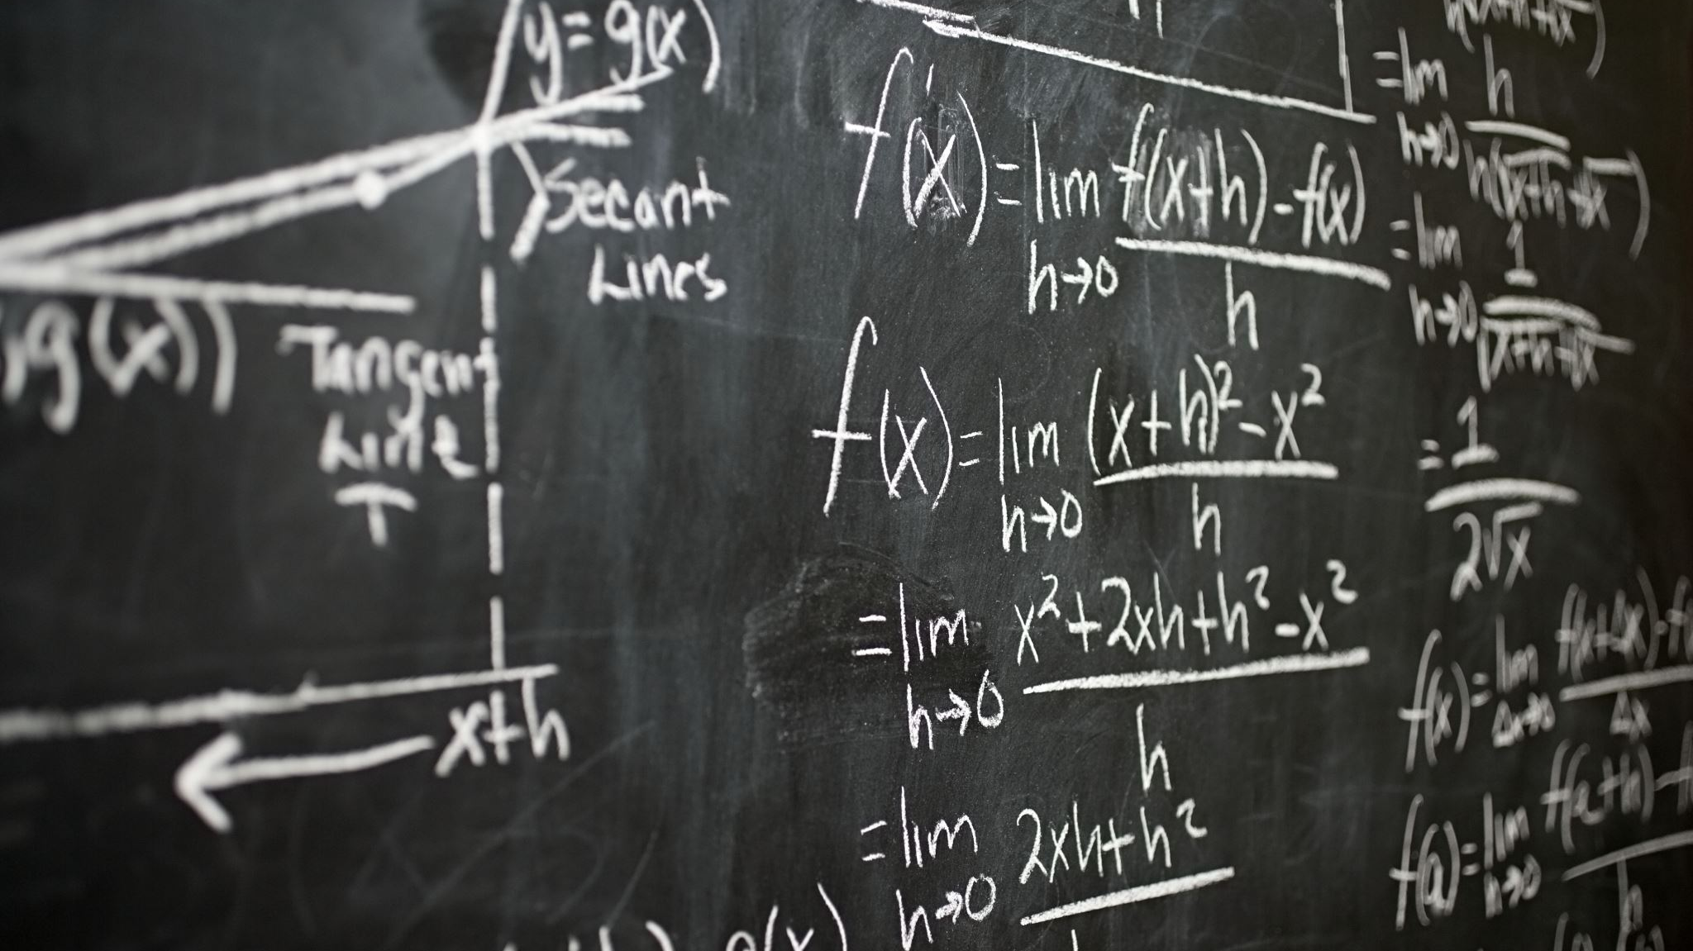
Solving Systems of Differential Equations Numerically

Slide 4
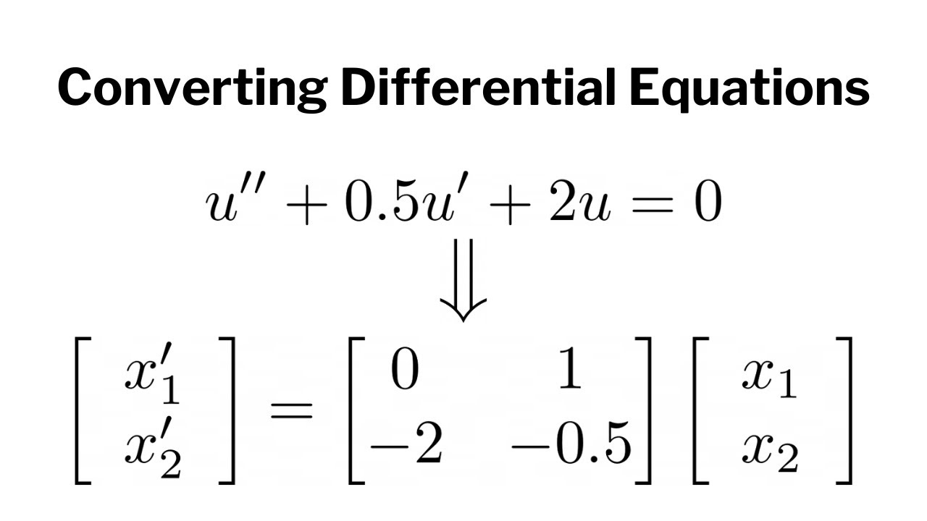

Converting Higher-Order ODEs to First-Order Systems
A higher-order differential equation can be rewritten as a system of first-order equations.
Consider a second-order ODE:
$y^{′′}=f(t,y,y′)$
Introduce auxiliary variables: $y= x_{1}$ $y^{′}=x_{2}$
Rewrite as:
$$x_{2}^{′}=f\left(t,x_{1},x_{2}\right)$$
$$x_{1}^{′}=x_{2}$$
In this way, an nth-order ODE can become n first-order equations.

Slide 5
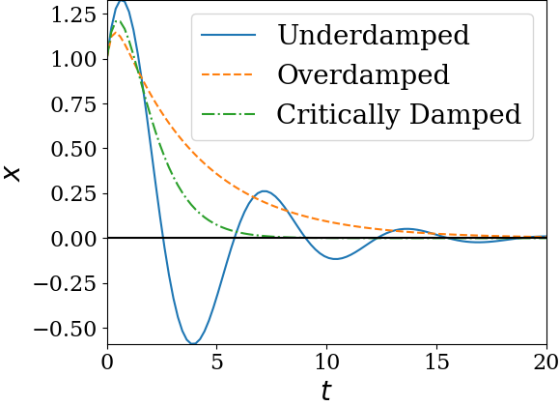
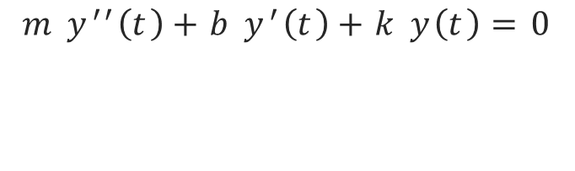
Example: Harmonic Oscillator
$${m y}^{′′}\left(t\right)+b y^{′}\left(t\right)+k y\left(t\right)=0$$

Slide 6
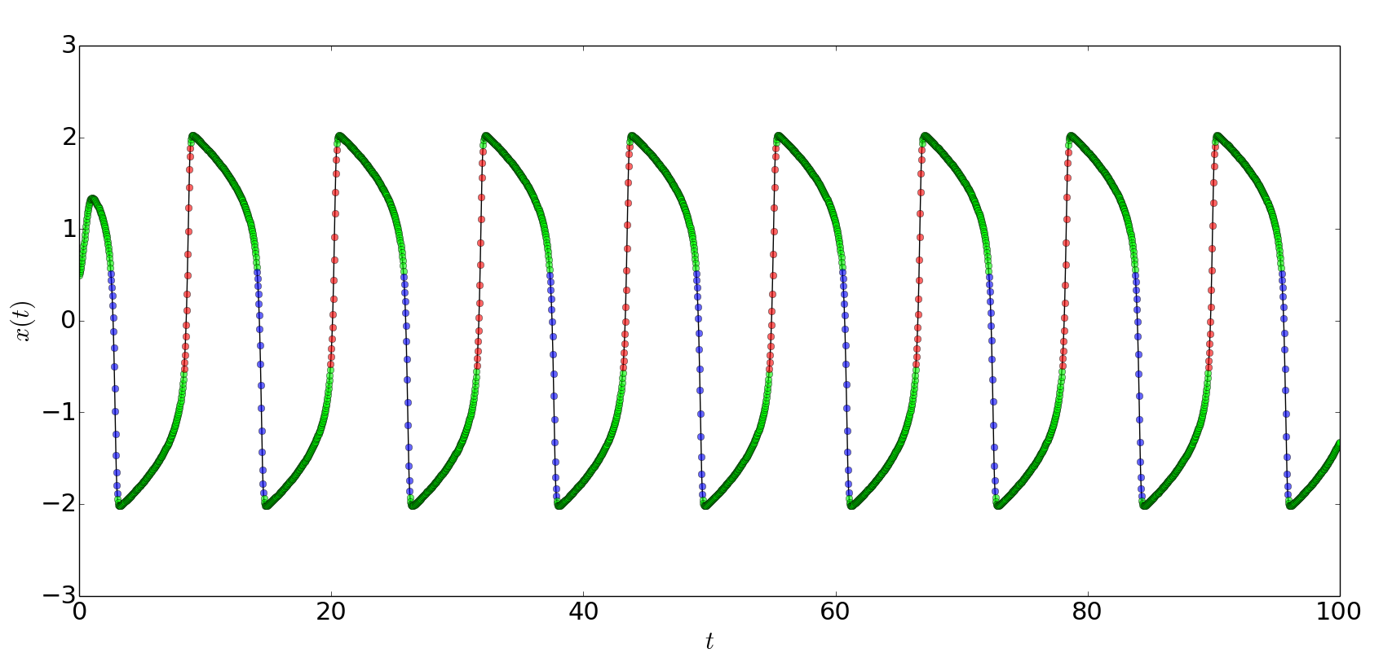
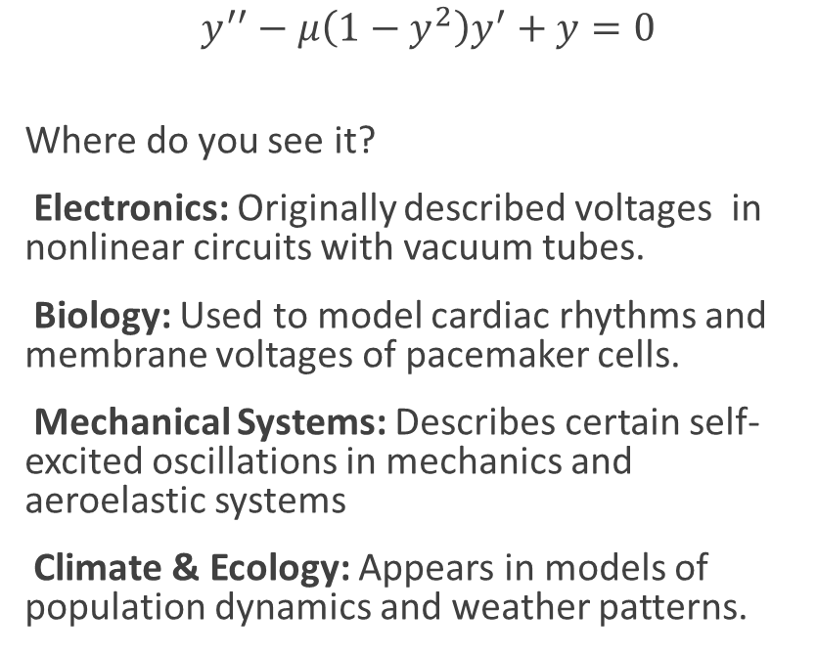
Van Der Pol Oscillator
$y^{′′}−μ\left(1−y^{2}\right)y^{′}+y=0$
Where do you see it?
Electronics: Originally described voltages in nonlinear circuits with vacuum tubes.
Biology: Used to model cardiac rhythms and membrane voltages of pacemaker cells.
Mechanical Systems: Describes certain self-excited oscillations in mechanics and aeroelastic systems
Climate & Ecology: Appears in models of population dynamics and weather patterns.

