Slide 1
Tight Binding Results

Slide 2
Parallelization Results
N | Serial | Parallel | Speedup | Bottleneck
100 | 4.67 s | 1.97 s | 2.4x | Overhead
500 | 399.93 s | 200.1 s | 2.0x | Memory
1000 | 2355.12 s | 857.53 s | 2.75x | Computation

Slide 3
What’s Happening with Speedup?
1. Small N: Overhead-limited
Time per matrix ~2 ms (serial) to 0.8 ms (parallel)
Very fast tasks
Overhead is 5-10% of total time
2. Medium N: Memory-limited
160 ms to 80 ms
8 cores x 2 MB/matrix = 16 MB saturates L3 cache (peak cache thrashing)
Reaches maximum memory bandwidth
3. Large N: Compute-Limited
Time per matrix: 942 ms to 343 ms
Long tasks reduces switching overhead

Slide 4
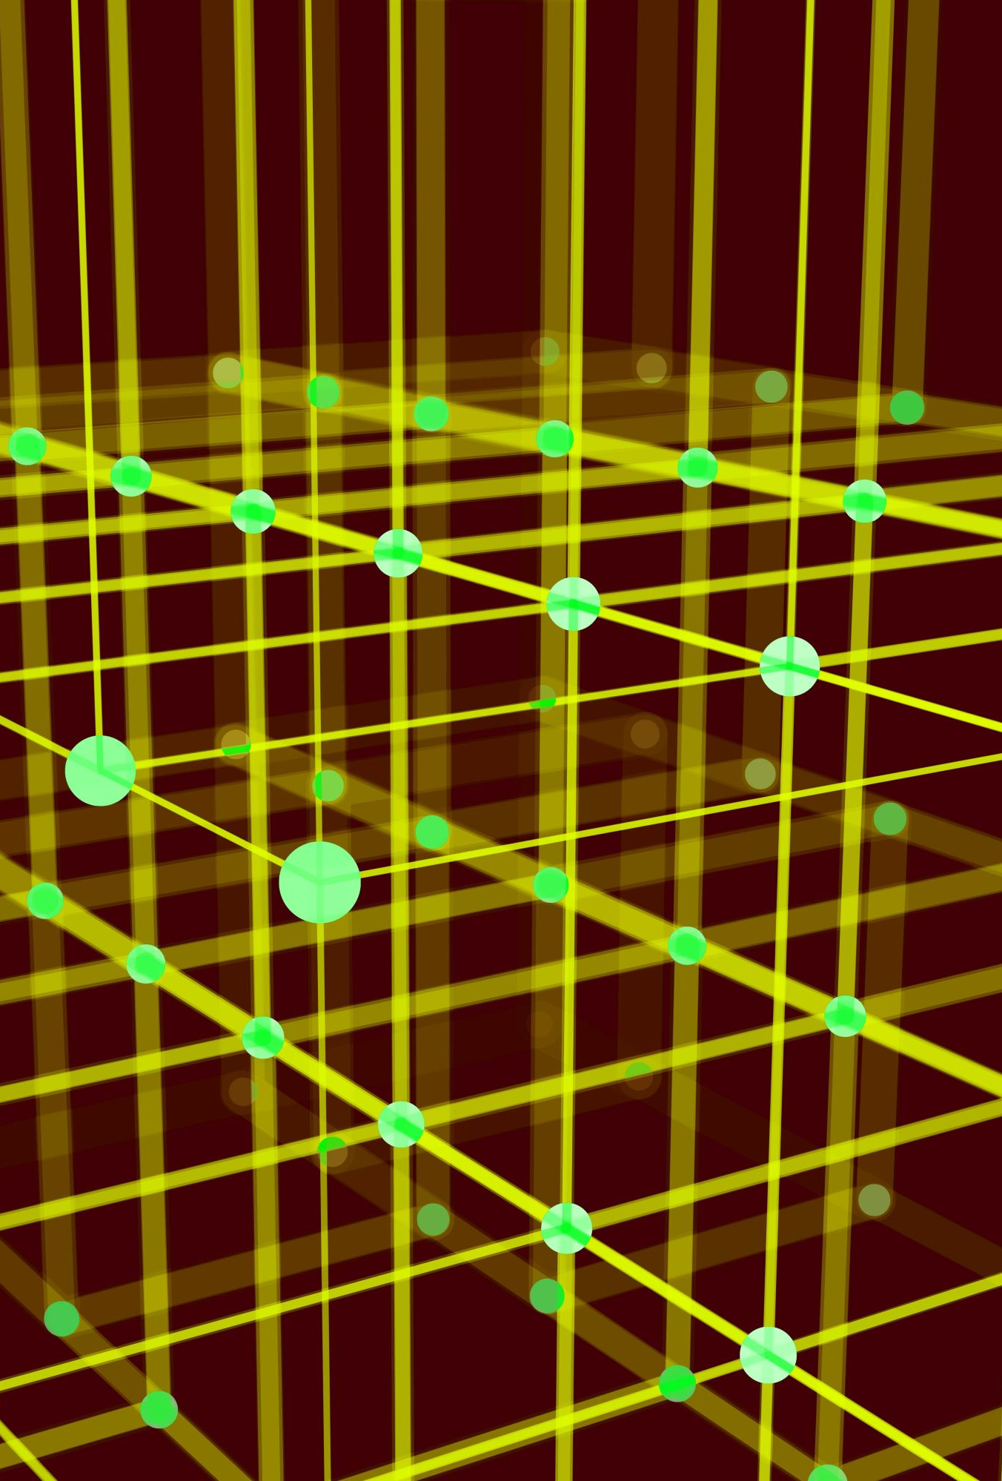

Complexity scaling
Eigenvalue decomposition requires $O\left(N^{3}\right)$ operations
Memory access requires $O\left(N^{2}\right)$ per matrix
As N grows:
Computational time grows faster than memory requirements
Memory bandwidth saturates before CPU does
More time spent moving data around than computing
$Speed up=\frac{T_{serial}}{T_{parallel}}=\frac{T_{compute}}{\frac{T_{compute}}{N_{cores}}+T_{overhead}+T_{memory}}$

Slide 5
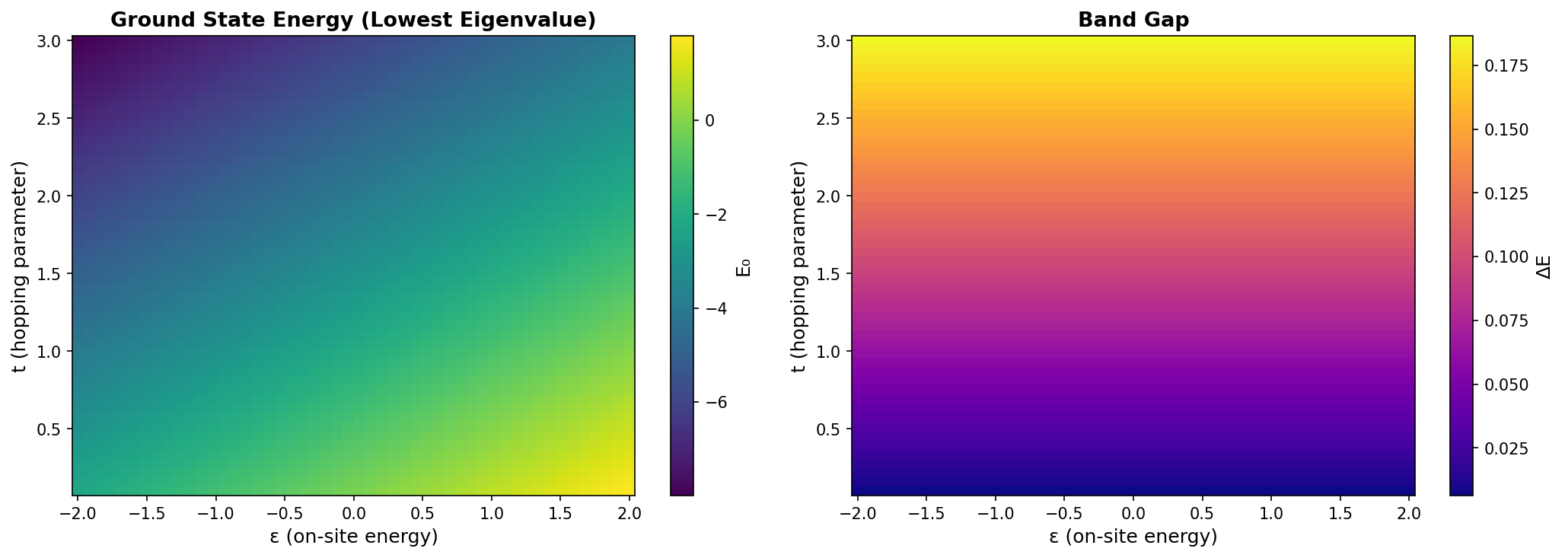
The Physics

Slide 6

Takeaways
Parallelization is always better at all scales. Different bottlenecks for different problems
Small N: overhead matters
Intermediate N: memory becomes an issue
Large N: compute time dominates
Real Considerations
Memory architecture matters as much as CPU count
Supercomputers worried as much about interconnect speed as FLOPS
GPUs are partially more effective because of high memory bandwidth

