Slide 1
events in solve_ivp
Automatically detecting physical events during ODE integration

Slide 2

Learning Objectives
Main Topic
Solving Systems of Differential Equations
To express 2nd order differential equations as a system of 1st order equations
Numerical solve this system using python
Visualize the results
Side quests
Classes
Animation
Events in solve_ivp

Slide 3
Why automatic detection?
Because Manual Detection:
Wastes computation (integrating past event)
Imprecise event timing
Hard to trigger actions at exact event moment
Instead define a function that crosses zero at the event
# After solving, manually filter data:
valid_indices = y_data >= 0
# Remove points after ground hit
x_data = x_data[valid_indices]

Slide 4
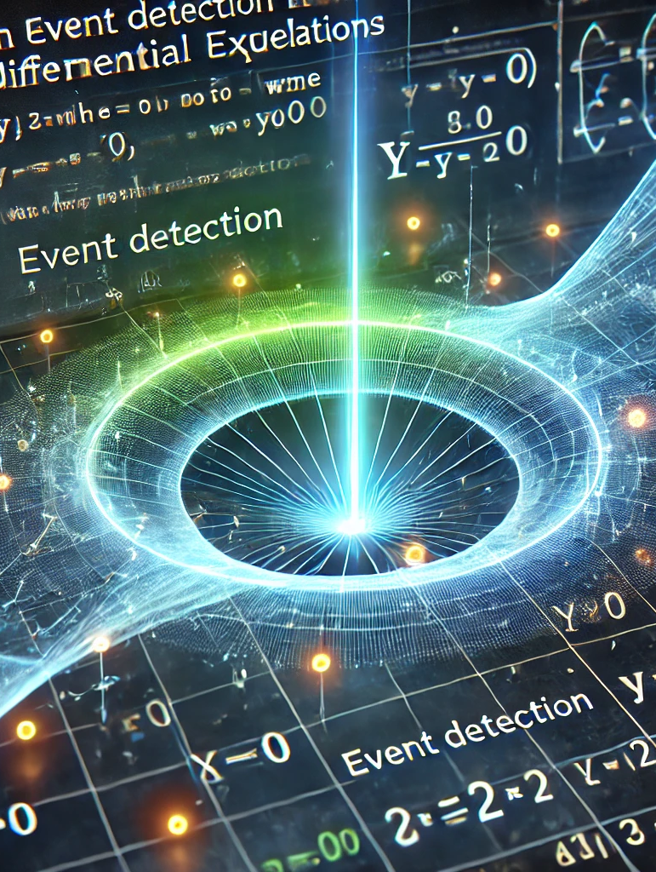
Events allow you to track specific condition
Example: Detecting when y = 0 in projectile motion.
Define an event function
def hit_ground(t, y):
return y
Stop at y=0
hit_ground.terminal = True
Detect direction
hit_ground.direction = -1
Pass to `solve_ivp`
solve_ivp(fun, (t0, tf), y0, events=hit_ground)

Slide 5
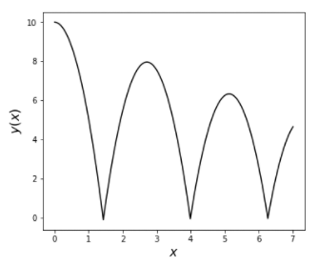
Use Events
Collisions: Ball hitting ground, wall impacts
Boundary conditions: Particle leaving a region
Phase transitions: Crossing critical temperature/pressure
Orbital mechanics: Perihelion/aphelion passages, satellite re-entry
Oscillations: Detecting peaks, zero-crossings in pendulum
Quantum tunneling: Wavefunction reaching barrier
Trajectory optimization: Reaching target position

Slide 6
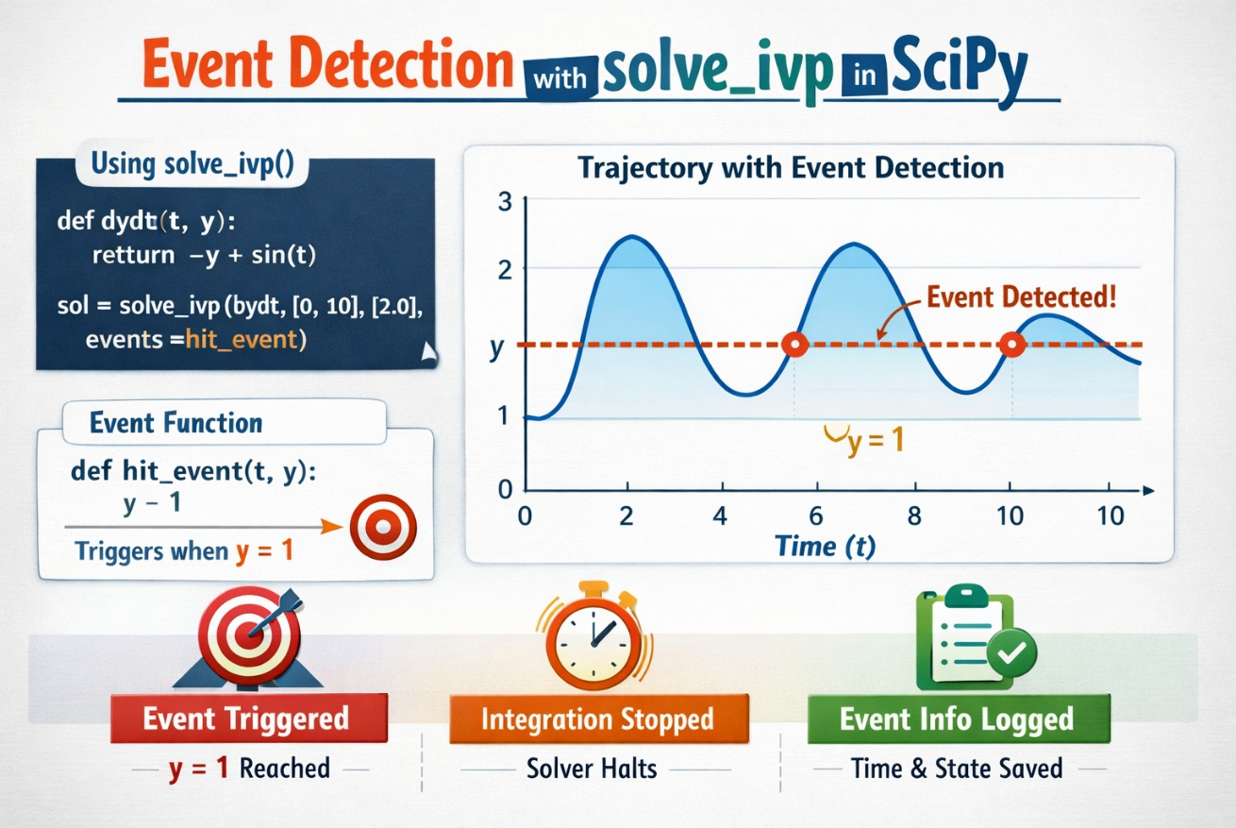
Advantages
Computational efficiency:
Integration stops exactly at event (no wasted steps)
Interpolates to find precise event time (not limited to dt grid)
Physical accuracy:
Event time accurate to solver tolerance (~1 in 1 billion)
State at event is consistent with ODE
Cleaner code:
No post-processing data trimming
Natural physics: "stop when ball hits ground"

