Slide 1
Github
Getting Organized

Slide 2
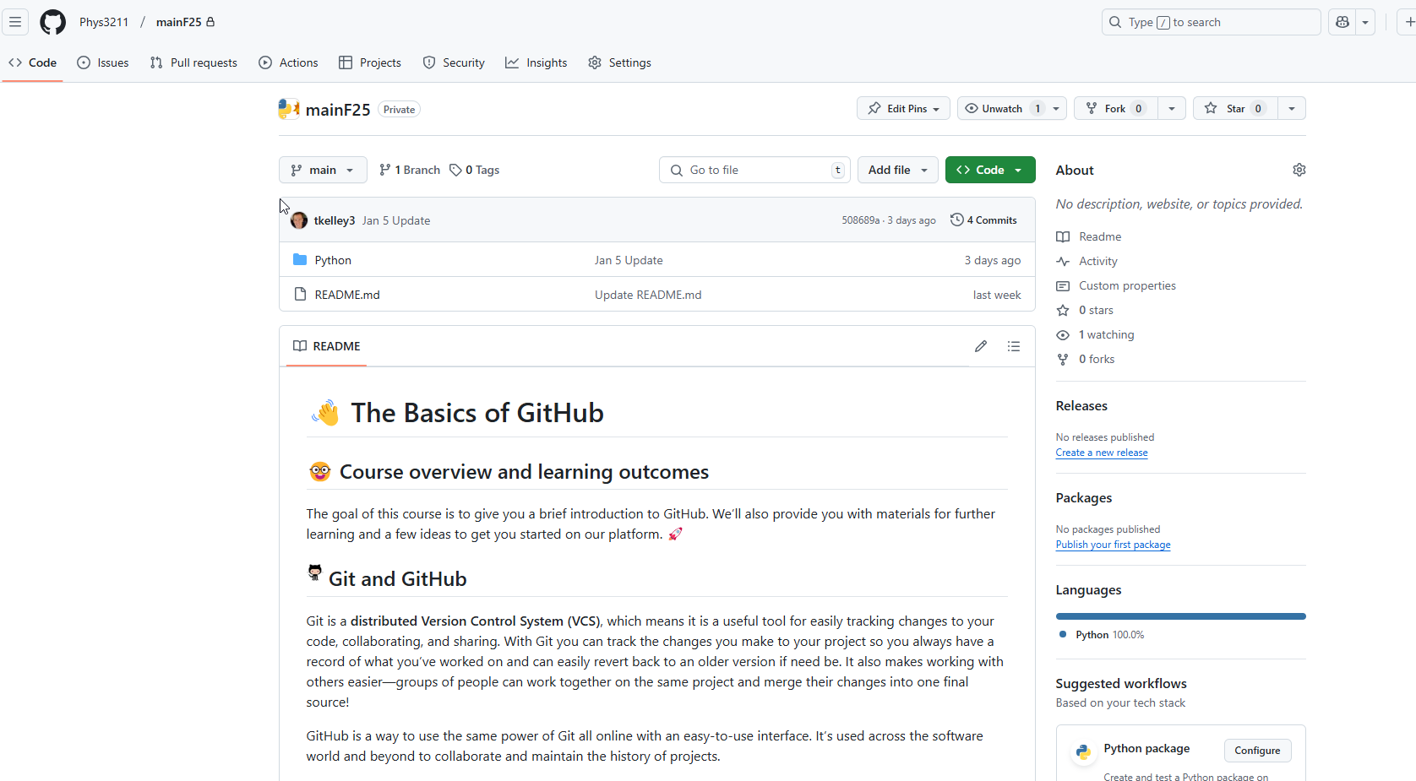
Github Page for 3211

Slide 3
What is GitHub
It is a web-based hosting service for version control using Git.
It offers all the distributed version control and source code management (SCM) functionality of Git
It provides bug tracking, feature requests, task management, and wikis for every projects.
Wait … what is git?
Well… it is a version-control system for tracking changes in computer files and coordinating work on those files among multiple people.
Take Home Message
Git is an open-source program that allows users to keep track of different versions of files and still collaborate while doing that

Slide 4
Name “Git” - From the creator Linus Torvalds
He described the tool as "the stupid content tracker“ and the name as (depending on your way): (these are quotes)
“random three-letter combination that is pronounceable, and not actually used by any common UNIX command. The fact that it is a mispronunciation of "get" may or may not be relevant.”
"global information tracker": you're in a good mood, and if it actually works for you. Angels sing, and a light suddenly fills the room.
"goddamn idiotic truckload of sh*t": when it breaks

Slide 5
How will we use GitHub?
We’re going to be passing code back and forth, using GitHub will help
You can interface with GitHub in two ways:
Command line
Desktop App: https://desktop.github.com/

Slide 6
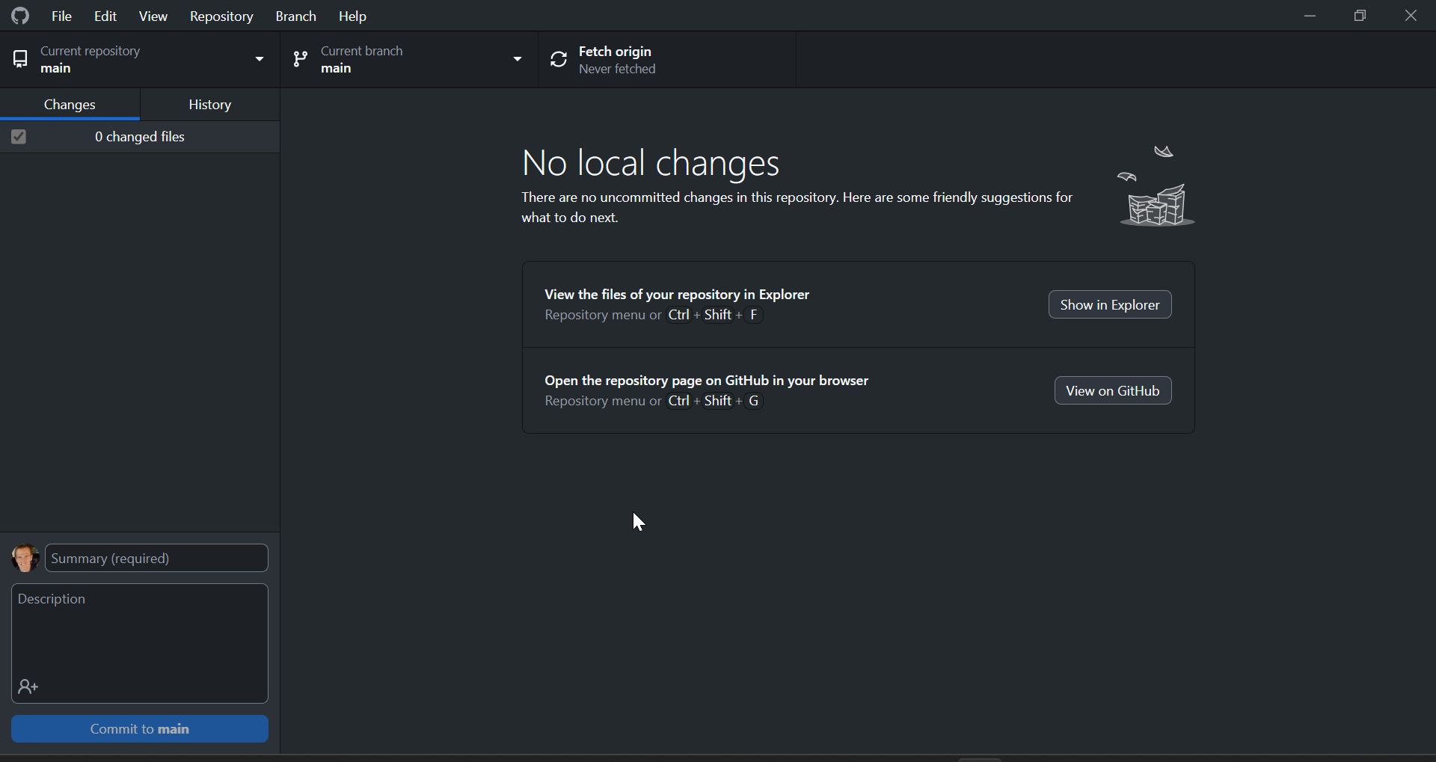
Desktop
The desktop app allows you to add local folders as repositories (repos)
You can then update these files in the local folder and push them up to the GitHub site
OR you can update these files on the GitHub site and pull them down to the local folder

Slide 7
