Slide 1
Feedforward Neural Networks
Linden Burack

Slide 2
A model with parameters. You input something, the model does a bunch of math, and outputs something. If you change the parameters of the model, that machinery will change and you’ll get something out. There are some set of parameters that will predict your problem well
The point of machine learning is that you can ‘learn’ what the best parameters are
I’m going to show you a particular, perhaps the most simple, and certainty earliest example of a way to ‘learn’ these best parameters.

Slide 3







A common problem in physics
What we see
What we want to know
$$μ^{−}$$
$$p_{T}=50GeV$$
$$μ^{−}$$
$$p_{T}=100GeV$$
$$μ^{−}$$
$$p_{T}=10GeV$$
$$μ^{−}$$
$$p_{T}=15GeV$$

Slide 4
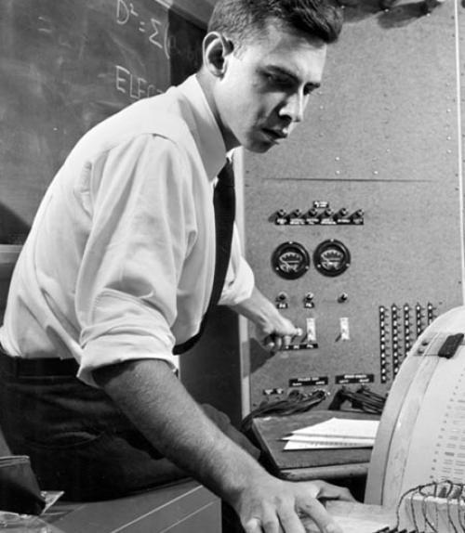
Feedforward Neural Networks – the first machines that learned
Not! a generative model.
Then what does it do? It learns functions.
I hope to use FNNs to demonstrate the basic principles behind machine learning.
Frank Rosenblatt

Slide 5
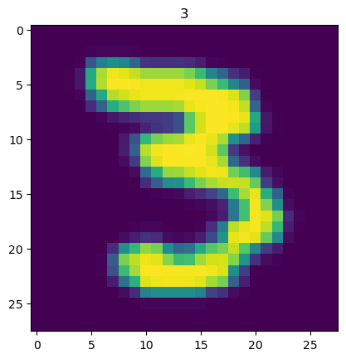
What types of problems can FNNs solve?
Input
Prediction
Feedforward Neural Network
It’s a three
Classification problems

Slide 6


What types of problems can FNNs solve?
Input
Prediction
$$μ^{−}$$
Feedforward Neural Network
It has $p_{T}=50GeV$
Inferring physical quantities

Slide 7
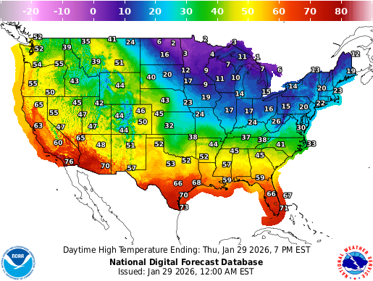
What types of problems can FNNs solve?
Input
Prediction
Feedforward Neural Network
There is a 50% chance of rain
Inferring physical quantities

Slide 8


Think of an FFN as a super flexible function.
Feedforward Neural Network
Some input data
$$\overset{⃑}{x}$$
A prediction
$$\overset{⃑}{y}$$

Slide 9
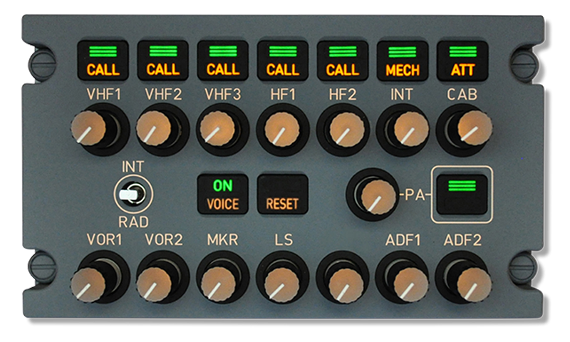
Think of an FFN as a super flexible function.
Feedforward Neural Network
Some input data
$$\overset{⃑}{x}$$
A prediction
$$\overset{⃑}{y}$$
Parameters

Slide 10
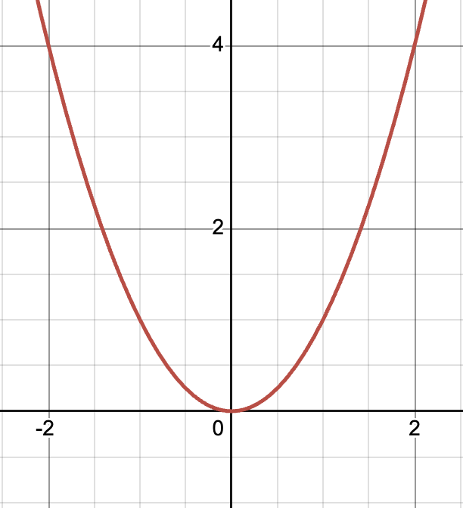

Think of an FFN as a super flexible function.
$$f\left(x\right)=x^{2}$$
Feedforward Neural Network
Input x
Parameters

Slide 11
If we tune the knobs and dials of an FNN right, we can model any function
Feedforward Neural Network
Parameters
Mathematically proven! Universal approximation theorem

Slide 12
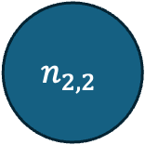
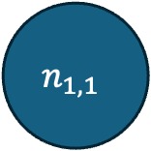
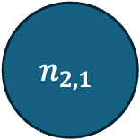

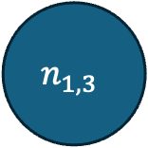
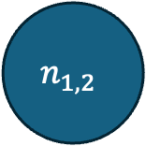

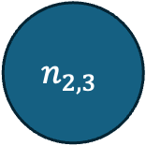
$$n_{1,1}$$
$$n_{2,1}$$
$$n_{in}$$
$$n_{1,2}$$
$$n_{2,2}$$
$$n_{out}$$
$$n_{1,3}$$
$$n_{2,3}$$

Slide 13











The parameters of our network are weights and biases
A weight associated with every edge
$$n_{1,1}$$
$$n_{2,1}$$
$$w=3$$
$$w=1$$
$$w=2$$
$$n_{in}$$
$$w=−1$$
$$n_{1,2}$$
$$w=2$$
$$n_{2,2}$$
$$n_{out}$$
$$w=2$$
$$w=5$$
$$w=2$$
$$w=2$$
$$w=2$$
$$w=−1$$
$$w=2$$
$$w=2$$
$$n_{1,3}$$
$$n_{2,3}$$

Slide 14







The parameters of our network are weights and biases
A bias associated with every node
$$b=2$$
$$b=1$$
$$n_{1,1}$$
$$n_{2,1}$$
$$w=3$$
$$w=1$$
$$b=−4$$
$$w=2$$
$$b=9$$
$$b=−1$$
$$n_{in}$$
$$w=−1$$
$$n_{1,2}$$
$$w=2$$
$$n_{2,2}$$
$$n_{out}$$
$$w=2$$
$$w=5$$
$$w=2$$
$$w=2$$
$$w=2$$
$$w=−1$$
$$w=2$$
$$b=5$$
$$w=2$$
$$b=−8$$
$$n_{1,3}$$
$$n_{2,3}$$

Slide 15
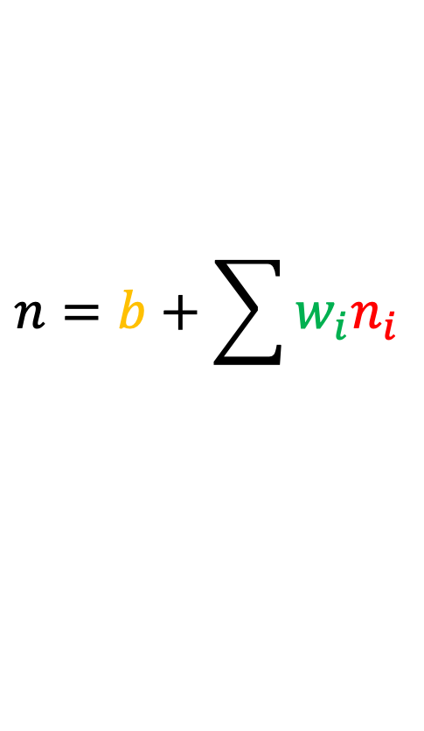
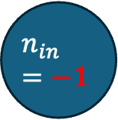
Let’s compute the value of this neuron
$$b=2$$
$$n_{1,1}$$
$$n_{2,1}$$
$$w=3$$
$$n_{in}=−1$$
$$n_{1,2}$$
$$n_{2,2}$$
$$n_{out}$$
$$n_{1,3}$$
$$n_{2,3}$$
$$n=b+\sum{w_{i}n_{i}}$$
(suppose all activations are linear for ease)

Slide 16
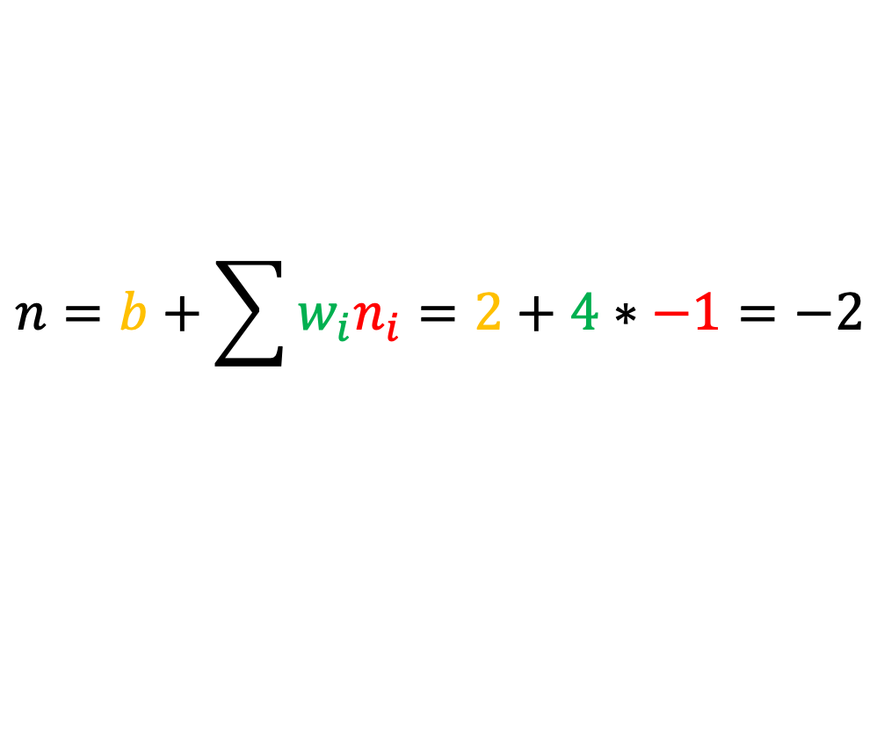

Let’s compute the value of this neuron
$$b=2$$
$$n_{1,1}$$
$$n_{2,1}$$
$$w=4$$
$$n_{in}=−1$$
$$n_{1,2}$$
$$n_{2,2}$$
$$n_{out}$$
$$n_{1,3}$$
$$n_{2,3}$$
$$n=b+\sum{w_{i}n_{i}}=2+4∗−1=−2$$

Slide 17

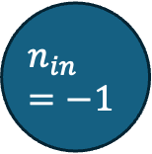


We compute the values of neurons in these layers from left to right
$$n_{1,1}$$
$$n_{2,1}$$
$$−2$$
$$n_{in}=−1$$
$$n_{1,2}$$
$$n_{2,2}$$
$$n_{out}$$
$$3$$
$$n_{1,3}$$
$$n_{2,3}$$
$$−1$$

Slide 18



$$n_{1,1}$$
$$n_{2,1}$$
$$−2$$
$$0.5$$
$$n_{in}=−1$$
$$n_{1,2}$$
$$n_{2,2}$$
$$n_{out}$$
$$3$$
$$2$$
$$n_{1,3}$$
$$n_{2,3}$$
$$−1$$
$$2$$

Slide 19






$$n_{1,1}$$
$$n_{2,1}$$
$$−2$$
$$0.5$$
$$w=2$$
$$b=−1$$
$$n_{in}=−1$$
$$n_{1,2}$$
$$n_{2,2}$$
$$w=5$$
$$n_{out}$$
$$3$$
$$2$$
$$w=−1$$
$$n_{1,3}$$
$$n_{2,3}$$
Let’s compute the value of the output neuron
$$−1$$
$$2$$
$$n=b+\sum{w_{i}n_{i}}$$

Slide 20
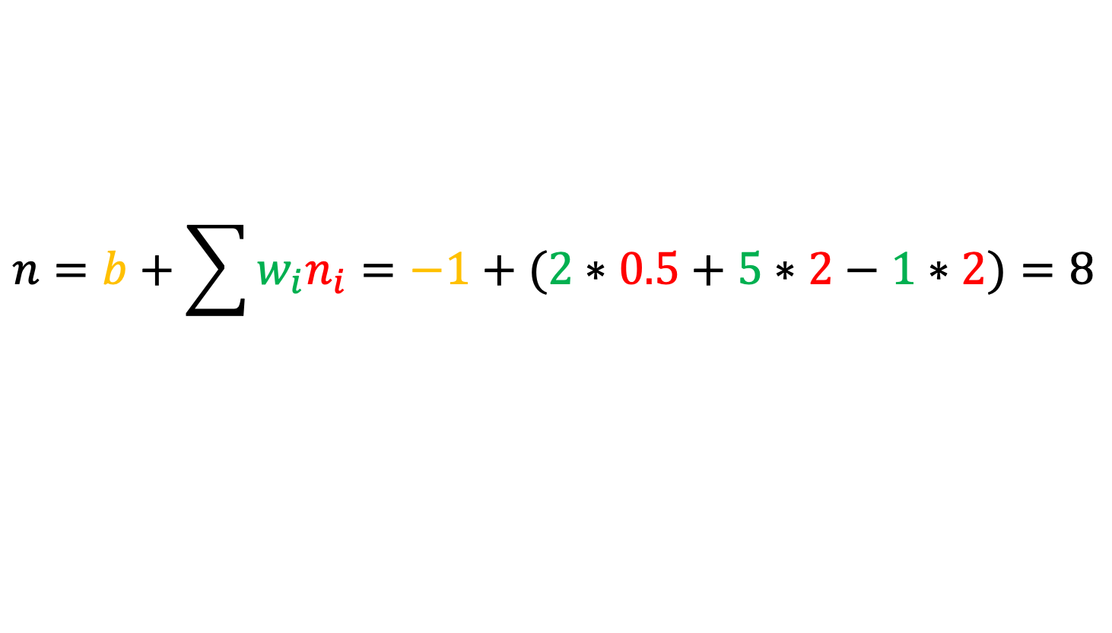

$$n_{1,1}$$
$$n_{2,1}$$
$$−2$$
$$0.5$$
$$w=2$$
$$b=−1$$
$$n_{in}=−1$$
$$n_{1,2}$$
$$n_{2,2}$$
$$w=5$$
$$n_{out}=8$$
$$3$$
$$2$$
$$w=−1$$
$$n_{1,3}$$
$$n_{2,3}$$
Let’s compute the value of the output neuron
$$−1$$
$$2$$
$$n=b+\sum{w_{i}n_{i}}=−1+(2∗0.5+5∗2−1∗2)=8$$

Slide 21














We know how to make a prediction given a set of weights a biases. But how do we tune them to represent a particular function? That’s the learning part.
$$n_{1,1}$$
$$n_{2,1}$$
$$−2$$
$$0.5$$
$$n_{in}=−1$$
$$n_{1,2}$$
$$n_{2,2}$$
$$n_{out}=8$$
$$3$$
$$2$$
$$n_{1,3}$$
$$n_{2,3}$$
$$−1$$
$$2$$

Slide 22
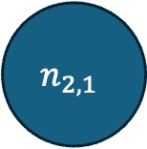


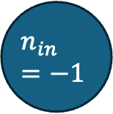

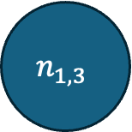



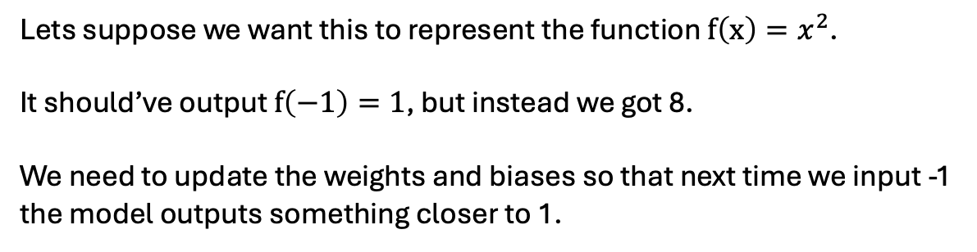

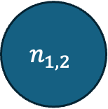


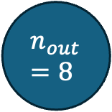



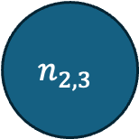

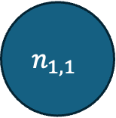
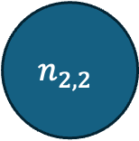



$$b=2$$
$$b=1$$
$$n_{1,1}$$
$$n_{2,1}$$
$$w=3$$
$$w=1$$
$$b=−4$$
$$w=2$$
$$b=9$$
$$b=−1$$
$$n_{in}=−1$$
$$w=−1$$
$$n_{1,2}$$
$$w=2$$
$$n_{2,2}$$
$$n_{out}=8$$
$$w=2$$
$$w=5$$
$$w=2$$
$$w=2$$
$$w=2$$
$$w=−1$$
$$w=2$$
$$b=5$$
$$w=2$$
$$b=−8$$
$$n_{1,3}$$
$$n_{2,3}$$
Lets suppose we want this to represent the function $f\left(x\right)=x^{2}$.
It should’ve output $f\left(−1\right)=1$, but instead we got 8.
We need to update the weights and biases so that next time we input -1 the model outputs something closer to 1.

Slide 23
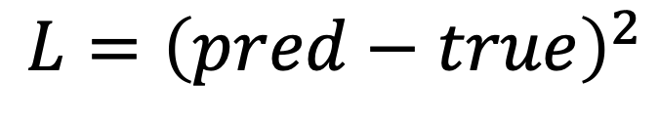
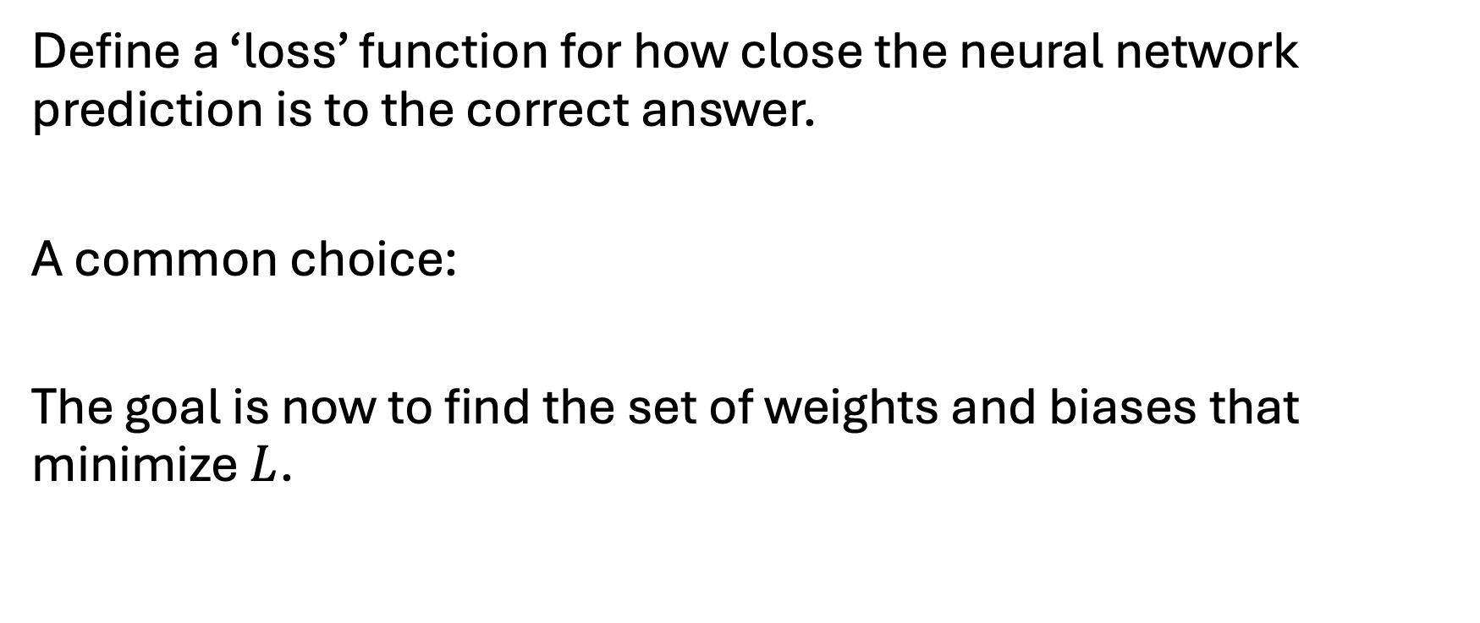
How can we find the right weights and biases?
Define a ‘loss’ function for how close the neural network prediction is to the correct answer.
A common choice:
The goal is now to find the set of weights and biases that minimize $L$.
$$L={\left(pred−true\right)}^{2}$$

Slide 24
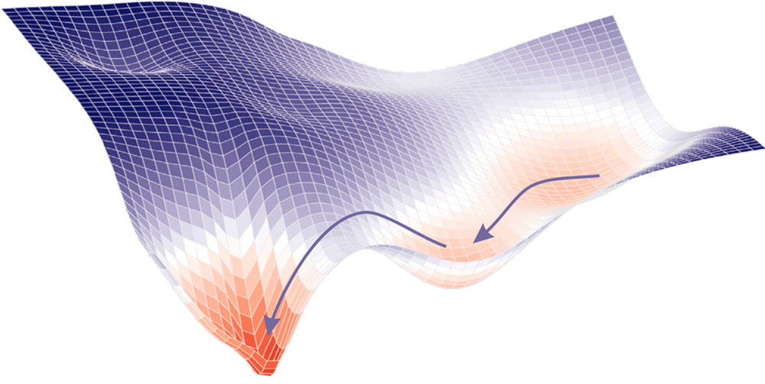
How can we find the weights and biases that minimize the loss?
How can we do this? A grid search would take a long time :-)
Loss
Our parameters

Slide 25
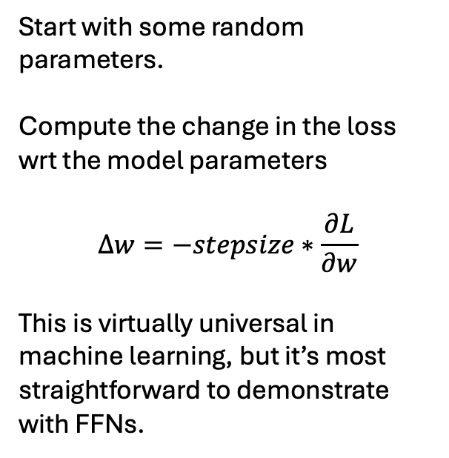
Gradient descent
Start with some random parameters.
Compute the change in the loss wrt the model parameters
$$Δw=−stepsize∗\frac{∂L}{∂w}$$
This is virtually universal in machine learning, but it’s most straightforward to demonstrate with FFNs.
Loss
Our parameters

Slide 26
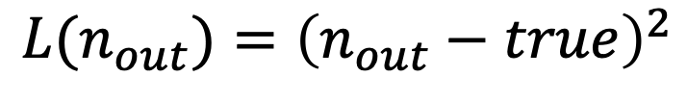

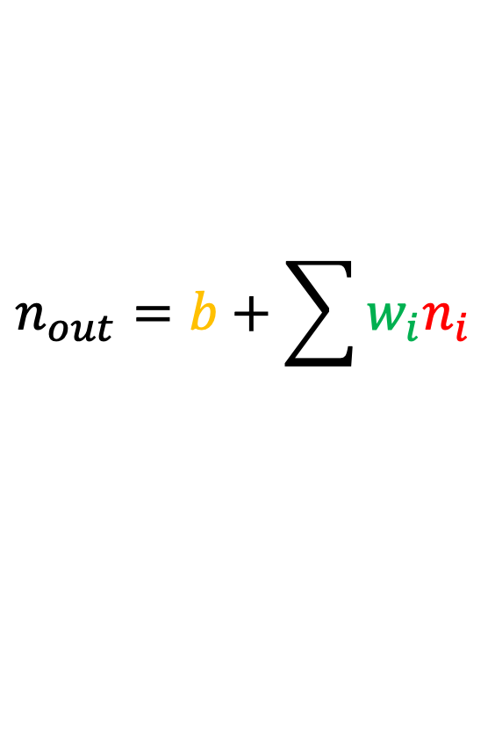
$$Δw=−stepsize∗\frac{∂L}{∂w}$$
We want to update weights according to
Givens
$$n_{out}=b+\sum{w_{i}n_{i}}$$
$$L(n_{out})={\left(n_{out}−true\right)}^{2}$$

Slide 27
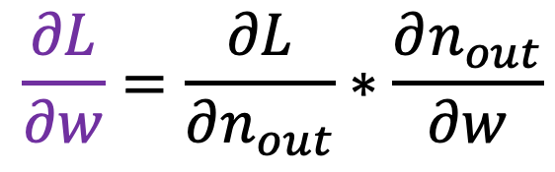
$$Δw=−stepsize∗\frac{∂L}{∂w}$$
We want to update weights according to
Givens
$$n_{out}=b+\sum{w_{i}n_{i}}$$
$$\frac{∂L}{∂w}=\frac{∂L}{∂n_{out}}∗\frac{∂n_{out}}{∂w}$$
$$L(n_{out})={\left(n_{out}−true\right)}^{2}$$

Slide 28
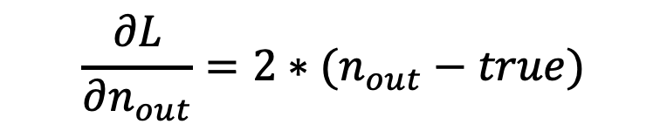
$$Δw=−stepsize∗\frac{∂L}{∂w}$$
We want to update weights according to
Givens
$$n_{out}=b+\sum{w_{i}n_{i}}$$
$$\frac{∂L}{∂w}=\frac{∂L}{∂n_{out}}∗\frac{∂n_{out}}{∂w}$$
$$L(n_{out})={\left(n_{out}−true\right)}^{2}$$
$$\frac{∂L}{∂n_{out}}=2∗(n_{out}−true)$$

Slide 29

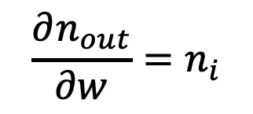
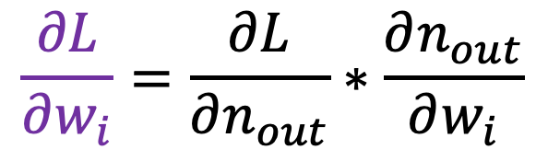
$$Δw_{i}=−stepsize∗\frac{∂L}{∂w_{i}}$$
We want to update weights according to
Givens
$$n_{out}=b+\sum{w_{i}n_{i}}$$
$$\frac{∂L}{∂w_{i}}=\frac{∂L}{∂n_{out}}∗\frac{∂n_{out}}{∂w_{i}}$$
$$L(n_{out})={\left(n_{out}−true\right)}^{2}$$
$$\frac{∂L}{∂n_{out}}=2∗(n_{out}−true)$$
$$\frac{∂n_{out}}{∂w}=n_{i}$$
$$Δw_{i}=−stepsize∗2∗\left(n_{out}−true\right)∗n_{i}$$

Slide 30


$$Δw_{i}=−stepsize∗2∗\left(n_{out}−true\right)∗n_{i}$$
$$b=2$$
$$b=1$$
$$n_{1,1}$$
$$n_{2,1}$$
$$w=3$$
$$0.5$$
$$w=1$$
$$b=−4$$
$$w=2$$
$$b=9$$
$$b=−1$$
$$n_{in}=−1$$
$$w=−1$$
$$n_{1,2}$$
$$w=2$$
$$n_{2,2}$$
$$n_{out}=8$$
$$w=2$$
$$w=5$$
$$w=2$$
$$w=2$$
$$w=2$$
$$2$$
$$w=−1$$
$$w=2$$
$$b=5$$
$$w=2$$
$$b=−8$$
$$n_{1,3}$$
$$n_{2,3}$$
$$2$$
Lets suppose we want this to represent the function $f\left(x\right)=x^{2}$.
It should’ve output $f\left(−1\right)=1$, but instead we got 8.
We need to update the weights and biases so that next time we input -1 the model outputs something closer to 1.

Slide 31
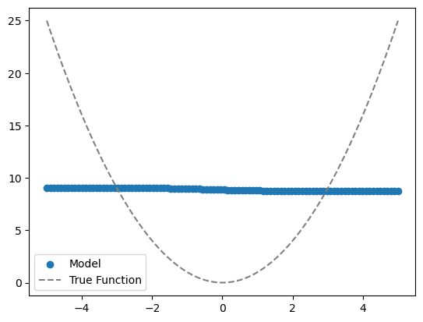
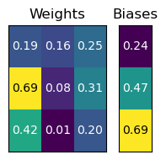
No training
Feedforward Neural Network
Input x
Parameters

Slide 32
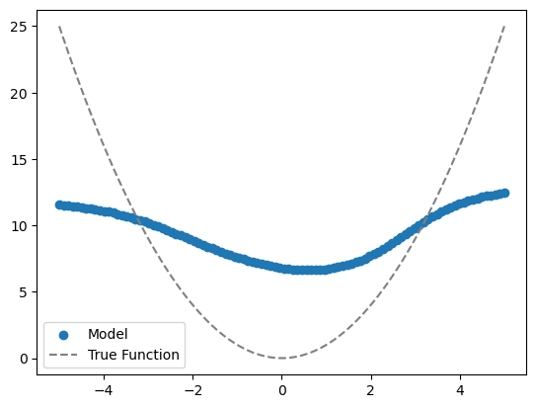
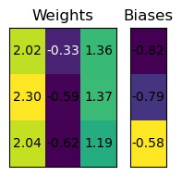
Two rounds of training
Feedforward Neural Network
Input x
Parameters

Slide 33
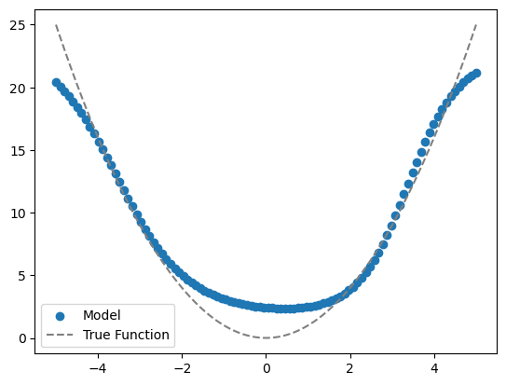
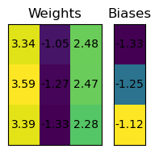
Three rounds of training
Feedforward Neural Network
Input x
Parameters

Slide 34


Six rounds of training
Feedforward Neural Network
Input x
Parameters

Slide 35



