Slide 1
Density Functional Theory
Physics Toolbox 1 – Emily Aitken

Slide 2
1.
What is Density Functional Theory?
(as far as I understand)

Slide 3

We first take the (time-dependent) Schrödinger equation….
Hѱ = 𝑖ħ $\frac{d}{dt}$ѱ
Where ѱ is dependent on each particle in the system.

Slide 4
We first take the (time-dependent) Schrödinger equation….
But if you have a large system with many particles, the wavefunction and hence the solution to the equation can become quite complicated.

Slide 5
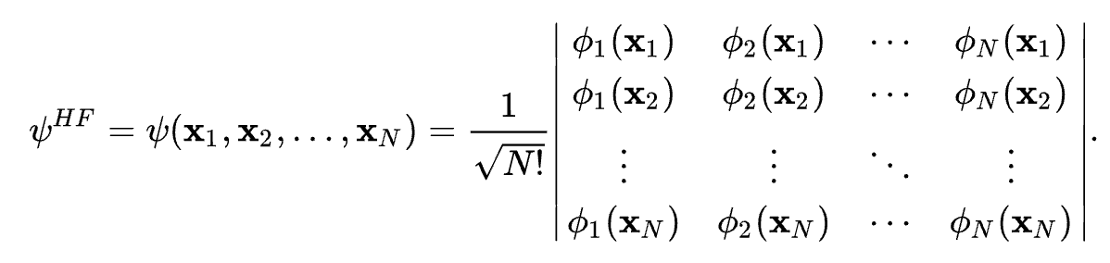
We first take the (time-dependent) Schrödinger equation….
Slater determinants can be used to determine the wave function for an N particle system of electrons (or bosons but don’t worry about bosons)….but this is….a lot

Slide 6
We first take the (time-dependent) Schrödinger equation….
So instead of considering individual particles, we just consider the electron density functional which depends on a couple terms
Ion-Ion PE
Ion-electron PE
Electron-Electron interactions
Kinetic energy
Exchange-correlation energy

Slide 7
We first take the (time-dependent) Schrödinger equation….
So instead of considering individual particles, we just consider the electron density functional which depends on a couple terms
Ion-Ion PE
Ion-electron PE
Electron-Electron interactions
Kinetic energy
Exchange-correlation energy

Slide 8
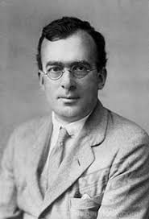
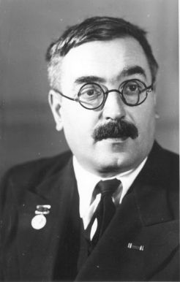
So these two guys
Hartree
Fock
Came up with the solutions for the missing component of exact energy exchange that other approximations for exchange energy frequently underestimate (Like LDA)
Notes:
Based on the fact that the ground state is unique, and the real value minimizes the energy of the overall function

Slide 9


And these two guys
Kohn
Sham
Came up with a fictitious system of non-interacting particles that produce the same density as interacting particles, which can be used to calculate the potential energy term. Which is the model used today for solving DFT
Notes:
Based on the fact that the ground state is unique, and the real value minimizes the energy of the overall function

Slide 10
And they pretty much figured it out
DFT
🎉🎉🎉🎉

Slide 11
1.
But How Does this Relate to Computation?
(as far as I understand)

Slide 12
Nobody is doing this by hand!

Slide 13
Nobody is doing this by hand!
Choose an approximate EC energy

Slide 14
Nobody is doing this by hand!
Choose an approximate EC energy
Pick a starting density close to the ground state

Slide 15
Nobody is doing this by hand!
Choose an approximate EC energy
Pick a starting density close to the ground state
Find the Nth particle ground state and compute a new density

Slide 16
Nobody is doing this by hand!
Choose an approximate EC energy
Pick a starting density close to the ground state
Find the Nth particle ground state and compute a new density
Iterate over Step 2

Slide 17
So then what?

Slide 18
DFT is useful! I swear
If you’re studying nanomaterials/2D you might think characteristics like bandgap, absorption, and electronic stability are particularly important

Slide 19
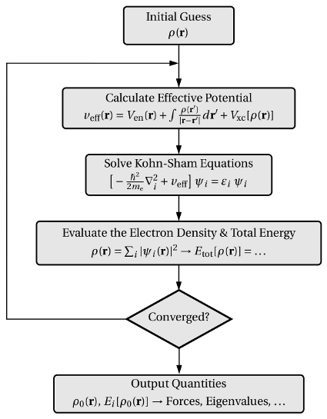
DFT is useful! I swear
And DFT calculates the band structure of these complicated systems, revealing this information

Slide 20
Overall:
the band structure for N particle (large) systems, revealing atomic scale properties of the material
Using an iterative program, estimations for the electron density functional can be used to calculate

Slide 21
Questions?

