Slide 1

CSI 1310 Final Project: Automated Radio Station
Matt Curtis - CSI 1310 - 4/8/21

Slide 2
1
INTRODUCTION & MOTIVATION

Slide 3
Introduction & Motivation - What is it?
I love technology of all types (especially being able to automate everything) and have always wanted to run my own radio station.
Why not combine the two?

Slide 4
Introduction & Motivation - What is it?
Introducing my (PhysCorp’s) Automated Radio Station, an open-source project built in Python and hosted on Ubuntu Server!
I was initially developing this for another language, but decided to switch to Python for its ease-of-use.

Slide 5
2
FEATURES

Slide 6
It’s a Smart Radio Host!
The software doesn’t just shuffle through a playlist. Check out some of these features:
Chooses a playlist based on the time of day and weekday.
Occasionally mentions time, weather info, playlist info, or the software itself.
Strips all “video” info from the video itself (converts to low-bandwidth audio track and avoids reading things like “Official Music Video” aloud).
Users can suggest their own songs or view station info from the included web dashboard!

Slide 7
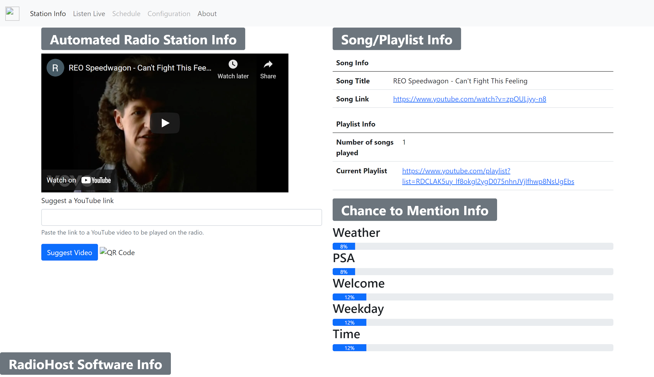
Check out the Web Dashboard (Visual Element)
A live (older) copy can be found at http://radio.physcorp.com
The dashboard features the current song title, current playlist URL, an option to listen now on your own, useful charts to show when info is likely to start, and even a section to suggest your own YouTube song link (if enabled on Options file)

Slide 8
3
CLASSES

Slide 9
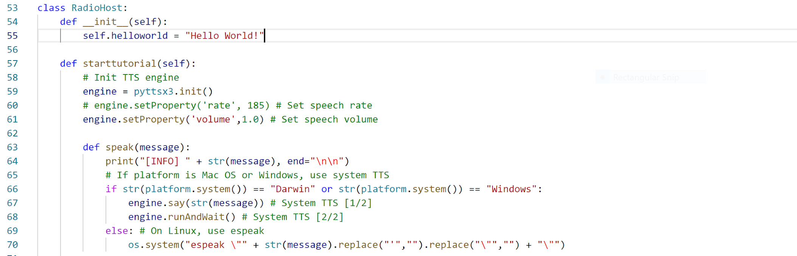
Classes [1/3] - RadioHost
RadioHost itself: Connects all other classes together. Serves to launch tutorial, as well as coordinate sounds and speech scripts for proper playback.

Slide 10
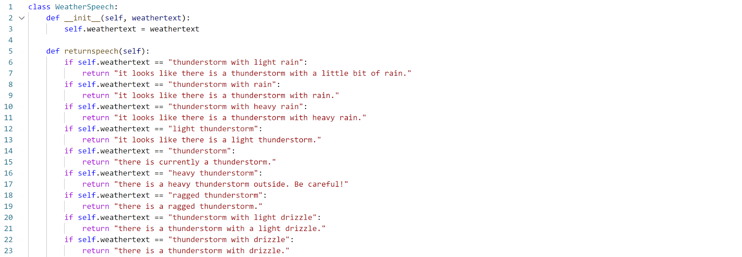
Classes [2/3] - WeatherSpeech
WeatherSpeech: Converts single-word OpenWeatherMap API responses to easily-readable text; essential “beautifies” responses, turning them into sentences.

Slide 11
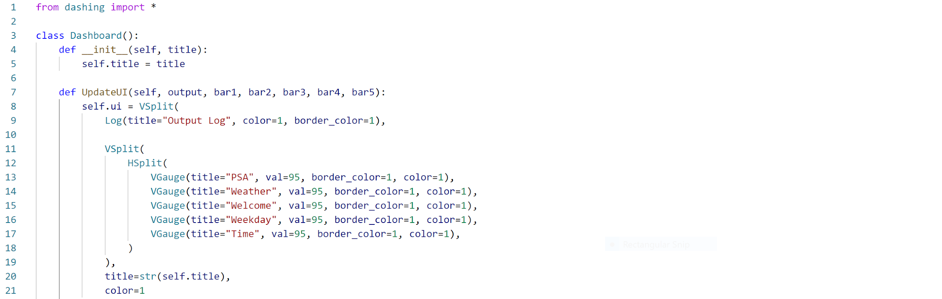
Classes [3/3] - Dashboard
Dashboard: Second visual element! Changes standard console output into a format that is easier to read; changes terminal output to a dashboard with log elements and graphs.

Slide 12
4
TEST CASES

Slide 13
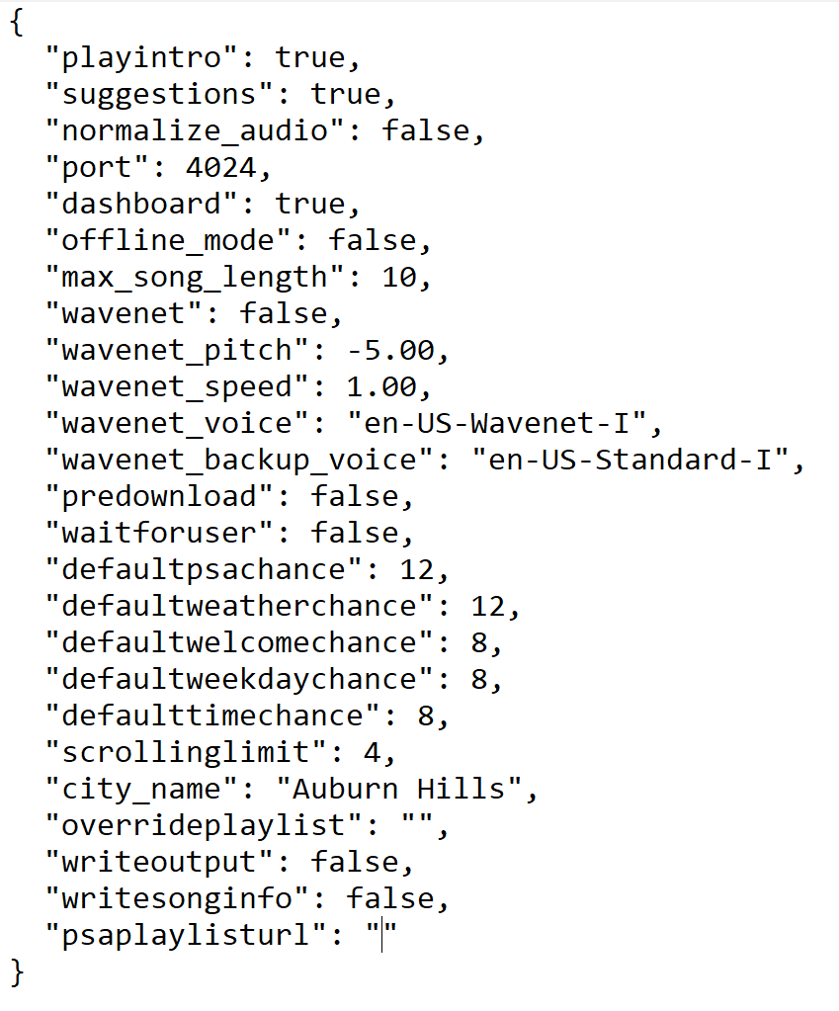
Test Cases [1/5] - References “Options.json”
Port Value:
This program uses its own web server to display song information to users. It is configured through the Options.json file. The following test ensures that users enter a valid port number to host the website.
Test: Expect to raise an error if user specifies a negative port number for the web server.
See full-page screenshot of test cases after the following slides.

Slide 14
Test Cases [2/5] - References “Options.json”
Maximum Allowable Song Length:
The program allows users to specify the maximum allowable song length for radio playback. The following test ensures that users enter a value that is in the correct range.
Test: Expect to raise different error if the maximum allowable song length option is negative.
See full-page screenshot of test cases after the following slides.

Slide 15
Test Cases [3/5] - References “Options.json”
City Name String:
The program allows users to specify which city the OpenWeatherMap API pulls weather info from. The following test ensures that users enter a string rather than an int.
Test: Expect error if the city name for weather info is an int instead of string.
See full-page screenshot of test cases after the following slides.

Slide 16
Test Cases [4/5] - References “Options.json”
Domain of Playlist URL:
The program allows users to specify a custom playlist URL. The following test ensures that users enter a link to a playlist from YouTube.com, as this program only scrapes videos from YouTube (error check also occurs on PSA playlist).
Test: Expect error if custom playlist URL is not from YouTube.com.
See full-page screenshot of test cases after the following slides.

Slide 17
Test Cases [5/5] - References “Options.json”
Range for Random Number Gen:
The program allows users to specify custom chance values for how often the announcer speaks about a given subject. The following test ensures that each chance is a positive event.
Test: Expect error if any range for random number generation is negative.
See full-page screenshot of test cases after the following slides.

Slide 18
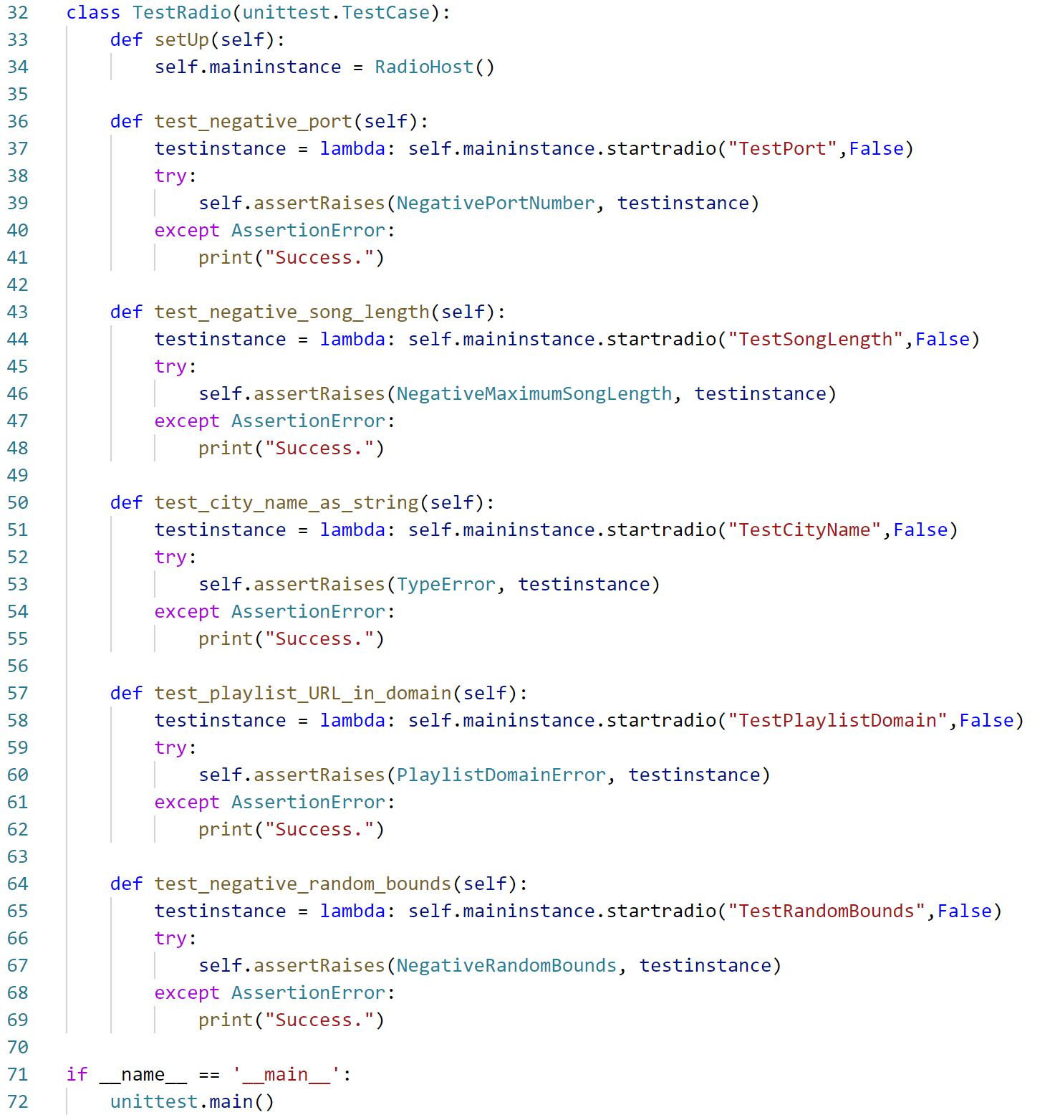
Test Cases in Code, using custom Options file per each test and “lambda” to fix issues with assertRaises(), as well as try except statement to pass when error is NOT thrown:

Slide 19
5
EXCEPTIONS

Slide 20
A Few Exceptions:
(Related to test cases) - See screenshot on next slide.
Negative port number - thrown when program detects user enters invalid port number.
Negative maximum allowable song length - thrown when user specifies invalid song length in Options file.
Playlist domain error - thrown when user-specified playlist URL does not reside from YouTube.com
Negative random bounds - thrown if user specifies chance value below zero; negative chance impossible.

Slide 21
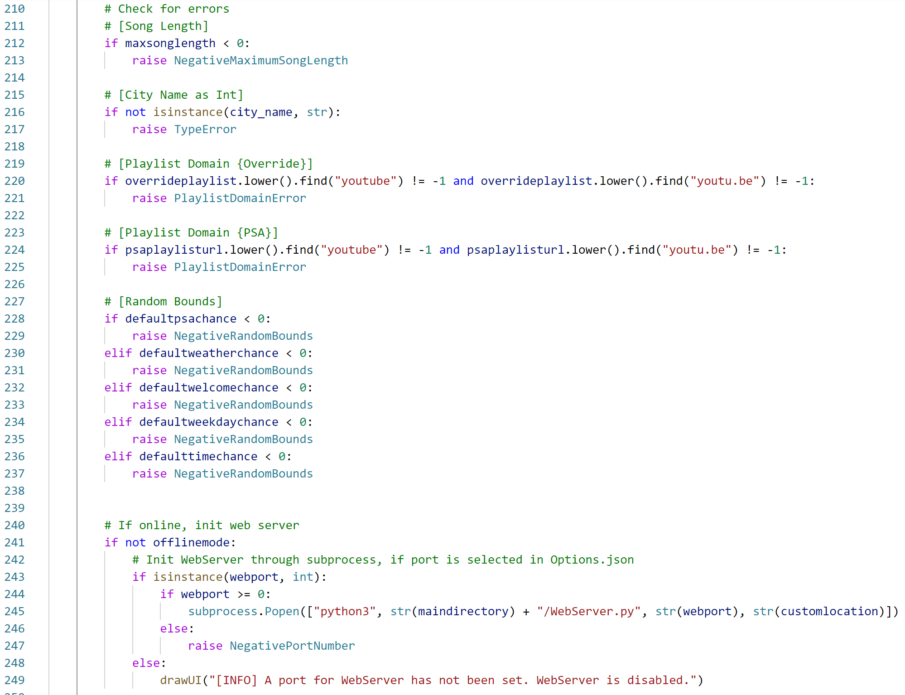
Example of some custom error usage, checking for test cases mentioned earlier.

Slide 22
6
LIVE DEMO

Slide 23
7
TRY IT YOURSELF!

Slide 24
It’s actually LIVE right now!
The program has been running for a few weeks on my Ubuntu Server.
Check out the station, listen live, and suggest songs at http://radio.physcorp.com

Slide 25

OR, Customize it Yourself!
Check out my GitHub page or my website for more info!
https://github.com/PhysCorp/AutomatedRadioStation
http://www.physcorp.com/radio
I have documentation for installing the program, as well as configuring the station to your liking. The script also comes with a guided voice tutorial!

Slide 26
8
LESSONS LEARNED

Slide 27
Time Management:
The program has changed significantly since it first started in January.
One crucial aspect of programming is always time management. While this program is functionally finished, it always helps to provide time for proper documentation (“How is someone going to use your program if they don’t know what is does?”).

Slide 28
Memory Management:
I have run into several issues detailing memory management, especially with audio processing.
The PyDub library provides an excellent set of tools for audio manipulation, but causes python to force-close if you try to pass too many audio files in a short amount of time.
Additionally, PyGame’s audio mixer is a great tool to crossfade tracks and play multiple sounds at the same time. However, continuing to pass multiple files to specific channels at a time causes a segmentation fault.
Be ready to switch libraries if you cannot get around these issues.

Slide 29
9
PROMOTIONAL MATERIALS

Slide 30
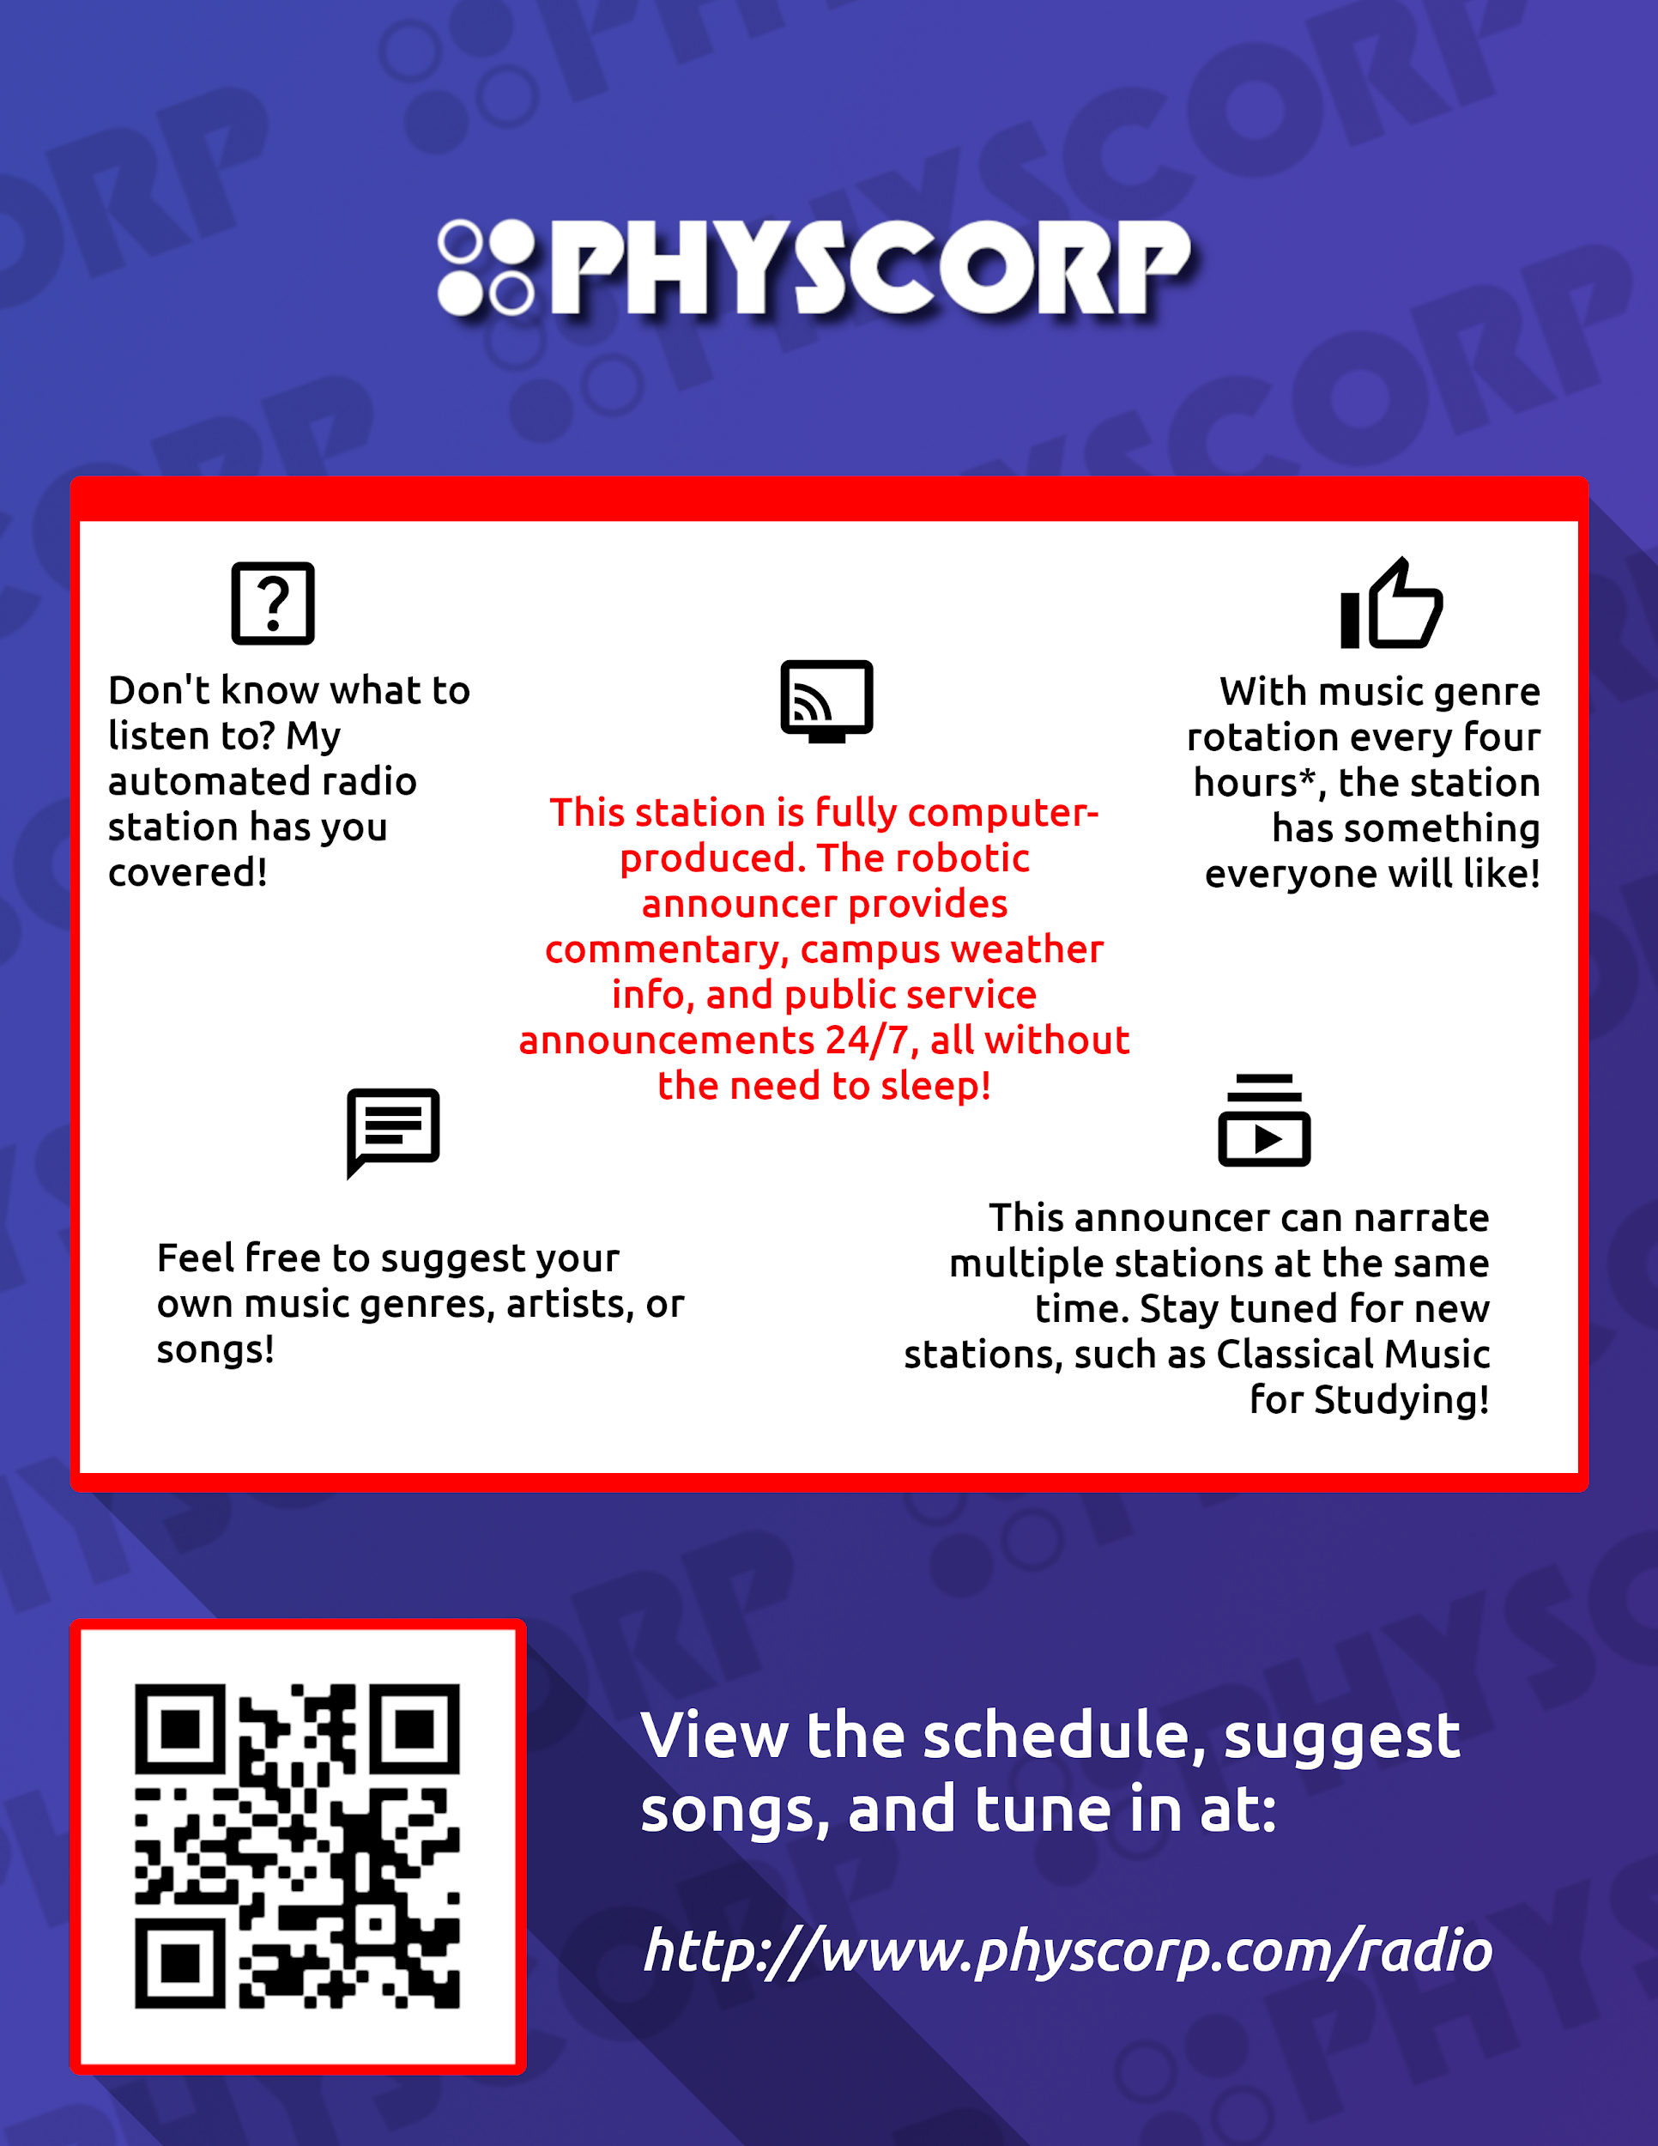
Printable Flyer:

Slide 31
Additionally, video documentation coming soon!

Slide 32
Thanks! 👍

