Slide 1


Metabarcoding of microbial communities
Berlin, 1-5 April 2019
Berlin, 11-15 March 2019

Slide 2


16S/ITS Metabarcoding: Berlin, 1-5 April 2019
Genomic dataviz in R: Berlin, 8-12 April 2019
Population Genomics: Berlin, 13-17 May 2019
Phylogenomics: Berlin, 20-24 May 2019
Ecological Niche models in R: : Berlin, 20-24 May 2019
Metagenomics: Berlin, 27-31 May 2019
Machine Learning: Berlin, 3-7 June 2019
RAD-seq data analysis: Berlin, 10-14 June 2019
aDNA Paleogenomics: Berlin, 26-30 Nov 2019
Advanced R Programming: Berlin, 1-5 July 2019
Phylogeny in biodiversity: Poland, 15-18 July 2019
Speciation Genomics: Quebec, 2-6 September 2019
GWAS: Quebec, 9-13 September 2019
R/Bioconductor for Bioinformatics: Berlin, 16-20 Sept 2019
Phylogenetic comparative methods: Berlin, 23-27 Sept 2019
Comparative Genomics: Berlin, 7-11 October 2019
Intro to Bash & Python: Berlin, 14-18 October 2019
Epigenomics: Berlin, 21-25 October 2019
Signature of Selection: Berlin, 29 Oct-1 Nov 2019
www. physalia-courses.org @Physacourses

Slide 3
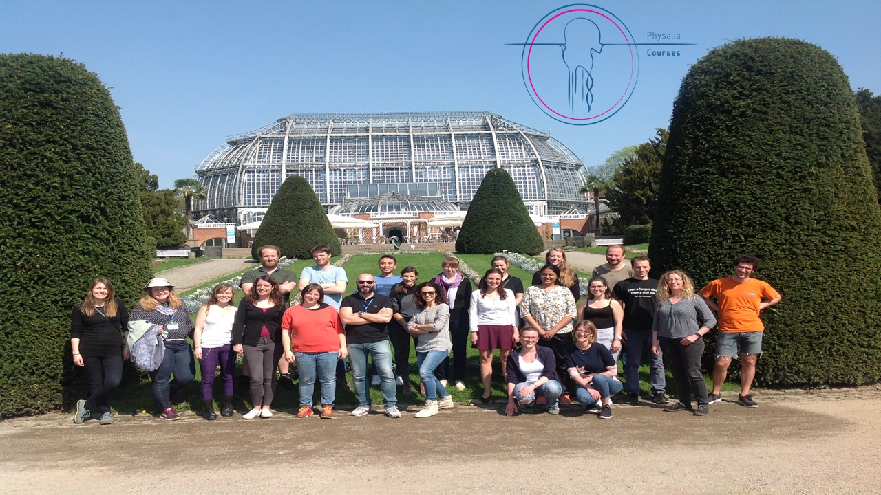
Metabarcoding of microbial communities
Berlin, 1-5 April 2019
Instructors
Dr Bruno Fosso
Dr Anna Sandionigi
Dr Antti Karkman
Teaching assistant
Giulia Agostinetto

Slide 4
General
Please try to be on time 9:30 -17:30
Two coffee breaks -> flexible
Lunch at 1 pm -> 1 hour of lunch break
The course is for you, not for us, so ask question!
Beer/dinner on Thursday
Toilets
Whatsapp
Google group to stay in touch after the course!
www. physalia-courses.org @Physacourses

Slide 5
Introduce yourself
Your Universty/Reseach Institute
Your Research topic
Why can this course be important for your research?
www. physalia-courses.org @Physacourses

