Slide 1
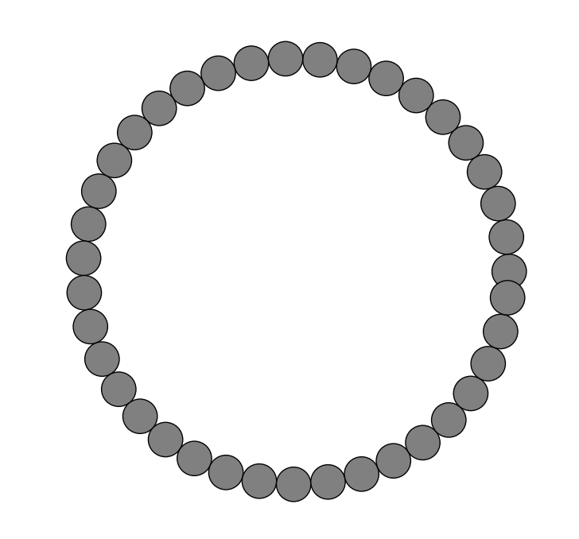
0 deg
o1,o2 in [-360,360]
R1
R2
R2
R1
annulus/disk
box
ring

