Slide 1
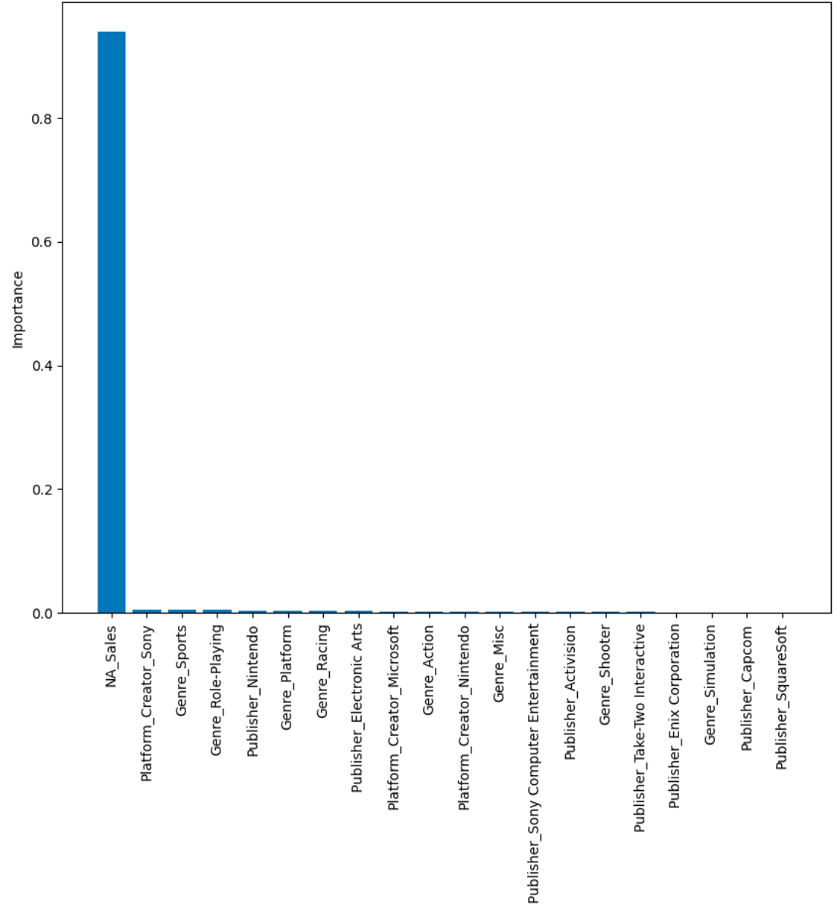
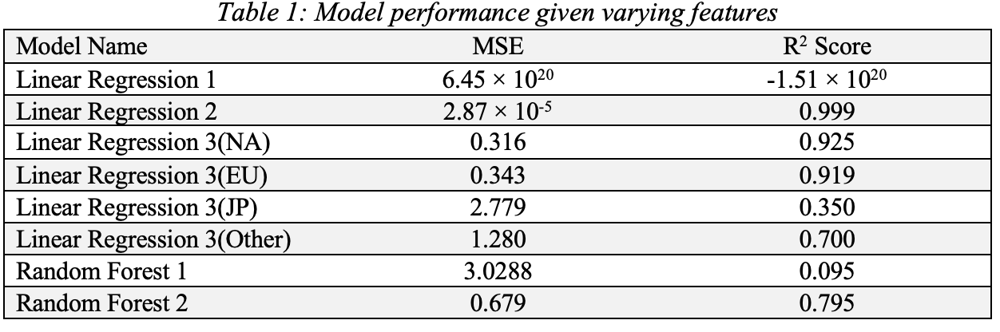
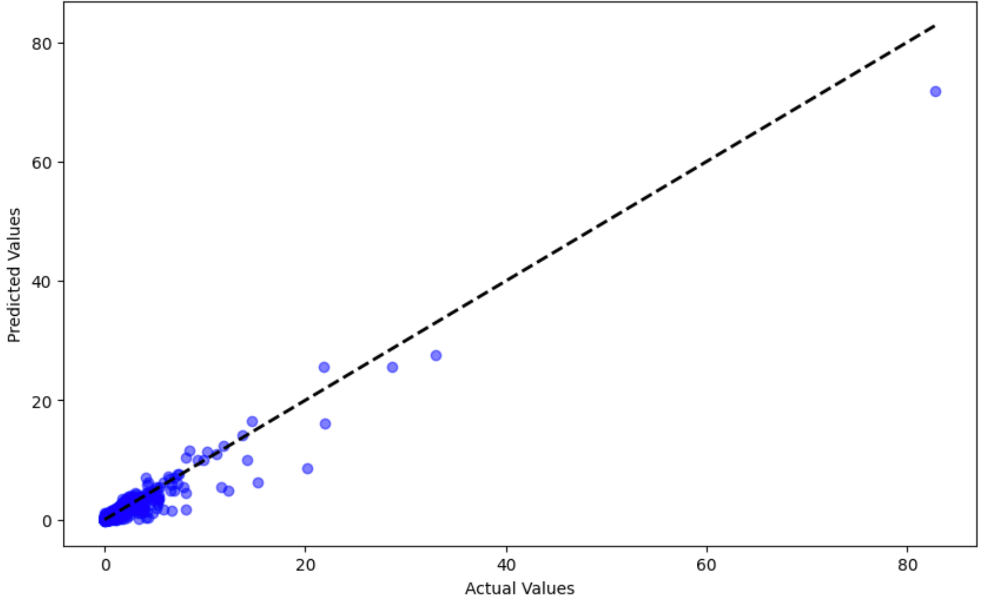
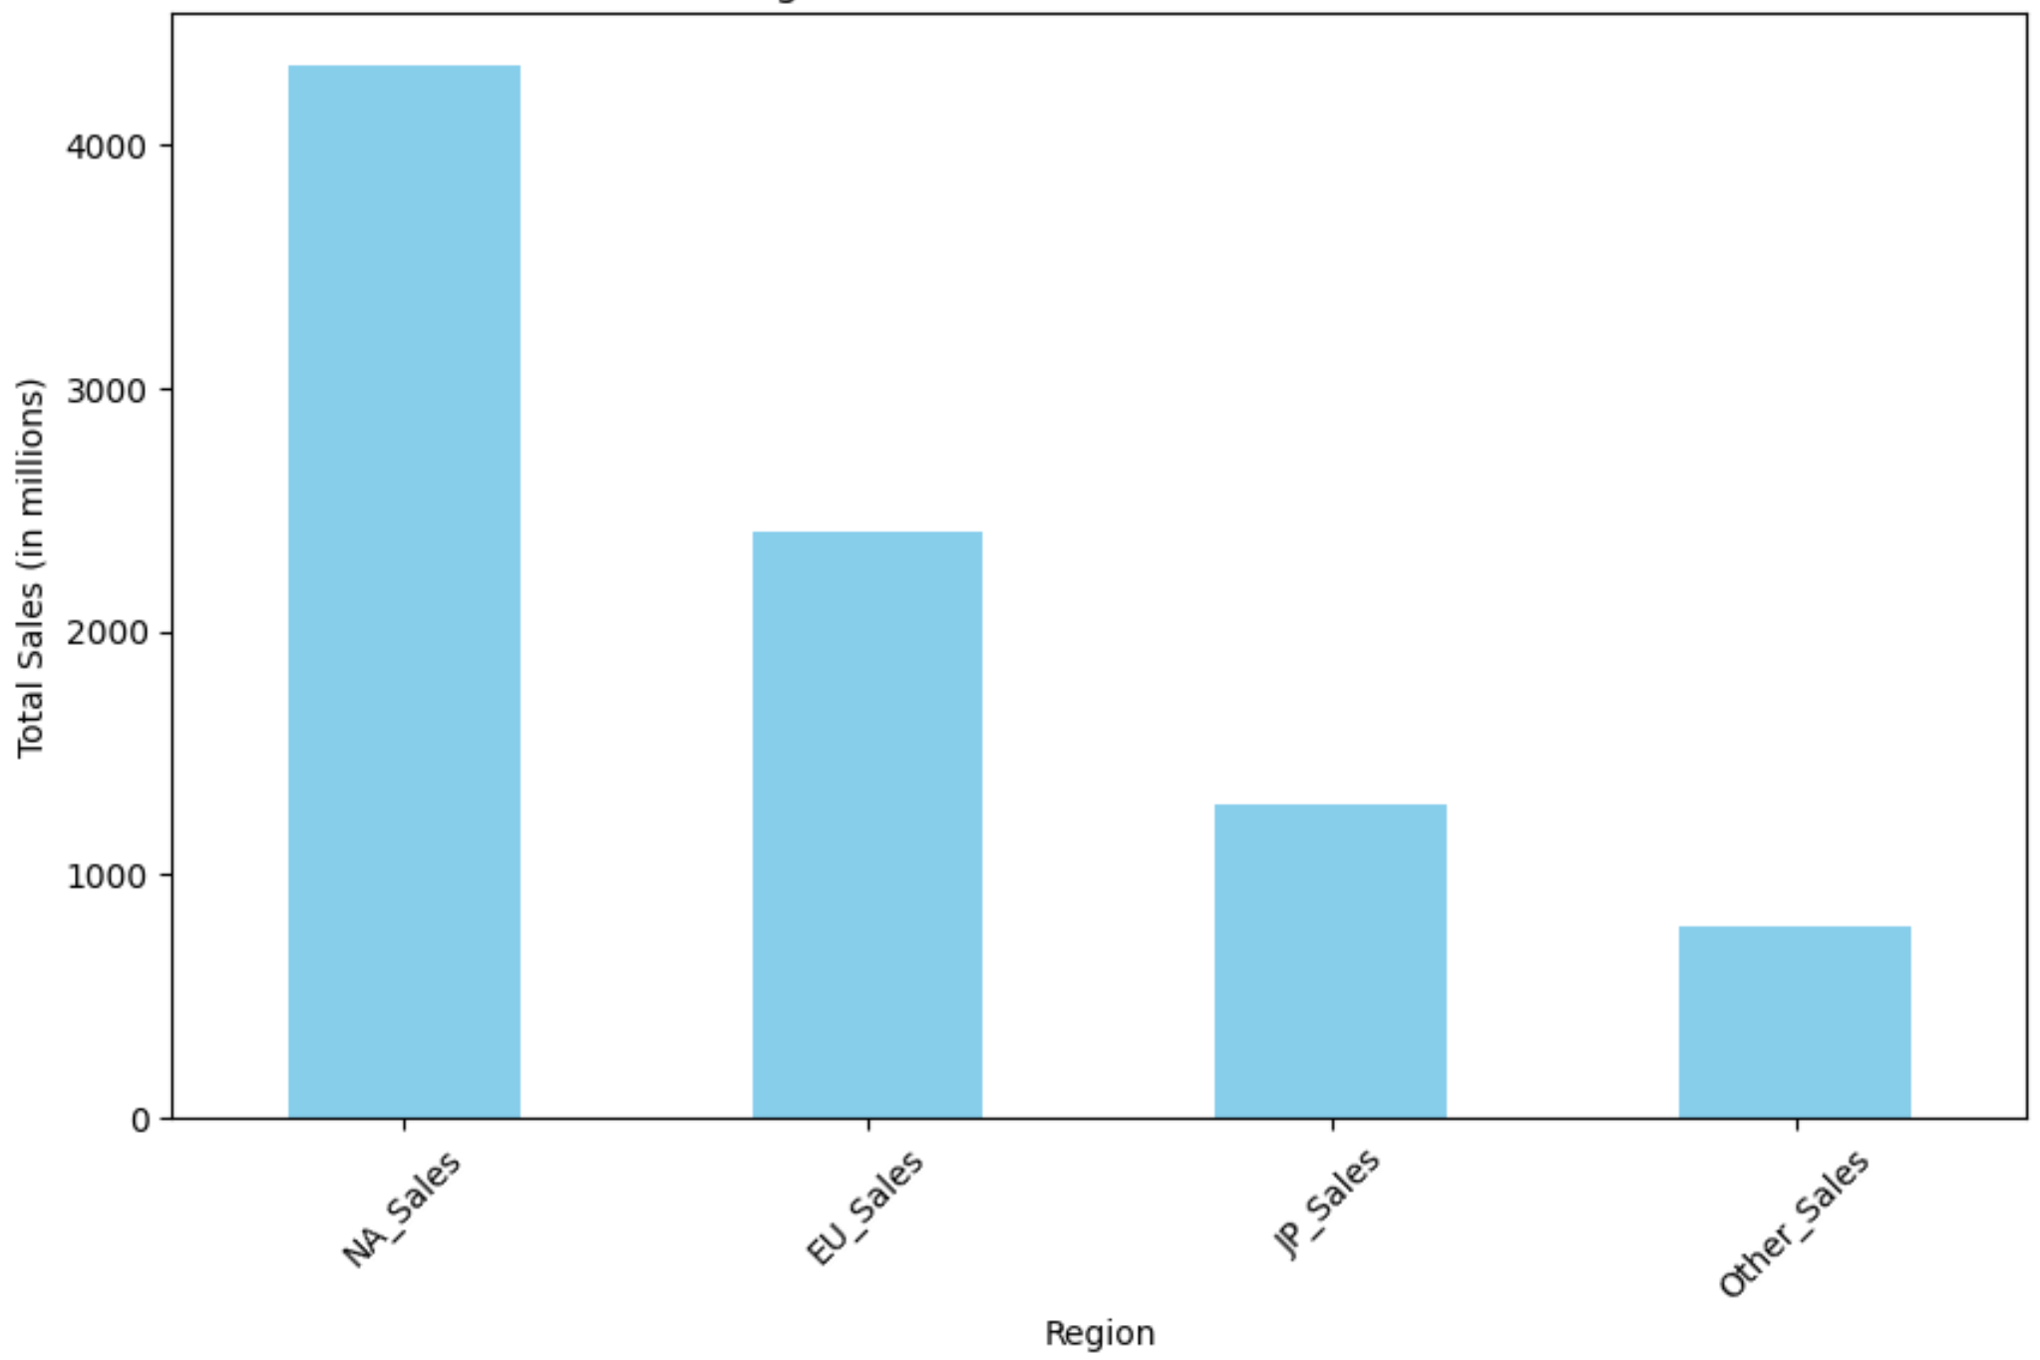
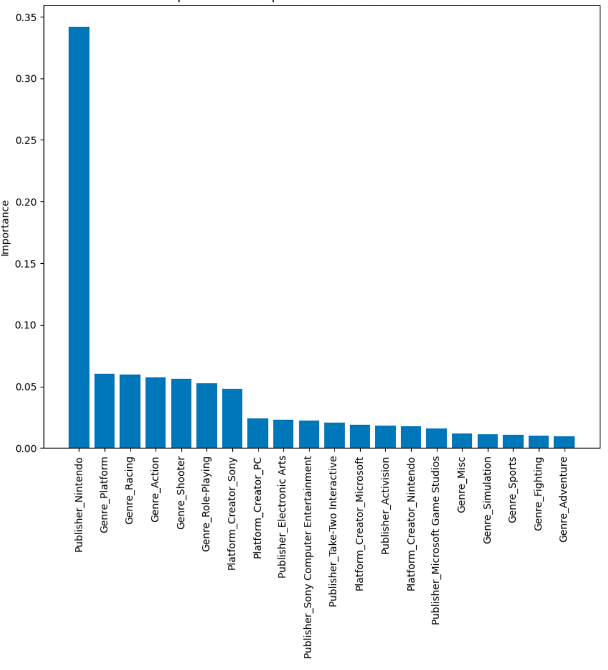
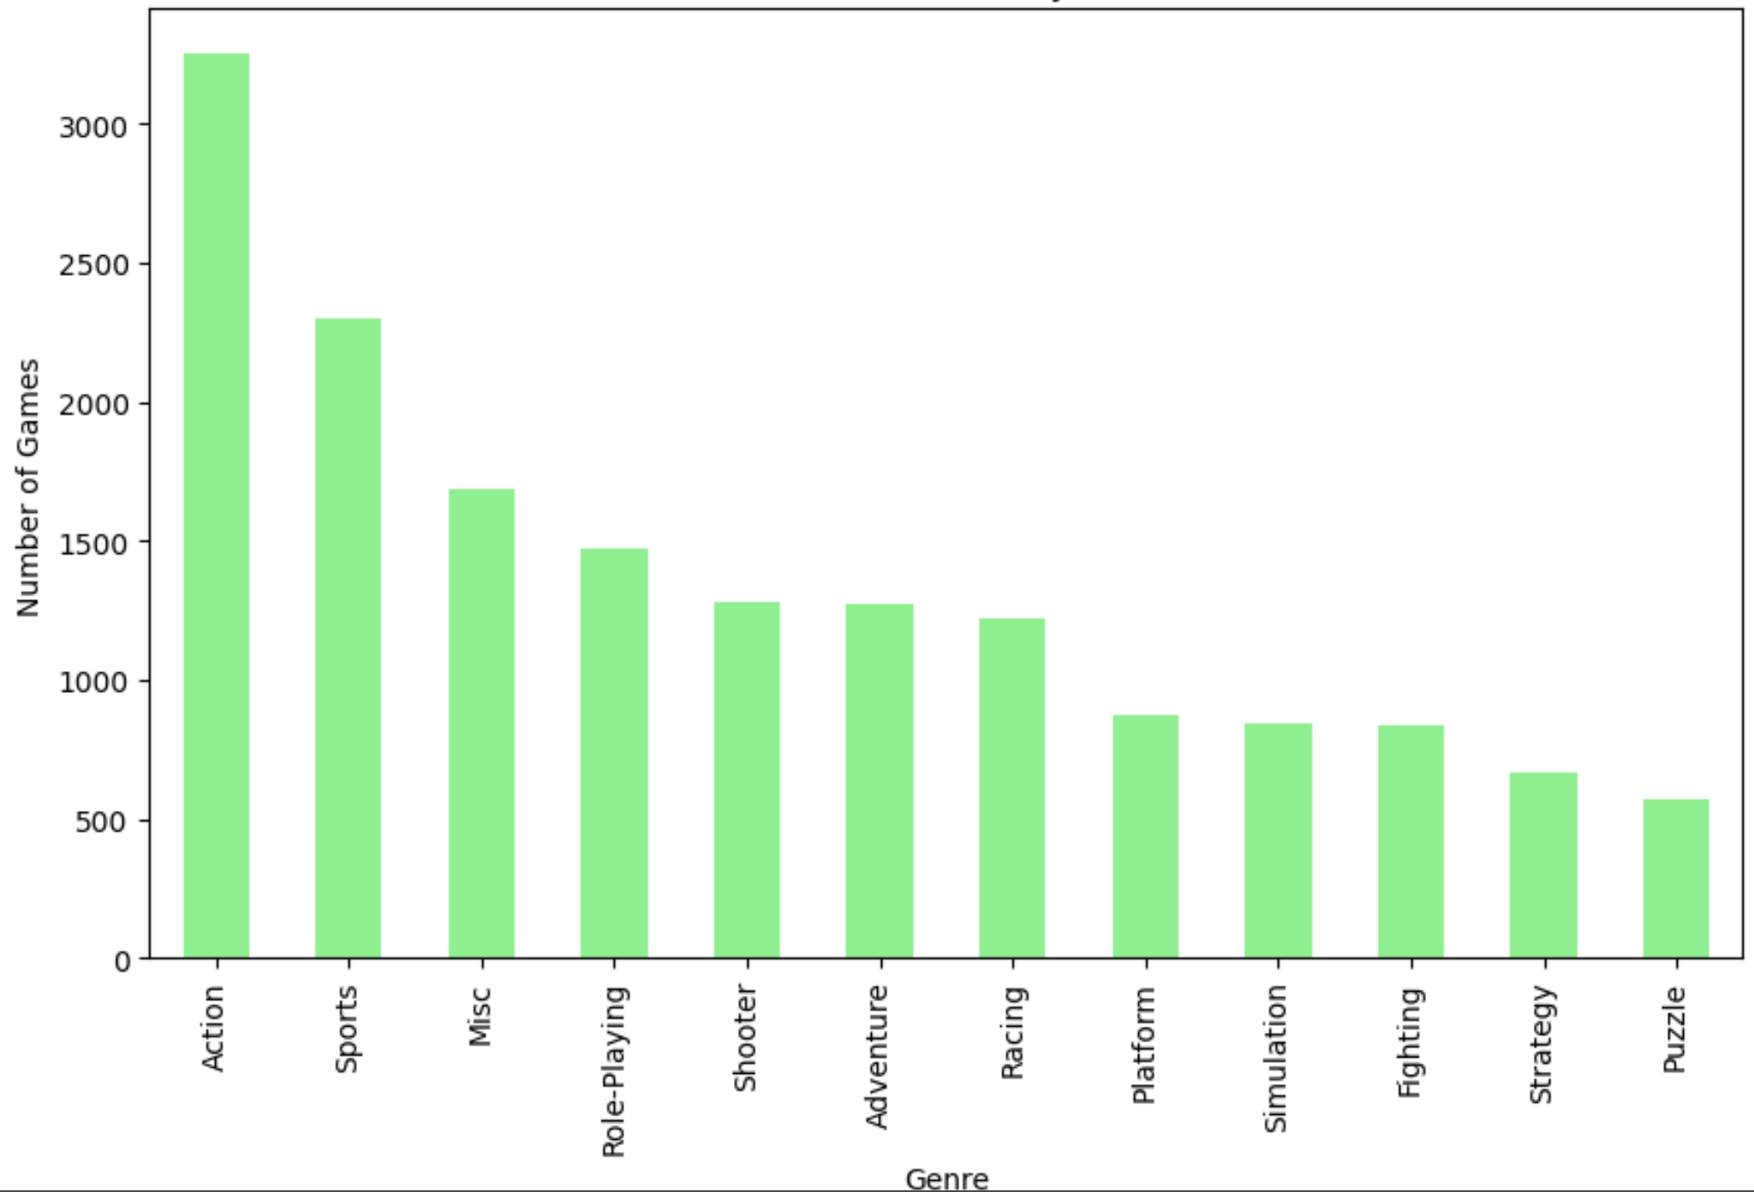
Predicting Global Video Game Sales: Analyzing Genre, Publisher, Platform, and Region Influences
Tanner Patrom
Arkansas State University
The video game industry has seen a significant transformation from its early days of simple gameplay. Technological trends gave video games the ability to boast advanced graphics, realistic physics, complex AI, and immersive storytelling, supported by powerful consoles and mobile computing devices.
A broad audience now partakes in video game culture, from large-scale multiplayer events to engaging with influencers on streaming platforms. Financially, the video game industry excels, with revenues reaching $406.2 billion and projected to grow to $666.69 billion by 2029[1].
Key factors influencing a game's success include its genre, the publisher, and the platform on which it's released. This growth and the factors driving sales are critical for companies in strategizing game development and marketing, aiming to tap into patterns and trends for better forecasting and decision-making.
This analysis focuses on predicting video game sales using platform creator, publisher, and genre.
The language of choice in the analysis was Python. The following packages were used: Pandas, Numpy, Matplotlib, Seaborn, and SciKit-Learn
The source code has also been made available on GitHub through the following public repository [3].
The dataset used [2] contains a list of video games with sales greater than 100,000 copies. Fields include rank, name, platform, year, genre, publisher, sales figures from North America, Europe, Japan, other regions, and global sales figures
There were a total of 16,598 records in the dataset. After dropping missing values, we were left with 16,291. A row called ”Platform Creator” was also created to aggregate platforms listed in the dataset.
In understanding the dataset figures were created to show samples of greater importance. Figure 1 and 2 show such.
INTRODUCTION
RESULTS
The first linear regression model performed very poorly due to the non-linear relationships between the features and our target variable.
The second linear regression model performed very well likely due to global sales being directly correlated with the sum of regional sales.
The remaining linear regression models performed moderately. Regional sales data is a strong influencer. Figure 3 shows a scatterplot of the predicted values vs. the actual values.
Figure 4: Top 20 feature importance’s in the second random forest model that includes North American sales figures
The first random forest model still does not perform very well in making predictions with solely platform creator, genre, and publisher. Figure 4 shows the features the model is deeming important in making decisions.
The second random forest model performed much better again suggesting the regional sales is highly predictive of global sales.
MATERIALS and METHODS
This study used linear regression models to determine the direct impact of platform creator, publisher, and genre predictors on sales. Random forest models were utilized to apply a more robust model to our problem.
In total three linear regression models were created. The predictors used are listed
Linear regression 1: platform creator, publisher, genre
Linear regression 2: NA, EU, JP, and other sales
Linear regression 3: platform creator, publisher, genre, and one of the four sales regions
Two random forests were created
Random forest 1: platform creator, publisher, genre
Random forest 2: platform creator, publisher, genre, North American sales
The primary metrics for evaluation were Mean Squared Error (MSE) and an R2 score
CONCLUSIONS
Figure 3: Linear regression model 3 scatter plot including North American sales figures
Seeing as North American sales(or possibly any other region) and global sales seem to be highly correlated this would indicate a limitation in the model and our prediction. There is a heavy reliance on regional sales figures to predict global sales figures.
For further analysis and an improvement in the predictive capabilities of the models chosen, without relying so heavily on regional sales data, we could try to enhance the dataset with additional relevant features that capture more dimensions of the factors influencing game popularity and market success.
Figure 1: Regional contributions to game sales
REFERENCES
https://www.statista.com/statistics/1344668/revenue-video-game-worldwide/
https://www.kaggle.com/datasets/gregorut/videogamesales
https://github.com/PhysicalBit7/Intro-to-Data-Science
Figure 2: Number of games by genre
Figure 4: Top 20 feature importance’s in the first random forest model

