Slide 1


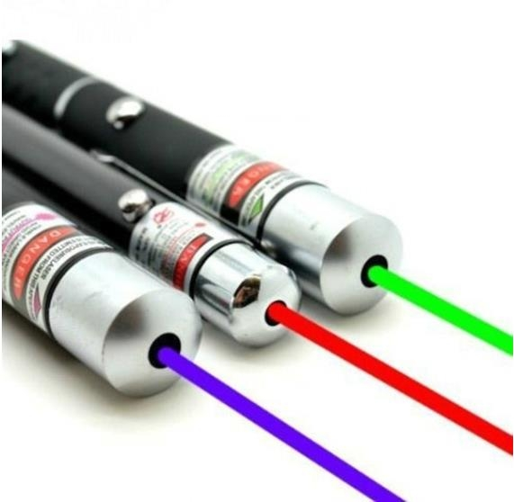
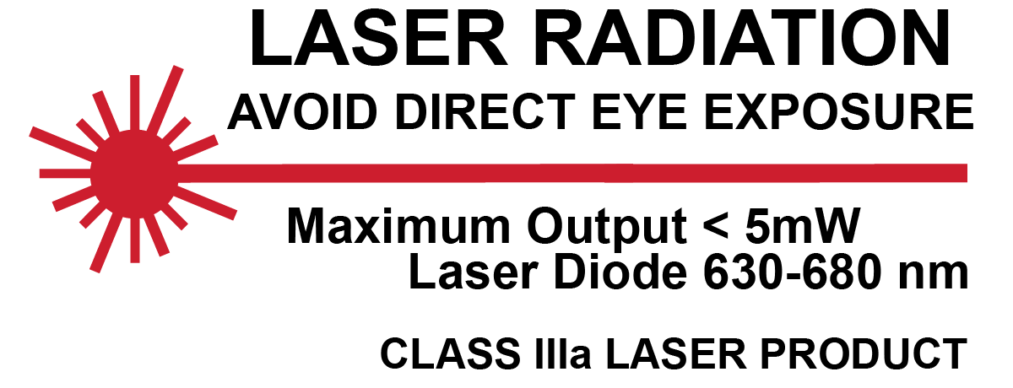
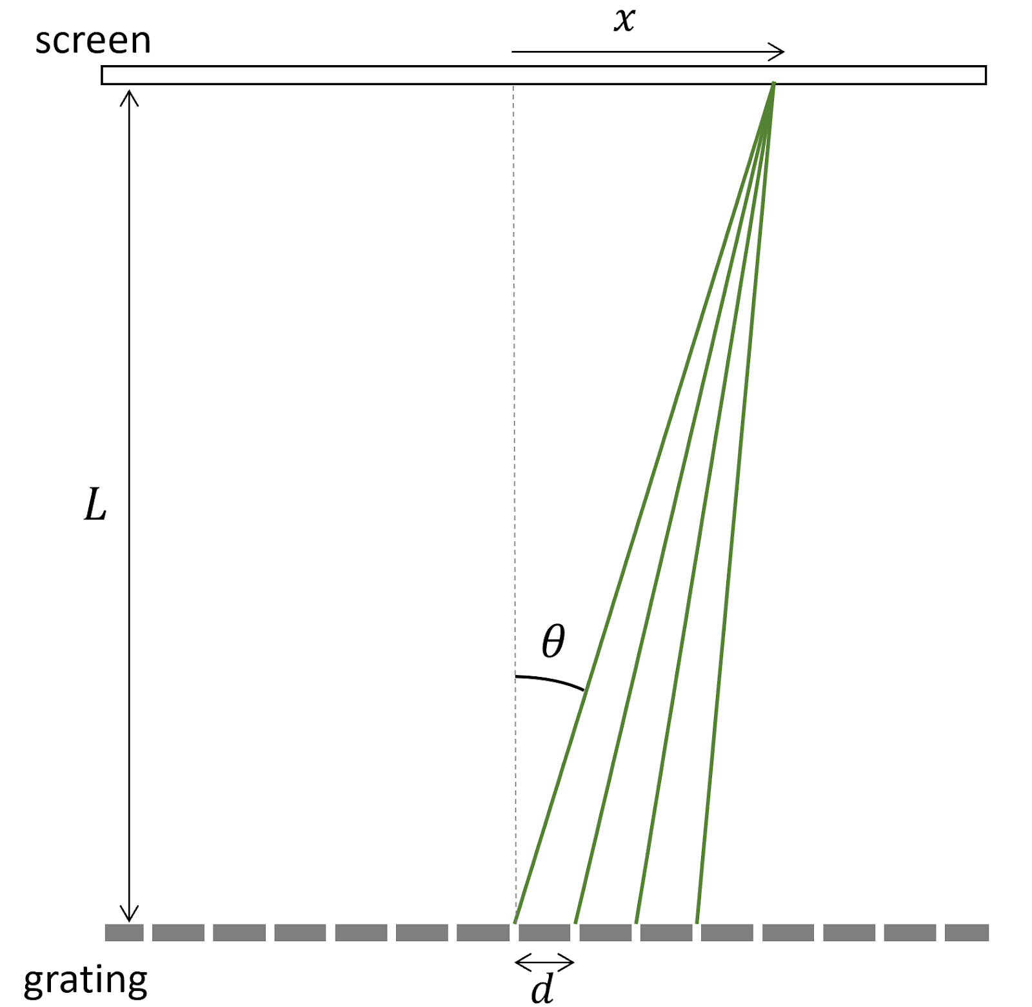
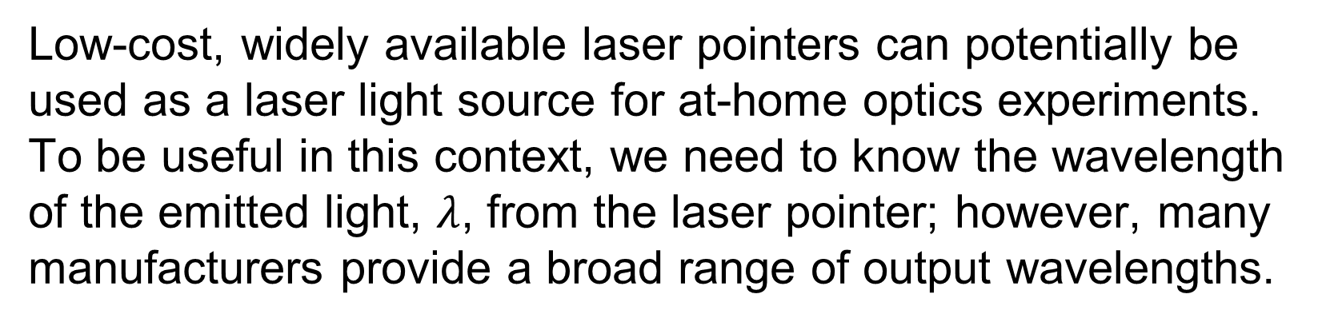
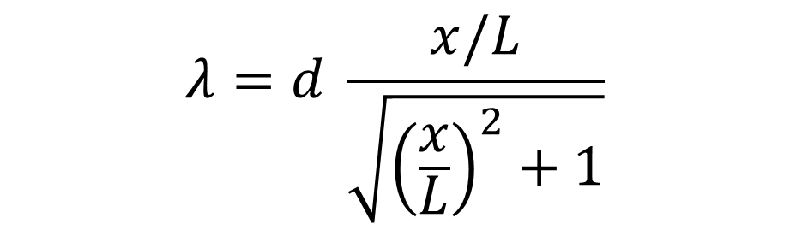
Poster Title Name Department of Physics, Harvey Mudd College
Introduction
Methods
Low-cost, widely available laser pointers can potentially be used as a laser light source for at-home optics experiments. To be useful in this context, we need to know the wavelength of the emitted light, $λ$, from the laser pointer; however, many manufacturers provide a broad range of output wavelengths.
Fig. 1 – Laser warning labels specify a range of possible wavelengths.
In this work, we measure the wavelength of a laser pointer by passing its output through a diffraction grating (Fig. 2). We measure the position of the first maximum in the diffracted pattern and determine the wavelength emitted by the laser pointer using Young’s Equation [1].
Results & Discussion
Young’s Equation
$$λ=d \frac{x/L}{\sqrt{{\left(\frac{x}{L}\right)}^{2}+1}}$$
(1)
Conclusion
distance between central bright spot and 1st maximum x
bulleted list of 3-5 “take-home” messages for your audience
Start with the most important result first
Make sure to properly qualify any conclusions that might be more speculative (e.g. “which suggests”, “possibly”, etc.)
You can also suggest ”next steps” of the project
distance between grating and screen
L
Acknowledgements
Thank you to FirstName1 LastName1 for assistance with data collection for Figure 4, and to FirstName2 LastName2 for helpful discussions about the results.
d
spacing between slits
References
Fig. 2 – Waves passing upwards through a diffraction grating constructively interfere to create a maximum on a screen. The first interference maximum on the screen is shown as the point where the lines of constructive interference (green lines) intersect, which occurs when the condition given by Eq. (1) is satisfied.
[1] Ling et al., “University Physics Volume 3, Section 4.4 Diffraction Gratings” (2016)

