Slide 1
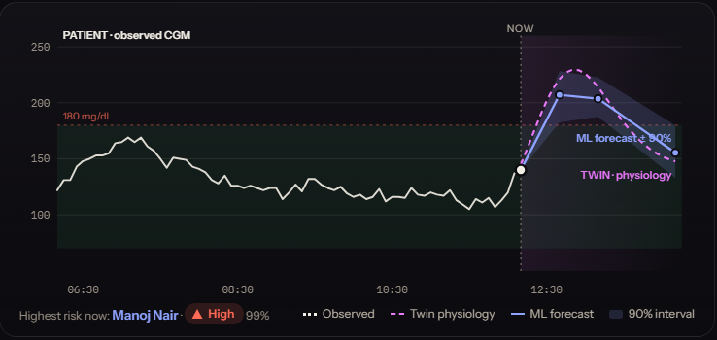
HAPPIEST HEALTH DIGITAL TWIN CHALLENGE 2026
GlucoTwin India
A personalised digital twin that warns a median of 70 minutes before a glucose spike, and lets a doctor test diet and activity changes on the patient's virtual replica before prescribing them.
Real model output for a synthetic patient: observed CGM, the ML forecast with its 90% interval, and the physiological twin.
Team Vicimus · Vishwakarma Institute of Technology, Pune
Chitrangad Ram Sapate (team leader) · Soham Joshi
Notes:
[0:00 to 0:30 · 30 s]
Good morning. We are Team Vicimus from Vishwakarma Institute of Technology, Pune. This is GlucoTwin India, a digital twin for Type 2 diabetes.
It warns a median of 70 minutes before a glucose spike, on patients it has never seen, and lets a doctor test a meal or a walk on the patient's virtual copy before prescribing. In twenty minutes: the problem, how it works, the results, and a live demo.
[Timing guide: problem and solution 0:30 to 2:50 · how it works 2:50 to 9:30 · results 9:30 to 13:35 · live demo 13:35 to 16:30 · India, safeguards, limits 16:30 to 19:30 · close 19:30 to 20:00.]

Slide 2
India manages diabetes by looking in the rear-view mirror
THE PROBLEM
101 M
< 1 in 3
~26,000
Indians living with diabetes, plus 136 M with prediabetes (ICMR-INDIAB, 2023)
reach glycaemic targets; most complications come from uncontrolled excursions
CGM readings per patient between two 3-monthly OPD visits, before counting smartwatch data
HbA1c is an average.
It hides the post-meal spikes that carbohydrate-heavy diets (rice, wheat) cause every day.
Care is reactive.
The doctor sees what already happened, never what is about to happen.
Advice is generic.
"Eat less rice" ignores that two patients respond to the same meal in completely different ways.
The challenge: fuse the static health record with the dynamic wearable stream into a model that predicts adverse events before they happen, and that a doctor can actually use.
Sources: ICMR-INDIAB (Lancet Diabetes Endocrinol 2023). 288 CGM readings a day over 90 days is about 26,000.
GlucoTwin India · Team Vicimus
2
Notes:
[0:30 to 1:40 · 70 s]
India has about 101 million people with diabetes and another 136 million with prediabetes, according to the ICMR-INDIAB study. Fewer than one in three reach their glycaemic targets.
The reason is how care works. A patient meets the doctor every three months. The doctor looks at HbA1c, which is a single average. Between those two visits a continuous glucose monitor produces about twenty-six thousand readings, and no doctor can read them.
Three consequences. HbA1c is an average, so it hides the post-meal spikes that rice and wheat heavy diets cause every day. Care is reactive: the doctor sees what already happened. And advice is generic: "eat less rice" ignores that two patients can respond to the same meal in completely different ways.
The challenge asks us to fuse the static health record with the dynamic wearable stream, and predict an adverse event before it happens, in a way a doctor can use. That is what we built.

Slide 3
A virtual patient the doctor can query, not just a risk score
OUR SOLUTION
EARLY WARNING
WHAT-IF
EXPLAINED
"A spike is likely within 2 hours"
"What if she eats jowar roti instead?"
"Why is the risk high?"
Forecasts glucose at 30, 60 and 120 minutes with a calibrated 90% interval, and alerts early enough to act: a walk or a smaller portion.
The doctor simulates meals, portions and post-meal walks on this patient's own calibrated physiology and sees the curve before prescribing.
Every alert lists its patient-specific drivers, and a pre-consultation summary is drafted automatically for the doctor to verify.
Adverse event predicted
Glucose above 180 mg/dL within the next 2 hours, with the glucose trajectory at 30, 60 and 120 minutes.
Who uses it
Endocrinologists and GPs in OPD and tele-consults, and diabetes educators for diet counselling. Next: patients and ASHA workers.
GlucoTwin India · Team Vicimus
3
Notes:
[1:40 to 2:50 · 70 s]
GlucoTwin turns that stream of data into a virtual patient the doctor can interact with, not just a risk score.
Three things. First, early warning. The model forecasts glucose at thirty, sixty and one hundred twenty minutes, with a calibrated ninety percent interval, and flags a spike early enough to act on it, a walk after lunch or a smaller portion.
Second, what-if. The doctor can ask: what happens if she eats jowar roti instead of white rice, or walks fifteen minutes after lunch? The answer comes from that patient's own calibrated physiology.
Third, explained. Every alert comes with its drivers, and a pre-consultation summary is drafted for the doctor to verify.
The adverse event we predict is glucose rising above 180 within the next two hours. The users are endocrinologists and GPs in OPD and tele-consults, and diabetes educators. The next step is patients and ASHA workers.

Slide 4
Five properties that separate a twin from a predictor
WHY THIS IS A DIGITAL TWIN
1
2
3
4
5
Personalised
Synchronised
Predictive
Simulatable
Actionable
Six physiological parameters are fitted to each patient, starting from a prior built from their own health record.
A state observer pulls the twin toward every new CGM reading, so the twin is always "now".
A machine-learning layer learns what physiology leaves out: sleep debt, stress, the dawn effect.
Because the core is mechanistic, it answers counterfactuals that a pure ML model cannot.
Triage, explanations and summaries sit inside the doctor's workflow.
Static EHR stream × dynamic wearable stream → a physiological replica, updated every 5 minutes.
Static: demographics, diagnoses, HbA1c history, labs, medications, TCF7L2 genotype, polygenic risk. Dynamic: CGM, heart rate, HRV, steps, sleep stages, meal log.
GlucoTwin India · Team Vicimus
4
Notes:
[2:50 to 3:50 · 60 s]
Many projects call a predictor a digital twin. We hold ourselves to five properties.
One, personalised. Six physiological parameters, such as insulin action, glucose effectiveness and how fast this patient absorbs carbohydrate, are fitted to that patient, starting from a prior built from their own health record.
Two, synchronised. A state observer nudges the twin toward every new CGM reading, so the twin is always at the present moment.
Three, predictive. The physiology model is deliberately simple. A machine-learning layer learns what physiology leaves out, like sleep debt, stress and the dawn effect, from the wearable and health-record data.
Four, simulatable. Because the core is mechanistic, it can answer what-if questions that a pure machine-learning model cannot.
Five, actionable. Triage, explanations and summaries sit in the doctor's workflow.
In one line: the static record times the dynamic wearable stream gives a physiological replica, updated every five minutes.

Slide 5
Two data streams fused: the record and the wearable
DATA AND THE SANDBOX RULES
STATIC STREAM · health record
DYNAMIC STREAM · wearables
SANDBOX · synthetic and open data only
Demographics and diagnoses (SNOMED CT)
HbA1c history, fasting glucose, lipids, eGFR, blood pressure (LOINC)
Medications: metformin, sulfonylurea, insulin (RxNorm)
Genetics: TCF7L2 rs7903146, polygenic risk score
Exported as HL7 FHIR R4 bundles with an ABHA identifier
Continuous glucose monitor, every 5 minutes
Smartwatch: heart rate, HRV (RMSSD), steps
Sleep stages: awake, light, deep, REM
Meal log from a 27-dish Indian food library (carbs, GI, fat, protein, fibre)
Apple Health / Google Fit style, replayed as a live stream
80 synthetic Indian T2D and prediabetes patients, 14 days each (seed 2026)
Our own generator: extended Bergman model with dawn effect, sleep debt, stress, drug action
CGM sensor model: lag, noise, dropouts; imperfect meal logging
Real-data check on the open CGMacros dataset (PhysioNet)
No real patient data: DPDP Act 2023 and HIPAA rules respected
GlucoTwin India · Team Vicimus
5
Notes:
[3:50 to 5:00 · 70 s]
The challenge requires fusing two streams, and the sandbox rules require synthetic or open data.
On the left, the static stream: a simulated health record. Demographics, diagnoses coded in SNOMED, lab results coded in LOINC, medications coded in RxNorm, and genetic markers, specifically the TCF7L2 diabetes risk variant and a polygenic risk score. We export it as HL7 FHIR R4 bundles with an ABHA identifier, so it looks like what a hospital system would send.
In the middle, the dynamic stream: CGM every five minutes, heart rate, heart-rate variability, steps, sleep stages and a meal log from a twenty-seven dish Indian food library.
On the right, how we respect the sandbox rules. All patients are synthetic: eighty Indian patients, fourteen days each, from our own generator that simulates the physiology, including dawn effect, sleep debt, stress and drug action, and a realistic CGM sensor with lag, noise and dropouts. For real-world evidence we validate on the open CGMacros dataset from PhysioNet. No real patient data is used anywhere.

Slide 6
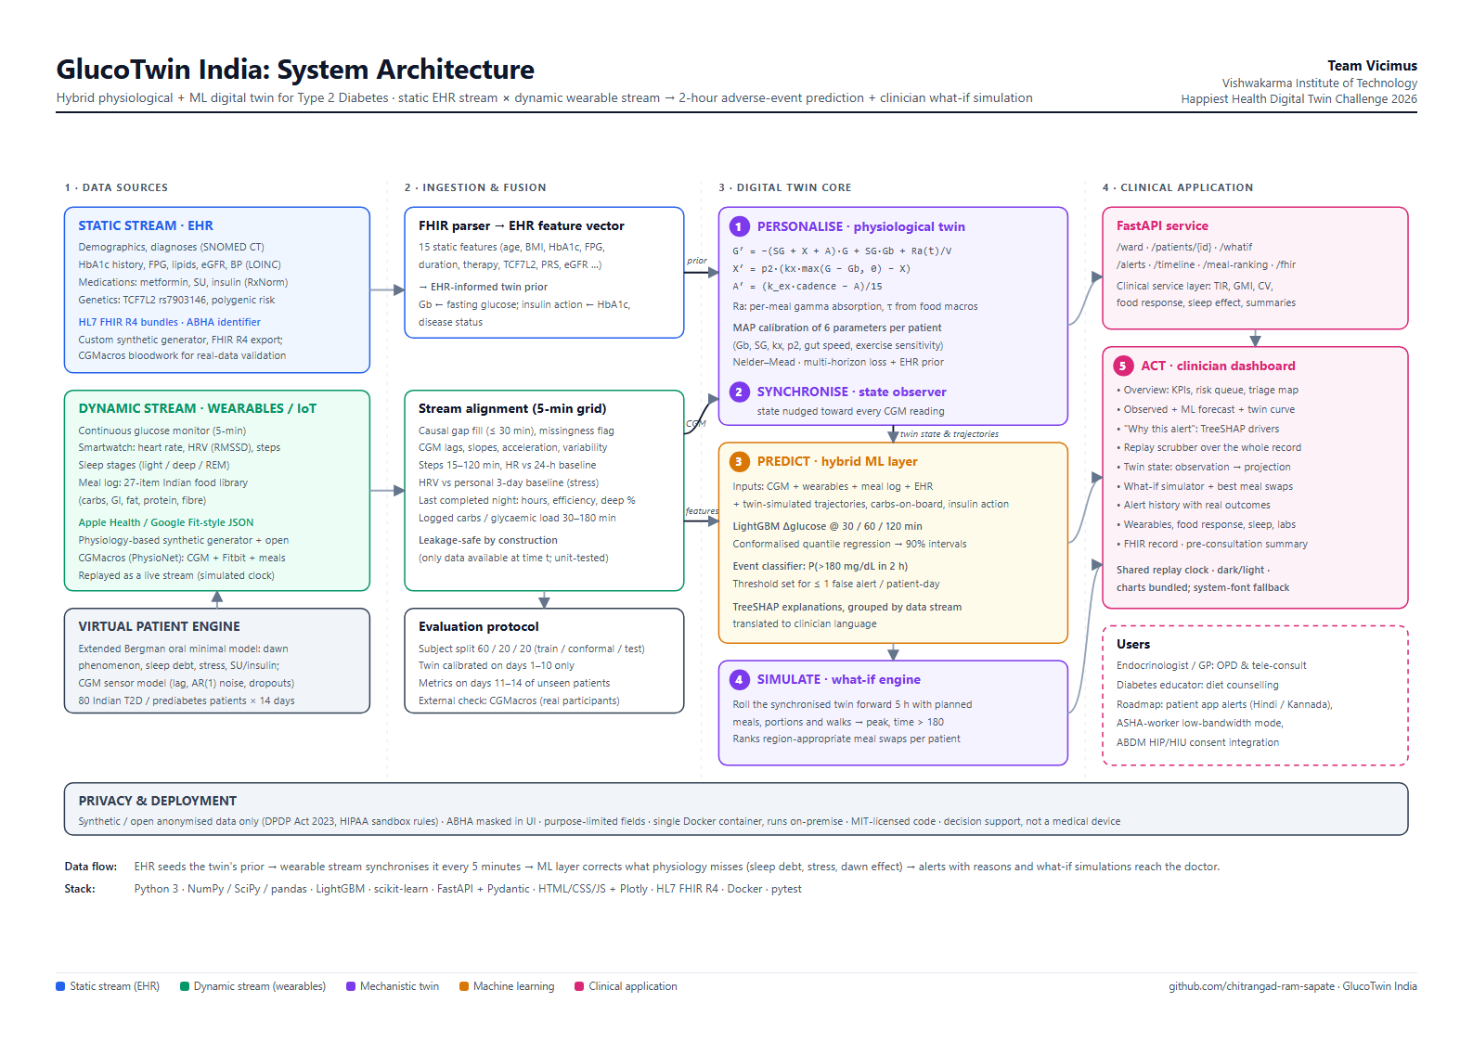
Architecture: from raw streams to the doctor's screen
ARCHITECTURE
1
Personalise
EHR-informed prior, then MAP calibration of six parameters on days 1 to 10
2
Synchronise
State observer corrects the twin at every CGM reading
3
Predict
LightGBM forecasts with conformal intervals and TreeSHAP reasons
4
Simulate
Roll the twin forward 5 hours under planned meals and walks
5
Act
FastAPI service and the clinician dashboard
Full diagram: docs/architecture.pdf in the repository.
GlucoTwin India · Team Vicimus
6
Notes:
[5:00 to 6:00 · 60 s]
This is the system architecture. Read it left to right.
Data sources on the left: the static record and the dynamic wearable stream. Next, ingestion and fusion: the health record becomes a feature vector and seeds the twin's prior, and the wearable stream is aligned to a five-minute grid. A rule we enforce everywhere: every feature uses only data available at that moment.
The twin core in the middle has four steps. Personalise: calibrate six parameters to the patient. Synchronise: a state observer corrects the twin at every reading. Predict: the hybrid machine-learning layer. And Simulate: the what-if engine.
On the right, a FastAPI service with a clinical service layer, and the clinician dashboard, which I will demonstrate shortly.
The full diagram is in the repository as a PDF.

Slide 7
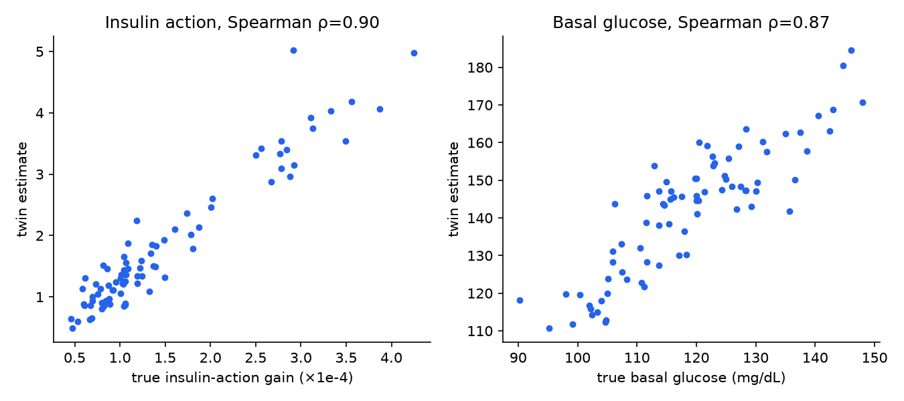
A personal physiology model, kept in sync with the patient
TWIN CORE
G′ = −(SG + X + A)·G + SG·Gb + Ra(t)/V
X′ = p2·(kx·max(G − Gb, 0) − X)
A′ = (k_ex·cadence − A)/15
Ra = Σ meals f·carbs·s/τ²·e^(−s/τ)
EHR prior: basal glucose from fasting glucose, insulin action from HbA1c and disease status
MAP calibration of six parameters on each patient's days 1 to 10
Observer: corrects the state at every CGM reading
Meal absorption from carbs, glycaemic index, fat, protein and fibre
ρ = 0.90
ρ = 0.87
insulin action recovered
basal glucose recovered
Personal calibration cuts the twin's forecast loss by 21% versus the health-record prior alone. Spearman ρ compares fitted parameters with the hidden ground truth of each synthetic patient.
GlucoTwin India · Team Vicimus
7
Notes:
[6:00 to 7:10 · 70 s]
The core is a classic physiological model: an oral glucose minimal model, the Bergman model, on a five-minute grid. Glucose G is pulled toward the patient's basal level Gb, reduced by insulin action X and by exercise A, and pushed up by meal absorption Ra.
Three steps make it a twin and not a generic model. First, the health record gives a prior: basal glucose from the fasting glucose, insulin action from HbA1c and disease status. Second, calibration: we fit six parameters to each patient's own first ten days, balancing forecast error against the prior. Third, synchronisation: the observer corrects the state at every reading, so forecasts and simulations start from the patient's current state.
Meal absorption speed comes from each dish's carbohydrate, glycaemic index, fat, protein and fibre.
Does it work? Because our patients are synthetic, we know their hidden true physiology. On the right, the twin's estimates against the truth: a rank correlation of 0.90 for insulin action and 0.87 for basal glucose. Personal calibration cuts forecast loss by about 21 percent compared with the record-only prior.

Slide 8
Machine learning corrects what physiology cannot see
HYBRID ML LAYER
LightGBM forecasts the change in glucose at 30, 60 and 120 minutes
Conformalised quantile regression gives 90% intervals calibrated on held-out patients (measured coverage 88.9% at 60 minutes)
Event classifier gives the probability that glucose exceeds 180 mg/dL within 2 hours
Twin-simulated trajectories, carbs on board and insulin action are inputs, so physiology and learning inform each other
What we do not claim
No hypoglycaemia model was trained: the synthetic cohort had too few low-glucose events to learn one, so the dashboard shows no hypo risk rather than an invented number.
70 fused features per 5-minute step, by data stream
GlucoTwin India · Team Vicimus
8
Notes:
[7:10 to 8:20 · 70 s]
The machine-learning layer learns what the physiology model leaves out.
For every five-minute step we fuse 70 features, shown on the left by data stream: CGM trends and variability, wearable signals such as steps, heart rate, HRV and last night's sleep, the meal log, the health record, and the twin's own outputs, simulated trajectories, carbs still absorbing and insulin action.
LightGBM predicts the change in glucose at thirty, sixty and one hundred twenty minutes. For uncertainty we use conformalised quantile regression, calibrated on held-out patients. At sixty minutes, the ninety percent interval contained the true value 88.9 percent of the time. A classifier gives the probability of exceeding 180 within two hours.
One honest point. We did not train a hypoglycaemia model: the cohort had too few low-glucose events. So the dashboard shows no hypo risk at all, rather than an invented number.

Slide 9
Alerts a clinician can trust: few, early and explained
ALERT POLICY AND EXPLAINABILITY
Why this patient is flagged
1
Pick the operating point the way a clinician would
Threshold 0.775: the most sensitive setting with at most 1 false alert per patient-day on calibration patients, not the one that maximises a statistic.
2
Confirm before notifying
Risk must stay above the threshold for two readings (10 minutes), which removes single-reading blips.
3
Snooze like a CGM alarm
No repeat notification within 60 minutes, because alert fatigue is a patient-safety problem.
Imran Gowda at 12:10 on the replay clock: glucose 123 mg/dL, 2-hour risk 86%. Red bars raise the risk, blue bars lower it (TreeSHAP, log-odds).
GlucoTwin India · Team Vicimus
9
Notes:
[8:20 to 9:30 · 70 s]
A model that fires constantly gets switched off, so the alert policy is as important as the model.
Step one: the threshold. We do not maximise a statistic. We choose the most sensitive threshold, 0.775, that keeps false alerts to at most one per patient per day on calibration patients the model did not train on. Step two: the risk must stay above the threshold for two consecutive readings, ten minutes, before anyone is notified. Step three: after an alert, a sixty-minute snooze, like a CGM alarm.
On the right, the explanation for one alert, which you will see again in the demo. Imran Gowda, glucose 123, comfortably in range, but a two-hour risk of 86 percent. The bars are TreeSHAP contributions. Current glucose and the time of day push the risk up; the twin's own trajectory pulls it down. The doctor can see why, not just that.

Slide 10
Every data stream adds value, and the hybrid twin is best
RESULTS · 16 UNSEEN PATIENTS, UNSEEN DAYS
17.5 mg/dL
129/162 80%
0.62 per day
0.959 AUROC
60-minute forecast error (persistence: 37.6)
excursions above 180 flagged in advance, median lead 70 min
false alerts per patient-day (target: at most 1)
2-hour spike alert · precision 0.89 · recall 0.63
Protocol: subject split 48 / 16 / 16 patients; twins calibrated on days 1 to 10; metrics on days 11 to 14. Bars show point-forecast ablation models; the final model with intervals scores 17.5.
GlucoTwin India · Team Vicimus
10
Notes:
[9:30 to 11:25 · 115 s]
Here are the results. The protocol matters: we split by patient, not by row. 48 patients train the model, 16 calibrate the uncertainty and alert threshold, and 16 are never seen. Each twin is calibrated on days one to ten only, and every metric is on days eleven to fourteen of the unseen patients.
Top left: the sixty-minute forecast error is 17.5 milligrams per decilitre, against 37.6 for simply assuming glucose stays where it is.
The alerts: of 162 excursions above 180, 129 were flagged in advance, 80 percent, with a median warning of 70 minutes, at 0.62 false alerts per patient per day, inside our limit of one. The ranking quality, AUROC, is 0.959.
The chart is the ablation: what each data stream adds. The physiology twin alone beats persistence. CGM alone is better. Adding wearables and meal logs cuts the error again. Adding the health record helps slightly. Adding the twin's physiology gives the best model, 17.2. Every stream earns its place. The final model with intervals scores 17.5.
I should be candid: these are synthetic results, which are an upper bound, because we designed that physiology. That is why the real-data check on the next slides matters.

Slide 11
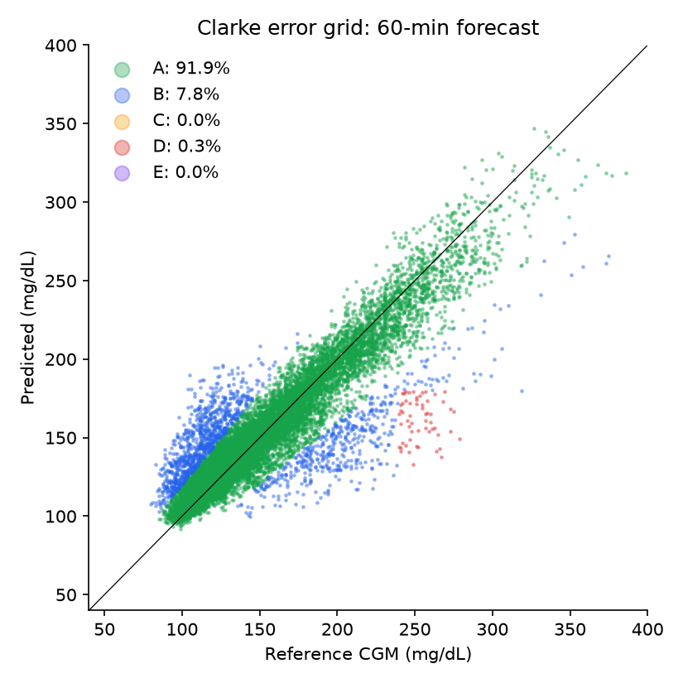
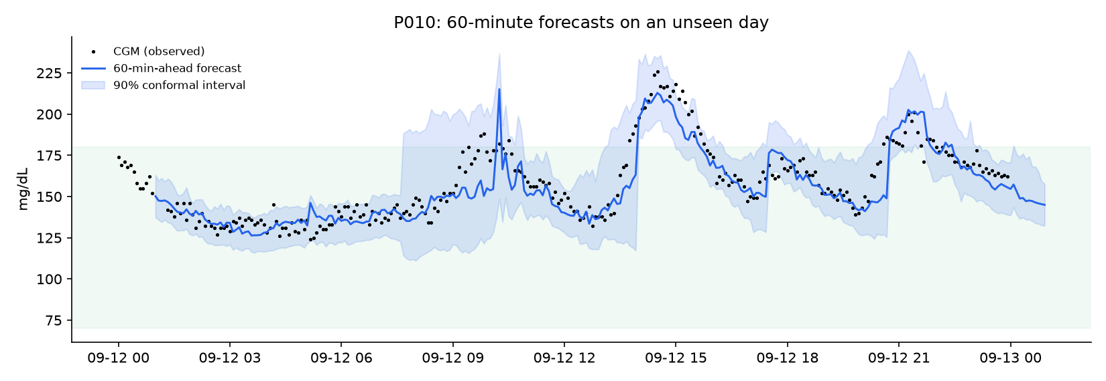
Clinically safe forecasts, with honest uncertainty
CLINICAL ACCURACY
Horizon | RMSE (mg/dL) | MAE | MARD | Clarke zone A | Clarke A + B | Interval coverage
30 min | 9.1 | 6.6 | 4.5% | 99.1% | 100.0% | 90.0%
60 min | 17.5 | 11.1 | 7.5% | 91.9% | 99.7% | 88.9%
120 min | 25.2 | 16.3 | 10.7% | 84.8% | 99.4% | 88.1%
Left: Clarke error grid at 60 minutes. Right: one unseen patient-day, forecast made 60 minutes ahead with its 90% conformal interval.
GlucoTwin India · Team Vicimus
11
Notes:
[11:25 to 12:25 · 60 s]
Accuracy alone is not safety, so we also report the clinical measures.
The table: mean absolute relative difference, the standard CGM accuracy measure, is 7.5 percent at sixty minutes. The Clarke error grid classifies errors by their clinical consequence. At sixty minutes, 99.7 percent of forecasts fall in zones A and B, meaning no dangerous treatment decision would follow, and 91.9 percent are in zone A.
On uncertainty: the ninety percent intervals contain the truth 90, 89 and 88 percent of the time at thirty, sixty and one hundred twenty minutes. Slightly below ninety at the longer horizons, and we report that as it is.
On the right, one unseen patient-day. The line is the forecast made sixty minutes earlier; the band is its interval; the dots are what the sensor actually recorded.

Slide 12
It also works on real people: 45 adults from CGMacros
EXTERNAL VALIDATION ON REAL DATA
Model (leave-subjects-out) | RMSE @30 | @60 | @120
Persistence | 20.0 | 29.1 | 38.6
Twin only (physiology) | 28.1 | 32.1 | 32.7
CGM only | 16.6 | 23.8 | 28.6
+ Wearable & meal log | 15.9 | 23.2 | 28.1
+ Labs/EHR (stream fusion) | 15.9 | 23.5 | 28.2
+ Twin physiology (full hybrid) | 15.5 | 22.5 | 27.2
23%
lower 60-minute error than persistence (22.5 vs 29.1)
207/298
excursions flagged in advance, median lead 41 min
1.18
false alerts per participant-day: close to, not yet under, the target of 1
Where it does not help yet: the twin alone is worse than persistence at 30 minutes (28.1 vs 20.0); fasting labs add no measurable accuracy with 45 people.
Differences from the synthetic study: no HRV or sleep staging, activity from Fitbit METs, a default glycaemic index of 55 for meals, and an American cohort. The same pipeline ran with a single data adapter.
15 healthy, 16 prediabetes and 14 type 2 diabetes participants (by HbA1c). Twins calibrated on the first 60% of each recording; models never see the test participants; metrics on the last 40%.
Data: Gutierrez-Osuna et al., CGMacros v1.0.0, PhysioNet 2025, CC BY-NC-SA 4.0.
GlucoTwin India · Team Vicimus
12
Notes:
[12:25 to 13:35 · 70 s]
Synthetic results are an upper bound, so we ran the same pipeline on 45 real adults from the open CGMacros dataset: 15 healthy, 16 prediabetic and 14 with type 2 diabetes. Twins are calibrated on the first sixty percent of each recording, the models never see the test participants, and metrics are on the final forty percent.
The full hybrid reaches 22.5 at sixty minutes against 29.1 for persistence, 23 percent lower, and beats the CGM-only model at every horizon. Alerts flagged 207 of 298 excursions, median lead 41 minutes, at 1.18 false alerts a day: close to our target of one, not yet under it.
Where it does not help: the twin alone is worse than persistence at thirty minutes, and fasting labs add nothing measurable with forty-five people. The cohort is American, with no HRV or sleep data.

Slide 13
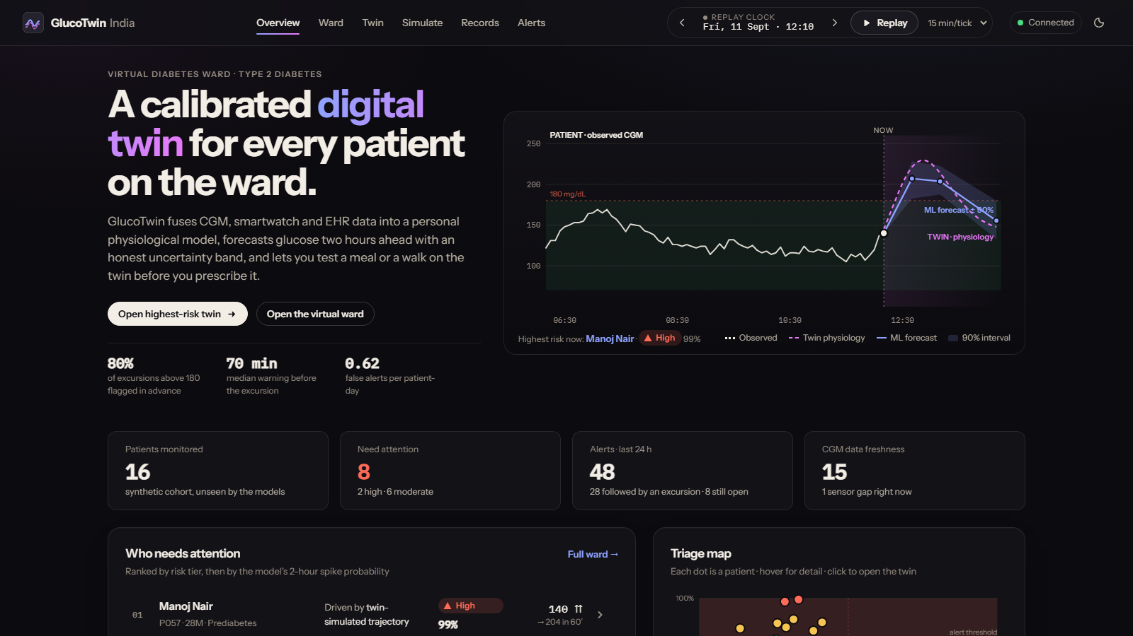
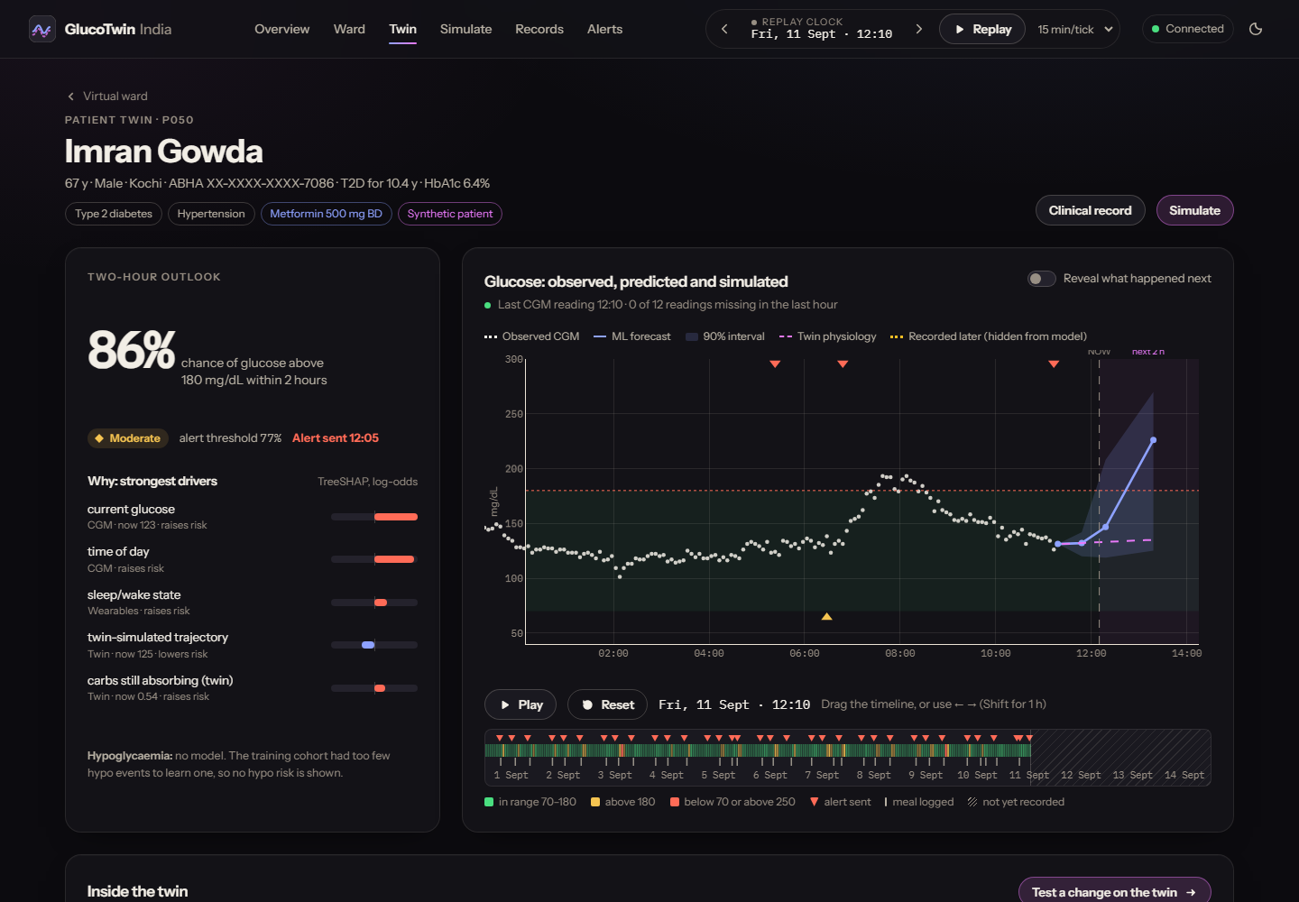
The doctor's view: from the ward to one patient's twin
LIVE DEMO
Overview
Risk queue with each patient's main driver, a triage map of glucose against risk, and recent alerts with their outcomes.
Patient twin
Risk and its TreeSHAP drivers; observed, forecast and twin series; a replay scrubber over the whole record.
Open the live site now: glucotwin-india.vercel.app · replay clock at Fri 11 Sept, 12:10
GlucoTwin India · Team Vicimus
13
Notes:
[13:35 to 15:20 · 105 s]
[LIVE DEMO. Open https://glucotwin-india.vercel.app before the talk and keep it ready. If it has been idle, the first load can take a few seconds; load it once before you start.]
This is the doctor's view. The header has a replay clock: the dataset is recorded, and we replay it as if live. I have set it to Friday the eleventh of September, twelve-ten.
Overview. Four numbers: patients monitored, how many need attention, alerts in the last day, data freshness. Then the risk queue, ranked by risk tier and the model's two-hour probability. Each row says which factor is driving the risk. [Click the top patient or press 'Open highest-risk twin'.] On the right, the triage map: each dot is a patient, glucose across, risk up; the shaded band is above the alert threshold.
Now the patient twin page, say Imran Gowda. [Click Ward, then P050 or use the link.] Two-hour risk and its drivers on the left. On the chart: observed glucose, the ML forecast with its interval, and the twin's own curve, each drawn and labelled differently so none can pass for another. The strip underneath is this patient's whole record up to the clock. [Drag the scrubber or press the right arrow.] The chart, risk and twin state all follow the clock. [Toggle 'Reveal what happened next'.] Amber circles are what the sensor recorded afterwards. They were never shown to the model. Over those two hours glucose actually peaked at 222, and the forecast for the two-hour mark was 218.

Slide 14
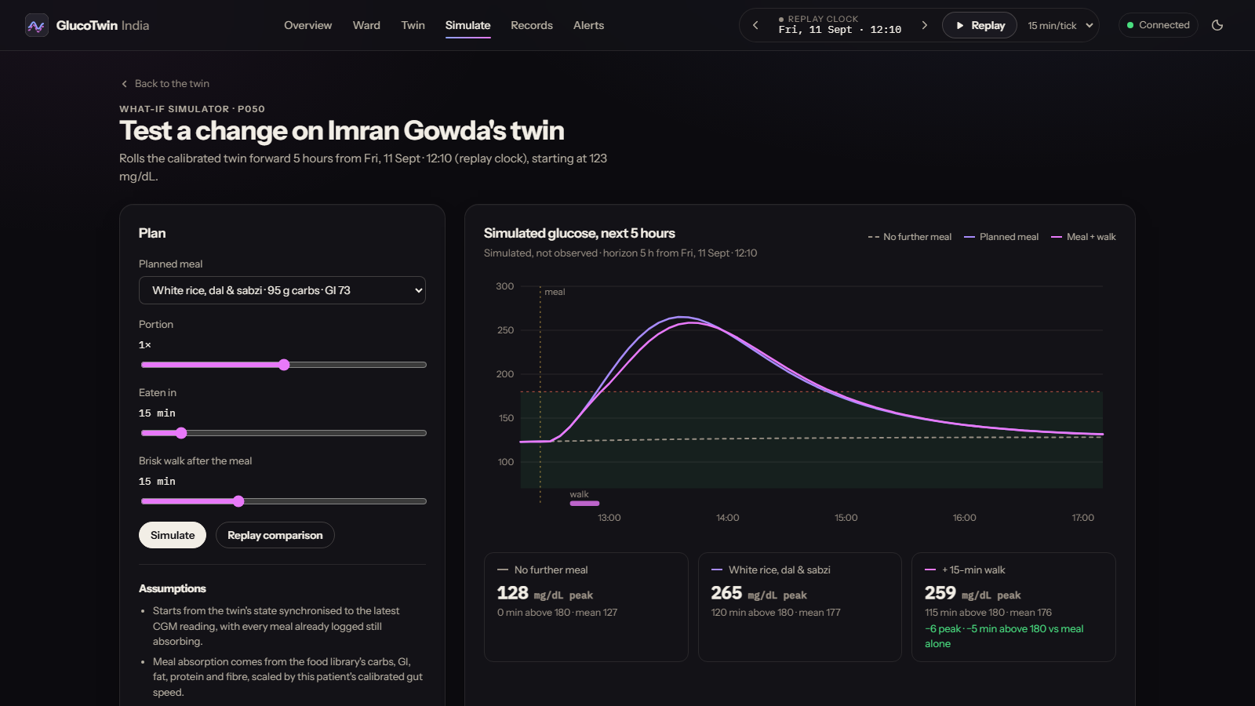
Ask the twin before you prescribe
WHAT-IF SIMULATOR
No further meal
128 mg/dL peak · 0 min above 180
White rice, dal and sabzi
265 mg/dL peak · 120 min above 180
+ 15-minute walk after the meal
259 mg/dL peak · 115 min above 180
-6 peak and -5 min above 180 versus the meal alone
Assumptions: the twin starts from its state at the replay clock, with logged meals still absorbing; the walk is 100 steps a minute using this patient's calibrated exercise response; medication, stress and sleep changes are not simulated; the physiology is deterministic, so no uncertainty band is drawn and the result is not a promise.
GlucoTwin India · Team Vicimus
14
Notes:
[15:20 to 16:30 · 70 s]
[LIVE DEMO. On the live site click 'Simulate' in the header.]
This is the what-if simulator: the page that makes it a twin rather than a predictor. The twin is rolled forward five hours from the replay clock under three futures: no further meal, a planned lunch of white rice, dal and sabzi, and the same lunch followed by a fifteen-minute walk.
For this patient, with no further meal glucose stays around 128. Eating the lunch sends it to a peak of 265, and 120 minutes above 180. Adding a fifteen-minute walk lowers the peak to 259, 6 points lower, and 5 fewer minutes above 180. [Move the portion or walk slider and press Simulate. Hover the chart to read all three at the same minute.]
Press 'Rank options' and the twin simulates every region-appropriate alternative for this meal slot for this patient, ranked by time above 180. That is the "what if she eats jowar roti instead" question, answered on her own physiology.
Be clear about limits: this is deterministic physiology. It does not simulate medication, stress or sleep changes, and it shows no uncertainty band, which must not be read as certainty.

Slide 15
Designed around Indian patients, food and health systems
BUILT FOR INDIA
Indian diet
South Asian profile
ABDM-ready
DPDP Act 2023
27 dishes (idli, dosa, poha, paratha, rajma chawal, biryani, ragi, jowar, chai and biscuits) with glycaemic index and macros driving absorption. North and South diets are modelled.
Diabetes at lower BMI, higher insulin resistance, and a TCF7L2 risk-allele frequency of about 0.28 in the synthetic cohort.
HL7 FHIR R4 resources with SNOMED CT, LOINC and RxNorm codes and an ABHA identifier, masked in the UI and the API.
Synthetic data only, purpose-limited fields, masking, and one container that runs on-premise.
Pre-consultation summary
An auto-drafted narrative (time in range, GMI, variability, food response, sleep effect, twin phenotype) with discussion points, so a 5-minute OPD slot starts informed.
A low-cost path to scale
Designed for affordable 14-day CGMs and any smartwatch. Next: Hindi and Kannada alerts and a low-bandwidth mode for ASHA workers.
GlucoTwin India · Team Vicimus
15
Notes:
[16:30 to 17:30 · 60 s]
We designed this for India, not adapted from a Western product.
Diet: a twenty-seven dish library, idli, dosa, poha, paratha, rajma chawal, biryani, ragi, jowar, each with glycaemic index and macros that drive absorption. North and South diets are modelled separately, and meal swaps are region-appropriate.
Phenotype: South Asians develop diabetes at lower BMI with higher insulin resistance, and our synthetic cohort reflects that.
Infrastructure: FHIR R4 resources with standard codes and an ABHA identifier, masked in the interface and the API, which fits the ABDM ecosystem.
Privacy: synthetic data only, masking, and one on-premise container, in line with the DPDP Act. And a pre-consultation summary, so a five-minute OPD slot starts informed.

Slide 16
Built to be trusted: tests, safeguards and open data
ENGINEERING QUALITY
Leakage-proof by construction
The API cannot peek
Honest labelling
Every feature uses only data available at that moment. A unit test perturbs the future, including right after a sensor dropout, and checks that present features do not change.
Tests check that outcomes and alerts use only data up to the replay clock, and that revealing the recorded future never changes the model's risk.
Observed, predicted, simulated and revealed data have different marks and labels everywhere. No hypo risk is shown because no hypo model exists.
Subject-level evaluation
Privacy and safety
Reproducible and deployed
Patients are split into train, calibration and test sets. Test patients are never seen, and results are on unseen days.
ABHA numbers masked in the UI and API, no cross-site access by default, request size limits, and synthetic data only.
16 automated tests, a one-command pipeline, a Docker image, and a live deployment. Results regenerate from a fixed seed.
GlucoTwin India · Team Vicimus
16
Notes:
[17:30 to 18:30 · 60 s]
A few things that make this trustworthy rather than just impressive.
Leakage. The easiest way to fake a good result is to let the model see the future. Every feature uses only data available at that moment, and a unit test perturbs the future, including right after a sensor dropout. We actually found and fixed a leak of exactly that kind late in the project. It changed our headline numbers slightly, and the numbers you see are after the fix.
The API cannot peek either: tests check that outcomes use only data up to the replay clock, and that revealing the recorded future never changes the model's risk.
Observed, predicted, simulated and revealed data always look different, and we show no hypoglycaemia risk because we have no such model. Evaluation is by patient. And it is reproducible: sixteen tests, a one-command pipeline, a Docker image and a live deployment.

Slide 17
What a proof of concept can and cannot claim
HONEST LIMITATIONS AND ROADMAP
Limitations
Roadmap
Synthetic results are an upper bound: we designed that physiology.
CGMacros is small (45 people), American, and has no sleep or HRV data; its meals use a default glycaemic index.
No hypoglycaemia model: too few low-glucose events to learn one.
The twin does not model medication changes, illness or stress; the ML layer only partly captures them.
Decision support only. Not a medical device, and not validated on Indian patients yet.
Validate on Indian CGM cohorts with partner diabetologists.
Twin upgrades: particle-filter state estimation and medication-titration simulation.
Patient app: Hindi and Kannada alerts, and WhatsApp or SMS for ASHA workers.
ABDM sandbox integration with a consent flow, then a prospective clinic pilot.
More open data: the Shanghai T2DM dataset and larger FHIR cohorts from Synthea.
GlucoTwin India · Team Vicimus
17
Notes:
[18:30 to 19:30 · 60 s]
What can a proof of concept claim, and what can it not?
Limitations, plainly. The synthetic results are an upper bound, because we designed the physiology that generated the data. The real-data check is small, American, and has no sleep or heart-rate-variability data. We have no hypoglycaemia model. The twin does not model medication changes, illness or stress. It is decision support, not a medical device, and it has not been validated on Indian patients.
Roadmap. First, validation on Indian CGM cohorts with partner diabetologists. Second, upgrades to the twin: better state estimation, and simulation of medication titration. Third, a patient app with Hindi and Kannada alerts, plus a low-bandwidth mode so ASHA workers can use it by WhatsApp or SMS. Fourth, ABDM sandbox integration and a prospective clinic pilot. And more open data, including the Shanghai dataset and larger FHIR cohorts.

Slide 18
THANK YOU
From reactive HbA1c reviews to a twin that sees the next two hours.
Team Vicimus · Vishwakarma Institute of Technology, Pune
Chitrangad Ram Sapate (team leader) · Soham Joshi
Live demo: glucotwin-india.vercel.app
Code (MIT): github.com/Physics0070/Vicimus_Vishwakarma-Institute-of-Technology
GlucoTwin India · Team Vicimus
18
Notes:
[19:30 to 20:00 · 30 s]
To sum up. GlucoTwin India fuses a health record and a wearable stream into a personal twin. It warns a median of 70 minutes before a spike on unseen patients, explains why, and lets the doctor test a meal or a walk first. We validated it on synthetic Indian patients and 45 real adults, we are open about its limits, and it is open source under MIT.
Thank you. We would be glad to take your questions.

