Slide 1
After cleaning the dataset for this part, there is a total of 444700 items to work with. (using: python-pandas-matplotlib)
All this analysis should be the basis for developing public programs that contribute to a safer way of traveling.
Part 1, considers the analysis of the number of traffic crashes vs the road conditions and speed limits.
Part 2, considers the analysis of the number of traffic crashes vs the lighting conditions, crash type and road defects.

Slide 2
Here are some interesting findings about traffic crashes
Let us begin saying that 47.4% of the traffic crashes occur:
at day light,
in dry roads and
no defect roads.

Slide 3
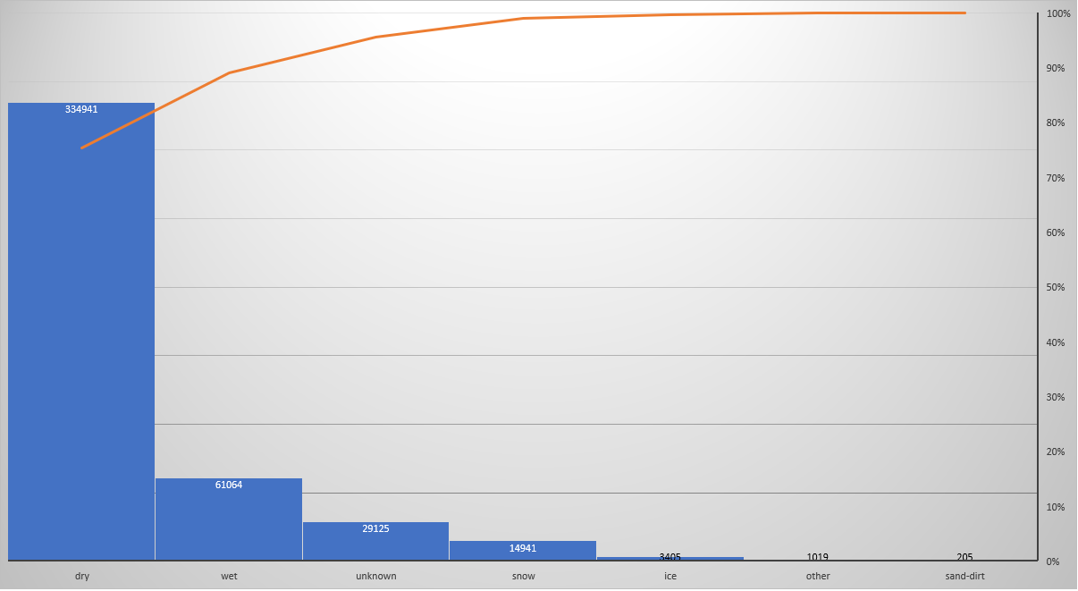
In what road conditions, traffic accidents mainly occurs?
DRY
75%
WET
14%
SNOW
ICE

Slide 4
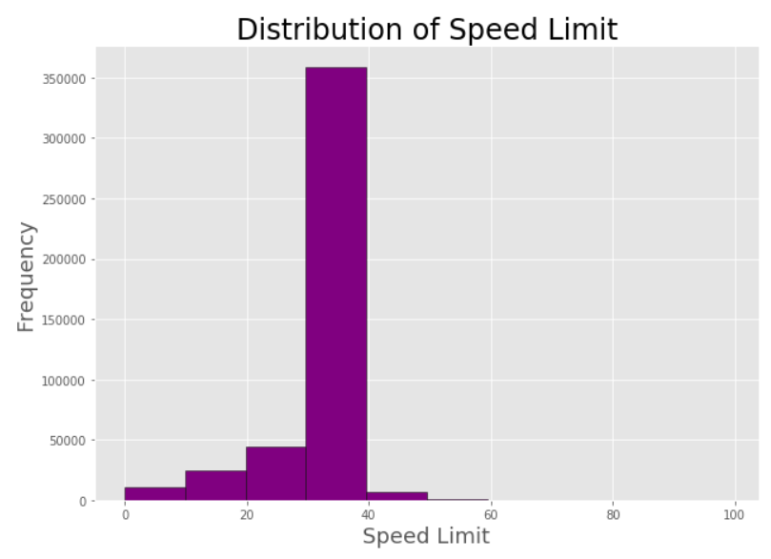
Most of the accidents occur when the speed limit is:
30< speed limit <40
(80%)

Slide 5
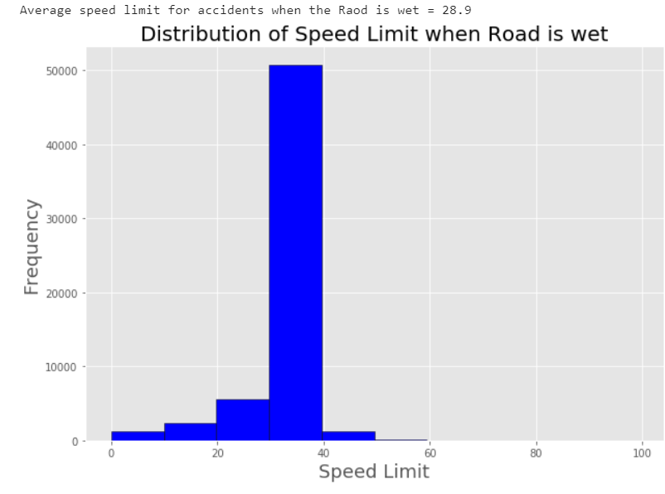
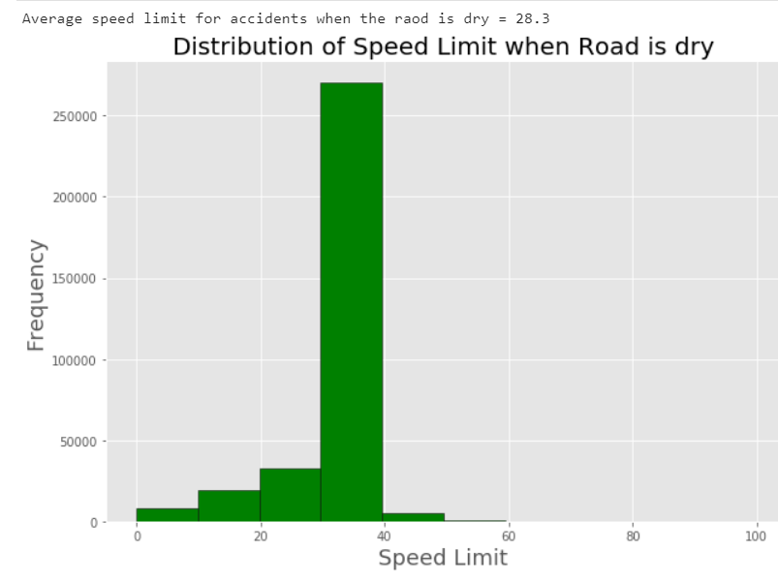
What happens when the road is:
wet
dry
50,000 traffic crashes
Average speed limit is 29 mph
275,000 traffic crashes
Average speed limit is 28 mph

Slide 6
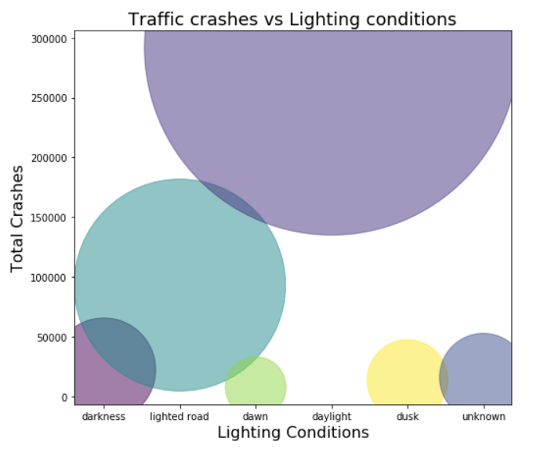
Daylight
65.6%
In what lighting conditions, traffic accidents mainly occurs?
Lighted road
20.9%

Slide 7
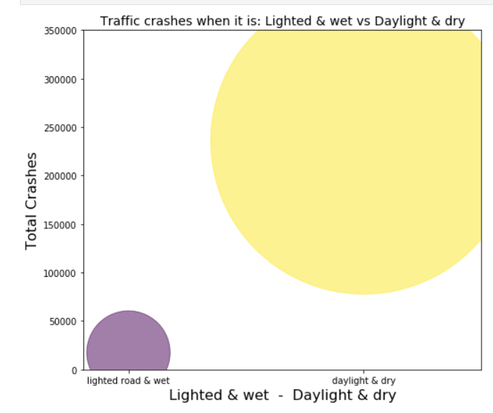
What happens with the traffic crashes, when:
Daylight & Dry
52.9%
Lighted road & Wet
3.9%

Slide 8
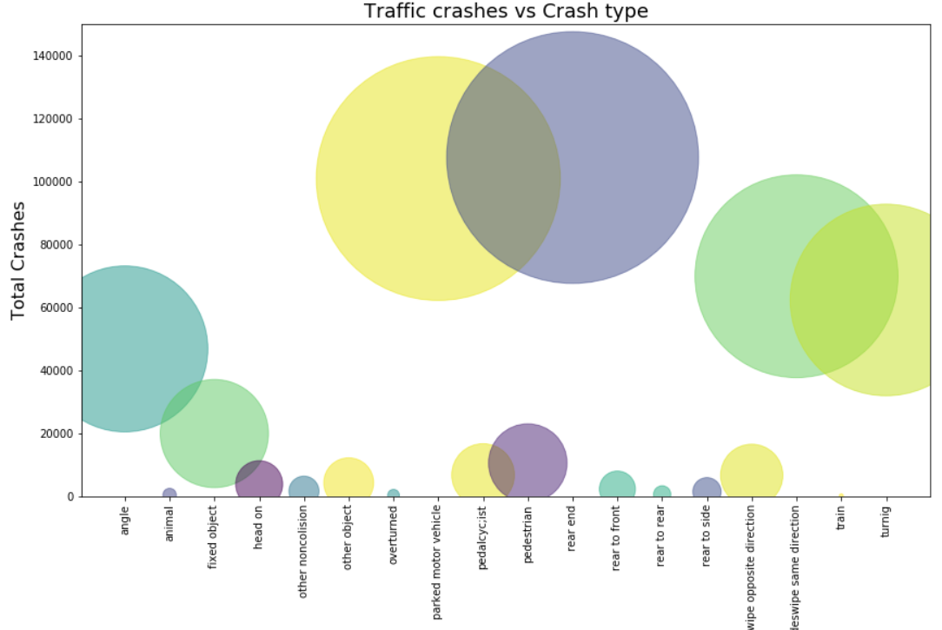
What are the most common types of traffic crashes?
Rear End 107499 (24.2%)
Parked Motor Vehicle 100832 (22.7%)
Sideswipe Same Direction 69800 (15.7%)

Slide 9
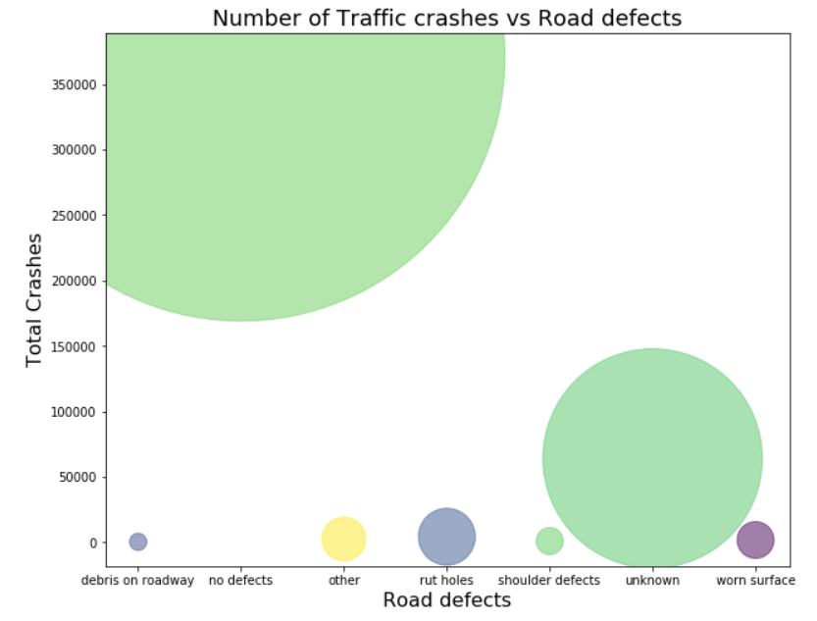
No Defect roads 370603 (83.3%)
What about the defects of the road?
Do they affect the frequency of the traffic crashes?
It seems that most of the traffic crashes occur in no-defects roads.

