Slide 2
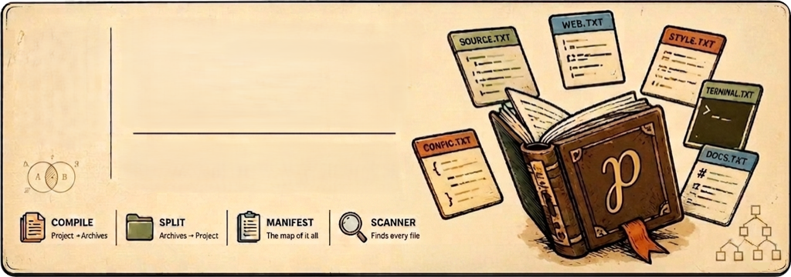



Pendex
Your project’s portable codex.
Compile your codebase into banner-delimited archives. Rebuild it anytime with px split

Slide 3


−


 

Slide 4



Slide 5
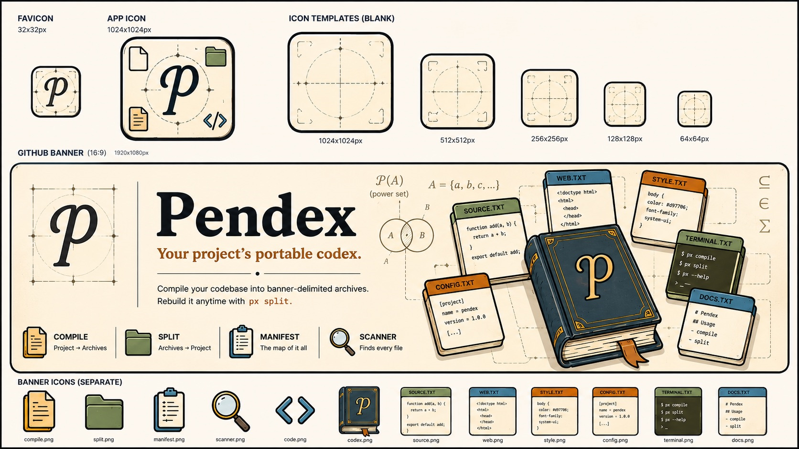

Slide 7
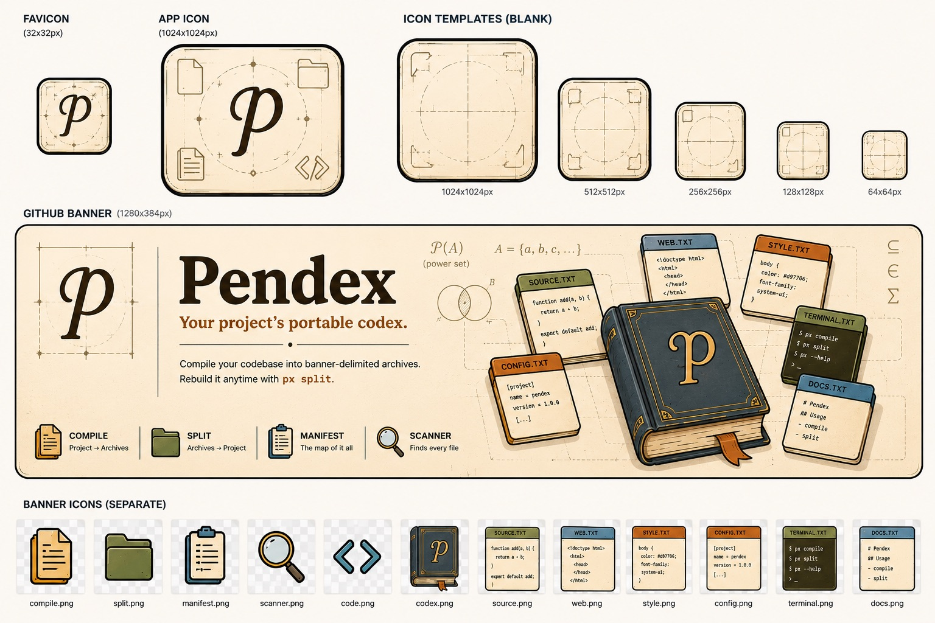

Slide 8
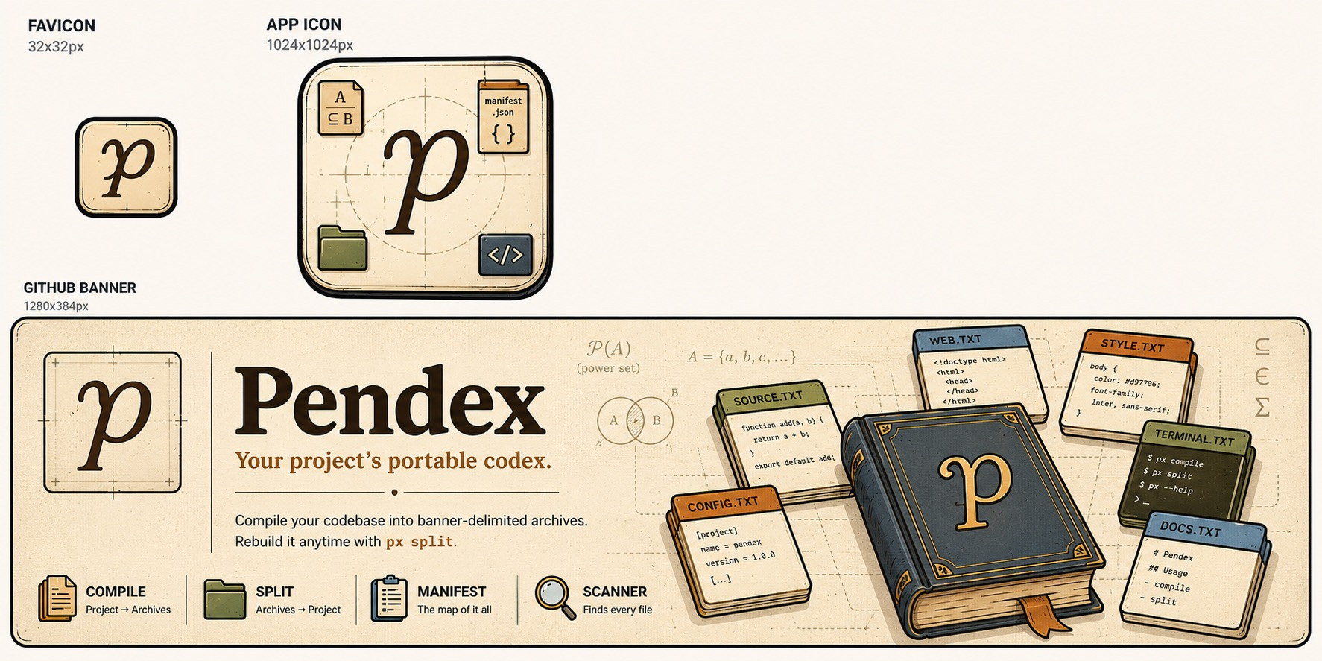

Slide 9
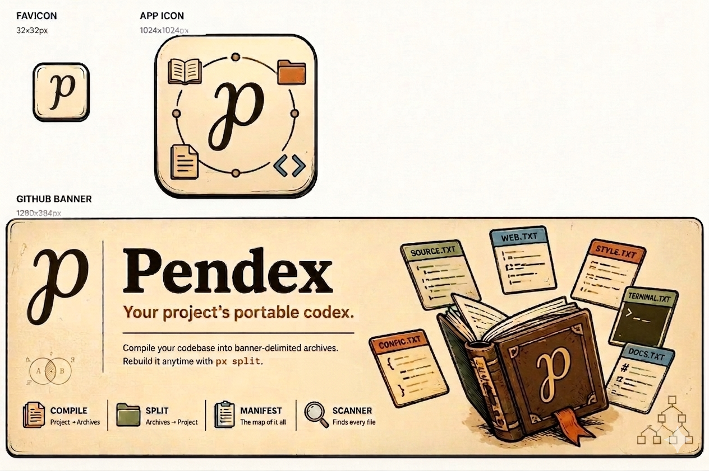

Slide 10





