Slide 1

Top Secret Mission Guide
Notes:
Welcome to the classified blueprint of the Super Lift Challenge. Prepare to be initiated into the realm of covert knowledge. Here you will find all sorts of tips to help you build. Are you set to unlock the secrets of the cosmos?

Slide 2
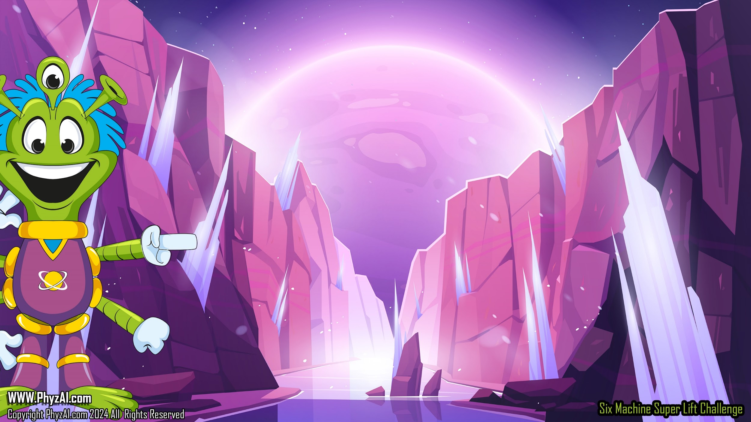
Tall System become unstable and fail easily.
If you find your system is getting too tall, try adding a pulley to change the direction of your effort.
Notes:
Tip 1: Tall System become unstable and fail easily.
If you find your system is getting too tall, try adding a pulley to change the direction of your effort.

Slide 3

Use all your Pistons and Cylinders
If you find you have extra Pistons
and Cylinders you are not getting all the life you can from the system
Notes:
Tip 2: Use all your Pistons and Cylinders
If you find you have extra Pistons and Cylinders you are not getting all the life you can from the system

Slide 4

Levers magnify force Block and Tackle give control
Notes:
Tip 3: Levers magnify force. Block and Tackle give control.

Slide 5

Never underestimate the power of the screw gear and axle.
Notes:
Tip 4: Never underestimate the power of the screw gear and axle.

Slide 6
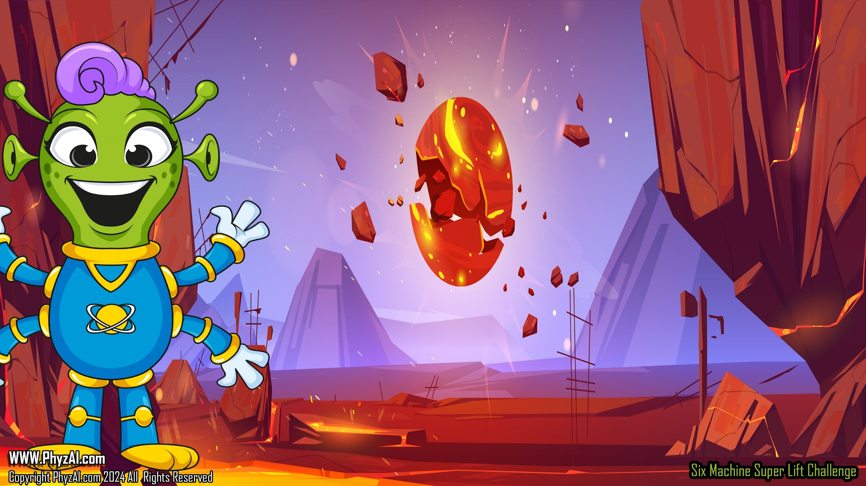
Winning Teams practice using their gear before the challenge
Notes:
Tip 5: Winning Teams practice using their gear before the challenge

Slide 7

Tall gear with lots of string causes weights to bounce. Make sure your weight does not hit the table after the lift starts.
Notes:
Tip 6: Tall gear with lots of string causes weights to bounce. Make sure your weight does not hit the table after the lift starts.

Slide 8
Think about systems that use many little movements rather than one large one.
Notes:
Tip 7: Think about systems that use many little movements rather than one large one.

Slide 9

You will get much more power pushing with a Cylinder and not pulling with it.
Notes:
Tip 8: You will get much more power pushing with a Cylinder and not pulling with it.

Slide 10
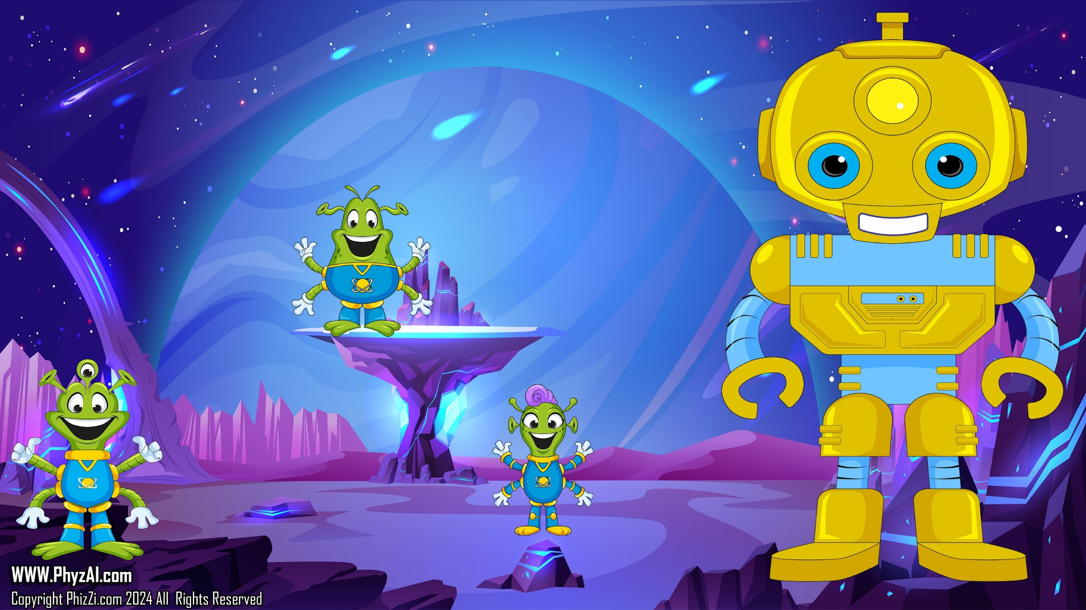
The Super Lift is a team challenge make sure all team members know how to use your machine.
Notes:
Tip 9: The Super Lift is a team challenge make sure all team members know how to use your machine.

