Slide 1
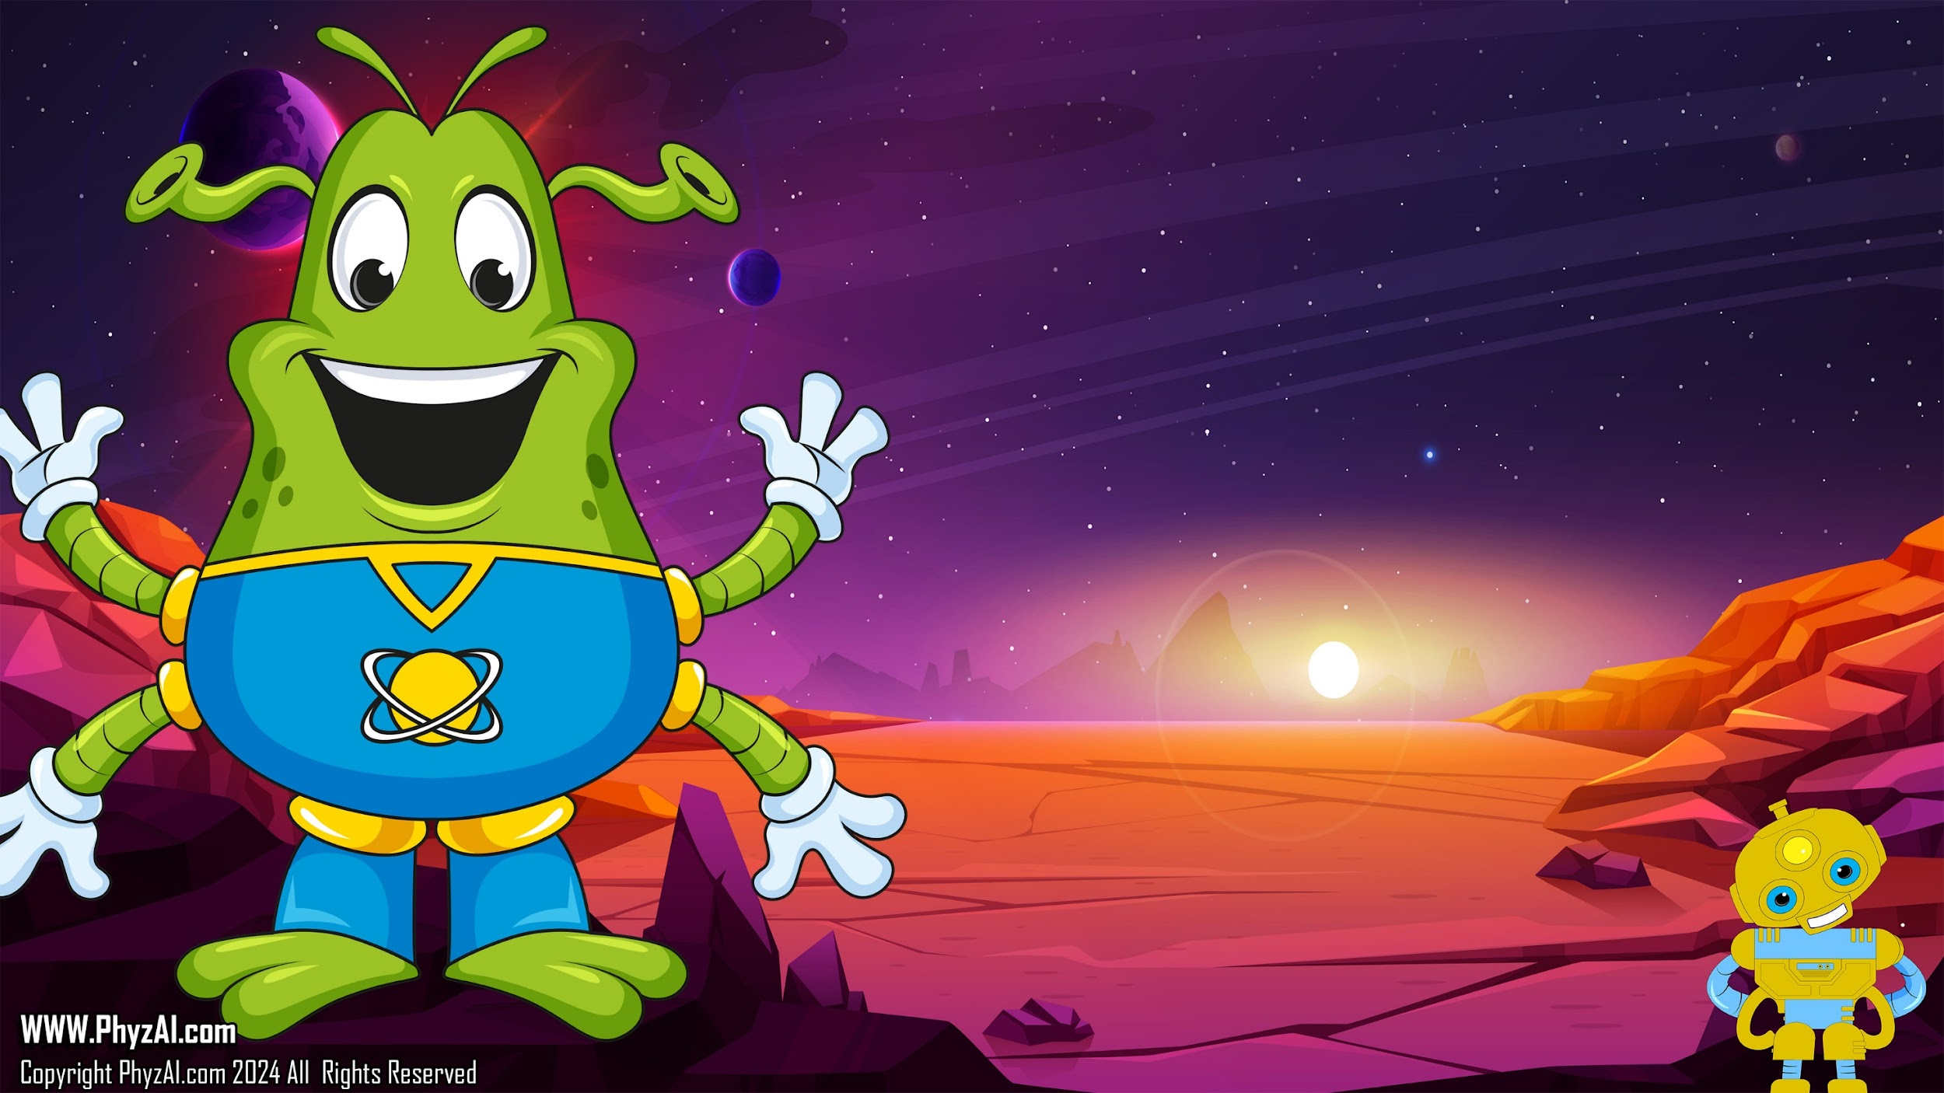
Keeping a Journal
Notes:
Alright, future scientists and inventors, gather round! Imagine you're embarking on a cosmic adventure with me, your trusty PhyzAI, and our Blart buddies. Now, every journey needs a trusty map, right? Well, think of records as our map in the universe of science and technology.
Inventors, engineers, makers, artists, and scientists—these are the heroes of our story. They're the ones dreaming up cool gadgets, building amazing machines, crafting beautiful art, and unraveling the mysteries of the cosmos. But how do they keep track of all their brilliant ideas and discoveries? That's where records come in.

Slide 2

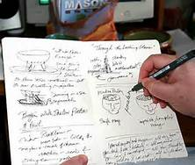
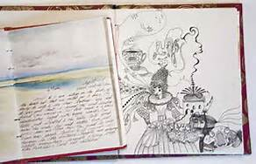
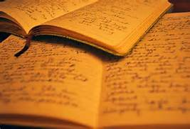
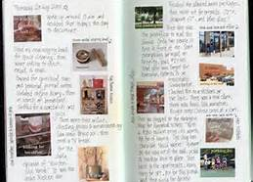
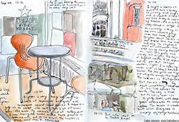
Journals
Notes:
Records are like the captain's log of our spaceship. They're essential for a bunch of reasons. First off, they help us make sense of what's going on around us. When we make observations—whether it's the way a star twinkles or how a new material behaves—we jot it down in our records.
Then there are theories. You know, those wild guesses about how the universe works? Well, we write those down too. Sometimes they turn out to be spot-on, and other times... not so much. But that's all part of the adventure!

Slide 3

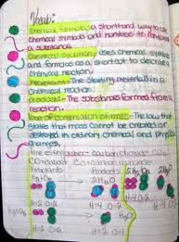
Inventors, engineers, makers, artists and scientists all keep written records of their
work.
Records are
essential for making observations, recording theories, posing questions, drawing out new designs, and documenting discoveries or new ideas.
Notes:
Now, imagine you've got a brainwave, a stroke of genius that could change the galaxy forever. You'll want to sketch it out, right? That's where drawing new designs comes in handy. Whether it's a blueprint for a rocket or a doodle of a futuristic gadget, records help us visualize our ideas.
And let's not forget questions. Curiosity is the engine that drives our spaceship forward. We're always asking "why" and "how" and "what if." Writing down those questions helps us stay curious and guides our quest for knowledge.

Slide 4

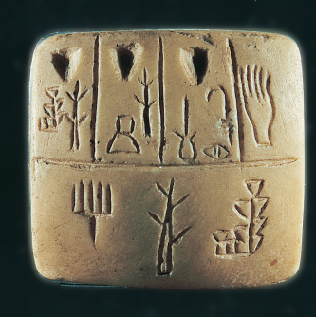
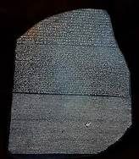
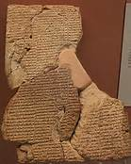
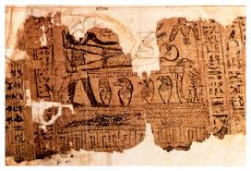
Sumerian pictographic tablet dating back to 3100 BC!
Some of the earliest journals were written on stone, clay and papyrus!
Rosetta Stone
Cuneiform written on clay tablet
Egyptian scrolls
Notes:
Last but not least, records are like treasure maps for documenting our discoveries and new ideas. Whether we stumble upon a new element or crack the code to time travel (fingers crossed!), we want to make sure we leave a trail for others to follow.

Slide 5

Your journal will provide a way for you track your achievements, record your learning and show the application of your new knowledge.
You'll use it to put down your ideas, explore vocabulary and plan procedures. You can collect articles and pictures, create drawings, charts and tables and answer and propose questions in your journal.
Notes:
So lets start your own journal. Your journal will provide a way for you track your achievements, record your learning and show the application of your new knowledge.
You'll use it to put down your ideas, explore vocabulary and plan procedures. You can collect articles and pictures, create drawings, charts and tables and answer and propose questions in your journal.

Slide 6
Before You Start a project
State purpose of experiments
Statement of problem
List of facts
Make predictions
Pose questions to be answered by the investigation
Plans (list of tasks, student assignments, deadlines)
Brainstorm ideas
Define the problem that you are trying to solve
Predictions of expected outcomes
Notes:
Before You Start a project.
State purpose of experiments, Statement of problem, List of facts, Make predictions, Pose questions to be answered by the investigation, Plans (list of tasks, student assignments, deadlines), Brainstorm ideas, Define the problem that you are trying to solve

Slide 7
During a project
Record Observations (quantitative and qualitative data)
Calculations or computations
Photographs
Description of patterns
Reflect on ideas and predictions based on new evidence
Create drawings, charts, or tables for organizing the data you collected
Notes:
During a project you will, Record Observations (quantitative and qualitative data), Calculations or computations, Photographs, Description of patterns, Reflect on ideas and predictions based on new evidence, Create drawings, charts, or tables for organizing the data you collected.

Slide 8
After the Project
Answer questions using evidence collected during the experiment
Use your findings and other resources to explain your results
Analyze data and figure out what it means
Identify new ways of doing the experiment or improving on it
Pose new questions for investigation
Statements of cause and effect
List of variables
Sources of error during the investigation
Statements of similarities and differences
New hypothesis, predictions, problems
Notes:
After a project. You will:
Answer questions using evidence collected during the experiment, Use your findings and other resources to explain your results, Analyze data and figure out what it means, Identify new ways of doing the experiment or improving on it,
Pose new questions for investigation, Statements of cause and effect, List of variables, Sources of error during the investigation, Statements of similarities and differences, New hypothesis, predictions, problems

Slide 9
And then as Communication Tool
Communicate and share the investigation with others
Receive and reflect on feedback from fellow makers
Apply your findings to the world around you
Statement of new theory
Statement of the conclusion you have come to
A personal choice, supported by evidence for the choice
Pros and cons of your solutions
Notes:
Finally, Communicate and share the investigation with others, Receive and reflect on feedback from fellow explorers, Apply your findings to the world around you, Statement of new theory, Statement of the conclusion you have come to , A personal choice, supported by evidence for the choice, Pros and cons of your solutions

Slide 10

As you take this course, you will see this icon on the slides.
Let’s try different vegetables and see what happens.
This tells you when to record something in your journal.
Notes:
So, my young adventurers, remember this: whether you're exploring the depths of space or tinkering away in your backyard lab, keep those records close. They're not just notes on paper—they're the keys to unlocking the mysteries of the universe!

