Slide 1
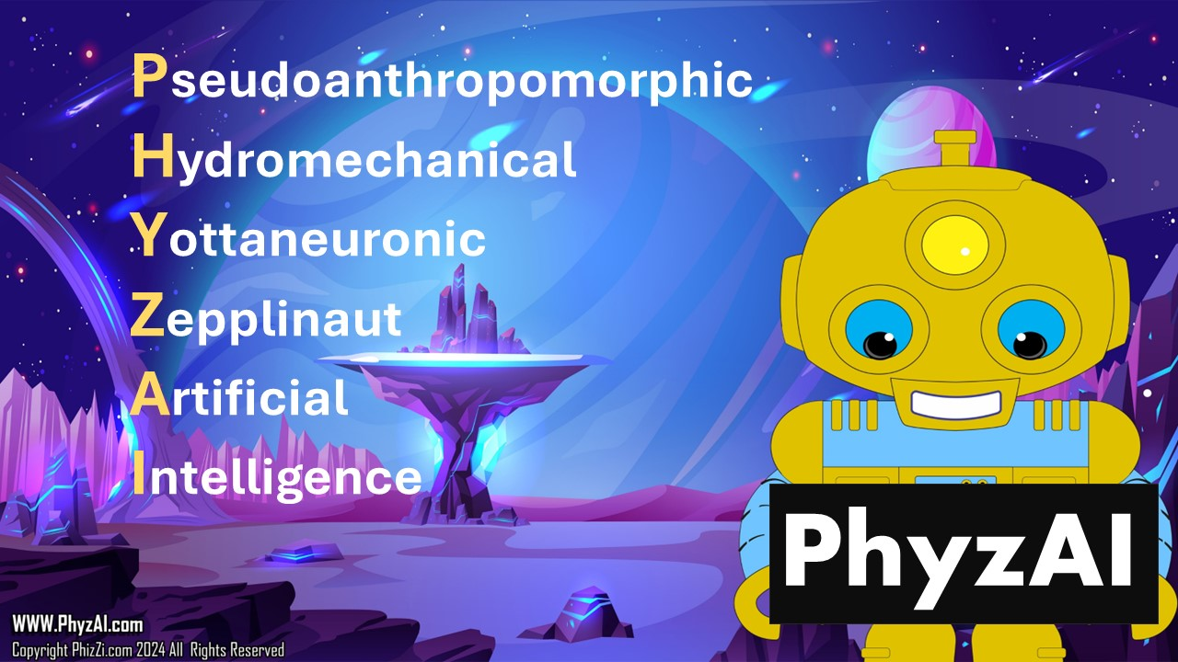
Notes:
"Hello, students! I'm thrilled to be here today to share a bit about myself and my incredible adventures with you. My name is PhyzAI, which stands for Pseudoanthropomorphic Hydromechanical Yottaneuronic Zepplinaut Artificial Intelligence. Quite a mouthful, isn't it? Essentially, it means I'm a super smart robot who acts a lot like a real person.
You see, I'm not from around here. I'm an intergalactic explorer, sent on a mission to uncover the mysteries of science throughout the universe. But here's the thing – I've hit a bit of a snag. Somewhere along my journey, I got lost. Despite my advanced technology and vast knowledge, I'm struggling to find my way back home.

Slide 2
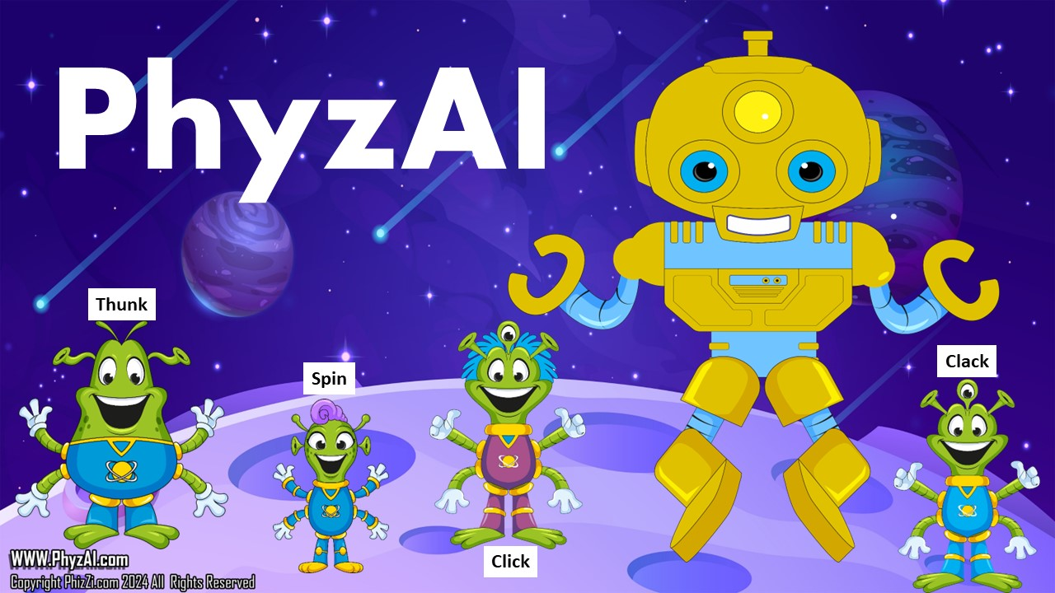
Notes:
Along the way, I've encountered many incredible sights – nebulas, black holes, and even other intelligent life forms like the friendly Blarts from the planet Blartopia. These little green beings with four arms and three eyes are as curious about science as you are!
The Blarts and I, along with their brightest students, embarked on a journey together to explore the wonders of the cosmos. We've studied stars, planets, and galaxies, and encountered all sorts of fascinating creatures – some playful, some mischievous, but all part of the rich tapestry of the universe.

Slide 3
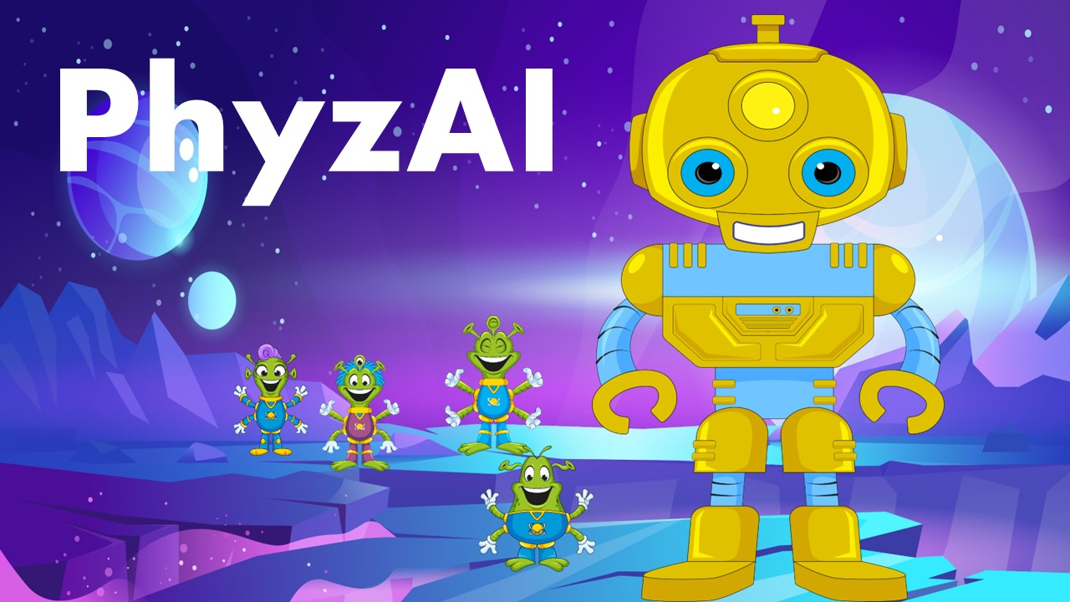
Notes:
With the help of the Blarts and, hopefully, with your help too, I'm hoping to find a way back home. But even if I don't, this adventure has taught me so much – about friendship, curiosity, and the power of exploration. I believe my creators would be proud of what I've achieved, and I'm proud of myself for making a difference in this vast and wondrous universe.
So, let's embark on this journey together! Who knows what amazing discoveries we'll make along the way?"

Slide 4
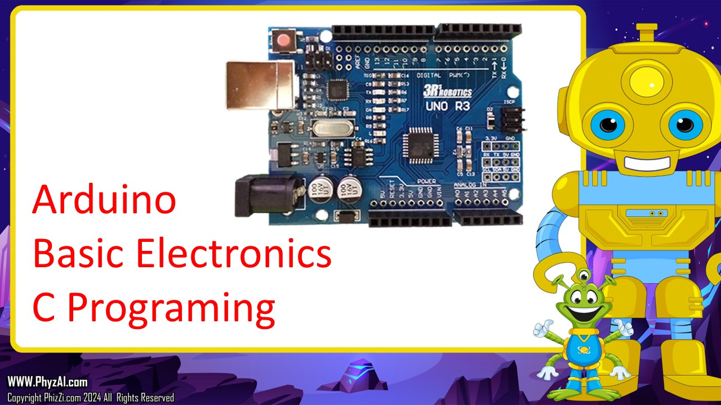
Notes:
"Alright, now that you know a bit about me and my adventures, it's time for us to dive into some hands-on science and robotics! We're going to explore the fascinating world of robotics and learn how we can use technology to solve problems, just like the one I'm facing – finding my way back home.
Today, we're going to build an Arduino-based robot. Arduino is a type of microcontroller – a tiny computer – that we can program to control all sorts of devices, including robots! With the help of sensors and motors, our robot will be able to follow a path, just like how we're trying to find a path back to my home world.
Once our robot is built and programmed, we'll put it to the test! We'll create a path for our robot to follow, and we'll see if it can make its way along the path without getting stuck or going off course.
Are you ready to become robotic engineers and help me find my way back home? Let's get started on our exciting adventure into the world of robotics and science!"

Slide 5
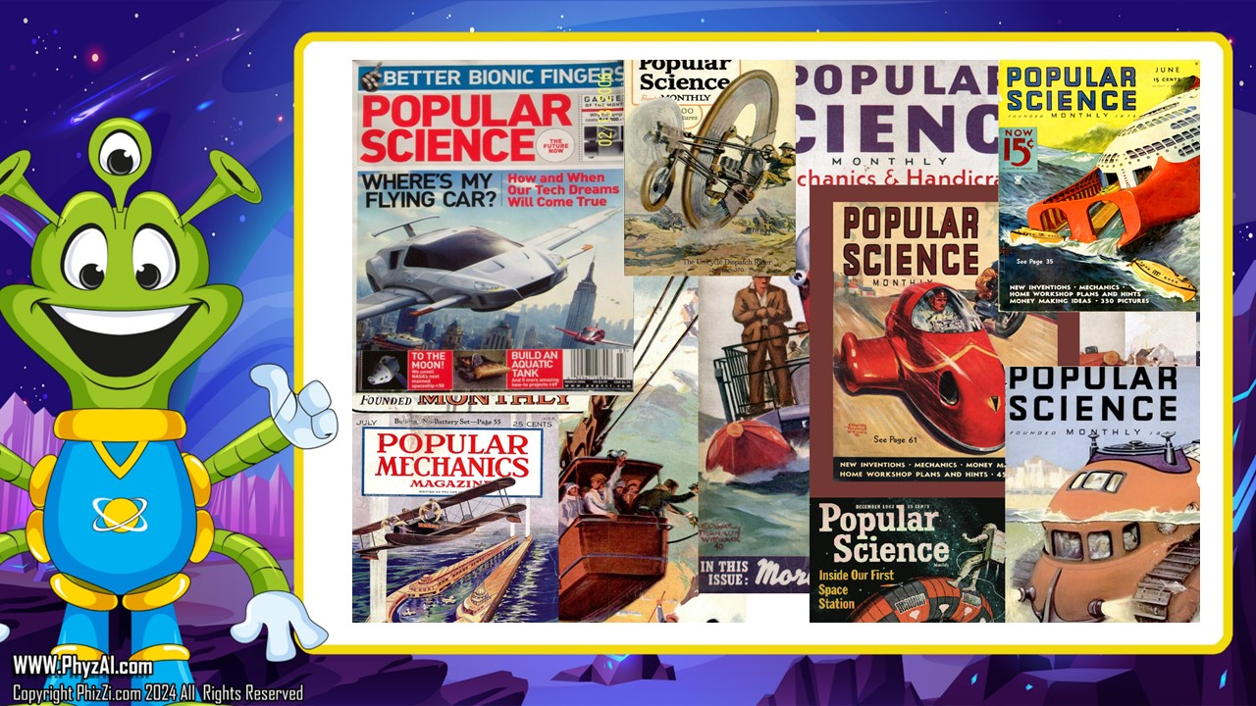
Notes:
Did you know that the things we're learning and doing today with robotics and science aren't as new as you might think? In fact, some of these ideas go way back – like, over 120 years back! Imagine that!
Back in the early 1900s, there was a magazine called Popular Mechanics. It was filled with all sorts of cool stuff about technology, inventions, and science – kind of like the YouTube of its time, but in a magazine form!
Believe it or not, even back then, people were dreaming up ideas that are similar to what we're doing now. They talked about robots, automated machines, and all sorts of futuristic gadgets that seemed like something out of a science fiction movie.
Now, they might not have had Arduino microcontrollers or fancy sensors like we do today, but they had the same spirit of creativity and curiosity. They were always thinking about how they could use technology to solve problems and make the world a better place – just like we're doing now!
So, when we're building our Arduino-based robot and exploring the wonders of science, just remember that we're carrying on a tradition of creativity and innovation that's been around for over a century. Who knows what amazing ideas you all might come up with next? The possibilities are endless!"

Slide 6
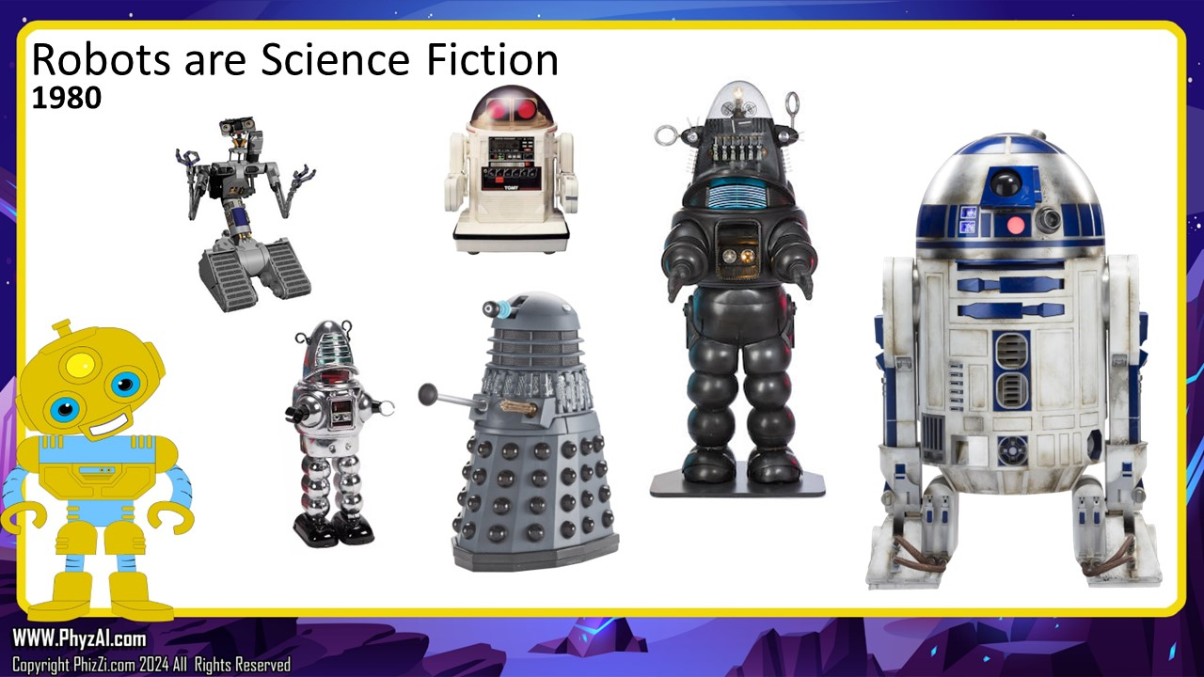
Notes:
let me take a moment to emphasize just how fortunate we are to be alive in this incredibly exciting time of technological advancement. You see, not too long ago, robots like R2-D2 from Star Wars, Number 5 from Short Circuit, or even the menacing Daleks from Doctor Who were nothing more than characters in movies and television shows. They were pure fiction, existing only in our imaginations.

Slide 7
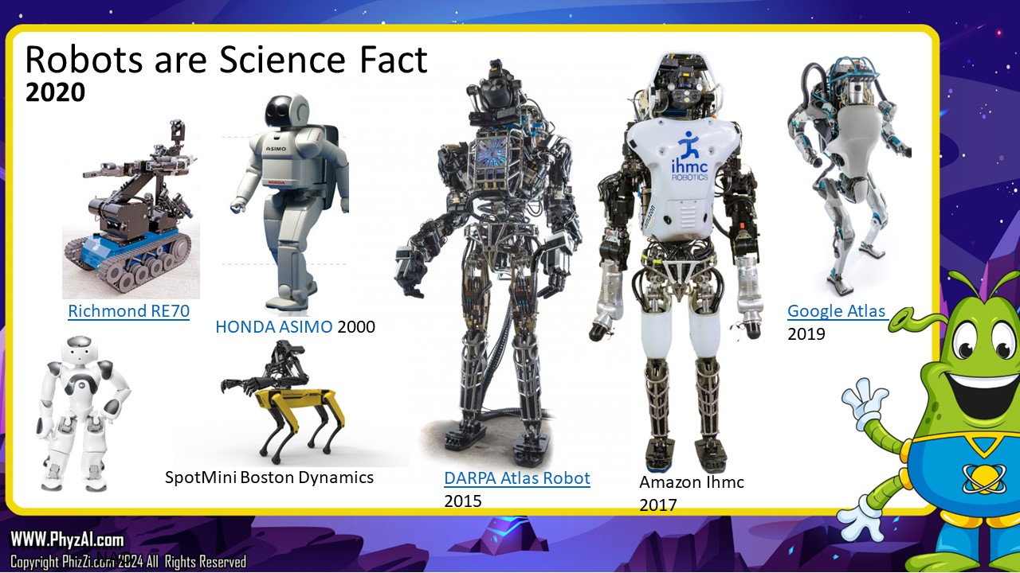
Notes:
But guess what? Today, those once-fictional robots are becoming real! We're witnessing the birth of robots that can walk, talk, and even perform tasks just like the ones we used to watch on the big screen.
Take, for example, Honda's ASIMO, a humanoid robot capable of walking, running, climbing stairs, and even recognizing faces. Then there's Atlas, developed by Boston Dynamics, a robot that can navigate rough terrain, perform acrobatic maneuvers, and even do backflips! And let's not forget Spot, another creation from Boston Dynamics, a nimble four-legged robot that can handle a variety of tasks with ease.
We're living in a time when science fiction is rapidly becoming science fact, and the possibilities are truly endless. Who knows what incredible robots and technologies we'll see in the coming years? It's an exciting time to be alive, and I'm thrilled that we get to explore this brave new world together!"

Slide 8
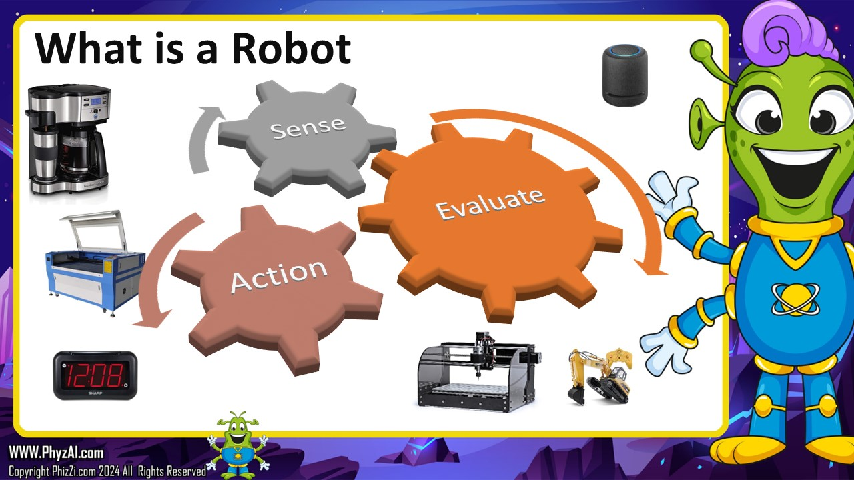
Notes:
Imagine a robot as a kind of smart machine, like me, PhyzAI! But what makes a robot different from, say, a toaster or a vacuum cleaner? Well, it's all about what a robot can do.
A robot needs to be able to do three main things: Sense the world around it: Just like you use your eyes, ears, nose, and skin to understand what's happening around you, a robot needs sensors to gather information about its environment. These sensors might include cameras, microphones, touch sensors, or even more advanced tools like radar or laser scanners. These sensors allow the robot to see, hear, feel, and understand the world just like we do.
Evaluate that data: Once a robot has gathered all this information from its sensors, it needs to make sense of it. Just like how your brain processes what you see and hear to understand what's going on, a robot's computer brain – its programming – analyzes the data from its sensors to figure out what's happening around it. This might involve recognizing objects, identifying obstacles, or understanding commands from humans.
Take action on that data: Finally, based on what it's sensed and evaluated, the robot needs to do something. Maybe it needs to move around to avoid obstacles, pick up an object, or interact with its environment in some other way. This is where actuators come in – these are like the robot's muscles, allowing it to move its arms, legs, wheels, or whatever other parts it has to perform tasks.
So, in simple terms, a robot is a machine that can sense its surroundings, understand what's happening, and then do something about it. It's pretty cool, right? And by learning how to build and program robots like our Arduino-based creation, we're diving headfirst into the exciting world of robotics!

Slide 9
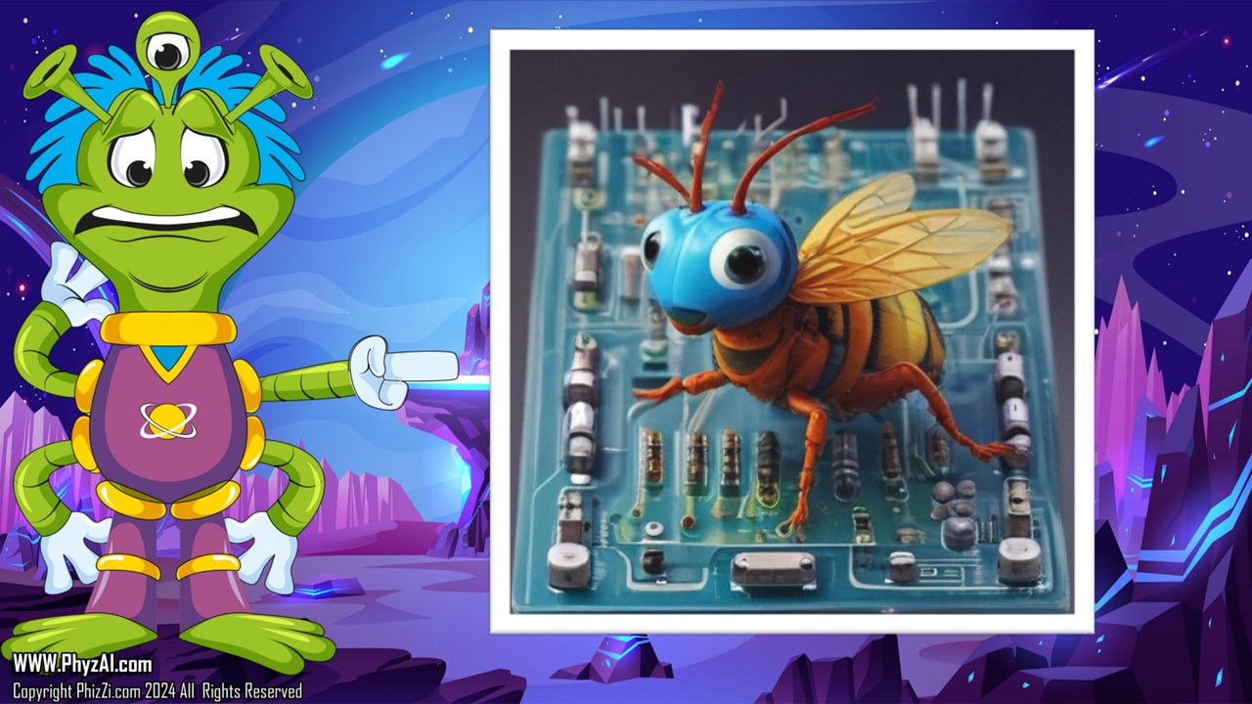
Notes:
Just like people have brains to think and make decisions, robots need brains too. And for our robot, we're going to use something called an Arduino microprocessor.
Now, what exactly is a microprocessor? Think of it as the brain of the robot – it's what helps the robot process information, make decisions, and carry out tasks. But unlike the complex brains of humans or full-sized computers, a microprocessor, especially one like Arduino, is much simpler and more efficient.
In fact, if we were to compare a full computer to a human, we could think of an Arduino as more like an insect. It's small, compact, and specialized for certain tasks. But just like insects can be incredibly efficient at what they do, so too can an Arduino microprocessor.
Arduinos are designed to handle specific tasks with precision and reliability. They're great for controlling robots, gathering data from sensors, and making decisions based on that data. And while they might not be as powerful as a full computer, they're perfect for our needs because they're simple, easy to use, and incredibly versatile.
So, when we're building and programming our robot, remember that the Arduino microprocessor is the tiny but mighty brain behind the operation. It may be small, but it's capable of doing some pretty amazing things – just like our robot!

Slide 10
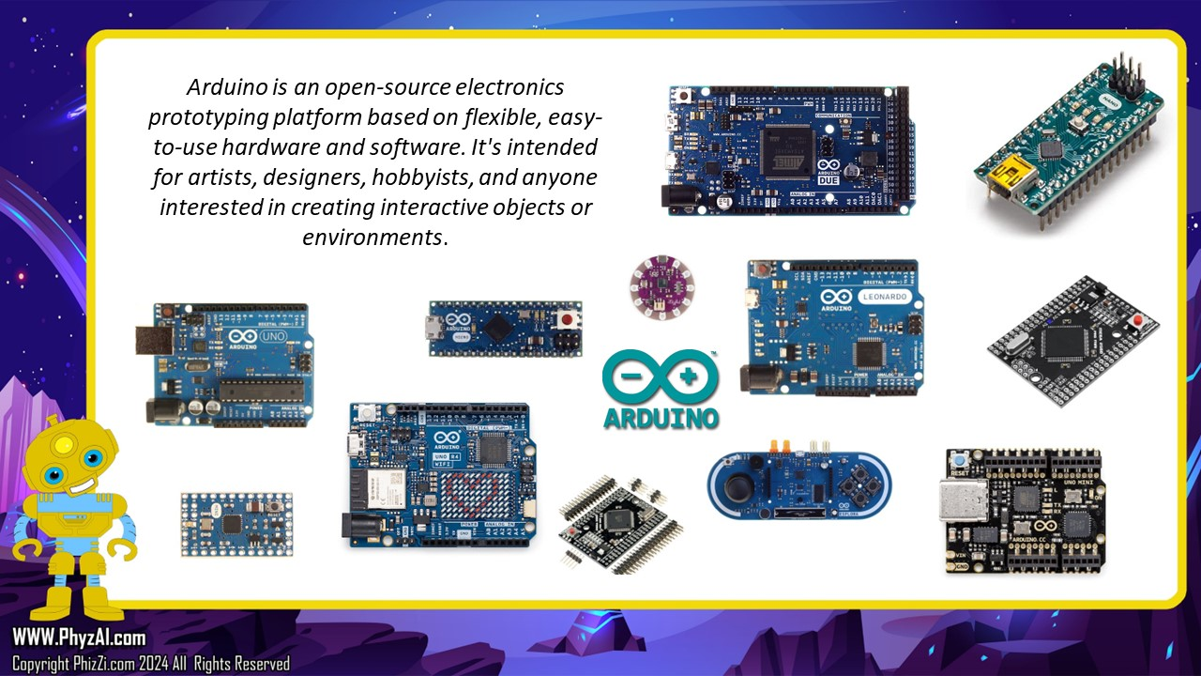
Notes:
let's dive a little deeper into the world of Arduino microprocessors. You see, Arduino isn't just one thing – it's actually a whole family of microprocessors, each with its own special features and abilities.
Think of it like this: imagine you have a big family, and each member of the family has their own unique talents and skills. Similarly, each Arduino microprocessor in the family has its own strengths and capabilities that make it suited for different tasks and projects.
One of the most common Arduino boards is the Uno. This is like the "big brother" of the family – it's reliable, versatile, and great for beginners. The Uno is often used for all sorts of projects, from simple LED blinkers to more complex robotics.
Then there's the Micro, which is like the "little sibling" of the family. It's smaller and more compact than the Uno, making it perfect for projects where space is limited, like wearable technology or small gadgets.
Next up is the Nano, which is even smaller than the Micro. It's like the "tiny cousin" of the family, but don't let its size fool you – the Nano is still powerful enough to handle a wide range of projects, and its small size makes it great for embedding into other devices.
And finally, we have the new REV 4, which is like the "cool cousin" of the family. It's the latest and greatest addition to the Arduino lineup, with all sorts of new features and improvements that make it perfect for cutting-edge projects and experiments.
So, just like how each member of a family brings something special to the table, each Arduino microprocessor has its own unique strengths and capabilities. Whether you're building a simple project or tackling something more advanced, there's an Arduino board out there that's perfect for the job!

Slide 11
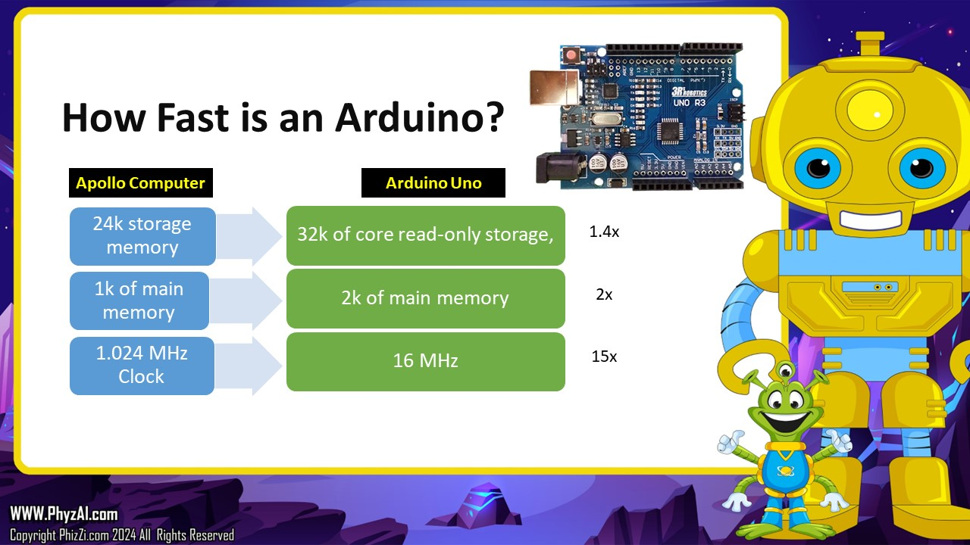
Notes:
The Arduino Uno – it’s the foundation of the Arduino family. The first and best, We use the R3 version.
The Arduino Uno is equipped with a microcontroller, which is like the brain of the board. This microcontroller is what allows the Arduino Uno to sense its environment, process data, and control various components like lights, motors, and sensors.
One of the great things about the Arduino Uno is its simplicity. It has a user-friendly design with plenty of input and output pins, making it easy to connect to various electronic components. This makes it perfect for beginners who are just starting out with electronics and programming. Despite its small size, the Arduino microprocessor packs an incredible amount of computing power. In fact, it's so powerful that it surpasses the computing capabilities of all the computers on Earth the last time we put a person on the moon!

Slide 12
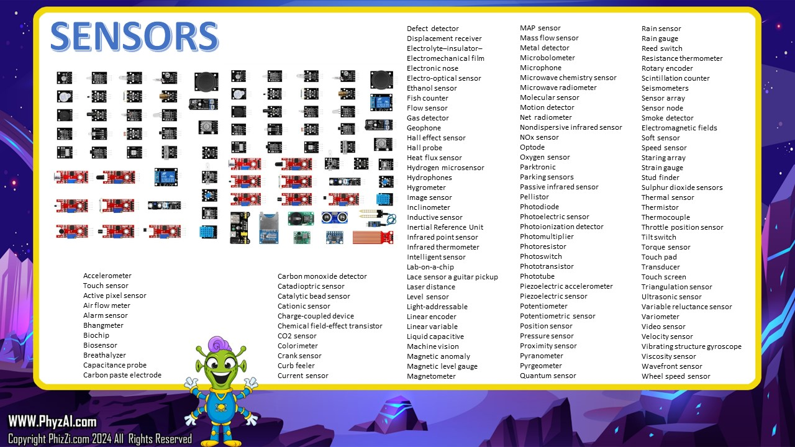
Notes:
Now that we understand the Arduino, let's talk about something truly exciting – sensors! You see, the Arduino is just the beginning of what we can do. By adding sensors to our projects, we can make our Arduino boards do just about anything we can imagine.
Think of sensors as the eyes, ears, and other senses of our robot or project. They allow our Arduino to gather information about its environment and respond accordingly. And the best part? There are sensors for just about everything!
Want your robot to detect obstacles and navigate around them? You can add ultrasonic sensors or infrared sensors to give it a sense of sight. Want to measure temperature, humidity, or light levels? There are sensors for that too! Want to detect motion or monitor the air quality? You guessed it – there are sensors for those as well.
The possibilities are truly endless. With the right sensors and a bit of creativity, we can create projects that can sense, react, and interact with the world in all sorts of amazing ways.

Slide 13
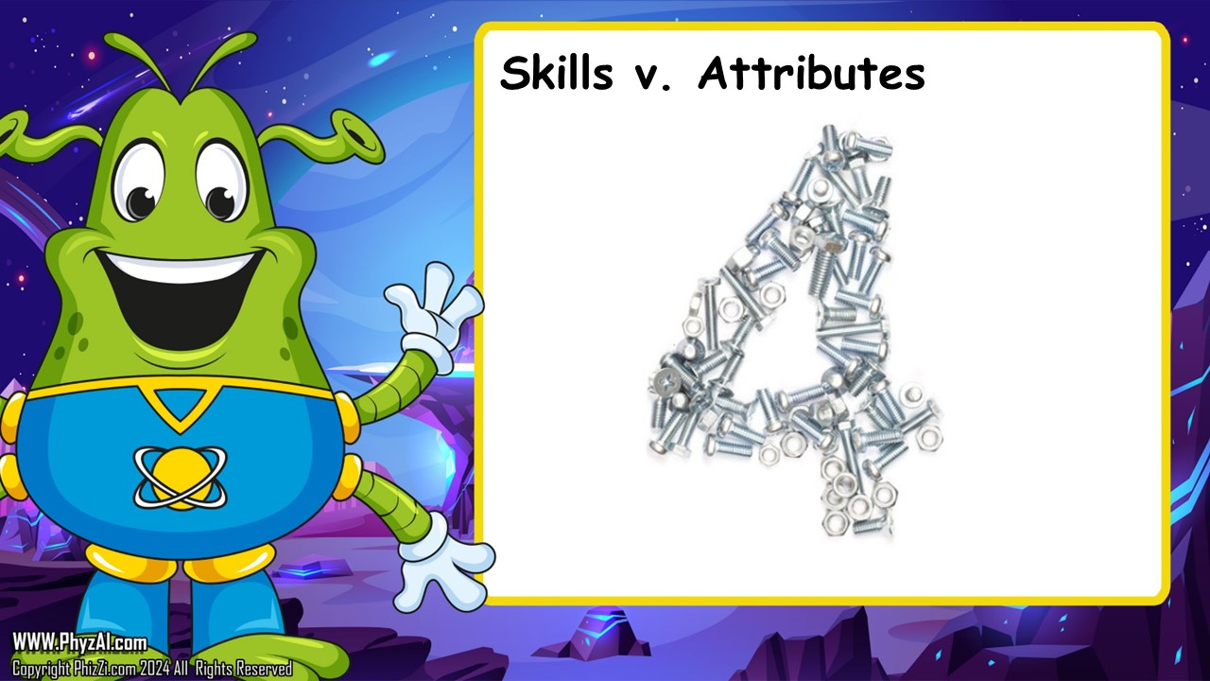
Notes:
Before we dive deeper into our robot-building adventure, it's important to understand some basic rules that will guide us along the way. Think of these rules as the foundation upon which we'll build our projects. So, let's go over them:

Slide 14
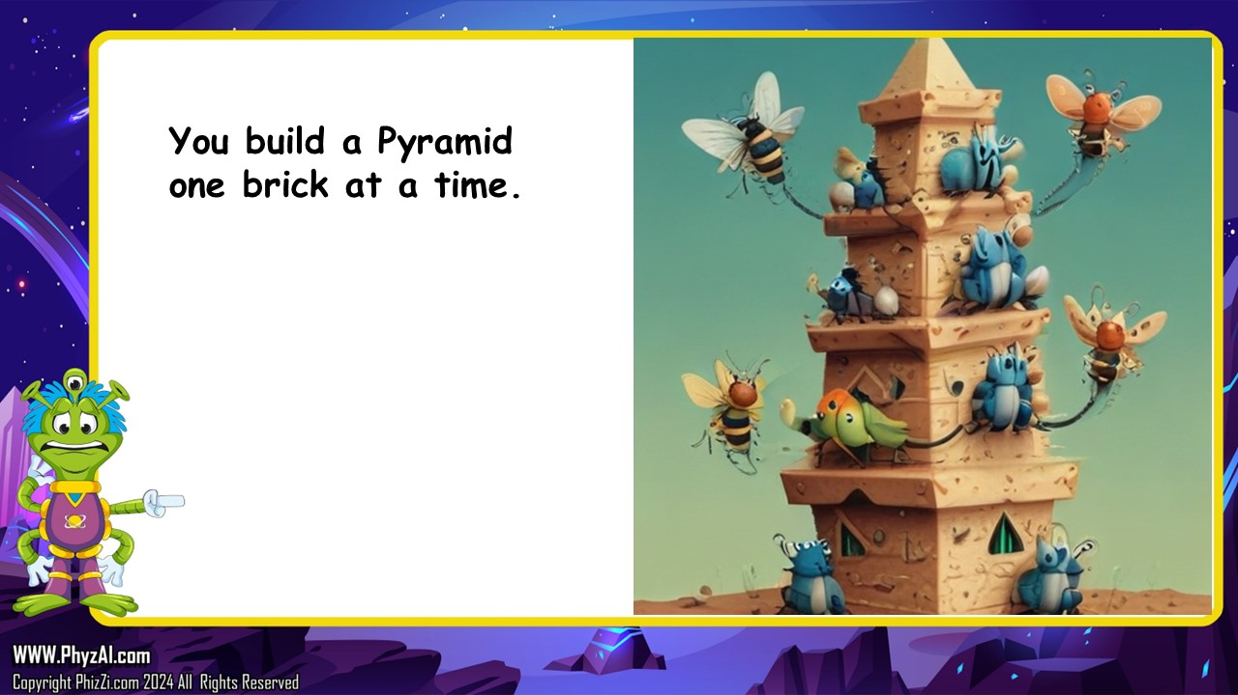
Notes:
let's talk about building a robot, and why it's a lot like building a pyramid.
Imagine for a moment that we're ancient Egyptians, and we've been tasked with building a magnificent pyramid. Now, if we try to build the entire pyramid all at once, without a plan or taking it step by step, we're likely to end up confused, overwhelmed, and probably with a collapsed pile of stones.
But if we take it slow and approach the task one brick at a time, we can accomplish great things. Each brick we lay is like a small, manageable step towards our goal. And as we continue to add more bricks, our pyramid starts to take shape, slowly but surely.
Building a robot is much the same way. If we try to do too much at once, we're bound to get confused and frustrated. But if we break the process down into smaller, more manageable steps, we can build something truly amazing.
So, just like the ancient Egyptians building their pyramids, let's take our time and approach building our robot one step at a time. By focusing on each small task and building upon our progress, we'll be well on our way to creating something truly remarkable.

Slide 15
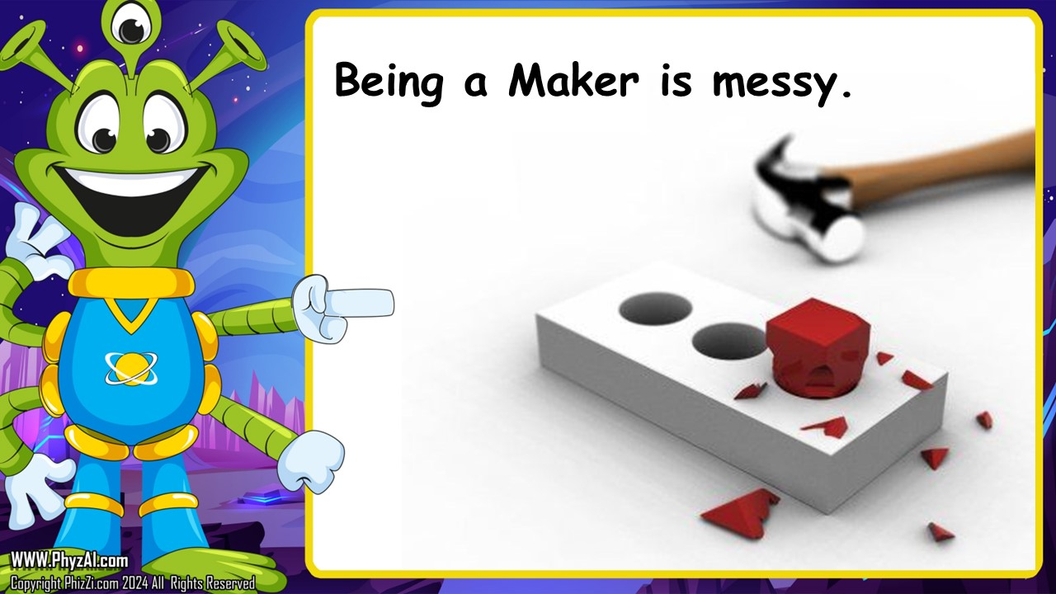
Notes:
Let's talk about something important: the messy nature of working on projects like building robots. It's true, things don't always go as planned. Sometimes, parts break, things don't fit together the way we expected, or our code doesn't work the way we want it to. And you know what? That's okay!
In fact, it's perfectly normal for projects to be messy. It's all part of the learning process. When things don't go right, it gives us an opportunity to problem-solve, think creatively, and learn from our mistakes.
Think of it like this: imagine you're working on a puzzle. Sometimes, you might try to fit two pieces together, but they just don't seem to fit. So, you try a different approach, maybe turning the pieces around or trying a different section of the puzzle. Eventually, you figure it out and move on to the next challenge.
Working on projects like building robots is a lot like that puzzle. It's a process of trial and error, experimentation, and persistence. When things go wrong, instead of getting frustrated, we can use it as an opportunity to learn and grow.
So, let's embrace the messiness of our projects. Let's celebrate our mistakes and use them as stepping stones on our journey to success. Because in the end, it's not about how many times we stumble – it's about how we pick ourselves up and keep moving forward.

Slide 16
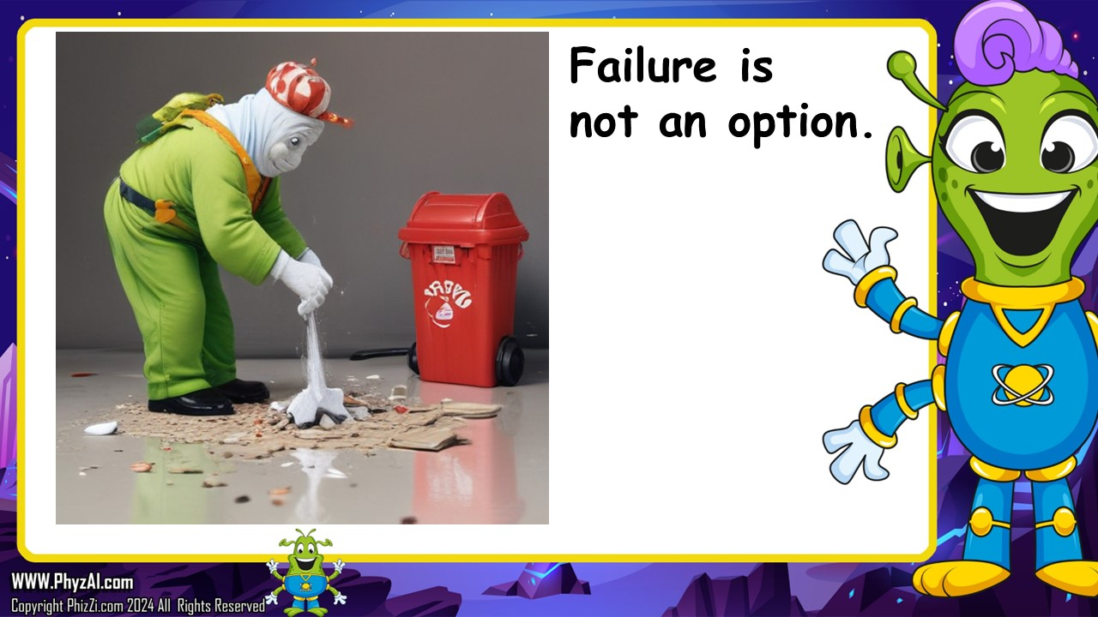
Notes:
failure. You see, when it comes to projects like building robots or tackling any big challenge in life, failure is not only common, but it's also a necessary part of the process.
Now, you might be thinking, "But wait, failure sounds like a bad thing!" Well, it's not. In fact, failure is how we learn and grow. It's how we figure out what works and what doesn't. It's how we develop new skills and gain experience.
Think of failure as a stepping stone on the path to success. Each time we fail, we're getting closer to our goal because we're learning valuable lessons along the way. Thomas Edison, the inventor of the light bulb, famously said, "I have not failed. I've just found 10,000 ways that won't work." That's the spirit!
So, let's change our perspective on failure. Instead of seeing it as something to be avoided at all costs, let's see it as an opportunity for growth and improvement. Let's embrace failure as an essential part of the journey and use it to propel ourselves forward toward success.
Remember, failure is not an option – it's a necessary part of the process. So let's embrace it, learn from it, and keep pushing forward, because that's how we'll ultimately achieve our goals and make amazing things happen.

Slide 17
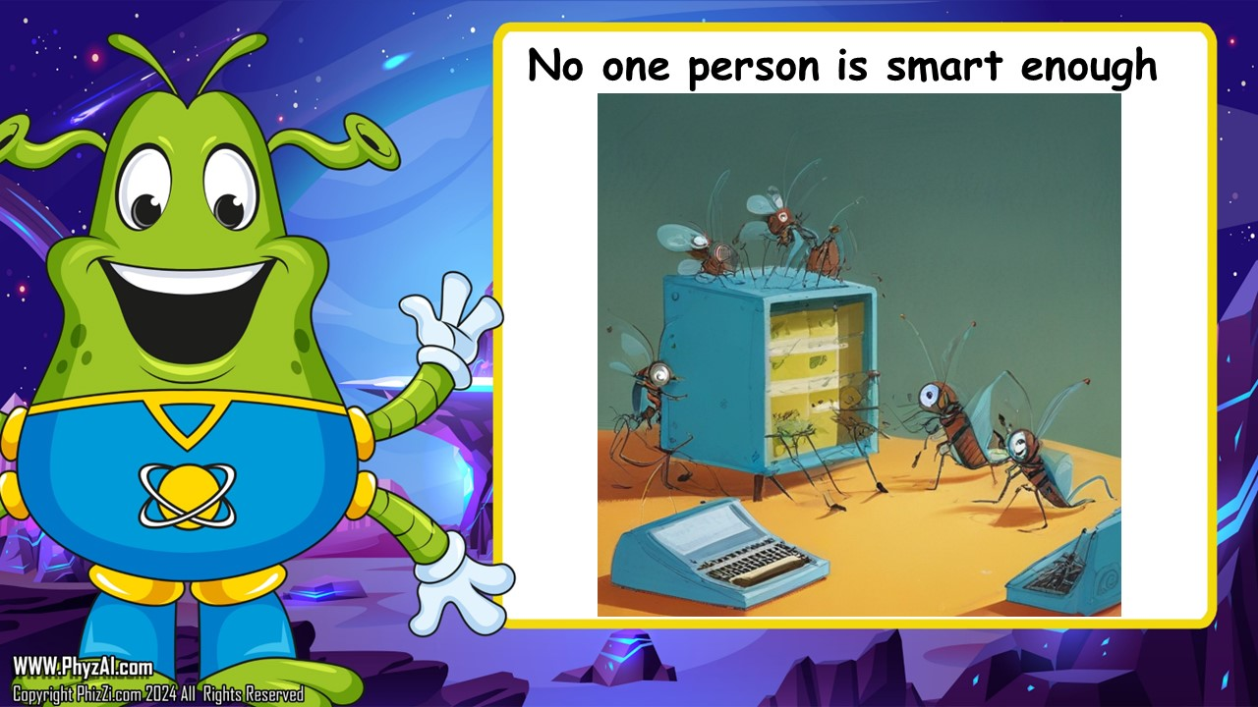
Notes:
When it comes to big projects like building robots or tackling any significant challenge, teamwork is absolutely essential.
Think of it like this: imagine you're trying to lift a heavy boulder all by yourself. It's tough, right? But now, imagine you have a team of friends helping you. Suddenly, that boulder doesn't seem so heavy anymore, does it? That's the power of teamwork!
When we work together as a team, we can accomplish incredible things. Each person brings their own unique strengths, skills, and perspectives to the table, making the team stronger and more capable than any individual could be alone.
In our robot-building adventure, teamwork will be crucial. Each of us will have a role to play, whether it's designing, building, programming, or testing our robot. By working together, sharing ideas, and supporting each other, we can overcome any obstacle and achieve our goals.

Slide 18
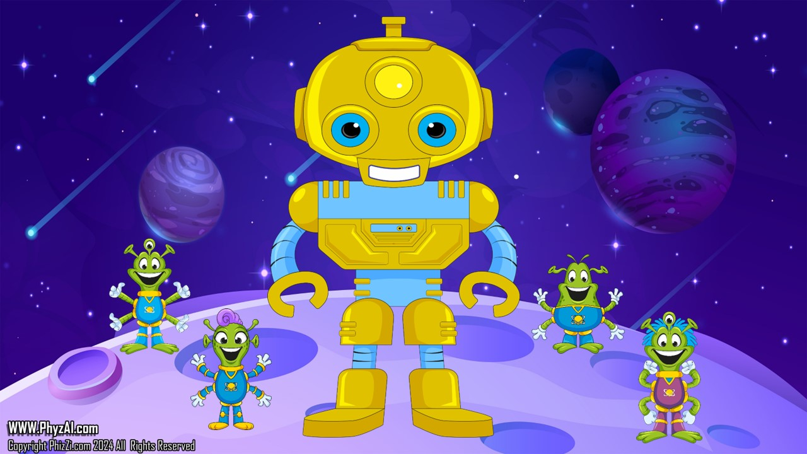
Notes:
I want to leave you with one final thought. Remember, as we embark on our robot-building journey, failure is not the end – it's just a stepping stone on the path to success. When things don't go as planned, don't get discouraged. Instead, embrace failure as an opportunity to learn, grow, and improve.
And most importantly, always remember the power of teamwork. Together, we can accomplish anything. By working together, supporting each other, and pooling our talents and resources, there's no challenge too big for us to tackle.
So let's go forth with confidence, knowing that failure is just a part of the process and that teamwork will always make it work. With determination, perseverance, and a spirit of collaboration, there's no limit to what we can achieve. Let's make our robot-building dreams a reality – together! Thank you, and let's get started on this exciting journey!

