Slide 1
Blocos lógicos
Chaves programáveis
Blocos I/O
Interconexões

Slide 2
Bloco Lógico
Bloco Lógico
Bloco I/O
Arranjo de Interconexão
Bloco I/O
Bloco Lógico
Bloco Lógico

Slide 3
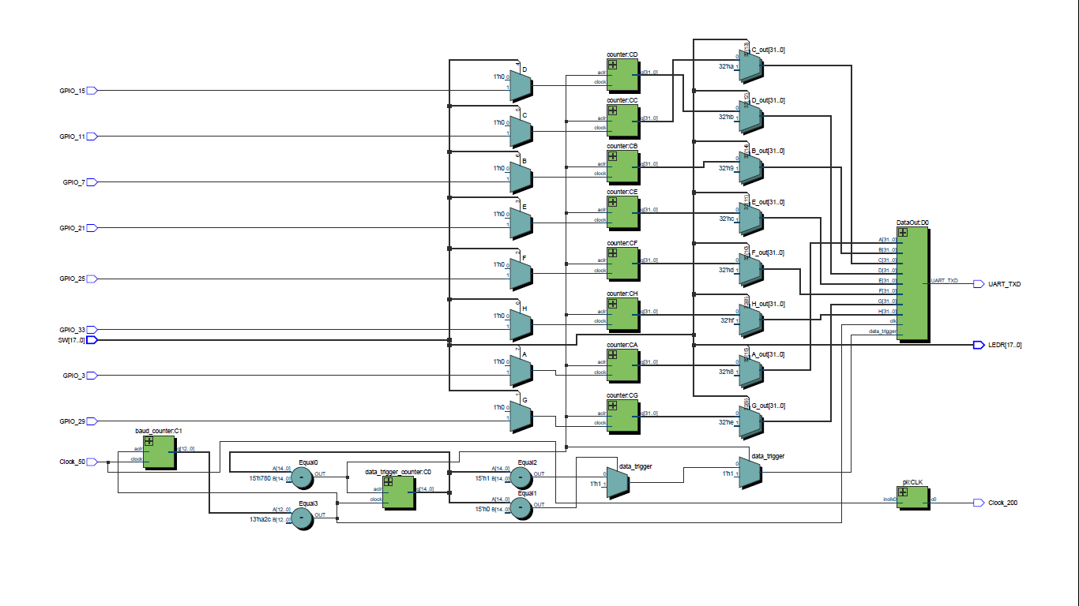

Slide 4
Baud Counter
50 MHz Clk
PLL (Intel IP)
200 MHz Clk
Data trigger counter
GPIO
UART TX
PC
GPIO
32-b Counters
GPIO
GPIO
32-b Counters
PMTs
A-H
32-b Counters
A-H Data Out
x8
x8
GPIO
GPIO
GPIO
SW
x8

Slide 5


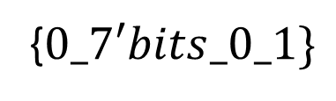




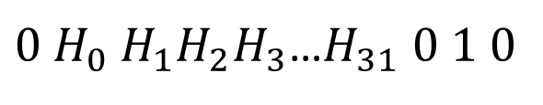












$$1^{st} stop$$
$2^{nd} stop$
$$3^{rd} stop$$
$$4^{th} stop$$
$$5^{th} stop$$
$$1^{st}start bit$$
$2^{nd} start$
$$3^{rd} start$$
$$4^{th} start$$
$$5^{th} start$$
1$0A_{0}A_{1}A_{2}$ … $A_{6}01$
$$0A_{7}A_{8}…A_{13}01$$
$0A_{14}A_{16}$ $…A_{20}01$
$$0A_{21}A_{22}…A_{27}01$$
$$0A_{28}A_{29}A_{30}A_{31}000 01BCDEFGH01111…$$
Throw Away bit
Termination bit
Termination bit
Termination bit
Termination bit
Termination bit
Termination byte
{$0_7′bits_0_1\}$
$$Start$$
$$Data$$
$$Stop$$
$$Termination$$
$0{ H}_{0} H_{1}H_{2}H_{3}$…$H_{31} 0 1 0$
… … …

Slide 6



Câmara escura com 7 PMTs
Conversor RS232-USB
Amostra
Pulsos TTL
FPGA (MCU)
Fonte de Alimentação

