Slide 1

Tech Mentorship Unit 3
Variables

Slide 2
Introduction
Ethan Halsall
Staff Software Engineer at John Deere ISG
10 years at Deere
Graduated 2015 Augustana College
Major: Computer Science
Minor: Music
Hobbies:
Electronics, Coding, anything technical
Lives in Des Moines with his partner Casey

Slide 3
What is Python
Python is a programming language.
A programming language is a set of grammatical rules that instruct a computer to perform a specific task.
Notes:
Make sure students understand that Python is just like a human language for students

Slide 4
Why Learn Python?
HIGH DEMAND
BEGINNER FRIENDLY
VERSATILITY
Python skills are in high demand in tech jobs, data science, machine learning, and more
Python is a beginner friendly language. It has simple rules and it is easy to read
Python can be multipurpose and used for web development, data analysis, scientific research, plus more
Notes:
Make sure students understand that Python is VERY versatile
And there is a High Demand for programmers
Please Make sure Women & Minority students are not discouraged and understand that they we are also capable of committing to a COmputer Science path
Python is beginner-friendly. It has simple syntax and high readability factor which makes it a great starting point for beginners12.

Slide 5
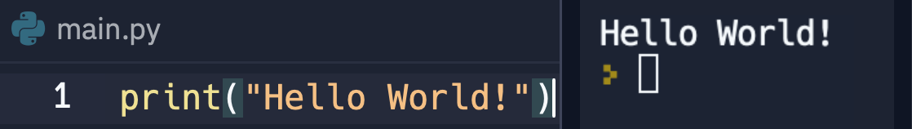
Print()
Print () is a special keyword in Python; its purpose is to exhibit or output a message onto the screen.
Notes:
Try on notebook! Ass seen
Try 5 more prints

Slide 6

Rule to print
You will also need a message to display
You will need keyword “print”
You will need an opening and closing double quotes and parentheses
Notes:
Make sure students understand that Python is just like a human language for students

Slide 7
01
Variables

Slide 8
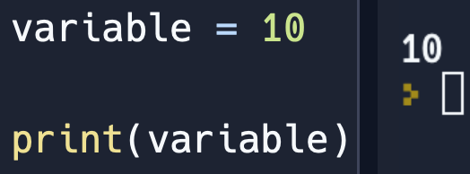
What are Variables?
A Variable is a container/box that holds a value.
It allows you to store all kinds of data types (“string”, Int(number), float(decimal))
Notes:
Make sure students understand that a variable holds information so if can be used later
Ask what data types are to refresh their memory

Slide 9
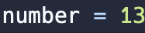
How to Create Variable
Variable Name
Equal Sign
Variable Value
A variable value can have any Data Type
Notes:
You need the three components to make a variable in python

Slide 10
Let’s Practice

Slide 11

Variable Example:
Notes:
Have students predict what the program will output
If they are stuck follow these steps:
Ask them what is the name of variable inside the print statement
They should say studentGrade
Then Ask students to look up in the code and ask them what does studentGrade equal
They should say 11
Then tell them if studentGrade equals 11 then what would the print statement output
They should say 11

Slide 12
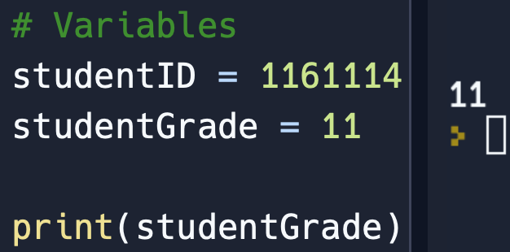
Variable Example: Answer
Notes:
Have discussion with students about any confusions they have

Slide 13
One More Practice

Slide 14
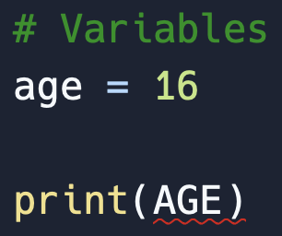
Variable Example:
Notes:
Have students predict what the program will output
If they are stuck follow these steps:
Ask them if they think age all lowercase is the same as AGE all uppercase
Lead them to answering with no
Then ask them what they think that red line means
Lead them to saying an error

Slide 15
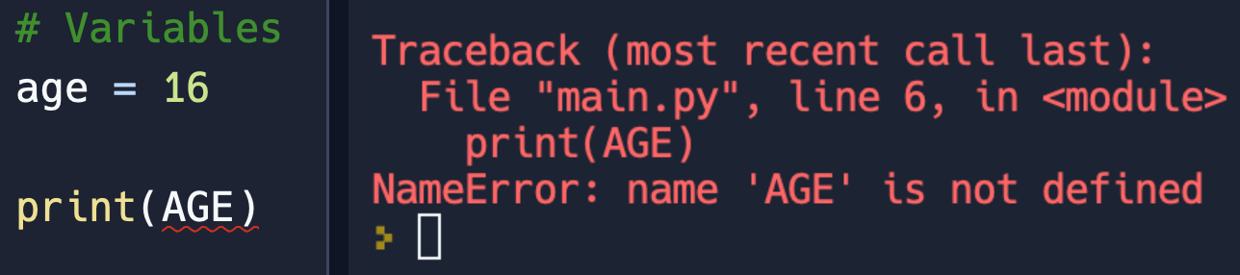
Variable Example: Answer
Capitalization & Spelling are important to Variable Names
Notes:
Have discussion with students about any confusions they have

Slide 16
02
Naming Rules

Slide 17
Variable Name
Rules
Variables should NEVER start with a Capital letter
Numbers
Spaces
Variables are unable to start with a number
Ex: 1option = 10
There cannot be spaces between numbers/words
Ex: option 1 = 10
Notes:
Explain to students that If a variable is to start with a Capital Letter there will be no Syntax Error
However, it is commonly accepted to NEVER start a variable with a Capital Letter because if it is then it will commonly be mistaken for a a Class Instance or Object which we will come cover much later in the Class

Slide 18

Naming Example:
Is there an Error in the variable name?
Notes:
Have students predict what the program will output
They should there will be an Error
Then Ask students what is wrong with the variable name They should say there is a space in the variable name
Then show next slide to show the error

Slide 19

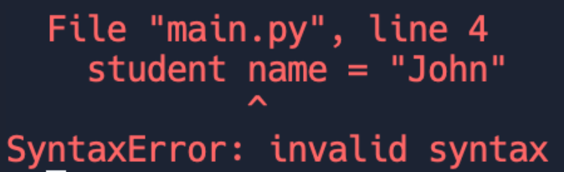
Naming Example: Answer
Code Written:
Output:
Notes:
Have discussion with students to make sure everything makes sense

Slide 20

Naming Example:
Is there an Error in the variable name?
Notes:
Have students predict what the program will output
They should there will be an Error
Then Ask students what is wrong with the variable name They should say there is a number at the beginning of the variable name
Then show next slide to show the error

Slide 21
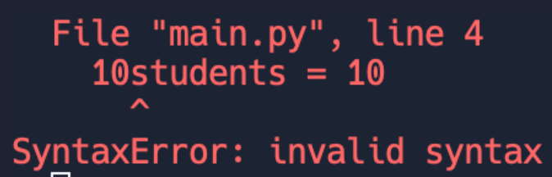
Naming Example: Answer
Code Written:
Output:
Notes:
Have discussion with students to make sure everything makes sense

Slide 22
03
Constant Variables

Slide 23
What is a Constant?
Constant variable refers to a variable that is assigned a value once and remains unchanged throughout the program's execution.
Constant Naming
Use all capital letters to represent a Constant Variable

Slide 24
Change These Variables Into the Constant Format
1.) Student Number
3.) Principal
Answer: STUDENT_NUMBER
Answer: PRINCIPAL
2.) John Deere
4.) Class 17
Answer: JOHN_DEERE
Answer: CLASS_17
Notes:
Have students write down what they think the correct variable name would be with Camel Case Format
Make sure students are not capitalizing the first letter of the variable
If asked why explain although it won’t cause an error it is normally coding etiquettecy to not capitalize the first letter of your variables

Slide 25
04
Camel Case

Slide 26
What is Camel Case?
Is a way of naming Variables where the first word is lowercase and each subsequent word starts with a capital letter.
Camel Case
Uses Capital letters to show when a new word starts
Ex: exampleSentence

Slide 27
Change These Variables Into the Camel Case Format
1.) Student Number
3.) Principal
Answer: studentNumber
Answer: principal
2.) John Deere
4.) Class 17
Answer: johnDeere
Answer: class17
Notes:
Have students write down what they think the correct variable name would be with Camel Case Format
Make sure students are not capitalizing the first letter of the variable
If asked why explain although it won’t cause an error it is normally coding etiquettecy to not capitalize the first letter of your variables

Slide 28
05
Snake Case

Slide 29
What is Snake Case?
Snake case is a writing style where the variable name is separated by underscores and all letters are lowercase
Snake Case
Uses Underscores to show when a new word starts
Ex: here_is_a_sentence

Slide 30
Change These Variables Into the Snake Case Format
1.) Student Number
3.) Principal
Answer: student_number
Answer: principal
2.) John Deere
4.) Class 17
Answer: john_deere
Answer: class_17
Notes:
Have students write down what they think the correct variable name would be with Camel Case Format
Make sure students are not capitalizing the first letter of the variable
If asked why explain although it won’t cause an error it is normally coding etiquettecy to not capitalize the first letter of your variables
Explain to students that although there are not errors for going against normal variable naming conventions it is still important to follow them because it allows for programmers to more easily understand one another's code

Slide 31
06
Review

Slide 32
Variable Name
Rules
Variables should NEVER start with a Capital letter
Numbers
Spaces
Variables are unable to start with a number
Ex: 1option = 10
There cannot be spaces between numbers/words
Ex: option 1 = 10
Notes:
Explain to students that If a variable is to start with a Capital Letter there will be no Syntax Error
However, it is commonly accepted to NEVER start a variable with a Capital Letter because if it is then it will commonly be mistaken for a a Class Instance or Object which we will come cover much later in the Class

Slide 33
07
List Challenge Activity

Slide 34
Create a Program
Create 5 Variables in Jupyter
A Variable named “Number of Students “ in Camel Case and have it equal 20
A Variable named “Number of Mentors “ in Snake Case and have it equal 6
A Variable named “Number of Interns “ as a Constant and have it equal 2

Slide 35
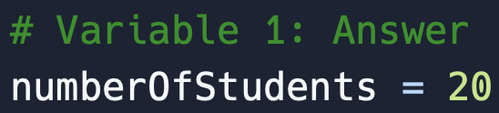
Create a Program: Answer 1

Slide 36
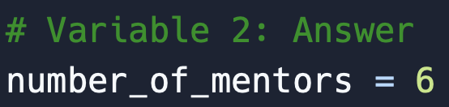
Create a Program: Answer 2

Slide 37
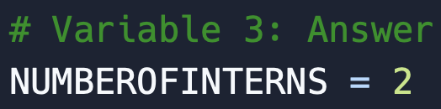
Create a Program: Answer 3

Slide 38
Create 2 Variables in Jupyter
A Variable named “Principle Students “ in Camel Case and have it equal 10
A Variable named “John Deere Students“ in Snake Case and have it equal 12
Print out each of the variables you created

