Slide 1

Tech Mentorship Unit 3
Variables

Slide 2
01
Variables

Slide 3
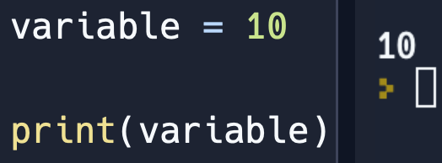
What are Variables?
A Variable is a container/box that holds a value.
It allows you to store all kinds of data types (“string”, Int(number), float(decimal))
Notes:
Make sure students understand that a variable holds information so if can be used later
Ask what data types are to refresh their memory

Slide 4
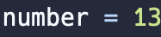
How to Create Variable
Variable Name
Equal Sign
Variable Value
A variable value can have any Data Type
Notes:
You need the three components to make a variable in python

Slide 5
Let’s Practice

Slide 6

Variable Example:
Notes:
Have students predict what the program will output
If they are stuck follow these steps:
Ask them what is the name of variable inside the print statement
They should say studentGrade
Then Ask students to look up in the code and ask them what does studentGrade equal
They should say 11
Then tell them if studentGrade equals 11 then what would the print statement output
They should say 11

Slide 7
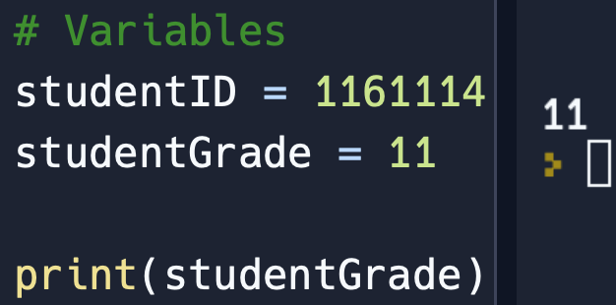
Variable Example: Answer
Notes:
Have discussion with students about any confusions they have

Slide 8
One More Practice

Slide 9
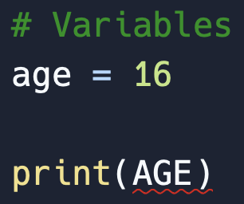
Variable Example:
Notes:
Have students predict what the program will output
If they are stuck follow these steps:
Ask them if they think age all lowercase is the same as AGE all uppercase
Lead them to answering with no
Then ask them what they think that red line means
Lead them to saying an error

Slide 10
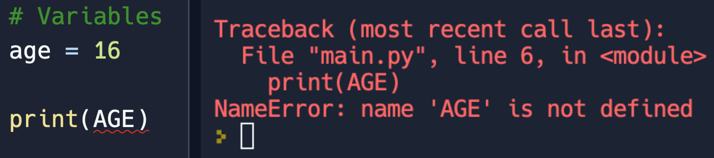
Variable Example: Answer
Capitalization & Spelling are important to Variable Names
Notes:
Have discussion with students about any confusions they have

Slide 11
02
Naming Rules

Slide 12
Variable Name
Rules
Variables should NEVER start with a Capital letter
Numbers
Spaces
Variables are unable to start with a number
Ex: 1option = 10
There cannot be spaces between numbers/words
Ex: option 1 = 10
Notes:
Explain to students that If a variable is to start with a Capital Letter there will be no Syntax Error
However, it is commonly accepted to NEVER start a variable with a Capital Letter because if it is then it will commonly be mistaken for a a Class Instance or Object which we will come cover much later in the Class

Slide 13

Naming Example:
Is there an Error in the variable name?
Notes:
Have students predict what the program will output
They should there will be an Error
Then Ask students what is wrong with the variable name They should say there is a space in the variable name
Then show next slide to show the error

Slide 14

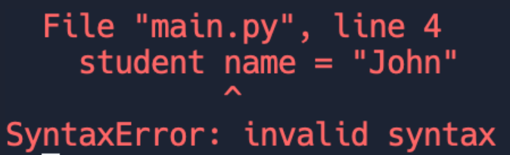
Naming Example: Answer
Code Written:
Output:
Notes:
Have discussion with students to make sure everything makes sense

Slide 15

Naming Example:
Is there an Error in the variable name?
Notes:
Have students predict what the program will output
They should there will be an Error
Then Ask students what is wrong with the variable name They should say there is a number at the beginning of the variable name
Then show next slide to show the error

Slide 16
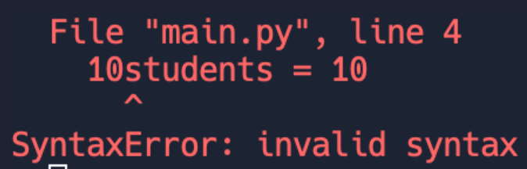
Naming Example: Answer
Code Written:
Output:
Notes:
Have discussion with students to make sure everything makes sense

Slide 17
03
Constant Variables

Slide 18
What is a Constant?
Constant variable refers to a variable that is assigned a value once and remains unchanged throughout the program's execution.
Constant Naming
Use all capital letters to represent a Constant Variable

Slide 19
Change These Variables Into the Constant Format
1.) Student Number
3.) Principal
Answer: STUDENTNUMBER
Answer: PRINCIPAL
2.) John Deere
4.) Class 17
Answer: JOHNDEERE
Answer: CLASS17
Notes:
Have students write down what they think the correct variable name would be with Camel Case Format
Make sure students are not capitalizing the first letter of the variable
If asked why explain although it won’t cause an error it is normally coding etiquettecy to not capitalize the first letter of your variables

Slide 20
04
Camel Case

Slide 21
What is Camel Case?
Is a way of naming Variables where the first word is lowercase and each subsequent word starts with a capital letter.
Camel Case
Uses Capital letters to show when a new word starts
Ex: exampleSentence

Slide 22
Change These Variables Into the Camel Case Format
1.) Student Number
3.) Principal
Answer: studentNumber
Answer: principal
2.) John Deere
4.) Class 17
Answer: johnDeere
Answer: class17
Notes:
Have students write down what they think the correct variable name would be with Camel Case Format
Make sure students are not capitalizing the first letter of the variable
If asked why explain although it won’t cause an error it is normally coding etiquettecy to not capitalize the first letter of your variables

Slide 23
05
Snake Case

Slide 24
What is Snake Case?
Snake case is a writing style where the variable name is separated by underscores and all letters are lowercase
Snake Case
Uses Underscores to show when a new word starts
Ex: here_is_a_sentence

Slide 25
Change These Variables Into the Snake Case Format
1.) Student Number
3.) Principal
Answer: student_number
Answer: principal
2.) John Deere
4.) Class 17
Answer: john_deere
Answer: class_17
Notes:
Have students write down what they think the correct variable name would be with Camel Case Format
Make sure students are not capitalizing the first letter of the variable
If asked why explain although it won’t cause an error it is normally coding etiquettecy to not capitalize the first letter of your variables
Explain to students that although there are not errors for going against normal variable naming conventions it is still important to follow them because it allows for programmers to more easily understand one another's code

Slide 26
06
Review

Slide 27
Variable Name
Rules
Variables should NEVER start with a Capital letter
Numbers
Spaces
Variables are unable to start with a number
Ex: 1option = 10
There cannot be spaces between numbers/words
Ex: option 1 = 10
Notes:
Explain to students that If a variable is to start with a Capital Letter there will be no Syntax Error
However, it is commonly accepted to NEVER start a variable with a Capital Letter because if it is then it will commonly be mistaken for a a Class Instance or Object which we will come cover much later in the Class

Slide 28
07
List Challenge Activity

Slide 29
Create a Program
Create 5 Variables in Replit
A Variable named “Number of Students “ in Camel Case and have it equal 20
A Variable named “Number of Mentors “ in Snake Case and have it equal 6
A Variable named “Number of Interns “ as a Constant and have it equal 2

Slide 30
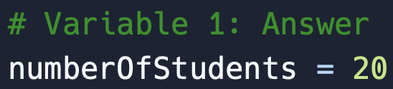
Create a Program: Answer 1

Slide 31
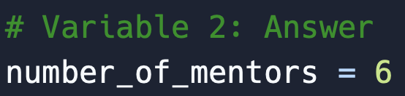
Create a Program: Answer 2

Slide 32
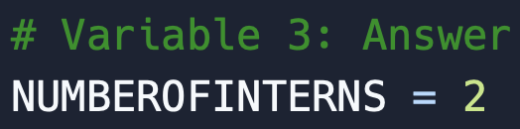
Create a Program: Answer 3

Slide 33
Create 2 Variables in Replit
A Variable named “Principle Students “ in Camel Case and have it equal 10
A Variable named “John Deere Students“ in Snake Case and have it equal 12
Print out each of the variables you created

