Slide 1
Tech Mentorship Unit 18
Reading & Writing Text Files

Slide 2
01
Files Type

Slide 3
What are Files?
At its core, a file is a collection of information or data that is stored as a single unit.
Example: Text Files

Slide 4
What is a Text File?
Text File
A Text File containing plain text without any special formatting, making it easy for humans to read and edit.

Slide 5
02
Import File

Slide 6
Import File: Step #1
Download a Text File, JSON File, or CSV FIle on your computer.
For today download the “Practice Text File.txt”

Slide 7
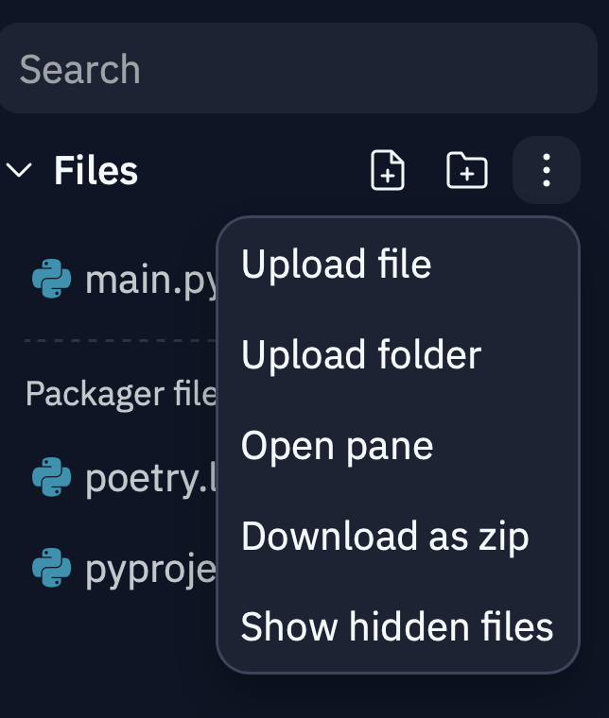
Import File: Step #2
Import your file into Replit
Click on the three dots by File
Then click on “Upload FIle”

Slide 8
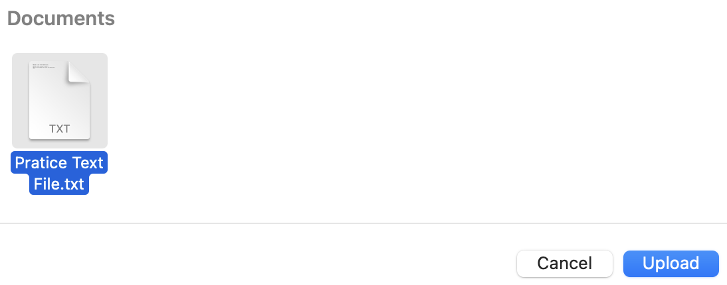
Import File: Step #3
Then upload the “Practice Text File.txt” to Replit

Slide 9
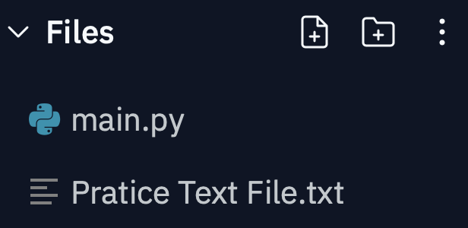
Import File: Step #4
Check to Make sure you can see “Practice Text File.txt” in your Replit
Notes:
Make sure students have all imported the their “Practice Text File.txt”

Slide 10
03
Import Text File into Python

Slide 11
File in Python: Step #1
Save the Text File into a variable
Notes:
Have students follow along on their computers so they can all read a file

Slide 12
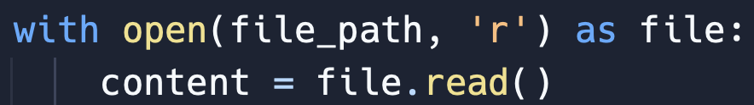
File in Python: Step #2
Write the Code: Below
Keyword “with” ensure FIle Closes Correctly
Keyword “as” allows the entire FIle to be read
Notes:
Explain to Students The Points Below. open(file_path, 'r'): This line of code is opening a file specified by the variable file_path. The 'r' mode indicates that the file is being opened in "read" mode, which means we can only read the contents of the file but not modify it.
with: The with statement is used in Python to ensure that the file is properly closed after its suite (indented block) finishes. It's a good practice to use the with statement when working with files, as it automatically handles file closing and prevents potential issues.
as file: This line is assigning the opened file to a variable named file. We can then use this variable to interact with the contents of the file.
content = file.read(): This line reads the entire content of the file and stores it in a variable called content. When file.read() is called, it reads the entire file content as a single string.
Point Out: That the file is saved into the content variable

Slide 13
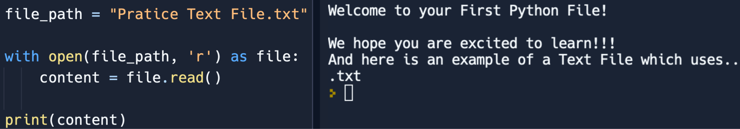
File in Python: Step #3
Use the file in anyway you choose.
Below we print out the file
Notes:
Have a discussion with students what data type

Slide 14
Why use a Text File?
Logging
Portability
Text files are often used for logging information and events generated by applications for debugging or tracking purposes
Text files are highly portable and can be opened and read on different operating systems (Windows, macOS, Linux) without compatibility issues.

Slide 15
05
List Challenge Activity

Slide 16
Create a Program (Help)
Notes:
Ask the Students to describe what the grocery list is
We are look for answers like [a bunch of item, order, and changeable]

