Slide 1


Performance Analysis of Shock-Absorber Using Test-rig
A Final Year (B.E.) Project by:
Aanand Gajjar
Pranav Pishawikar
Debjyoti Mazumdar
Project Guide:
Prof. P.P. Hujare
H.O.D:
Prof. S.C. Shilwant
Department of Mechanical Engineering,
Sinhgad Academy of Engineering (Kondhwa), Pune.

Slide 2
INTRODUCTION
Shock-absorbers are prone to wear over prolonged usage. Usual method to test a shock-absorber is for a mechanic to push down on the vehicle’s hood or trunk and watch the dynamic response when the force is abruptly removed. However, his process is highly objective.
Our setup enables quantitative measurement of dynamic response of a vehicle’s suspension system and put an objective basis behind the decision of when to replace shock-absorbers.
We have utilized simple and economical components and USB-interfacing, with the real-time output being displayed on a widely-used software platform, Visual Basic (VB).

Slide 3
LITERATURE REVIEW
Velocity Transducer in Shock Absorber Testing Machine by Using Scotch Yoke Mechanism
Hydraulically Operated Shock Absorber Testing Machine

Slide 4
SCOPE
By using shock absorber testing machine we can find force transmitted, force impressed and frequency. This enables us to plot graph between transmissibility ratio and frequency.
By analysing the graph obtained we can derive the “damping factor” of the shock absorber, and hence its condition and whether it needs replacement or not. This is esp. useful in automobile industry.
We can also add the subsystem which can find the viscosity of damper oil at different temperature and the performance and reliability of system can be calculated. This can give the operation range of the shock absorber.

Slide 5
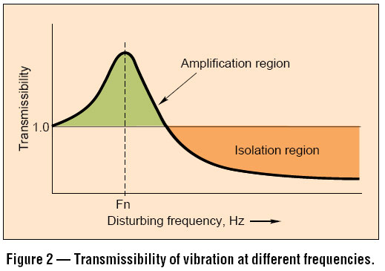
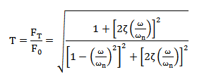

THEORY
The main objective of the system is to plot the Transmissibility vs. Frequency Ratio curve at various damping conditions as well as amplitudes.
Transmissibility (T_{r}) is the ratio of the force transmitted to the supporting structure or foundation (F_{t}), to the force impressed upon the system (F_{o}).
$Tr=\frac{Ft}{Fo}$

Slide 6
COMPONENTS USED
Shock absorber (test specimen)
Motor
Worm and worm-wheel gearbox
Cam-follower mechanism
Load cell (CZL-601) – x2
Microcontroller (ATmega16)
Communication port (RS-232)
RS-232 to USB cable
Computer with VB installed
LASER and photo detector based Tachometer

Slide 7
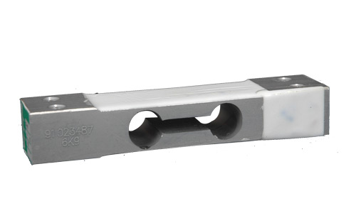
LOAD CELL – CZL-601
A load cell is a transducer which converts a load acting on it into a analog electric signal (pressure energy into electrical energy).
CZL-601 is a strain-gauge load cell, based on the principle that the resistance of the electrical conductor changes when its length changes due to stress.
It is made of Aluminium alloy, and its rated output is 2mV/V which means that at maximum loading (60kg) and an input voltage of 1V, the output voltage is 2mV.
The datasheet for the load cell is available.

Slide 8
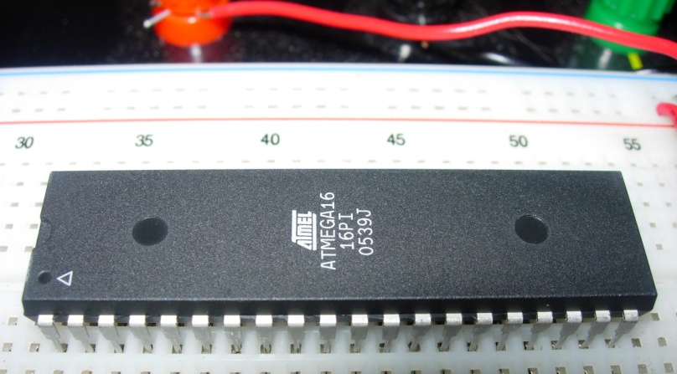
MICROCONTROLLER – ATmega16
ATmega16 is an 8-bit high-performance microcontroller of Atmel’s Mega AVR family with a low power consumption. It has 131 instructions, with a maximum frequency of 16MHz.
It is a 40-pin microcontroller, with 32 I/O lines.
It has 16KB programmable flash-memory.
We have used 3 of those input ports (ADC0, ADC1, ADC2) for input signals from the 2 load-cells and 1 from the tachometer.
The instructions shall be given using the BASCOM AVR programming software.

Slide 9
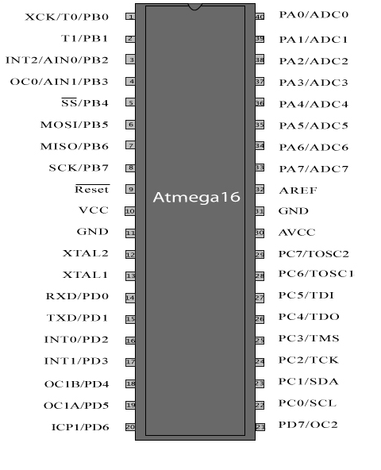
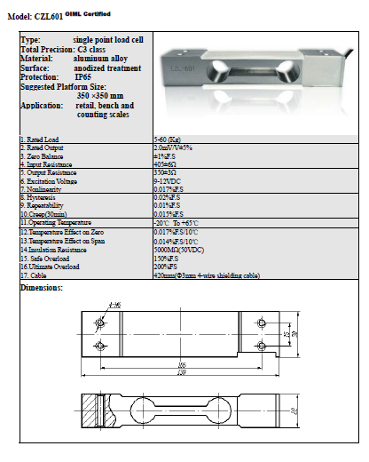
Fig: CZL-601 data-sheet
Fig: ATmega16 pin configuration

Slide 10
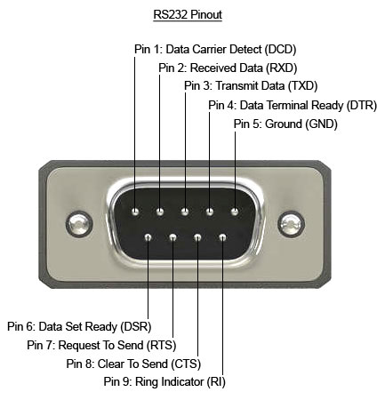
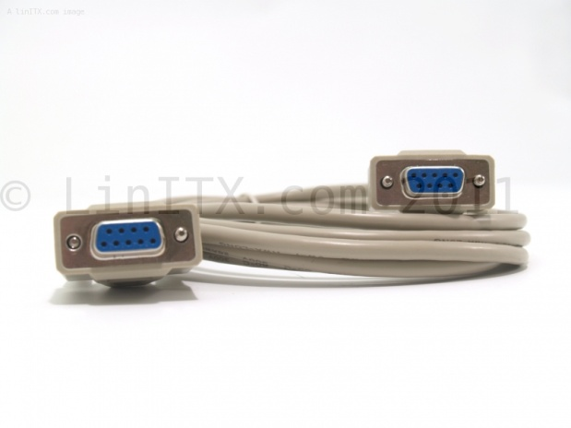
COMMUNICATION PORT – RS-232
RS-232 is a standard computer communications systems, commonly known serial connection.
We have used the 9-pin “AT” style.
The connector is used to relay the digital signals as output from the ATmega16 to the PC, where it will be interpreted by the software.

Slide 11
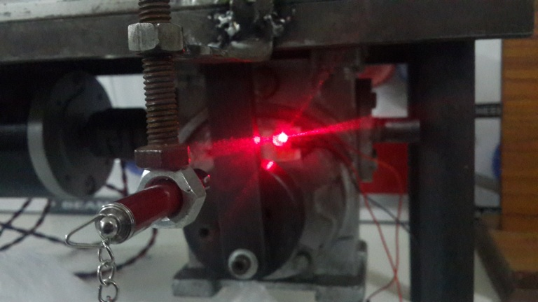
TACHOMETER
We have used an LDR and LASER light source for the tachometer to measure the final RPM of the gearbox (no. of excitations per minute of the absorber) and slot the drive wheel accordingly.
The sensor is attached to the frame of the setup and the no. of interruptions of the LASER beam by the cam-link slot per minute will give us the RPM.
The voltage output is given to the ATmega ADC which converts it to rpm and is given to the COM port for plotting.

Slide 12
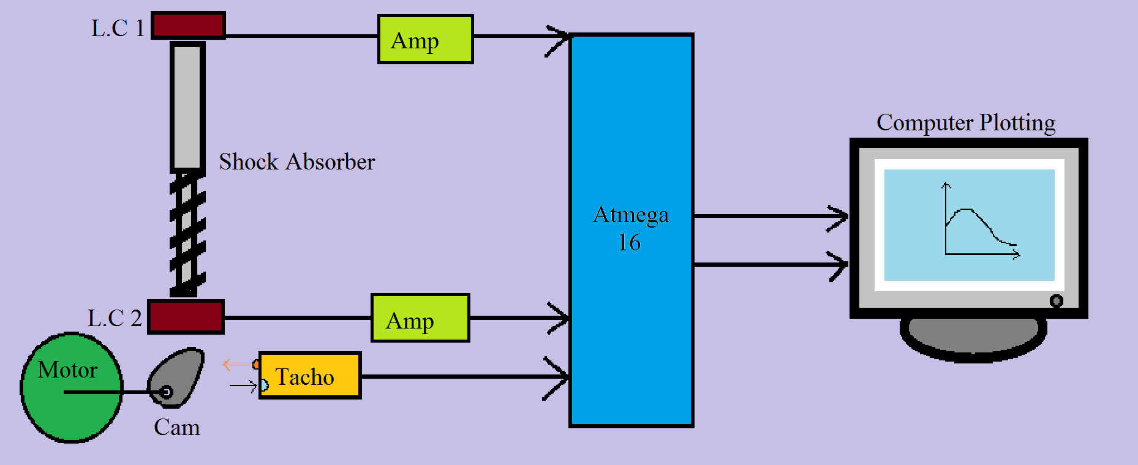
FINAL SYSTEM LAYOUT

Slide 13
WORKING
Motor – Gearbox – Drive wheel – Cam follower – Actuator – L.C. 2 – Shock absorber – L.C. 1
Outputs from L.C. 1 (F_{t}) and L.C. 2 (F_{o}) amplified using an amplifier.
Amplifier voltage outputs sent to ATmega16, along with tachometer voltage output (N).
ATmega16 converts the analogue signals to digital binary signals, and perform the required calculation to find Transmissibility and the Frequency Ratio as 2 separate outputs, using BASCOM AVR programmer.

Slide 14
$Tr= \frac{Ft}{Fo}$ = $\frac{L.C. 1}{L.C. 2}$ $FR$= $\frac{ω}{ωn}; ω= \frac{2πN}{60}$
These 2 outputs will be relayed to the computer with VB using the RS-232 to USB cable.
The ‘tryplot’ function of VB will be used to plot these values in real-time and display the curve of Transmissibility vs. Frequency Ratio.

Slide 15
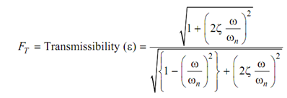
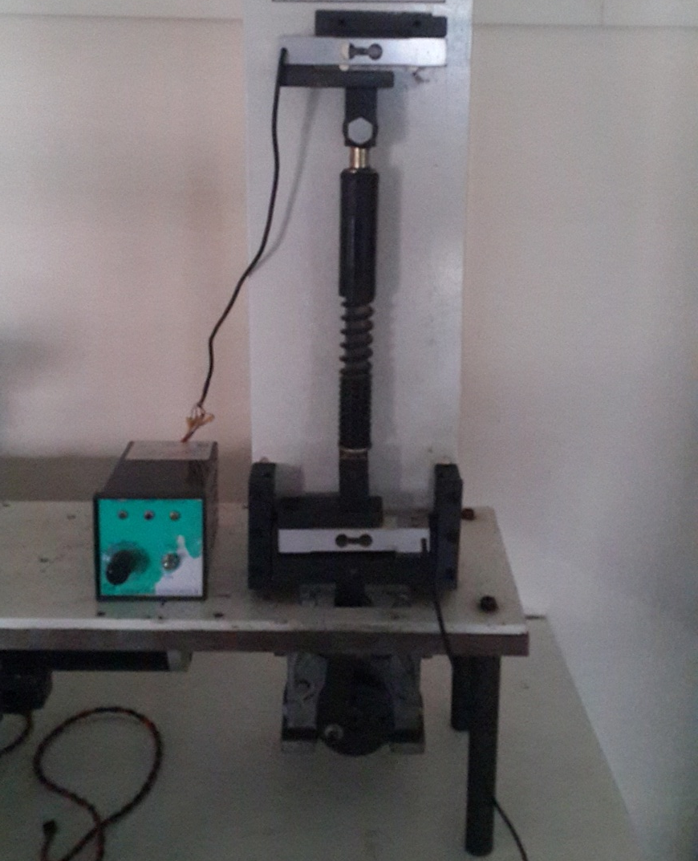
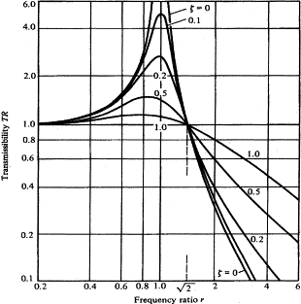
Fig: Test setup
TEST SPECIMEN
Fig: Governing equation
MOTOR-
CONTROLLER
LOAD-CELLS
Fig: Curves for different damping ratios
MOTOR
GEARBOX

Slide 16
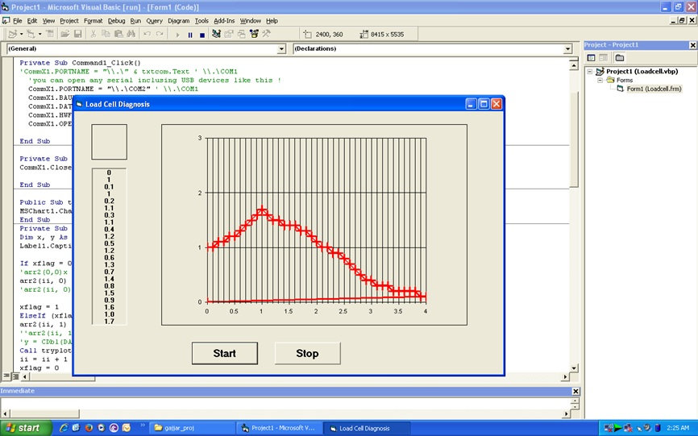
RESULTS
Hence the damping curve of the shock-absorber is obtained. This curve can be studied easily to find out the damping ratio of the shock-absorber.
Studying this curve, and knowing the natural frequency of the system, damping ratio can be calculated.
It can be used to find out whether a shock-absorber needs replacement, and also to analyse the general performance characteristics of the shock-absorber.

Slide 17
CONCLUSION
The current status of the shock-absorber performance is instantly displayed, and corrective measures can be taken quickly.
Present testing machines in the market are very bulky and expensive due to their exclusive nature of result output peripherals; this system is relatively inexpensive.
The compactness and ease-of-use of the system allows it to be used by private automobile restorers and mechanics, and small service-centres.

Slide 18
REFERENCES
“Mechanical Vibrations” - Singiresu S. Rao
“The Shock Absorber Handbook” – John C. Dixon
“Vibration and Shock Isolation” – C.E. Crede
“Understanding your Dampers” – Jim Kasprzak
“Damped Simple Harmonic Motion” – Weisstein Eric W.

Slide 19
THANK YOU! ☺

