Slide 1
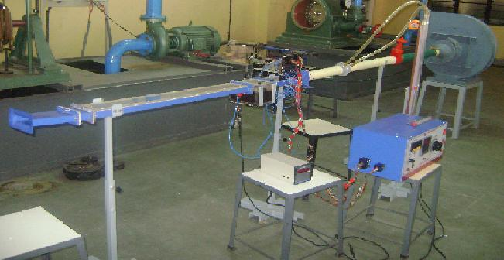
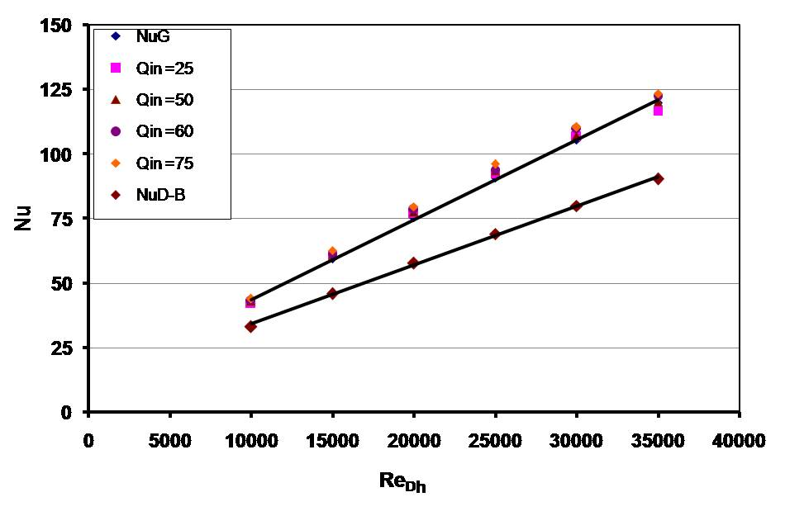
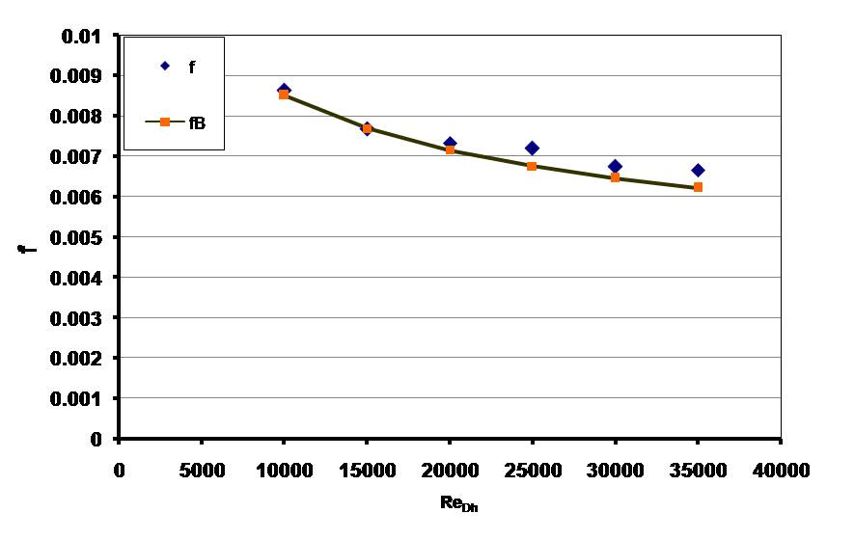
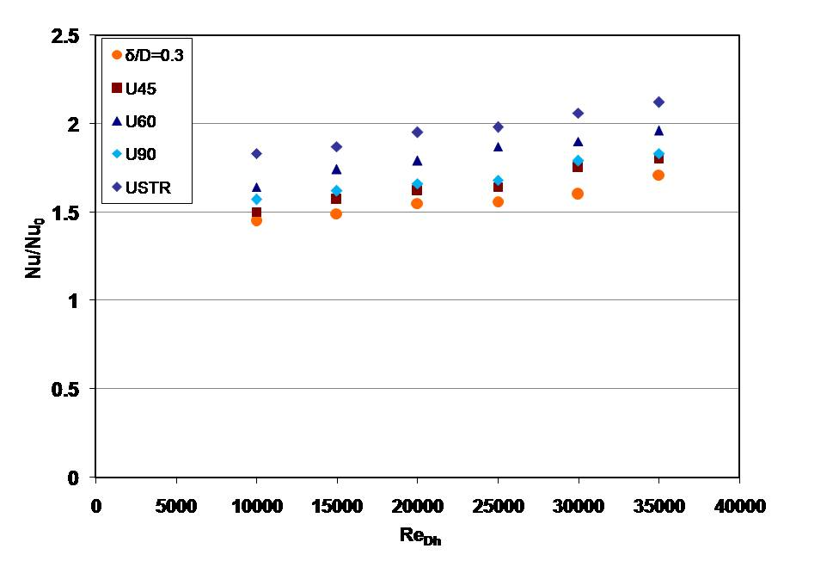
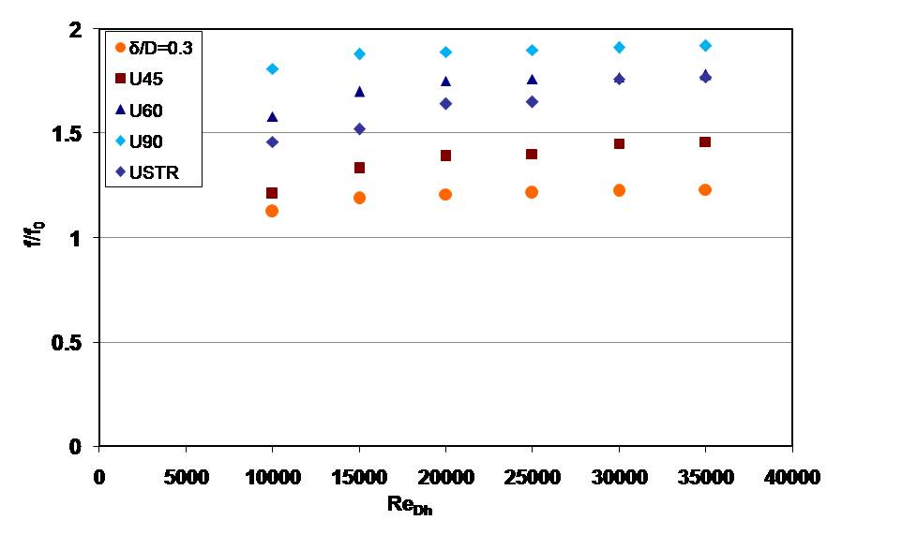
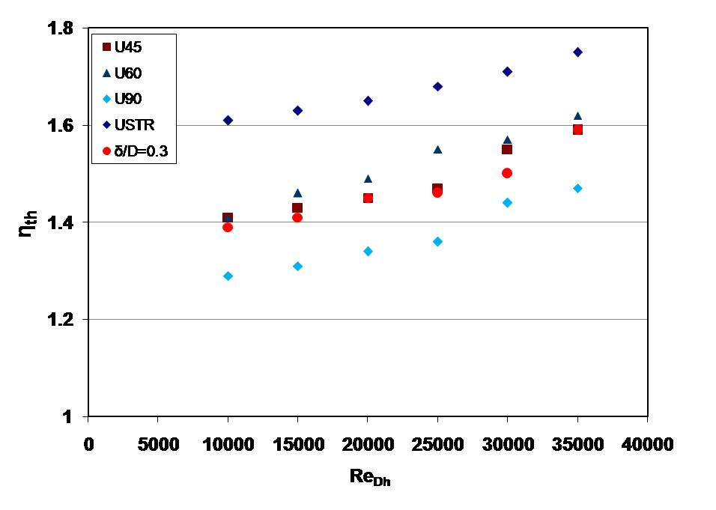
EXPERIMENTAL INVESTIGATIONS OF SINGLE DIMPLE WITH ON HEAT TRANSFER AND FLUID FLOW WITHIN IN A CHANNEL
Group No. 4
Sandeep S Kore, Satishchandra V. Joshi, N.K.Sane
Sinhgad Academy of Engg.,Pune,D.Y.Patil College of Engg.,Pune,Vishakarma Inst. of Tech.Pune
e-mail: kore2005@rediffmail.com, joshisv17@gmail.com,narayan_sane@yahoo.co.in
ABSTRACT
Experimental Set Up:
An experimental investigation has been carried out to study the effect of single dimple with inverted U turbulator on heat transfer and fluid flow.
The aspect ratio of the rectangular channel is 4:1. The Reynolds number based on hydraulic diameter is varied from 10000 to 35000. The ratio of channel height to print diameter is kept at 0.5and the dimple depth to dimple print diameter is kept constant at 0.3. In order to enhance the fluid velocities and heat transfer in the first half of the dimple, two types of inverted U turbulators are tried namely curved and straight inverted U turbulator.
The included angle of the curved inverted U turbulator is varied at 45⁰,60⁰ and 90⁰ while the straight inverted U turbulator is inclined at 12⁰ to the plane surface. The inverted U turbulator is placed at the leading edge of the dimple.
FOCUS OF THE STUDY:
To investigate the effect of single dimple with inverted U turbulator on heat transfer and fluid flow
To study the effect of curved and straight inverted U turbulator
The experimental results are presented in the form of normalized Nusselt number, normalized friction factor and thermal performance
Details of straight inverted U turbulator geometry
Representative Parameters:
Height of channel = 25 mm
Width of channel = 100 mm
Aspect ratio of the channel = 4
Dimple dia.= 50 mm
Dimple depth= 15 mm
Re_{Dh} = 10000 to 35000
Included angle of curved inverted U turbulator = 45⁰,60⁰ & 90⁰
Straight inverted U turbulator is placed at 12 ⁰ to flat surface
RESULTS
Top and side view of inverted U turbulator geometry of solid model
Validation of test set up:
EFFECT OF INVERTED U TURBULATOR ON Nu/Nu₀
EFFECT OF INVERTED U TURBULATOR ON f/f₀
EFFECT OF INVERTED U TURBULATOR ON η_{th}
Gnielinski and Dittus Boelter equation
Nu=0.0214(Re^{0.8}– 100) Pr^{0.4} [1+ (Dh/L) ^{2/3}]
Nu=0.023 Re^{0.8} Pr^{0.4}
Modified Blasius equation
f = 0.085 Re^{-0.25}
Normalized Nu is higher for straight inverted U turbulator compared to curved inverted U turbulator
Normalized f/f₀ is higher for 90º curved inverted U turbulator and lowest for 45º curved inverted U turbulator
The thermal performance of 90º curved inverted U turbulator is lower and of 45º, 60º curved inverted U turbulator and straight inverted U is higher than dimple depth δ/D=0.3.
CONCLUSION
References
The thermal performance and augmented heat transfer rate from the straight inverted U and curved inverted U turbulator for dimple depth δ/D=0.3 is presented in this paper. Compared to all inverted U turbulator configurations, the performance of the straight inverted U turbulator is higher due to following reasons
The turbulator provides a very simple but promising augmentation technique over ribbed wall augmentation with moderate pressure penalty.

