Slide 1

Exploring Facebook Data through Topic Modelling
Pierre Arquillano
Parquillano@myseneca.ca
Seneca College
Abstract
Challenges
Examples
Evaluations
\
With Social media becoming a larger part of society, it has become a great source for data and information. Through an exploratory analysis we will be attempting to gain insight from social media data.
Framework
Objective
Conclusions
References

Slide 2
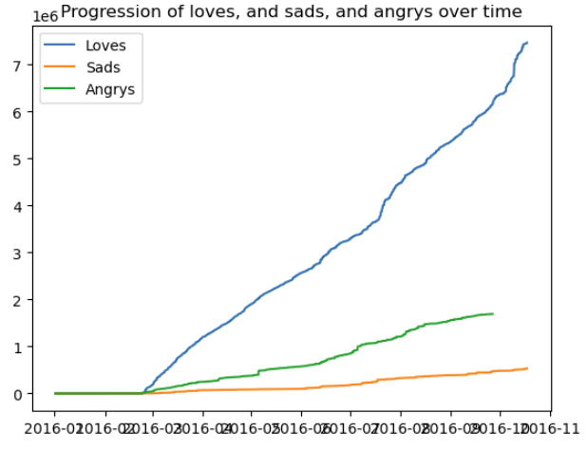
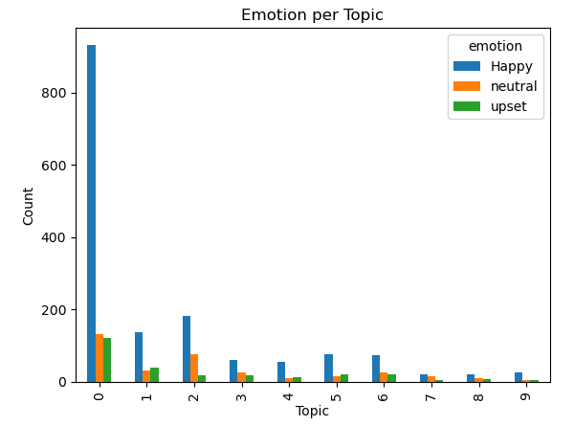
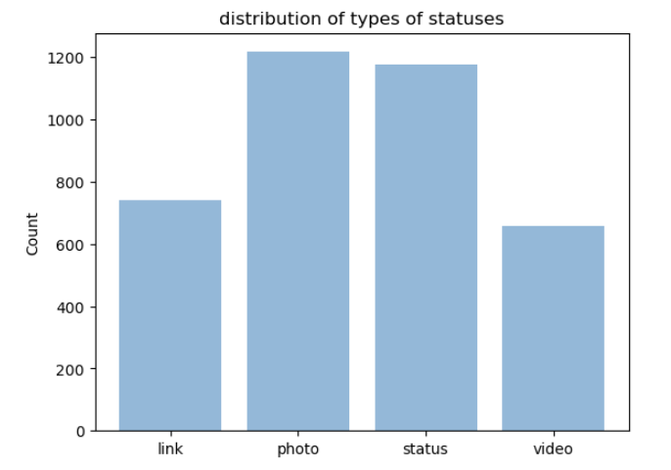
Exploring Facebook Data through Topic Modelling
Pierre Arquillano
Parquillano@myseneca.ca
Seneca College
Abstract
Objective
Challenges
With Social media becoming a larger part of society, it has become a great source for data and information. Through an exploratory analysis we will be attempting to gain insight from social media data.
Social Media holds a vast amount of data. The problem we are trying to explore is how to extract that data from Trumps status posts to gain meaningful insight
Social Media utilizes several forms of media such as images, text and links. It may be a challenge to get meaningful insight from all sources.
Initial Analysis
Model Results
Conclusion
Gained insight on our audiences topic of preference through topic modelling.
This information can be used to focus on the topics that return a positive reaction.
Media Distribution
Future Direction
Apply Machine Learning Algorithms for emotion prediction for future posts
Utilize classification models such as Naives Bayes and SVM

