Slide 1
Minimum Cost Spanning Tree
Guided by Dr Zin Mar Myo
Presented by
Mg Ko Ko Naing 5CS-39
Mg Kaung Khant Winn 5CS-40
Mg Hein Htet Aung 5CS-57

Slide 2
Project Description
In our project we implement Kruskal's minimum cost spanning tree algorithm. Let G = (V, E) be a connected, undirected graph with a cost function mapping edges to real numbers. A spanning tree is an undirected tree that connects all vertices in V. The cost of a spanning tree is just the sum of the costs of its edges. Our goal is to find a spanning tree of minimal cost for G. Computation on paper by hand is difficult, so we implement with python.

Slide 3
Theory Background
begin
1. T←null;
2. VS←null;
3. construct a priority queue Q containing all edges in E:
4. for each vertex v is in V do add {v} to VS;
5. while ||VS||>1 do
begin
6. choose(v,w), an edge in Q of lowest cost;
7. delete(v,w) from Q;
8. if v and w are in different sets W1 and W2 in VS then
begin
9. replace W1 and W2 in VS by W1 union W2;
10. add(v,w) to T
end
end
end

Slide 4
Theory Background
Discovery of a lowest-cost edge on Q requires O(log e) steps if Q is implemented by a priority queue. The total time to find all sets W1 and W2 containing v and w and to replace them by their union is at most O(e G(e)) if the fast disjoint-set union algorithm is used. The remainder of the loop clearly requires a constant amount of time independent of the size of G. Initializing of Q takes O(e) time and initialization of VS,O(n) time,where n is the number of vertices in V.

Slide 5
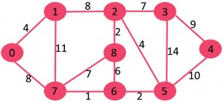
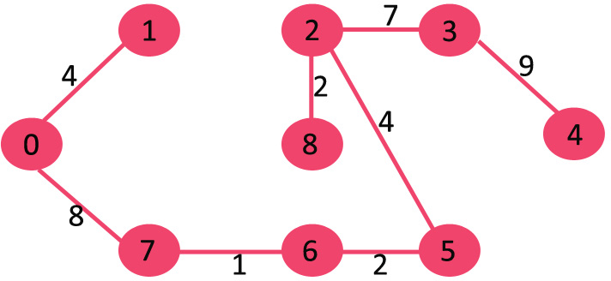
Figure-1. Given Graph
Figure-2. Output Graph

Slide 6
Implementation
We use python3 to implement Kruskal’s Minimum Cost Spanning Tree Algorithm.

Slide 7
Conclusion
By using Kruskal's minimum cost spanning tree algorithm, we find shortest path of the graph. For example, in real world, if we travel from city A to city B, we can find the shortest path by using this algorithm.

Slide 8
Thanks You

Slide 9
References
https://www.stackoverflow.com
https://realpython.com
The Design and Analysis of Computer Algorithms by Aho Hopcroft Ullman

