Slide 1

PiTrust – A blockchain based trust network
CS6675 Advanced Internet Systems – Course Project
03 May 2022

Slide 2

PiTrust – A blockchain based trust network
Use case
Why blockchain?
System description
Preparation for Live Demo
Guidance for Live Demo

Slide 3

PiTrust – Use Case
Imagine being new in a company or at a location
You need to know something about a particular topic
Whom could you ask for assistance?
=> Database of people to find a knowledgeable person

Slide 4
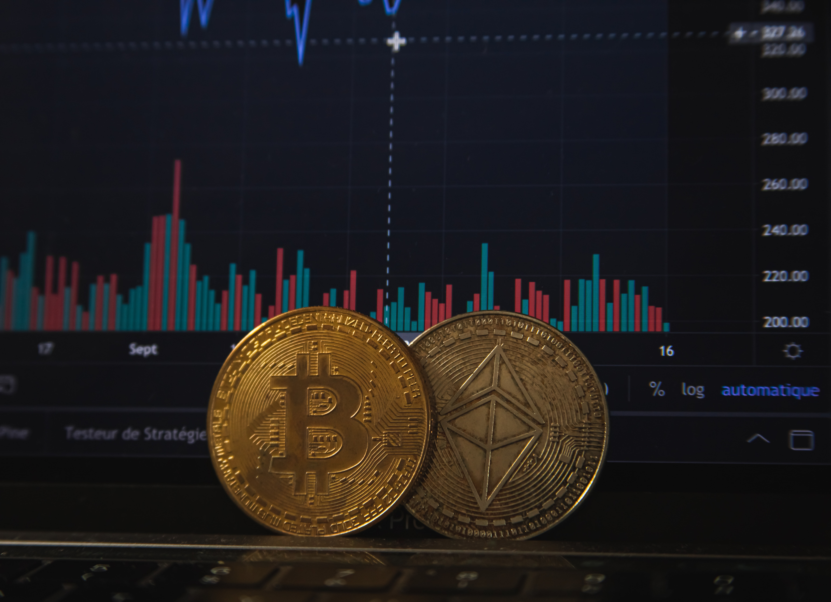
PiTrust – Why blockcain?
Central database may be well-suited for a network of people trusting each other, but not for larger scale
Lack of transparency
Prone to manipulation
Scalability
Blockchain solves these issues as it is publicly verifiable, non-revokable and highly scalable

Slide 5
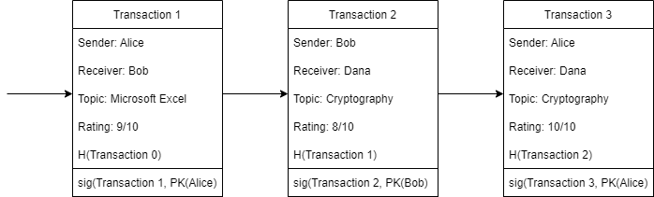
System Description - General
Transaction (rating) information will be stored on the Polygon blockchain
Polygon is compatible to the very well-known Ethereum blockchain, but comes with much lower transaction fees (~$0.10 compared to ~$30 on Ethereum)
Each transaction will store information about the actual rating (on a scale between 1 and 10), topic and also who has rated whom: T = (Sender, Receiver, Topic, Rating)

Slide 6
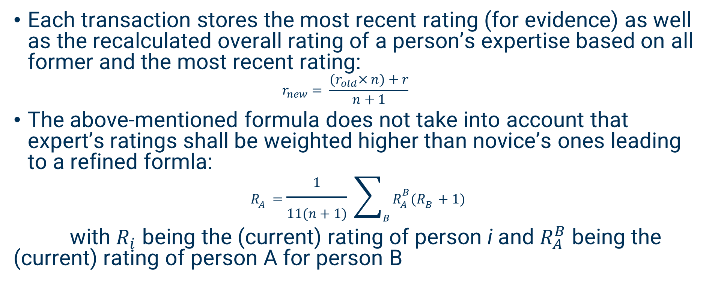
System Description –Rating calculation
Each transaction stores the most recent rating (for evidence) as well as the recalculated overall rating of a person’s expertise based on all former and the most recent rating:
$$r_{new}= \frac{{(r}_{old}×n)+r}{n+1}$$
The above-mentioned formula does not take into account that expert’s ratings shall be weighted higher than novice’s ones leading to a refined formla:
$$R_{A}=\frac{1}{11(n+1)} \sum_{B}{R_{A}^{B}(R_{B}+1) }$$
with $R_{i}$ being the (current) rating of person i and $R_{A}^{B}$ being the (current) rating of person A for person B

Slide 7
System Description – Tokenomics (1)
The implementation the system as proposed would work, but also be prone to manipulation by creating large counts of fake-reviews, being positive or negative
This may be mitigated by introducing a cryptocurrency token, which has a small, but real-world value as it can be exchanged against other cryptocurrencies such as Bitcoin and finally fiat money as well.
Tokens can also be used as incentive for positive behavior (i.e., receiving, but also providing valuable feedback)

Slide 8
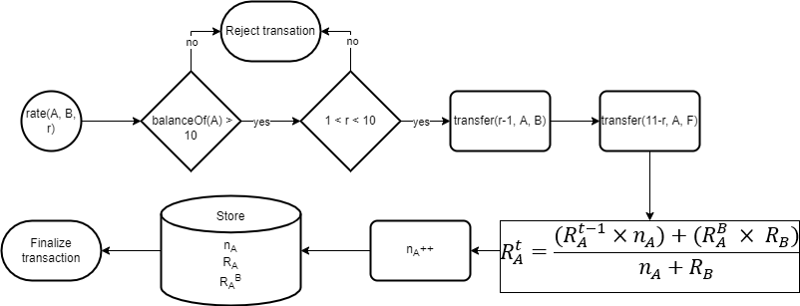
System Description – Tokenomics (2)
Basic idea: Fixed supply with ability to buy tokens on (decentralized and/or centralized) exchanges
Each rating costs 10 tokens, whereof r-1 tokens will be transferred to the rated person and the rest being sent (back) to the contract wallet
Burning the tokens, i.e., sending them to an unusable address, was also considered

Slide 9
System Description – Tokenomics, additional thoughts
Spending tokens for ratings currently does not provide any benefit for the users
Incentivation could be implemented by increasing voting power (social benefit) and/or provide some kind of interest on performed votings, comparable to staking tokens/coins
Hoarding tokens for investment purposes does not fit its purpose
Rather high inflation (e.g. creating 20% additional tokens per year, currently implemented) or controlled burn of unmoved tokens (e.g. 10% per month) could mitigate that

Slide 10
System Description – Frontend (1)
Ethereum/Polygon smart contract alone is not usable by even technically versed people without prior knowledge of and tools for blockchain development
Frontend could be developed as a “classic” executable application, but modern Web (3.0) applications rather make use of general-purpose web servers using HTML & JavaScript
More sophisticated frameworks such as React add even more value to the usability but have not been evaluated in-depth or used for the prototype
Main interface between the frontend and the smart contract is provided by Metamask (or any other Web3 crypto wallet)

Slide 11
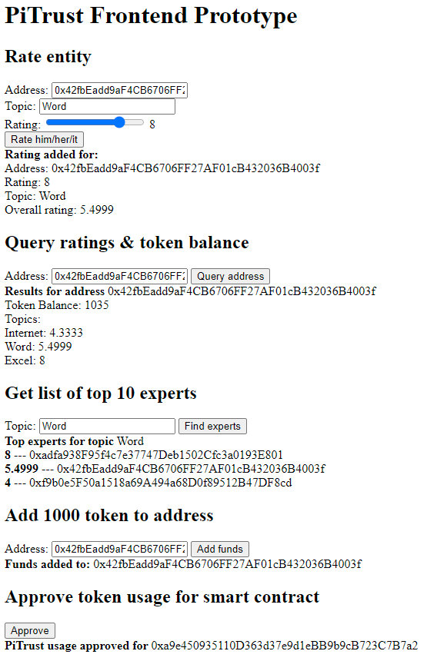
System Description – Frontend (2)
Frontend was tested purely local, but will be provided on a publicly accessible webserver for the live demo
Consists of 5 actions:
Rate an entity/person (i.e. a wallet address)
Query ratings & balance of one address
Get a list of experts for a given topic
Add 1000 token to an address (admin only)
Approve token usage (prerequisite for any action)

Slide 12
Preparation for Live Demo (1) - Prerequisites
Browser capable to use Metamask extension (Chrome, Brave, Firefox, Edge)
Mobile browsers & other Web3 wallets (e.g. Wallet Connect) shall also work but are not covered by the project’s scope
Installation of Metamask extension
Configuration of Metamask for Polygon Mumbai testnet
Import of (test-)wallet

Slide 13
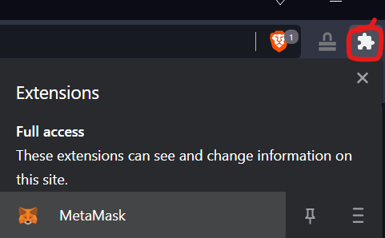
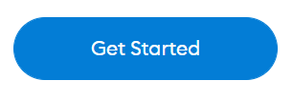
Preparation for Live Demo (1) – Metamask installation
Go to https://metamask.io/download/
Click on “Install Metamask for <your browser>
Install from the Chrome (or other browser’s) web store
After installation, you will find the MetaMask icon (a fox) after clicking on the puzzle tile in the upper right corner
After clicking on the Metamask symbol click on

Slide 14
Preparation for Live Demo (2) – Metamask configuration
Click on “Create a wallet”
Then “I agree”
Chose a password you like and accept the terms of use
Click on “Next” and “Remind me later”
You won’t use the wallet you created at all, but Metamask does not allow to start with importing a private key, which we will use (next slide)

Slide 15
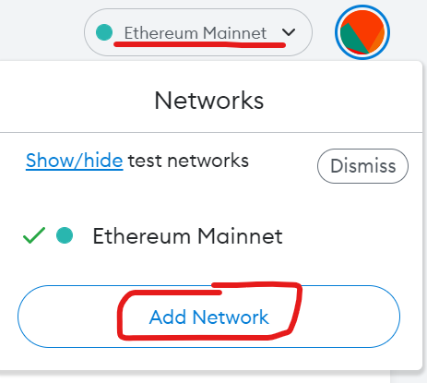
Preparation for Live Demo (3) – Adding Polygon Testnet
Next, we will add the Polygon (Mumbai) testnet to Metamask (which is by default only configured for Ethereum Mainnet)
Click on “Ethereum Mainnet” at the top of the Metamask site, then on “Add Network”
Enter following network data:
Network Name: Polygon Testnet (does not matter)
New RPC URL: https://rpc-mumbai.maticvigil.com
Chain ID: 80001
Currency symbol: MATIC
Block explorer URL: https://polygonscan.com/

Slide 16
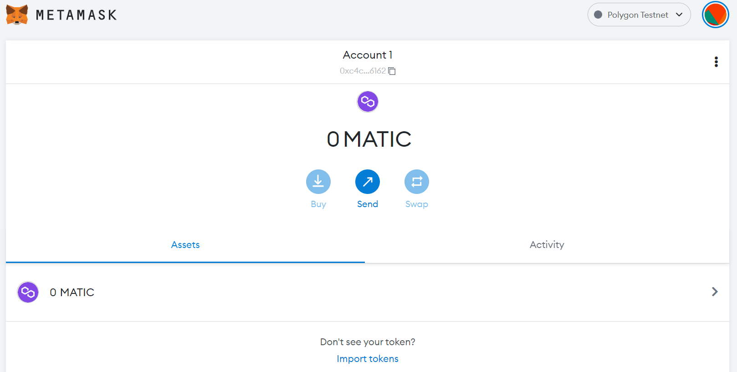
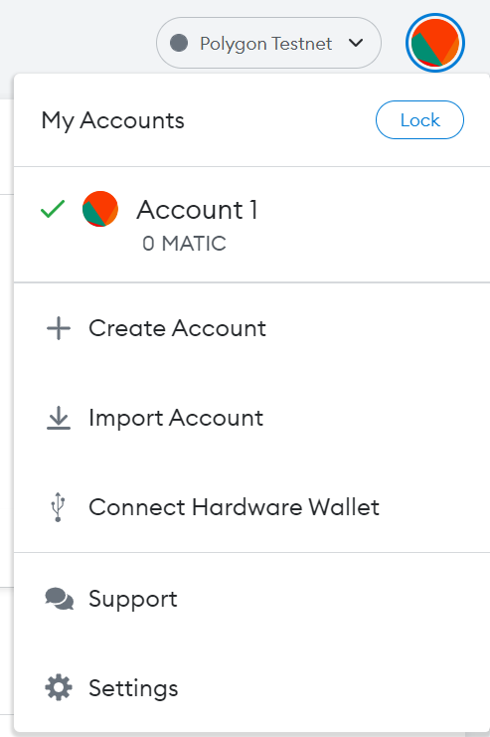
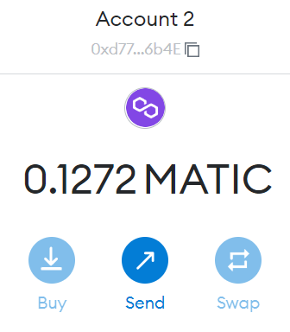
Preparation for Live Demo (4) – Adding Test account
The screen shall now look like this:
Next, we will add a “public” test account to Metamask.
Click on the colorful “ball” in the top-right corner (colors may differ from the screenshot)
Then click on “Import Account”
Enter the (not-so-) private key string: 7790309415a34c7019b60fa9cb4e03e027acb6174067b8901cf7e144f54612f1
And click on “Import”
Now you shall see a (small) amount of MATIC available

Slide 17
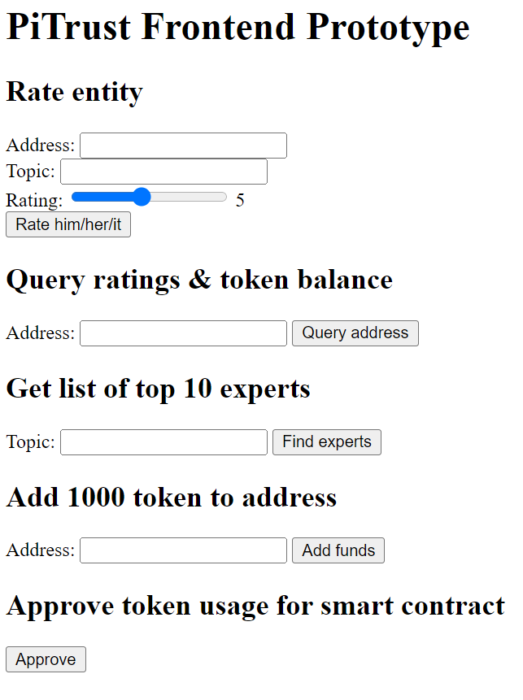
Live Demo
After setting up Metamask, you are ready to interact with the smart contract
Call http://pitrust.pidabbelju.de
No need to “approve” token usage (was already done by me)
Adding tokens to addresses will not work (admin only), but if you need some for additional addresses please just drop a message in the Ed Discussion forum

Slide 18
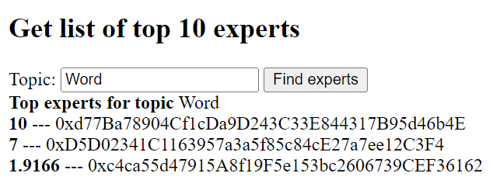
Live Demo
You can create ratings for arbitrary Polygon addresses and topics
Some exemplary addresses: 0xc4ca55d47915A8f19F5e153bc2606739CEF36162 (your wallet) 0xd77Ba78904Cf1cDa9D243C33E844317B95d46b4E (admin wallet) 0xD5D02341C1163957a3a5f85c84cE27a7ee12C3F4 (contract address)
You can search for already rated addresse, for example the above-mentioned ones or any other
You can search for “experts”; at the time of writing, only the topic “Word” was used

Slide 19

Thanks for clicking through this presentation!
Any comments, questions, recommendations and discussions are heavily appreciated!
Please just post in the dedicated Ed discussion thread – or via mail at
pwissmann3@gatech.edu

