Slide 1

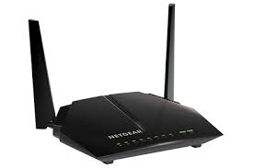

MO-MQTT MTSMS(AerFrame)
MT-SMS(AerPort)
MO-MQTT
SS7
SMS
AAA
Device
IoT Cloud
Project # 3
Aeris’ backend
GCP
MT-SMS Reg connect
*Gammu <AT>a
Paho
AerFrame R.O.
AerPort
Pub: T6MO Sub: T6MT
GCP API
Aercloud
Display
Event data
MQTT
Report Activity: SS7;AAA
Appl
MQTT broker
Pub/Sub
Appl
Raspbian
modem
Agosta
RMQ
Appl
Echo back
wifi
Paho
Android
MM/DK
NI
NI
DH/WH

