Slide 1
Freedom and the Feminist Challenge Day 3
Module 2, Feminism and Freedom
Tshisimani Centre for Activist Education

Slide 2
Freedom – the power of an idea
The idea of freedom has played a big role in the history of political thought and struggle.
In the name of ‘freedom’ struggles for social change have been waged
Across different political traditions, there is no agreement on what freedom means.

Slide 3
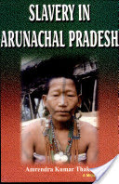
“The history of freedom is really a history of contests over its constructions and exclusions”
AK Thakur

Slide 4
There is also fierce contestation on ‘who’ should be free and how freedom comes about.
The boundaries of freedom are always shifting.
Bernard Gallie’s (1955) speaks about “essentially contested concepts”. Freedom qualifies as one.
There have been times when freedom was synonymous with calls for formal legal and political equality, while at other times freedom had economic, social and personal dimensions.

Slide 5
What exactly is freedom? What does it mean to be free?
Throughout history, there are big contestations about what freedom means
Our starting point is to look at 4 conceptions of freedom that are tied to 4 moments and struggles in history AND the big questions that each conception brings to the fore

Slide 6
Conception 1: Political Rights and Equality
Freedom as the end of the absolute rule of the monarchy and the rise of individualism
Freedom from overbearing and arbitrary power of the state/church/king
Freedom for individuals to own property and to enter into contracts with other individuals in society
Freedom to choose a government through regulations elections
Equal rights and an end of privileges linked to the “accident of birth”
An end to absolute arbitrary power
Freedom as synonymous with calls for formal legal and political equality

Slide 7
Conception 2: Freedom as emancipation from slavery (the case of Saint Domingue Haiti)
The campaign to abolish slavery led to fierce debates about what freedom would look like for those who were forced into chattel slavery
Was freedom about a formal end to slavery and allowing the former slaves to be free to enter into employment contracts as waged workers?
Was freedom about a complete separation between the slaves and labour regime of the plantation?
What would freedom mean in the absence of land (property) ownership? Could the slaves be free when they were still suffered economic dependence on the former slave masters/ planter class?
What about self-ownership or “property in one’s self” and self-sufficiency?
What about other rights of citizenship like voting and equality before the law regardless of race?

Slide 8
Conception 3: Social and economic Freedom
Freedom is not possible for so long as society is organized around private property ownership, which allows for the exercise of excessive and unaccountable power by capitalist.
In a society organized around the market and around the idea of competition, our ability to fulfil our needs and desires is tempered with.
The majority’s ability to realise their dreams and desires is severely constrained by the coercive power of capital.
‘Social freedom’ can only be won with the total abolishment of private ownership of property and the establishment of a system of interdependent cooperation, cooperative production, and communal ownership and deliberation.

Slide 9
Conception 4: Freedom as Independence (post WWII)
Freedom became closely associated with the idea of forming sovereign nation states.
In this framework, decolonisation had the following dimensions:
It would provide freedom from foreign rule and domination
It would create space for colonised people to chart their futures – self determination
Independence would provide space to advance radical social and economic programmes which in some cases included socialism.

Slide 10
What these conceptions of freedom tell us
The major contestations in society – who is free and who is not? What is the marker of unfreedom? In what ways do people feel unfree?
Conceptions of freedom tell us about social relations and the structure of society. What is the source of wealth and how is wealth distributed?
Who are the contending forces in society? Who is the oppressor? Who is the oppressed? What is the social condition that they are struggling against?
Views on the state
Views on property
Views on social relations
Conceptions of freedom are also forms of social critique

Slide 11
What these conceptions of freedom tell us
Definitions and meanings of freedom do not develop in a vacuum
They are part of the contestations that take place between different groups in society
In some meanings, there is a yearning to recover a lost past, to restore what has been lost or taken away and to make claims about the future
In the process of challenging their subjugation, oppressed people have played a key role in our understanding of freedom.

Slide 12
They have borrowed what they deemed useful from different political traditions and from those who already enjoyed freedom.
Ideas about freedom travel. They get taken up, refined, made specific and relevant to the social condition and order that the oppressed people seek to overturn
Ideas about freedom are indigenised and are fused with already existing ideas
Victory of freedom in one place can raise questions about freedoms of others
Freedom is a constant struggle!

Slide 13
What does Feminism say about these conceptions of freedom?
Feminists look at these conceptions of freedom and make several claims which all start with the question: What about gender? What about women?
“Feminists[…]have argued that “freedom” is defined within dominant discourses specifically for heterosexual white men of economic privilege. They seek an extension and even a refiguring of the concept [of freedom] to apply to their experiences of exclusion and oppression” (Brown 1995; Cohen 1995; Mills 1997; Hirschmann 2003).

Slide 14
Feminist Challenge to dominant conceptions of freedom?
How some of these conceptions of freedom ignored women’s oppression and treated this oppression as natural and as something that cannot be changed
How these visions of freedom ignored women altogether – the subject of freedom as a masculine, economically privileged, white and heterosexual figure
How those fighting for freedom from foreign (colonial) domination and freedom from the institution of slavery ignored women’s experiences of these social realities
Women’s oppression treated as less important to oppression on the basis of race and class exploitation
These dominant conceptions of freedom miss the political nature of gender relations and how gender relations are about power relations

Slide 15
Feminist visions of freedom
Feminism is not just a response to the blind-spots in the dominant conceptions of freedom
It is also about making a case for new visions of freedom
These new visions are about understanding the source of women’s oppression (unfreedom) and what it will take to change this
Looking at women’s everyday experiences as political experiences not just personal issues
Challenging the separation between the private and public sphere, the personal and political
Understanding how reproductive labour is a source of women’s unfreedom
How women’s freedom will not fall from the sky or be won only after capitalism and colonialism have been toppled
Feminist conceptions of freedom have covered issues as varied as sexual freedom and pleasure, bodily integrity, autonomy and reproductive freedom, freedom from fear and harassment, economic freedom, social freedom.

Slide 16
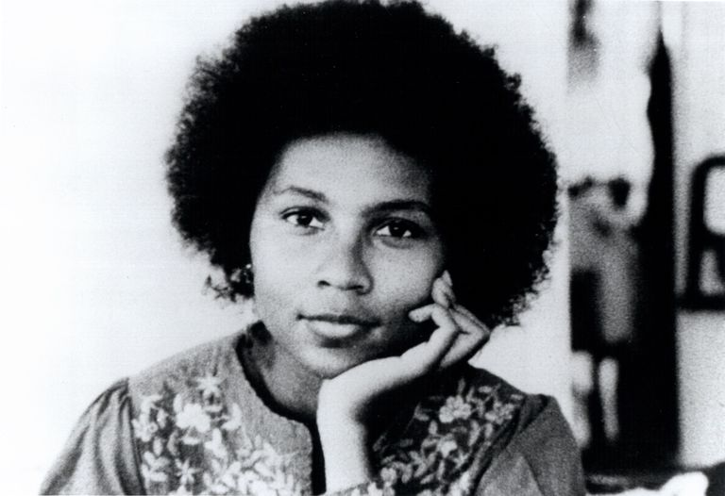
“Visionary feminism is a wise and loving politics. It is rooted in the love of male and female being, refusing to privilege one over the other. The soul of feminist politics is the commitment to ending patriarchal domination of women and men, girls and boys. Love cannot exist in any relationship that is based on domination and coercion. Males cannot love themselves in patriarchal culture if their very self-definition relies on submission to patriarchal rules. When men embrace feminist thinking and practice, which emphasises the value of mutual growth and self-actualisation in all relationships, their emotional well-being will be enhanced. A genuine feminist politics always brings us from bondage to freedom, from lovelessness to loving”.
– bell hooks

