Slide 1
WHY QUEER THEORY
How Queer Theory expands feminist conceptions of Freedom

Slide 2
THE PHOBIAS!!
Homophobia:
An intolerance and discrimination against persons who are homosexual
Transphobia
An intolerance and discrimination against persons who do not relate to gender in a way society and power structure dictates
Bonus section:
Heterosexism
A way of navigating the world to the exclusion of queer individuals which assumes being straight is the norm and everything else is not the norm. It also operates on boxes of identity – assuming queer looks a particular way

Slide 3
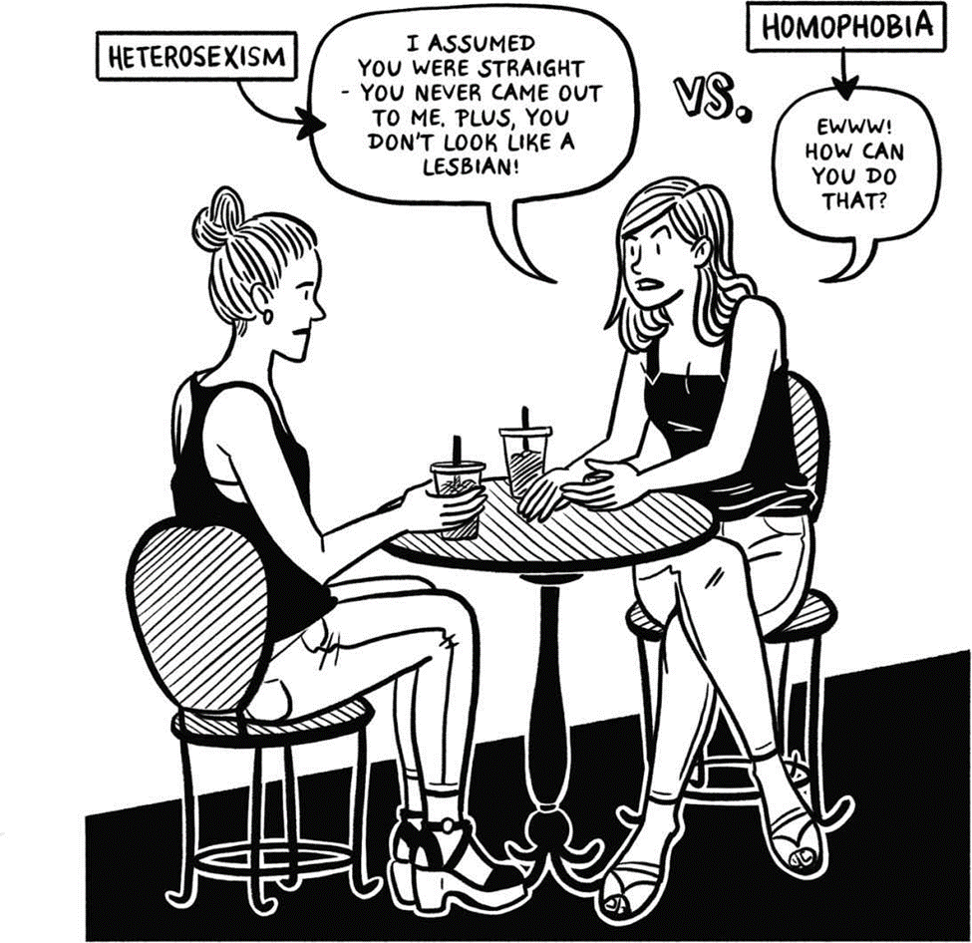

Slide 4
What is the LGBTQIA+?
L - Lesbian, a cis-woman attracted to other women
G – Gay, a cis-man attracted to other men
B – Bisexual, someone who is attracted to both men and women (contested)
T – Transgender, someone who identifies with a different gender to their biological sex
Q – Queer, an umbrella term for those who practice sex and gender differently to the performative norm.
I – Intersex, someone born with two or more biological sexes (around 3% of the human population is born intersex, as many as there are red headed persons)
A – Asexual, someone who has no sexual attraction to any persons

Slide 5
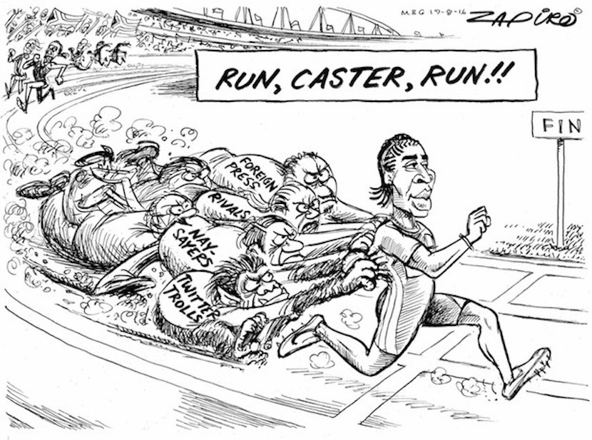

Slide 6
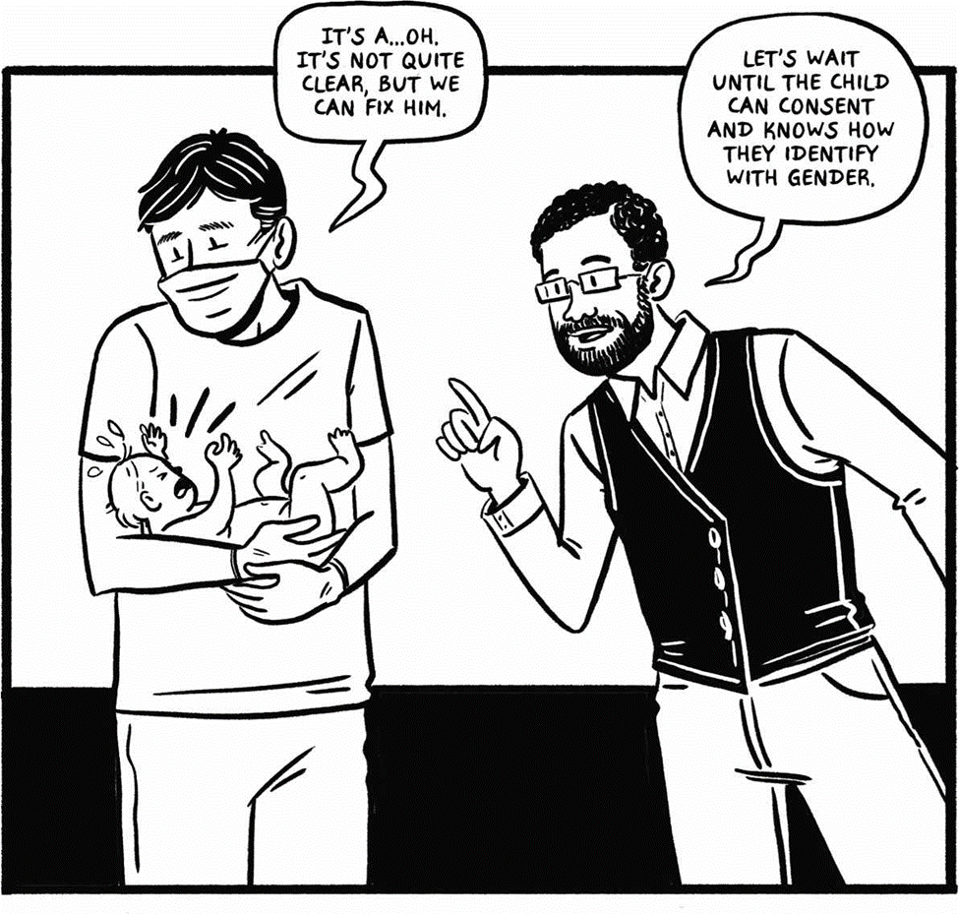

Slide 7
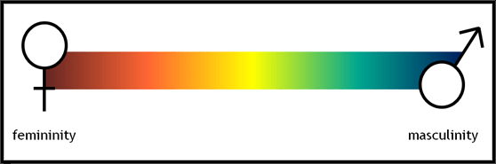
Gender as a spectrum
Queer theory is able to expand on feminist conceptions of freedom by complicating and deepening conceptions around gender and freedom.
By understanding the complexities of gender we are able to develop theories of freedom which are more inclusive and breaks the gender binary.

Slide 8
Gender Trouble
What is a cis-person?
Person who identifies with the same gender as their biological sex assigned by medical professionals and institutions from birth.
‘Cis’ means same. ‘Trans’ means across.
Where as cis refers to people whose gender is the same as their assigned biological sex, trans refers to people whose gender is different (or across) from their assigned biological sex.
BUT THEN WHAT IS GNC/GENDER NON-CONFORMING
Those whose gender expression does not conform to traditional gender identities or to the gender binary
WHAT ARE GENDER NON-BINARY PERSONS!
are persons who find no identity within binary gender boxes who exist outside the binary of traditional genders – not identifying as a man or woman.
There are also other gender expressions such as agender – who are without gender BUT this is why queer theory asserts that gender is a spectrum and should never be assumed!

Slide 9
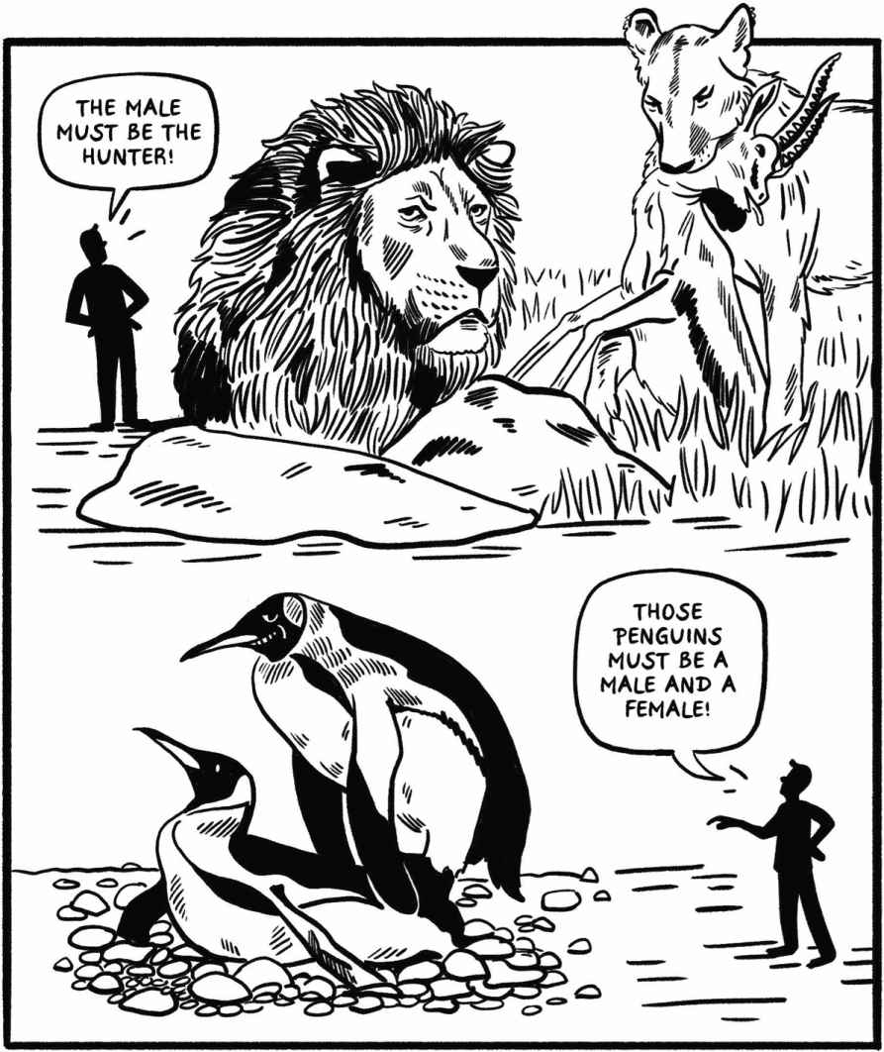

Slide 10
Breaking systems of cis-heteronormativity
Queer theory identifies patriarchy as a system of domination but expands this understanding by identifying cis-heteronormativity as equally oppressive and systemic.
Queer theory believes these systems limit access to freedoms and that as long as there is a normative vision of sex and gender society will be organized in an oppressive way.
Queer theory challenges feminist perspectives of freedom to expand on gender roles and sexuality to create a new understanding which envisions a more inclusive world.

Slide 11
CONSTRUCTED GENDER
Gender is believed to be constructed. This is what gender theory attempts to excavate.
From birth society decides what gender someone is and what sexuality they might assume.
Society and institutions also create gender roles which decide how one performs gender and the ways in which power relates to that gender
Queer theory sees this normative behaviour/structures as oppressive. As oppressive as patriarchy and complicit to patriarchy.
In order for patriarchy to exist, normative gender structures must be created

Slide 12
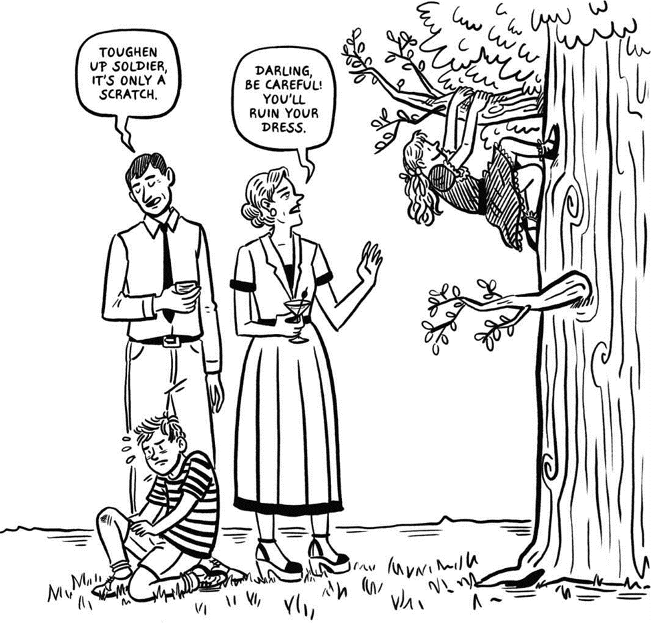

Slide 13
Normative sexualities
The basis of homophobia is that persons to not practice ‘normative’ sexuality.
Gayle Rubin believes that this is due to society not being sex positive.
This is a belief that people are not free to perform sexuality in their own way.

Slide 14
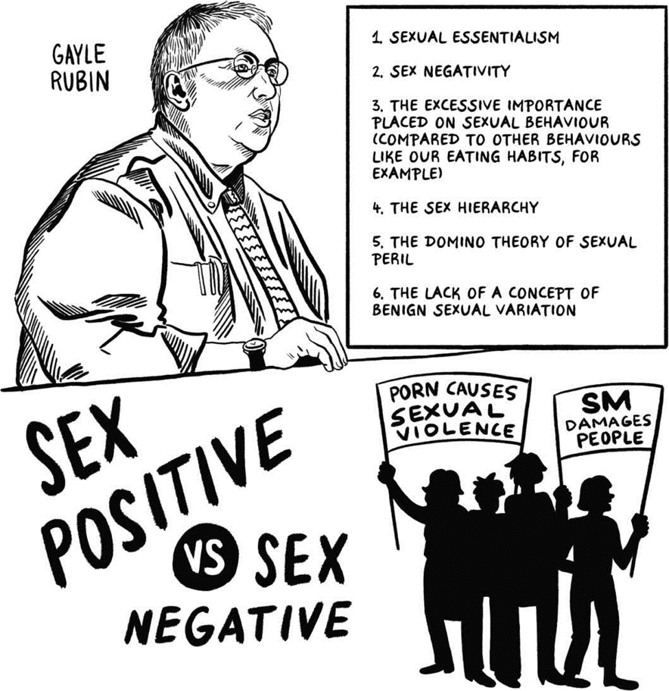

Slide 15
Post-structural /ridding of the boxes/static categories
Existential freedom – a freedom to exist outside of the categories build by society and not understood by society.
eg.Outside of a binary or identity.

Slide 16
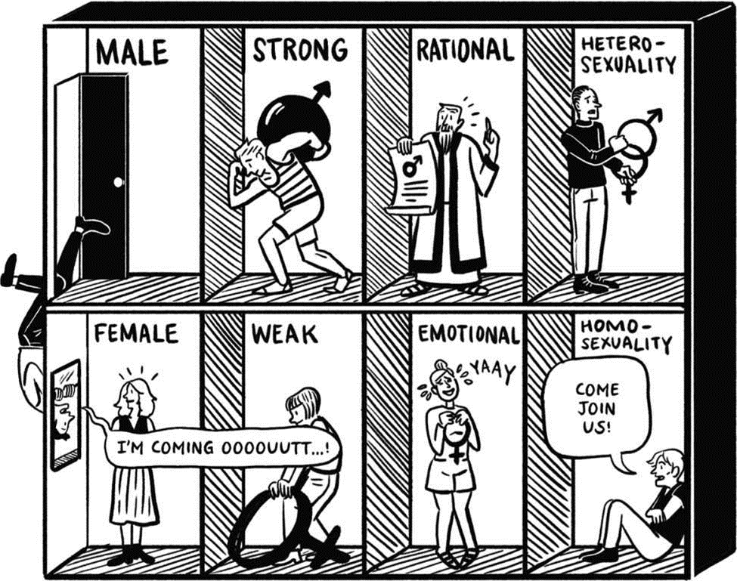

Slide 17
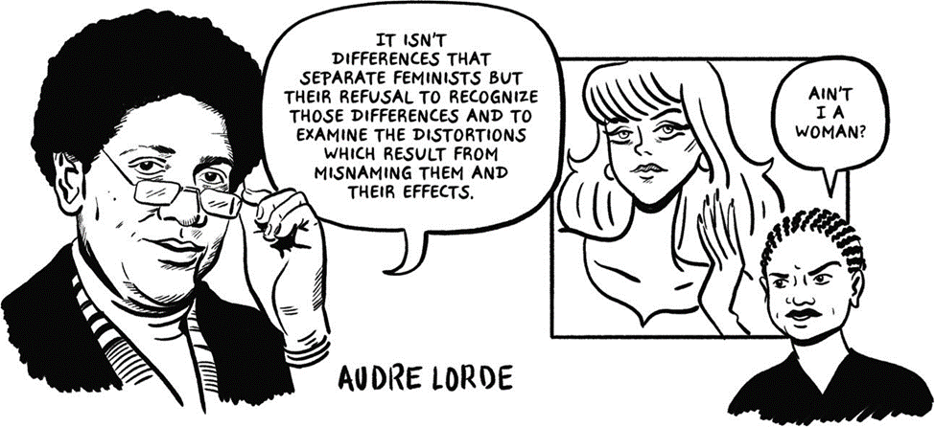

Slide 18
‘Women’ as an organizing category
Perhaps the biggest contestation of feminist conceptions of freedom is the idea that it excludes queer identities and exclusively organizes around ‘women’ as understood in the gender binary identity.
Queer theory expands on feminist conceptions of organizing by imploring it to be more inclusive of not only those who identify as queer but also those whose bodies are outside of what is considered normative.
This is not unlike the lens offered to us by intersectionality – an inclusive way of organizing which considers that some experience intersections of oppression
This is a contested viewpoint however.

Slide 19
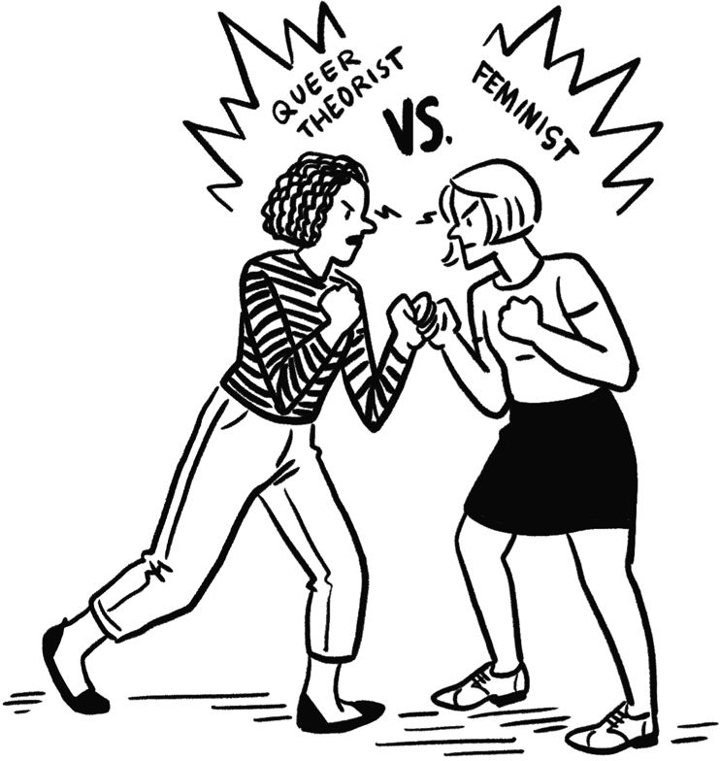

Slide 20
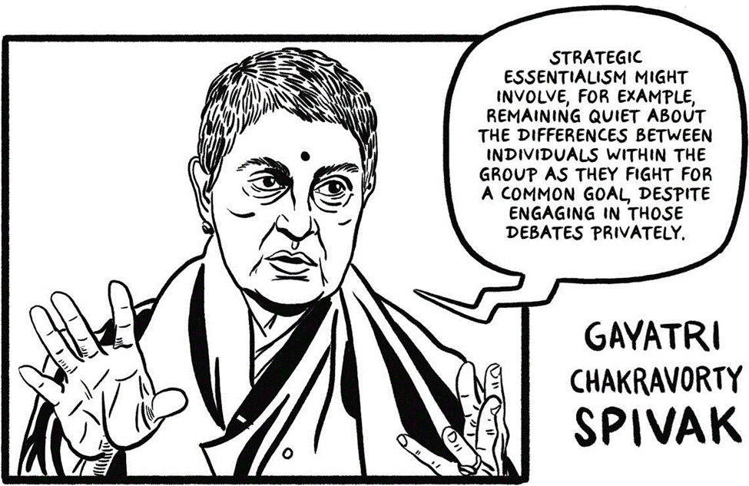

Slide 21
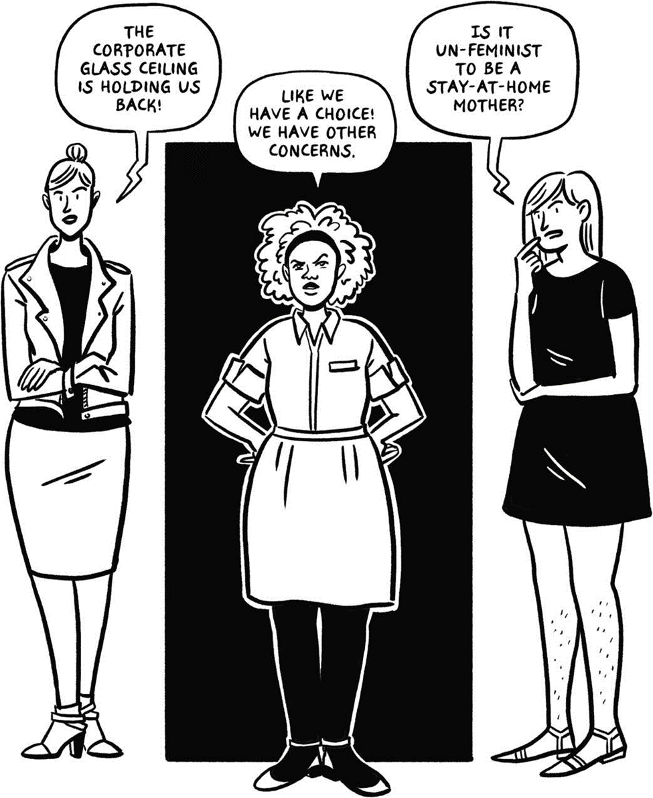
Feminism as exclusionary
Sara Ahmed notes, “The idealization of movement, or transformation of movement into a fetish, depends on the exclusion of other who are already positioned as not free in the same way.”
This reflects on how the women’s movement through the centring and fetishizing of women excludes oppressions of gender/race and ability

Slide 22
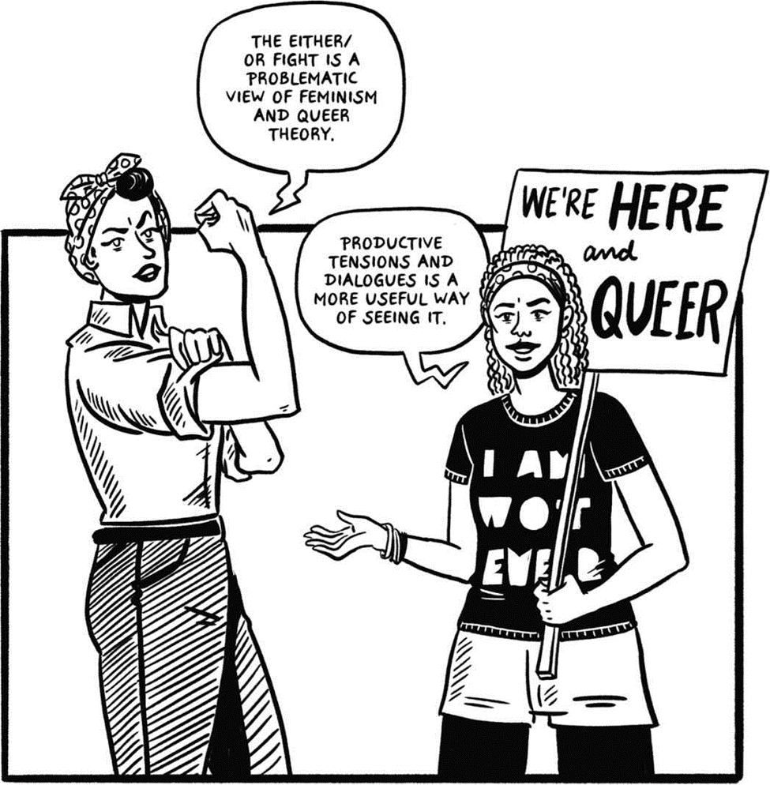

Slide 23
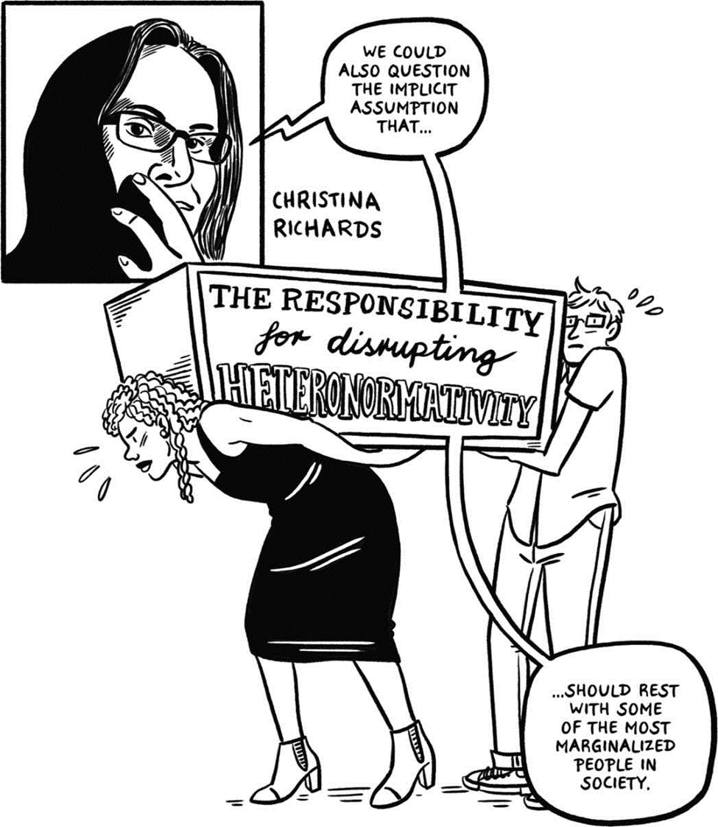

Slide 24
3 ways queer theory expands feminist conceptions of freedom
It asks to break the gender binary
It seeks to disrupt systems of heteronormativity
It questions woman as an organizing strategy

Slide 25
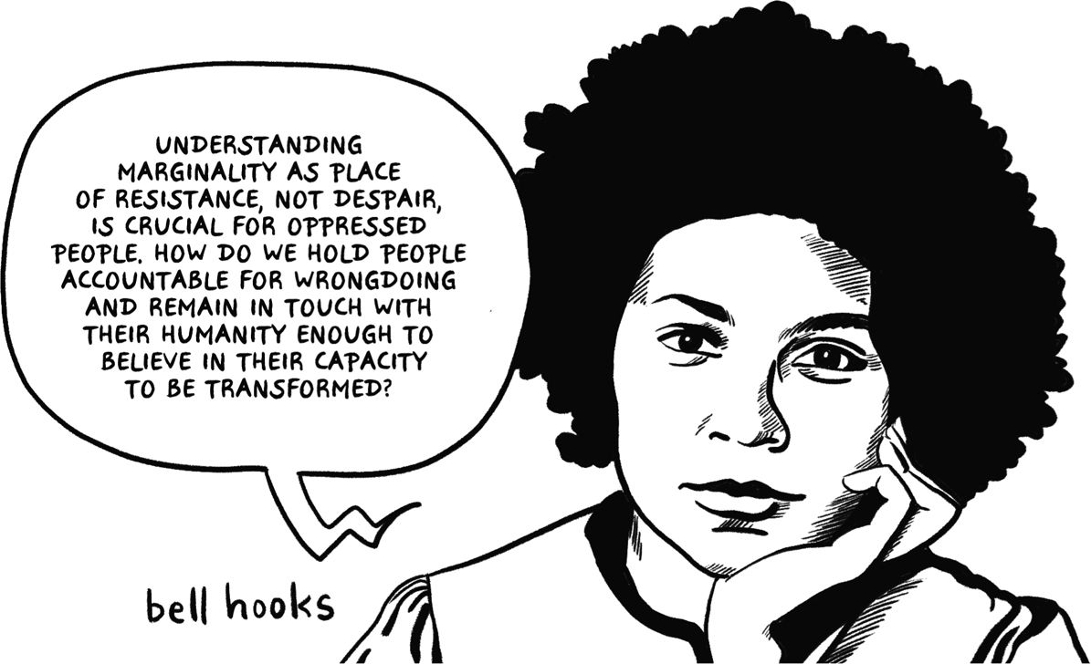

Slide 26
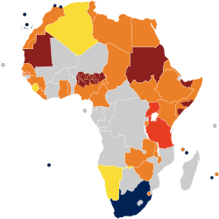
Today in some African countries – but also globally – anti-LGBT laws are being repealed.
These laws are seen as remnants of the colonial era. As colonial governments worked to exclude LGBT persons and criminalize LGBT lifestyles.
This is evident in contexts such as Botswana, Namibia and Uganda.
In historical studies – it has been revealed that in the native African past many genders existed and gender was dictated by a binary.
It is beneficial to the colonial, imperial and capitalist society to exclude queer persons and limit gender identity

Slide 27
But what is the legal framework today?
https://en.wikipedia.org/wiki/Recognition_of_same-sex_unions_in_Africa

Slide 28
