Slide 1
Introduction Day 1
Module 2, Feminism and Freedom
Tshisimani Centre for Activist Education

Slide 2
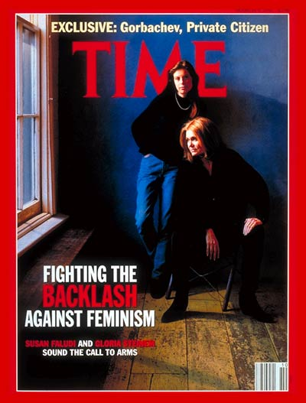
Backlash – undeclared war on women
“a counterassault on women’s rights…an attempt to retract the handful of small and hard-won victories that the feminist movement did manage to achieve for women”
Susan Faludi, 1991

Slide 3
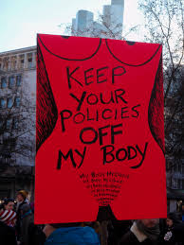
Attack on Sexual and Reproductive Rights
Georgia, US bans abortion after 6 weeks of pregnancy (“the heartbeat bill”)

Slide 4
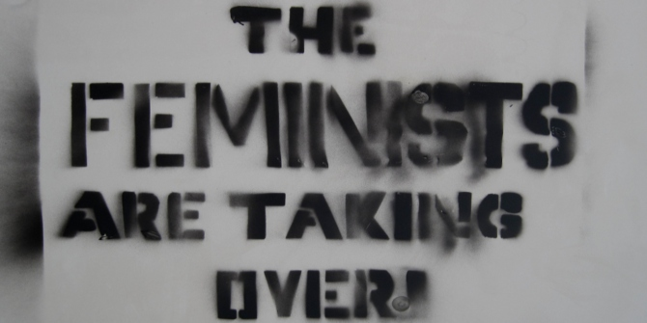
Bolsonaro moves to delete all references to feminism, homosexuality, and violence against women from the nation’s school textbooks.

Slide 5
Signs of the backlash
Erosion of sexual and reproductive rights
Re-asserting ‘family values’, natural order – with men as superior and women and inferior
Appeal to traditional gender roles
Policy pronouncements and legislation
Dismissing concerns about gendered violence

Slide 6
A gendered expression of authoritarianism / the “strong men era” (Time Magazine)
Politics of fear, regressive nostalgia and exclusion (“us and them”)
Use of the internet as a tool to censor, silence and surveil
Use of democratic instruments as ticket to power followed by an attack on these instruments
Growing insecurity fueled by the years of economic policies that called for budget cuts for social services

Slide 7
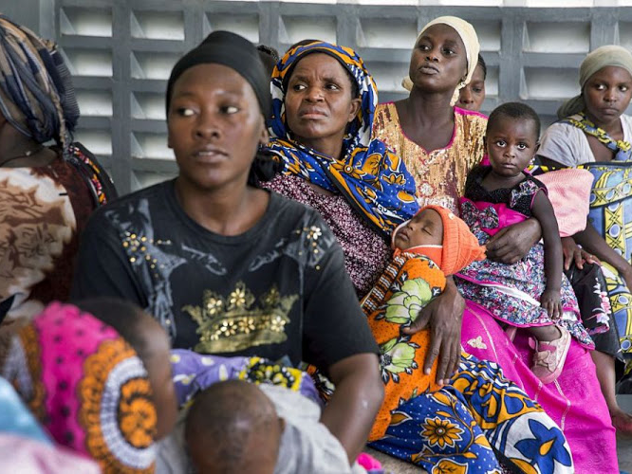
Kenya bans Marie Stopes clinics
Kenya bans Marie Stopes clinic from offering post abortion services
Abortion is illegal in Kenya
7 women die everyday from ‘botched’ abortions

Slide 8
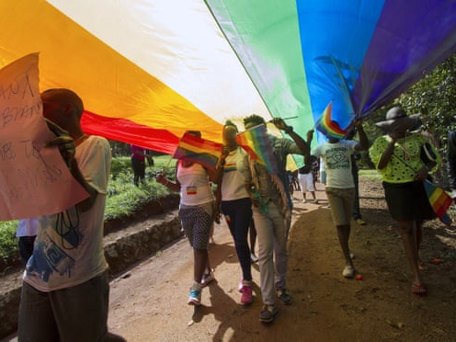
Uganda bans Pride marches
Homosexuality is illegal in Uganda under colonial-era laws, punishable by a jail sentence

Slide 9
Backlash or push for a breakthrough
Caution against the reference to the ‘backlash’ in general terms
Some of the freedoms that are being eroded in places like US are still to be won elsewhere
Status of women & LGBTIQ reflect realities of living and struggling in ‘partial democracies’

Slide 10
Areas of agreement
There is a big challenge to freedom in the world today
There is a need to resist erosions to freedom
Fight against the deliberate shrinking of spaces for freedom
Strengthen the efforts of those who are struggling for a breakthrough under authoritarian regimes

Slide 11

What emancipatory ideas are at our disposal as we fight for freedom?

Slide 12
Three questions
How does feminism help us to defend freedom?
How does feminism help us to expand notions and understandings of freedom?
In what ways does feminism give us insights that are neglected in other political traditions?

