Slide 1
Septa Notifier
Peter Gagliardi
LeoNARD Chan
Karishma Changlani

Slide 2
Problem
Buses are never on time.
Who wants to waste time waiting (especially in the cold/rain)?

Slide 3
What Septa Notifier Does
For a given bus route, stop ID, and direction (e.g. ‘eastbound’), calculates when the next bus should arrive.
Notifies the user when the optimal time to leave for the bus stop arrives.

Slide 4
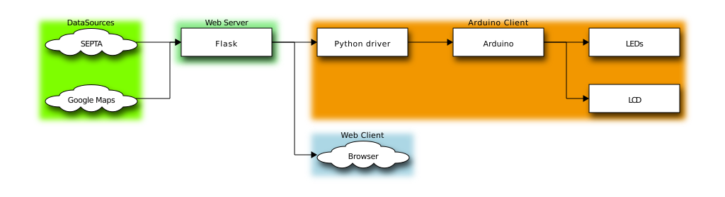
Overview
Diagram made with blockdiag

Slide 5
Workflow
Planned out project in three sections: (Data aggregation, Map web page, Arduino Client)
Each team member worked on a separate part of the project
After each part was complete, we integrated all parts together into a Flask server + clients

Slide 6
Challenges
Challenge
How it was solved
Predicting true location of bus
Integrating components together
Used Google Maps Traffic API + SEPTA API to determine avg. velocity of bus
Defined JSON and serial message formats first before beginning development.

Slide 7
Challenges (Cont.)
Challenges
How we solved them
Getting Google Maps to display
Avoiding Google Maps Query Rate Limits
Fixed the width and height in CSS stylesheet
Caching data, limiting polling rate in both clients

Slide 8
Future Features
Add more features to the Arduino Client
Add buttons for user input
Animate the LCD display
Android App
Improving accuracy of bus location estimations
GUI improvements in the map web app
Deploy Flask application to a virtual machine

Slide 9
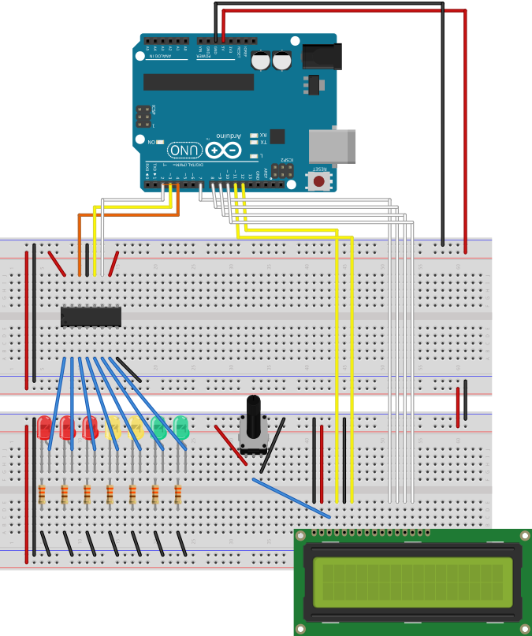
Arduino Circuit
LEDs count down to the optimal time to leave
LCD displays messages including estimated time of arrival (ETA)
Diagram made with Fritzing

Slide 10
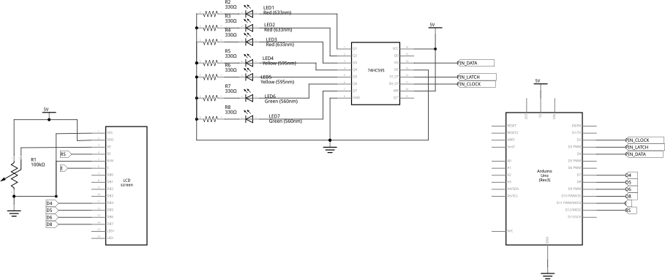
Arduino Schematics
Diagram made with Fritzing

Slide 11
Schematics (Cont.)
Diagram made with Fritzing

