Slide 1
OCR Applied to Handwritten Notes
Leonard Chan

Slide 2
Introduction
Implement an optical character recognizer (OCR) trained from an individual's handwriting.
Use this OCR is to extract words from an image with text to create keywords for that image.
Use these keywords to make the individual’s notes searchable by a search engine or database.

Slide 3
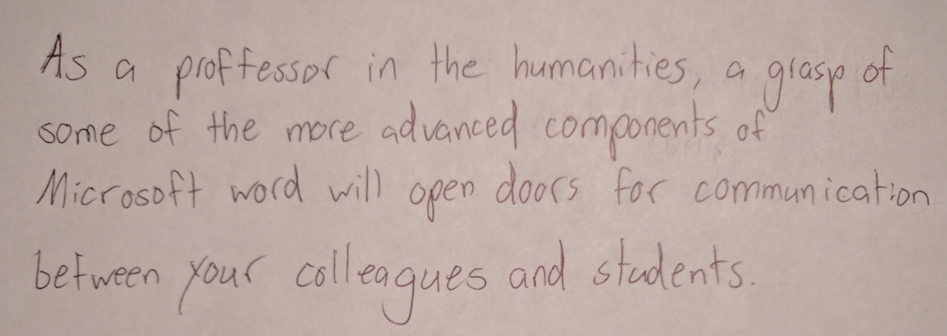
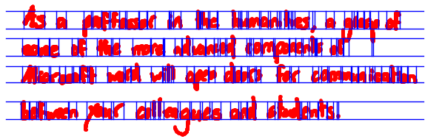
Implementation
Breaking up text in an image

Slide 4
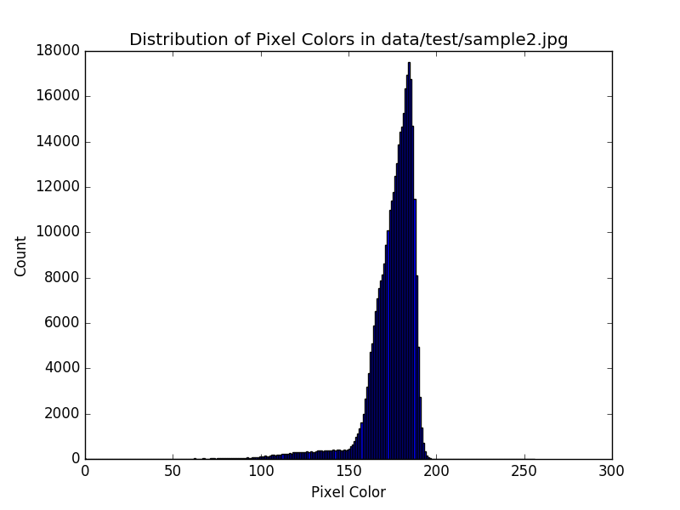
Implementation
Get overall background pixel color

Slide 5
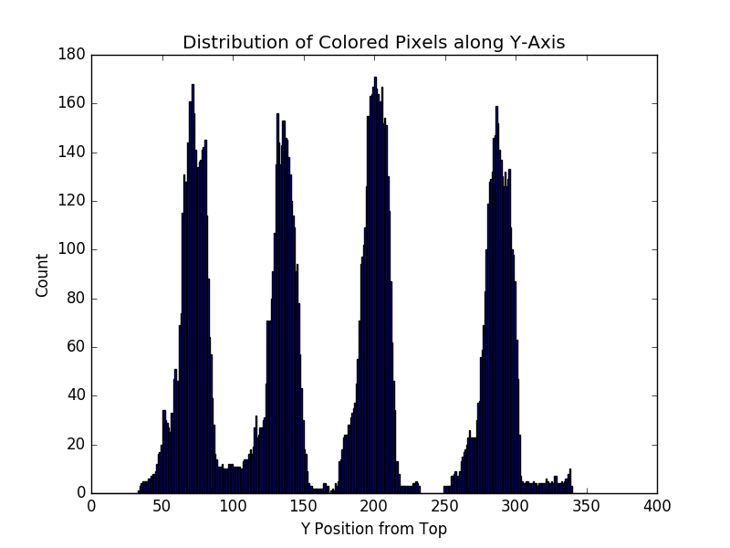
Implementation
Project image onto Y-axis to find lines

Slide 6
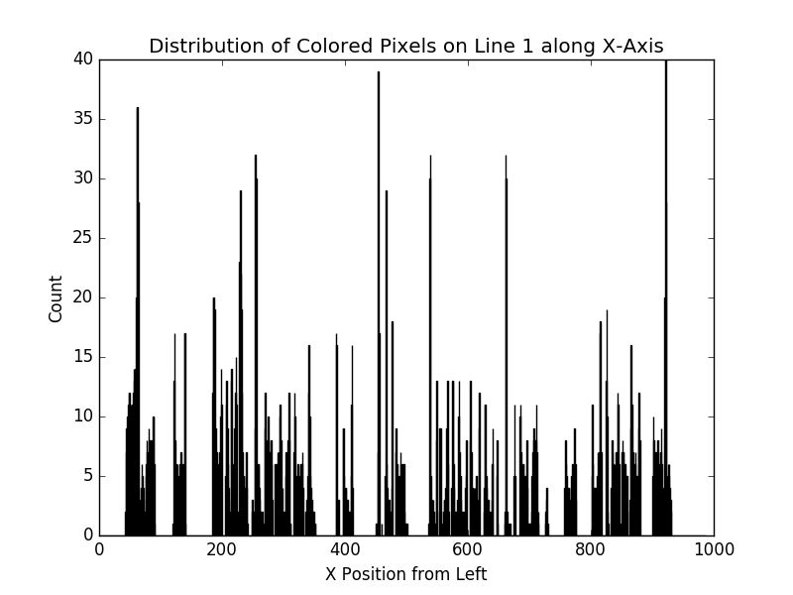
Implementation
Project each line onto X-axis to find characters

Slide 7
Implementation
Classifying character in each region
62 characters
Scaled down to 20x20 image
Aspect ratio of character is maintained
Classifiers
K Nearest Neighbors
Multilayer Perceptron
Trained from different types of data sets
Handwritten English Characters (pen/bold marker)
Typed Characters
MNIST Digits

Slide 8
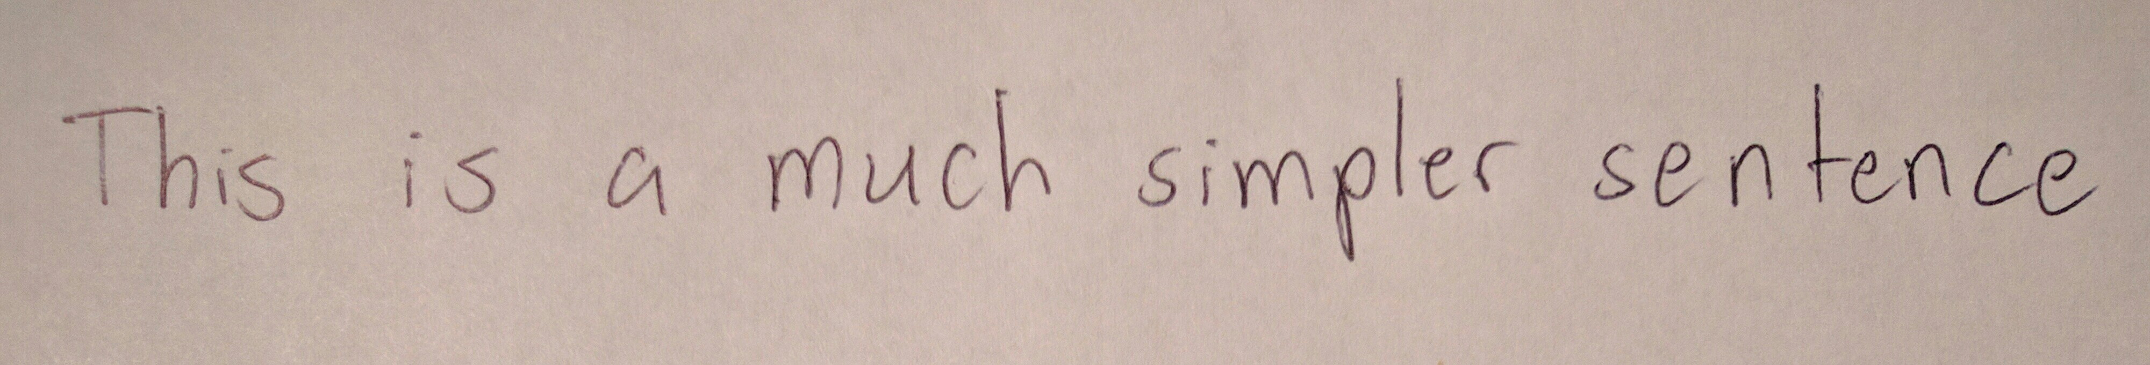

Results
Did not get expected output
“6hhVL tS L mUYh kYttrYYr 6b h qYhcY” – KNN
“iYYij jY N CjYj iYjV1Y1L 1j Y YYLG1” – MLP

Slide 9
Conclusions
Better sample data
Better features
Only the individual gray scale pixel values are used as features
Alternative features that should be experimented with include
Number of edges on each character (Hough Line Transform)
Number of circles on each character (Hough Circle Transform)
Projecting each character onto the x and y axis and using the distributions along each axis as features
Smarter character region finding in an image

Slide 10
Code
https://github.com/PiJoules/ocr-project
https://pypi.python.org/pypi/ocr-testbed

