Slide 1

2-3 Trees
A 2-3 tree
Has 2-nodes and 3-nodes
A 2-node
A node with one data item and two children
A 3-node
A node with two data items and three children
Is not a binary tree
Is never taller than a minimum-height binary tree
A 2-3 tree with n nodes never has height greater than
⎡log₂(n + 1)⎤
© 2004 Pearson Addison-Wesley. All rights reserved
13 A-<number>

Slide 2
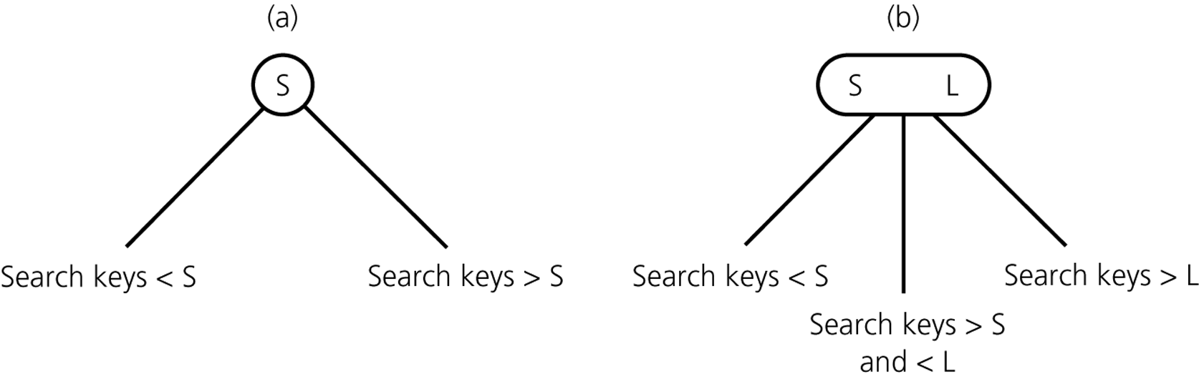
2-3 Trees
Figure 13.3
Nodes in a 2-3 tree a) a 2-node; b) a 3-node
© 2004 Pearson Addison-Wesley. All rights reserved
13 A-<number>

Slide 3
2-3 Trees
Advantage of a 2-3 tree over a balanced binary search tree
Maintaining the balance of a binary search tree is difficult
Maintaining the balance of a 2-3 tree is relatively easy
© 2004 Pearson Addison-Wesley. All rights reserved
13 A-<number>

Slide 4
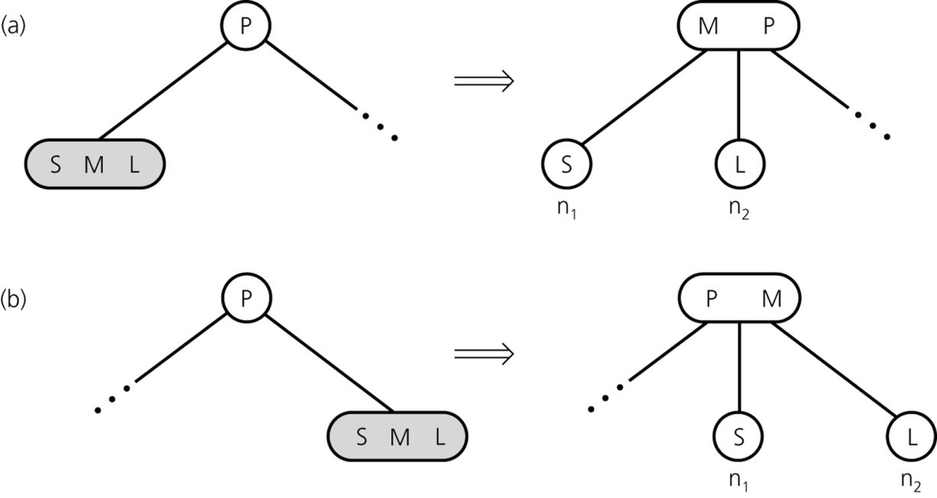
2-3 Trees: The Insertion Algorithm
To insert an item I into a 2-3 tree
Locate the leaf at which the search for I would terminate
Insert the new item I into the leaf
If the leaf now contains only two items, you are done
If the leaf now contains three items, split the leaf into two nodes, n₁ and n₂
Figure 13.12
Splitting a leaf in a 2-3 tree
© 2004 Pearson Addison-Wesley. All rights reserved
13 A-<number>

Slide 5
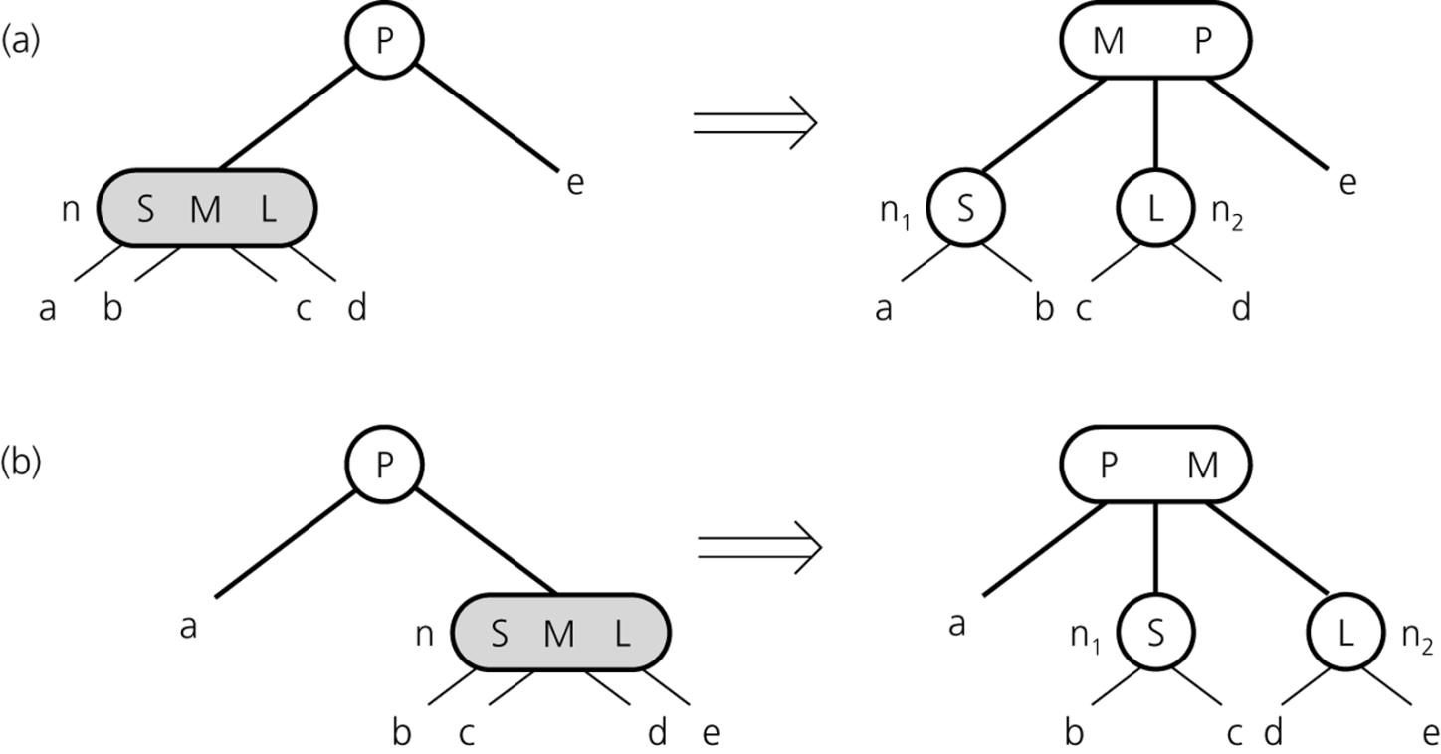
2-3 Trees: The Insertion Algorithm
When an internal node contains three items
Split the node into two nodes
Accommodate the node’s children
Figure 13.13
Splitting an internal node in a 2-3 tree
© 2004 Pearson Addison-Wesley. All rights reserved
13 A-<number>

Slide 6
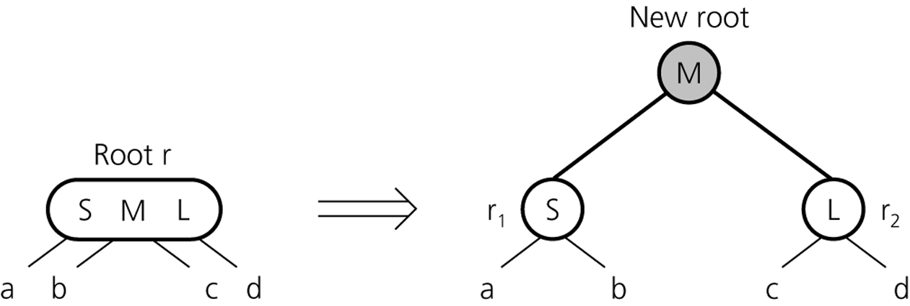
2-3 Trees: The Insertion Algorithm
When the root contains three items
Split the root into two nodes
Create a new root node
Figure 13.14
Splitting the root of a 2-3 tree
© 2004 Pearson Addison-Wesley. All rights reserved
13 A-<number>

Slide 7
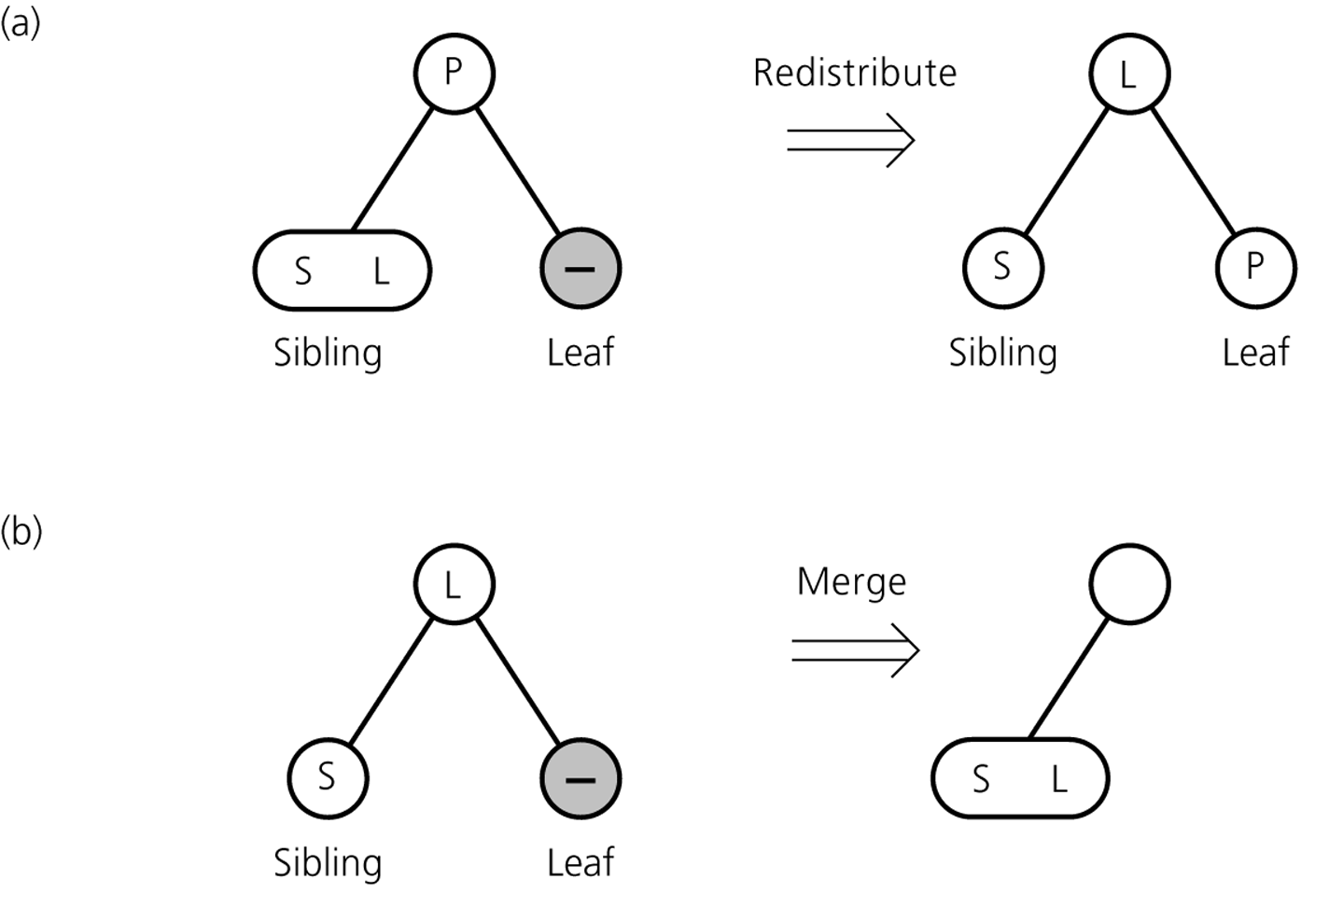
2-3 Trees: The Deletion Algorithm
Figure 13.19a and 13.19b
a) Redistributing values; b) merging a leaf
© 2004 Pearson Addison-Wesley. All rights reserved
13 A-<number>

Slide 8
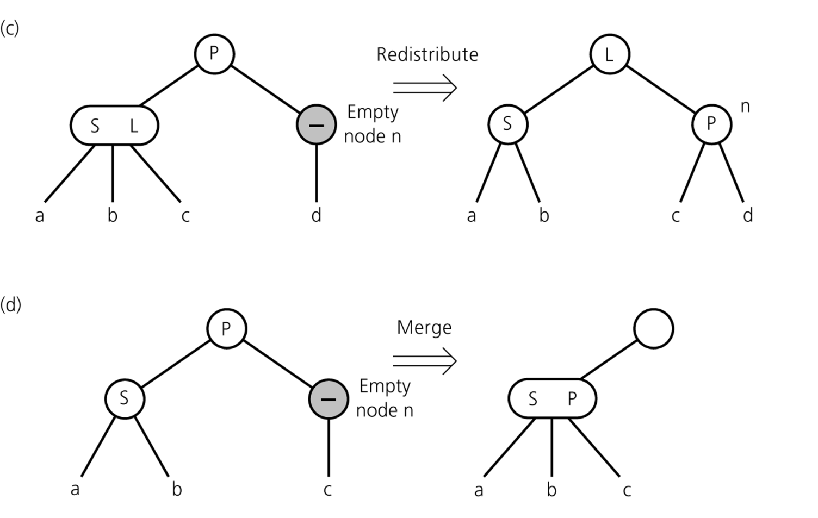
2-3 Trees: The Deletion Algorithm
Figure 13.19c and 13.19d
c) redistributing values and children; d) merging internal nodes
© 2004 Pearson Addison-Wesley. All rights reserved
13 A-<number>

Slide 9
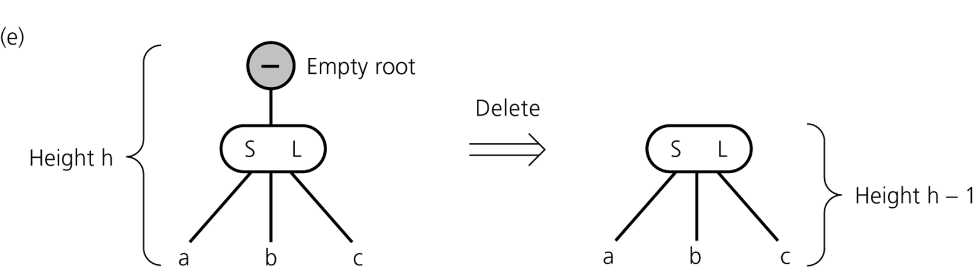
2-3 Trees: The Deletion Algorithm
Figure 13.19e
e) deleting the root
© 2004 Pearson Addison-Wesley. All rights reserved
13 A-<number>

Slide 10
2-3 Trees – Concluding Remarks
Easy-to-maintain balance
A 2-3 implementation of a table is O(log₂n) for all table operations
A 2-3 tree is a compromise
Searching a 2-3 tree is not quite as efficient as searching a binary search tree of minimum height
A 2-3 tree is relatively simple to maintain
© 2004 Pearson Addison-Wesley. All rights reserved
13 A-<number>

