Slide 1
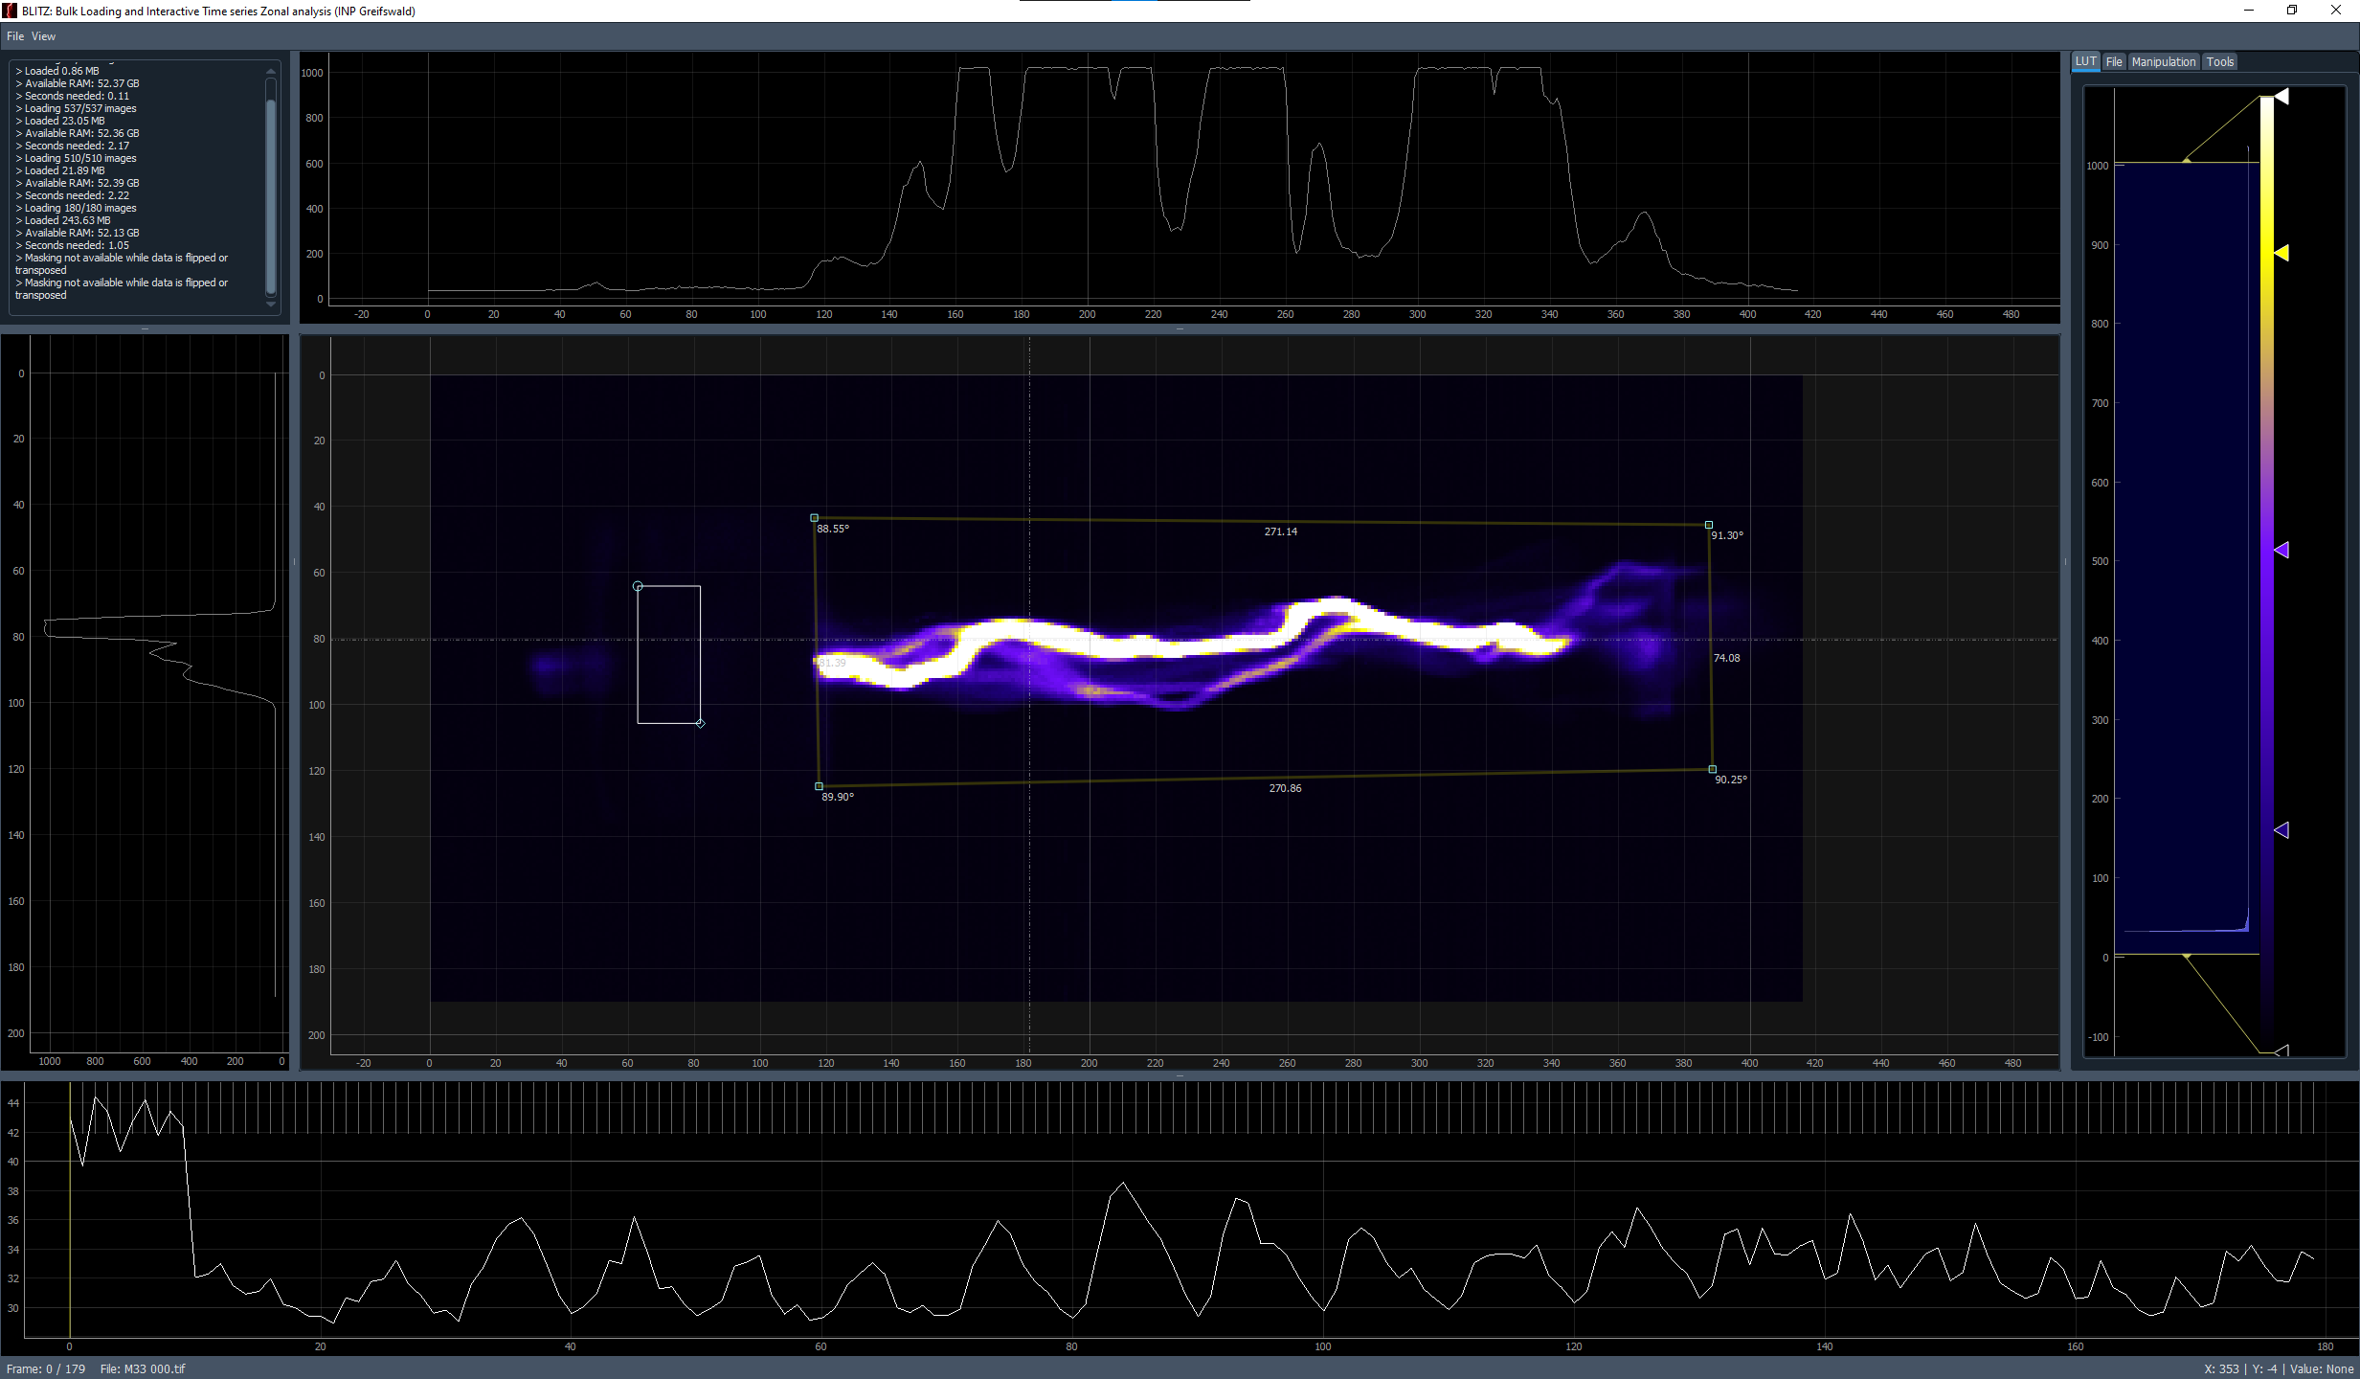
Log
Intensity Profile H
LUT +
Options
Image Viewer
Zonal Intensity
Integration over time
Intensity Profile V
Length / Angle
Measurement
Timeline
Fileinfo
Cursor info

Slide 2
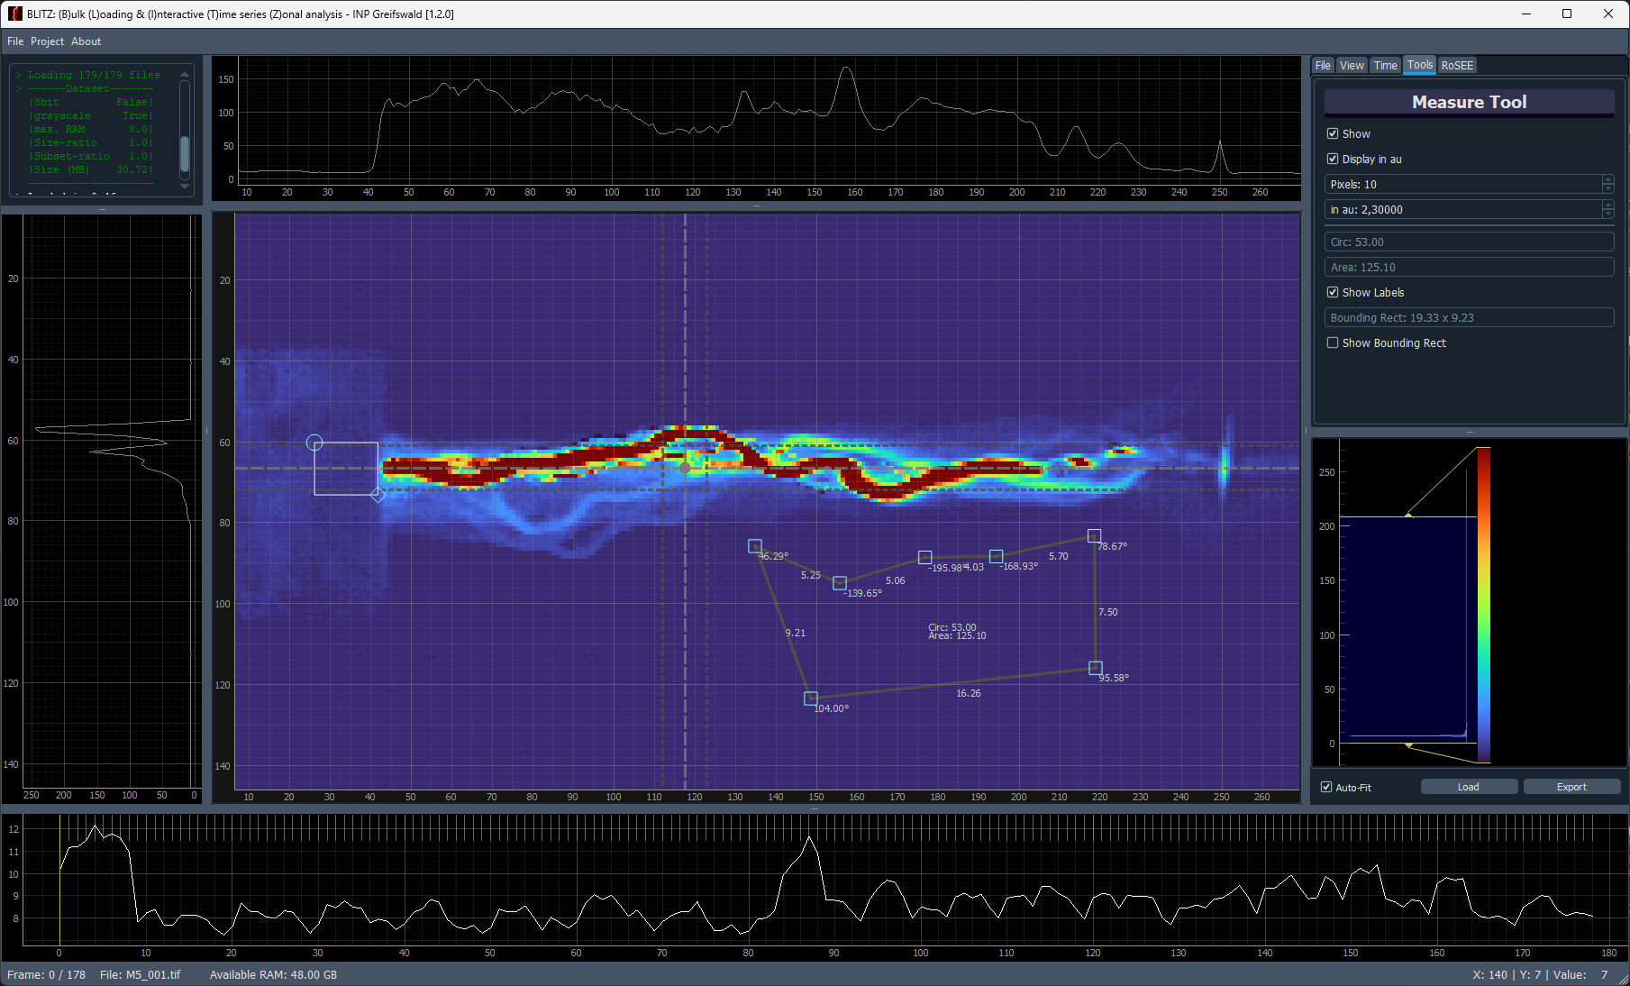
Log
Horz. Intensity Profile
Options
Vert. Intensity
Profile
Image Viewer
LUT
ROI Measurements
Zonal Intensity
over time
Timeline
Fileinfo
Cursor info

