Slide 1
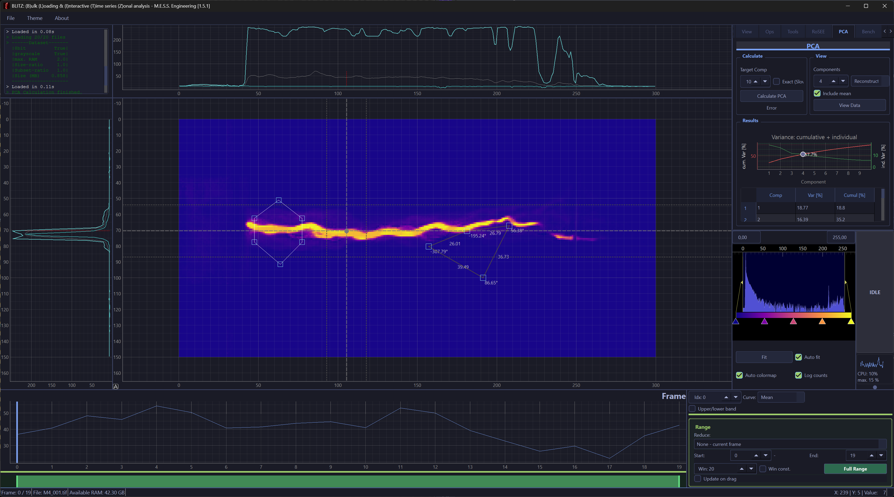
Image Operations
Intensity Profiles
Zonal Intensity
Measure
Timeline

