Slide 1

♠ ♥ ♦ ♣
PiNNTORP
PiNNTORP LLC
Eric Beaulne - Project Manager
Adrian Ahmadi - Front-End Lead
Nikola Grujin - Back-End Lead
Hayden Dunn - Quality Lead / Tech Manager
Lab 11 - Final Demo Presentation

Slide 2
Iteration 3 - What we did
Account Deletion
A new way to earn money in PiNNTORP
Full /api/user/delete endpoint which wipes user data, goes through all friend lists, and clears browser session tokens.
This is a new page that mimics the popular Cookie Clicker, where the users click on the coin and earn money by gambling. Users will not be able to do this once their money crosses $500 until they go below that amount.
Comprehensive Test Suite
Global Profit Leaderboard
30+ automated tests: 24 unit, 12 integration, 10 system scenarios.
GET /leaderboard API call now provides rankings for all users based on lifetime profits (even dummy users are listed to motivate real users). Leaderboard gets shown in the homepage in each refresh. Current user's position in the leaderboard is also shown depending on the user's lifetime profits.
UI Rework
Architecture & API Documentation
An entire rework to our base white UI from the previous iterations, giving the app a more "casino" feel by expanding the main panels.
ARCHITECTURE.md, API.md, JSDoc / JavaDoc comments added across all major modules for final quality.
QoL improvements
New quick access cells across the many pages to enhance existing and new user experiences.

Slide 3
Documentation & Deliverables
Developer Docs
User-Facing Docs
▸ JavaDoc - ConnectionHandler, AuthHelper, Server
▸ README.md - quick-start, prerequisites, Docker
▸ JSDoc - game.js, auth.js, friends.js, rec.js
▸ In-app game rules (tooltip per game panel)
▸ ARCHITECTURE.md - component diagram + data flow
▸ Different explanation cards on the various pages
▸ API.md - all REST endpoints with request / response
Project Write-ups
Iteration Artefacts
▸ ITERATION3_WRITEUP.md - architecture narrative
▸ Burndown charts (Iter 1, 2, 3)
▸ ITERATION3_CUSTOMER_MEETING.md - feature list,
▸ Task boards per iteration
▸ test plan & documentation commitments
▸ Retrospective & velocity write-ups
▸ All docs are committed to /docs/ in the repository
▸ UML class & sequence diagrams (Iter 1)
▸ WebSocket state chart (Iter 2)

Slide 4
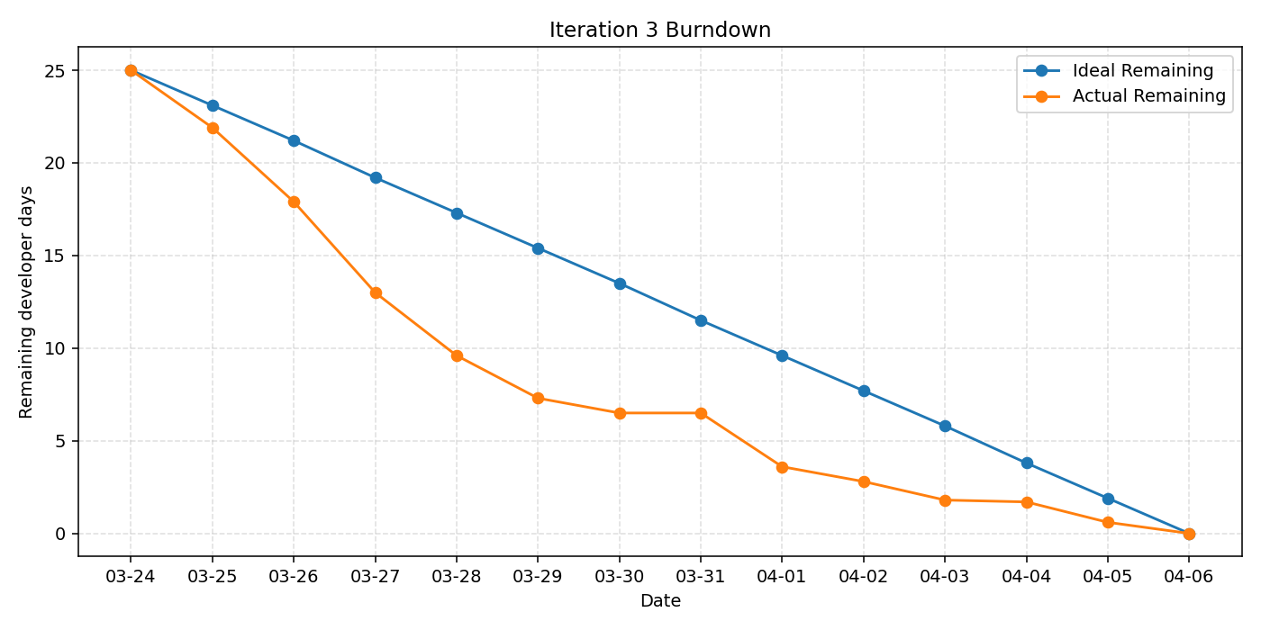
Iteration 3 - Burndown Chart
Key Observations
Ahead of schedule from Day 1
Getting the most important things out of the way first to finalize the project, minor UI polishes + global leaderboard + improvements to existing features + full test suite
Plateau on Days 6-7
Progress died down a lot during this time
The final push Days 8-13
Updated test suites + coin clicker + final UI polishes + QoL features + account deletion + document finalizations
0.0 remaining on Apr 6 - done!
All planned work completed
Final Velocity
25 dev-days completed (89% of capacity)
Iter 1: 26 | Iter 2: 28 | Iter 3: 25

Slide 5
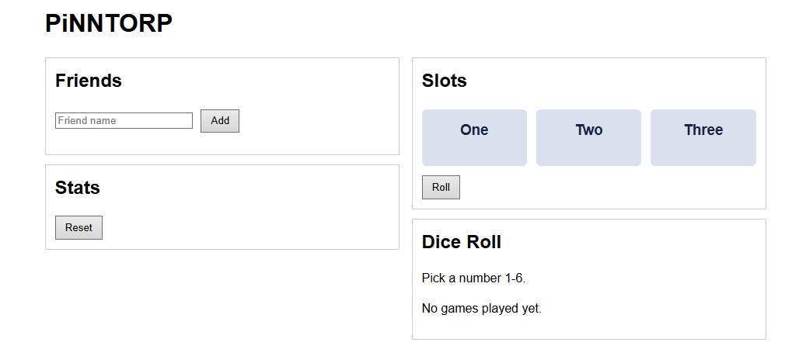
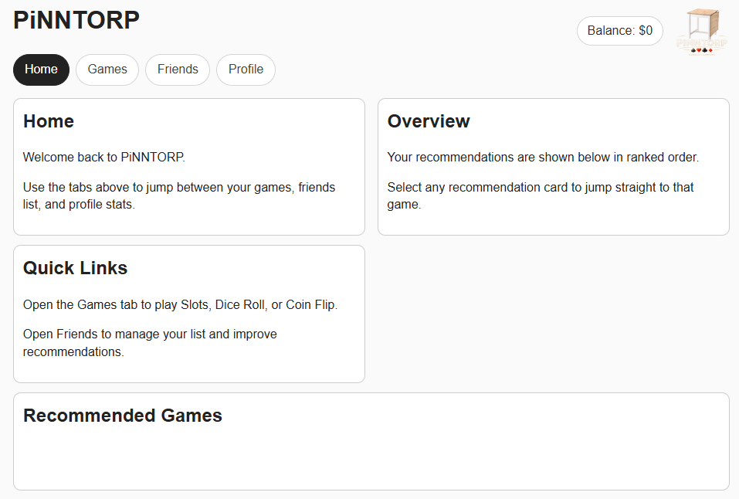
PiNNTORP - Across iterations
Iteration 1
Iteration 2
See the next slide
Iteration 3

Slide 6
Live Demo
Demonstrating our best features:
1
User Registration & Login
2
Playing the Games
New account creation with form validation
Slot Machine, Blackjack, Dice Roll, Coin Flip + Money earning system
3
Game History & Stats
4
Friends System
Profile page - win/loss ratio, total profit, game history
Sending a friend request, accepting it, and seeing both users connected
5
Personalised Recommendations
6
Global Leaderboard
Home page recommendations update based on friend play patterns and own history
Real-time profit ranking across all registered users on a persisting panel
7
Account Deletion
Complete wipe - user data, sessions, and removal from all friend lists

Slide 7
Testing Strategy
Clear Box (CB)
Translucent Box (TB)
Opaque Box (OB)
Full source access Automated unit tests Adrian (JS) & Nikola (Java) 24 tests
API known, internals hidden Integration-level tests Nikola & Eric 12 tests
Browser-only, no source End-to-end system scenarios Hayden & Eric 10 tests
Test Coverage Summary
Level
Count
Tool / Runner
Unit Tests
24
Node.js test runner / JUnit 5
Integration Tests
12
Node.js test runner / JUnit 5
System Tests
10
Manual

Slide 8
Interesting Bugs Found
Bug #1
Number Guesser game still appeared in recommendations even though it no longer existed
What happened: Initially, the name of the game was Number Guesser. It got renamed to Dice Roll. However, the old game remained under the dummy accounts favorite games list as Number Guesser. As a result, whenever the system analyzed the user's friends and tried recommending a game for them, the system would show "Number Guesser" in the recommended games list as well as the Dice Roll.
Fix: Creating a lookup table to translate old games into their modern names before making recommendations
Bug #2
You could bet more money than you had
What happened: In the game of Blackjack, there was no maximum value for the "+" button placed beside the betting amount. This allowed you to increase the bet beyond your account balance and make a bet that couldn't possibly be made. After applying the fix to this by setting a maximum value for the "+" button, it led to being stuck betting with the previous bet value if insufficient funds because both the "+" and "-" buttons were restricted.
Fix: Setting the maximum value of the "+" button to your account balance as well as automatically checking the bet value against the user balance after each game ended and updating the bet amount accordingly.
Bug #3
The startup script kept crashing on Windows due to its parser
What happened: There was an issue in the start-server.bat file that prevented the server from starting up. Initially, there was a statement that echoed a progress status message with the word "not" in it. This disrupted the batch parser in Windows and made it throw a syntax error instead of showing the useful status message. However, this problem was solved initially by eliminating that statement, but after putting the same statement in a different form that included an apostrophe, the same issue occurred again.
Fix: Removing keywords from the echo statements such as "not" and apostrophes, and avoiding those words entirely in future statements.

Slide 9
Project Retrospective
Cover 1 or more points each
What went well? What did you enjoy about the project?
What would you do differently knowing what you know now?
What is one lesson/takeaway you have learned from this project?

Slide 10
♠ ♥ ♦ ♣
Thank You
https://github.com/PiNNTORP-LLC/PiNNTORP
Hayden Dunn · Adrian Ahmadi · Nikola Grujin · Eric Beaulne
♠ ♥ ♦ ♣

