Slide 1
Phoebe the Python Quadcopter

Slide 2
Applications
Professional Video
  Countryfile
Big Boys' Toys
  Blooming Market
Research Projects

Slide 3
Demonstration
Keep you expectations low!
  3 seconds take-off
  3 seconds hover
  3 seconds descent
  autonomously
Stand well back and be ready to run

Slide 4
Hardware
Props, Motors, ESCs, Frame off the shelf
Raspberry Pi model A
Custom PiBow + breadboard
MPU6050 Sensor
Velco, Blu-tack, Double-sided sticky tape

Slide 5
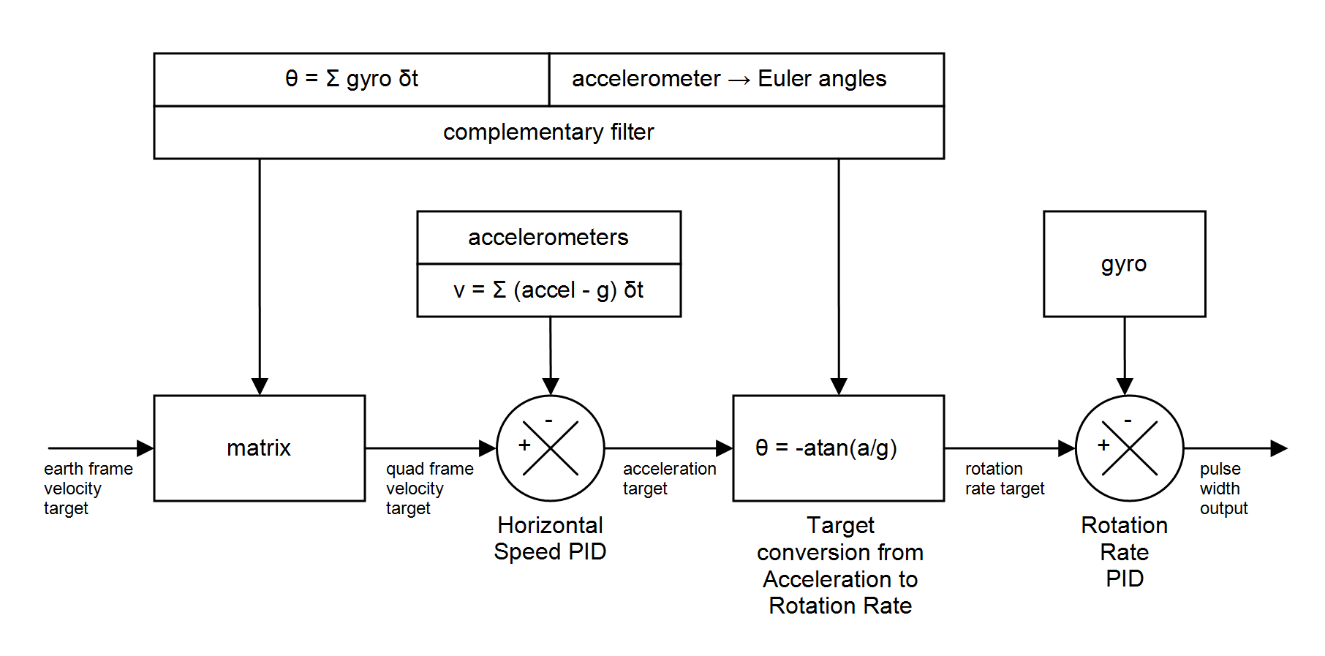
Software

Slide 6
Calibration
Improve sensor accuracy
Critical for velocity / gravity

Slide 7
Performance
Read sensors and integrate each loop
Process results and feed @ 41Hz
Performance 100Hz → 465Hz
  I2C bus speed to 400kHz
  MPU6050 data updates @ 1kHz
  time.time()
  GPIO interrupt
  I2C read 1 x 14 bytes not 14 x 1 byte
  GPU memory minimal
  Code locked into memory

Slide 8
What next?
Physical rebuild
  Frame
  Motors, props, ESCs
Sensors
  Barometer / Altimeter
  Magnetometer / Compass
  GPS
RaspiCam

Slide 9
Any questions?

