Slide 1

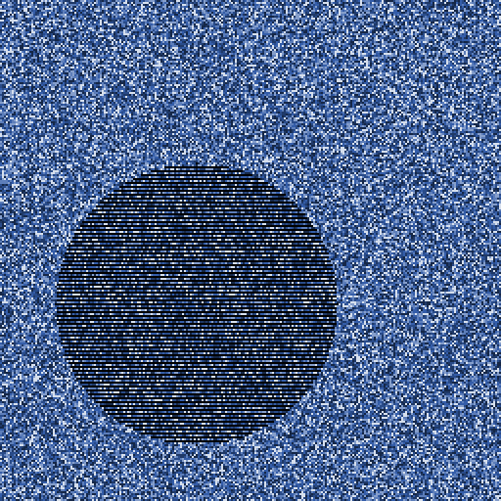
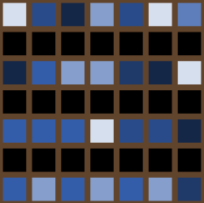
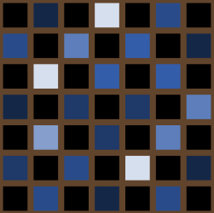
Are fragments stable in time?
Fragment
Lines
Checkerboard

Slide 2
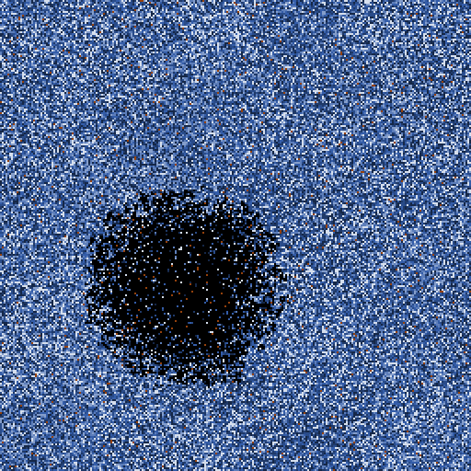
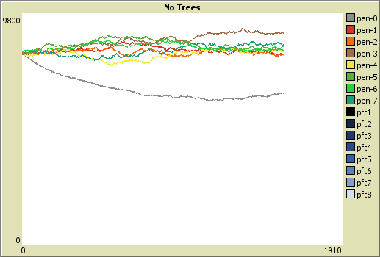
Are fragments stable in time?

Slide 3
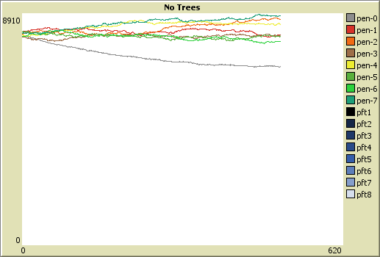
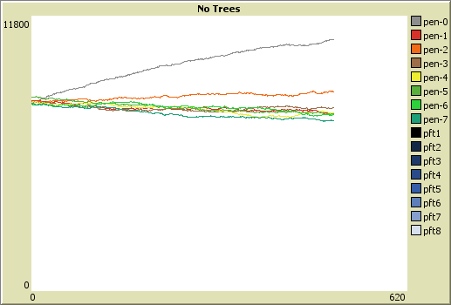
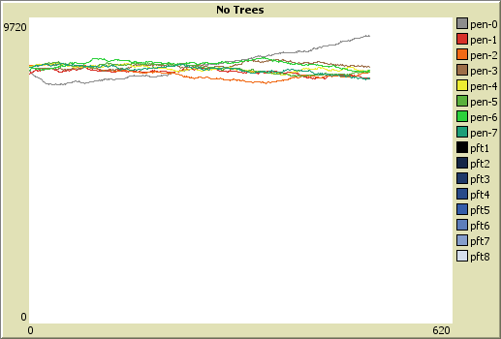

Slide 4
 | Self Replacement | Invasion
Fragment Center | 1.00 | 0.00
Fragment Edge - 1 neighbour | 0.41 | 0.41
Fragment Edge - 2 neighbours | 0.58 | 0.58
Lines | 0.58 | 0.58
Checkerboard | 0.00 | 0.74

Slide 5
Constructive arguments….
0.41

