Slide 1

Single Pulse Del IDS
Dados e Gráficos

Slide 2
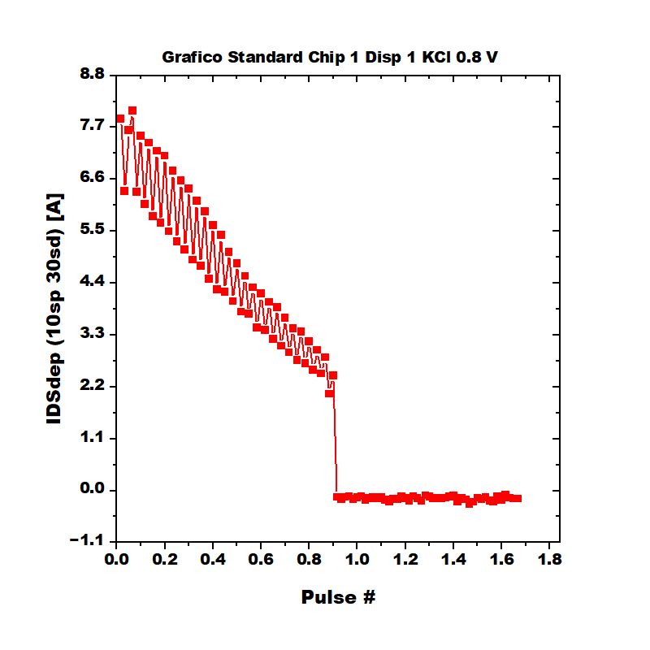
Stability Standard Chip 1 Disp 1 KCl 0.8 V.png

Slide 3
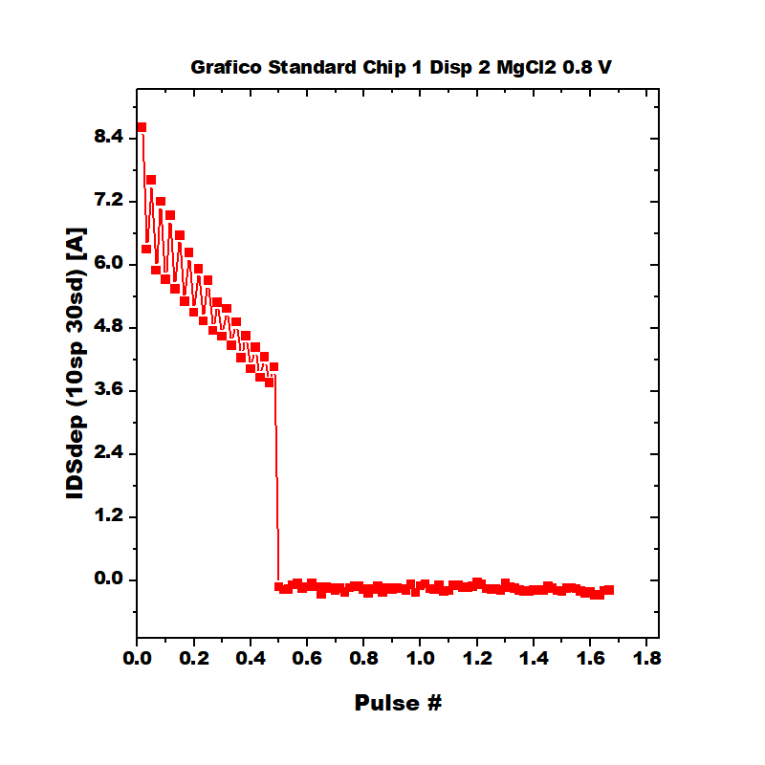
Stability Standard Chip 1 Disp 2 MgCl2 0.8 V.png

Slide 4
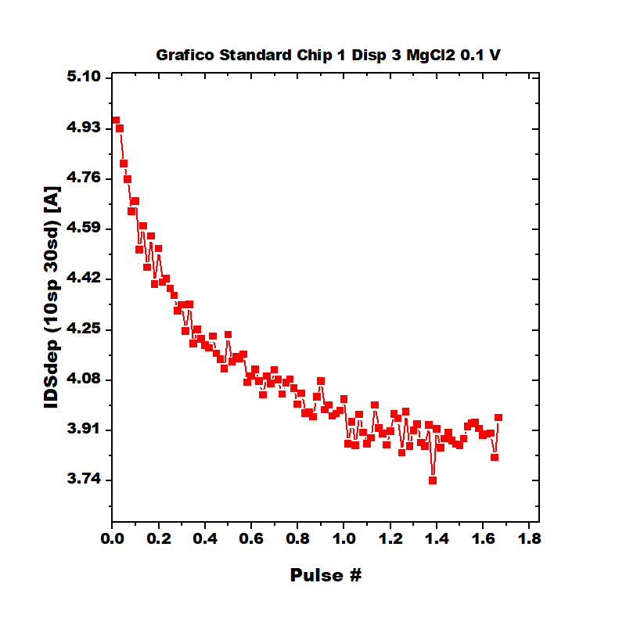
Stability Standard Chip 1 Disp 3 MgCl2 0.1 V.png

Slide 5
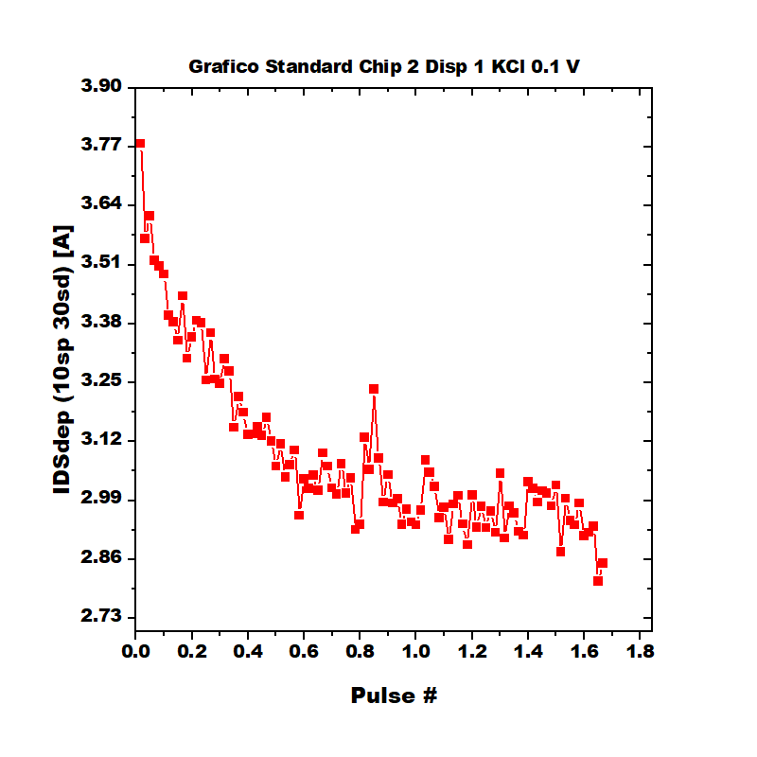
Stability Standard Chip 2 Disp 1 KCl 0.1 V.png

