Slide 1






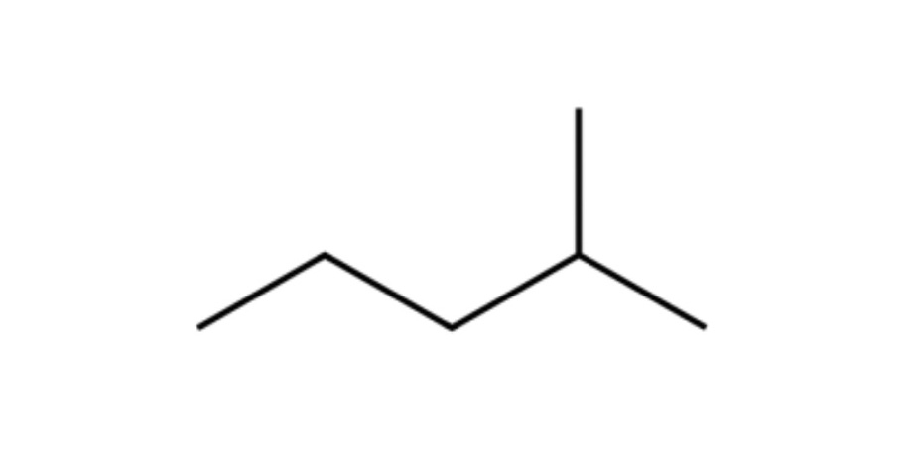

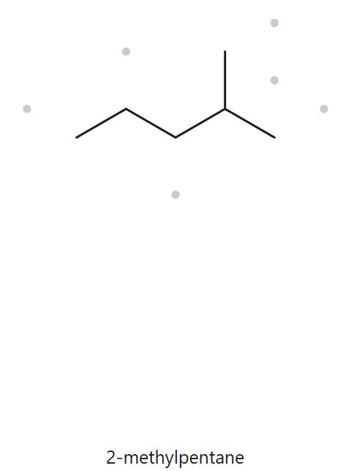




A01-FOUNDATION C6H14
Parent: longest chain = 5 C → pentane.
Numbering: left → right gives {2}; right → left gives {4}. First point of difference: 2 < 4, so number from the left.
Substituents: methyl on C2 → 2-methyl.
4
2
5
3
1
2-methylpentane
Returned Name: 2-methylpentane
Match ✓
✓ longest chain/ring ✓ lowest locants ✓ alphabetical order ✓ punctuation ✓ formula counted

Slide 2
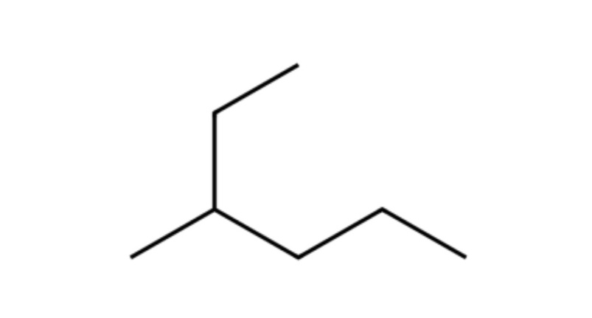
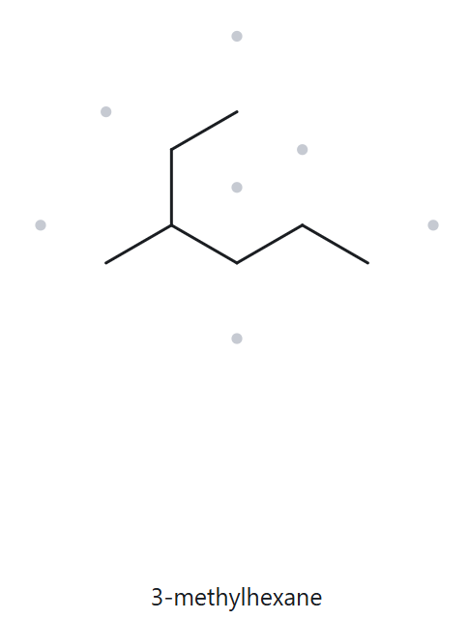
A02-FOUNDATION c7h16
Parent: longest chain = 6 C → hexane (continuous chain is drawn bent; runs from top-left arm through branch down to bottom-right).
Numbering: top → bottom-right gives {3}; bottom-right → top gives {4}. First point of difference: 3 < 4, so number from top arm.
Substituents: methyl on C3 → 3-methyl.
1
2
5
3
4
6
3-methylhexane
Returned Name: 3-methylhexane
Match ✓
✓ longest chain/ring ✓ lowest locants ✓ alphabetical order ✓ punctuation ✓ formula counted

Slide 3
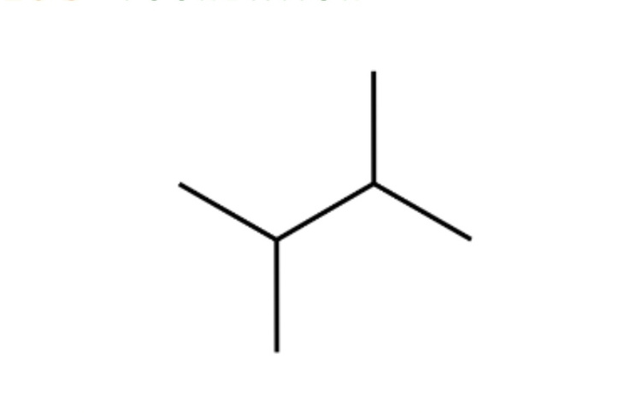
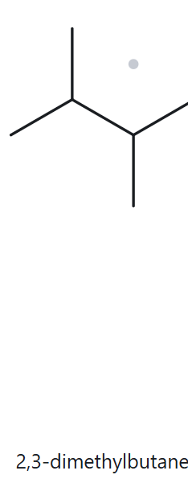
A03-FOUNDATION C6H14
Parent: longest chain = 4 C → butane.
Numbering: both directions give 2,3, so either direction works.
Substituents (A→Z): two identical methyl groups on C2 and C3 → 2,3-dimethyl.
3
1
2
4
2,3-dimethylbutane
Returned Name: 2,3-dimethylbutane
Match ✓
✓ longest chain/ring ✓ lowest locants ✓ alphabetical order ✓ punctuation ✓ formula counted

Slide 4
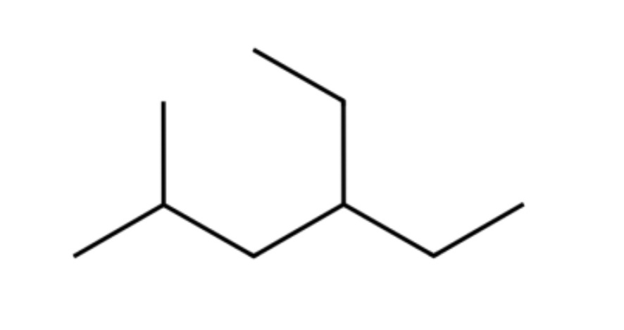
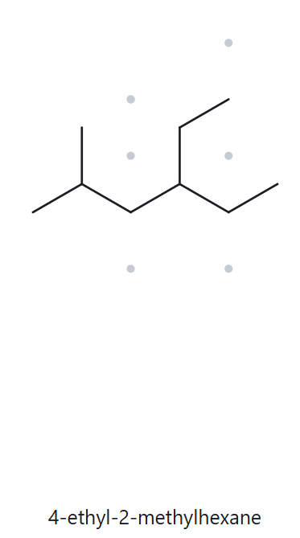
A04-developing C9H20
6
Parent: longest chain = 6 C → hexane. Two 6-C paths exist (through either two-carbon arm on C4), but both give the same name.
Numbering: lower left → upper right gives 2,4; the reverse gives 3,5. First point of difference: 2 < 3, so number from the lower left.
Substituents (A→Z): ethyl on C4, methyl on C2 → 4-ethyl-2-methyl (ethyl is cited first alphabetically).
5
4
2
1
3
4-ethyl-2-methylhexane
Returned Name: 4-ethyl-2-methylhexane
Match ✓
✓ longest chain/ring ✓ lowest locants ✓ alphabetical order ✓ punctuation ✓ formula counted

Slide 5
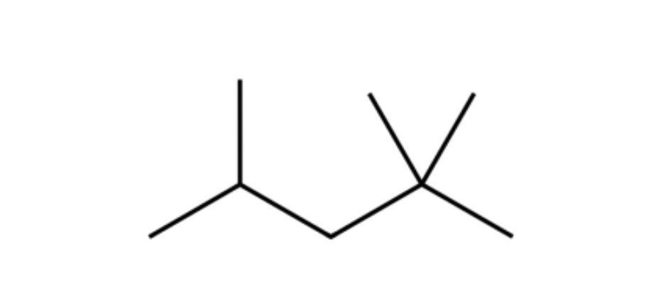
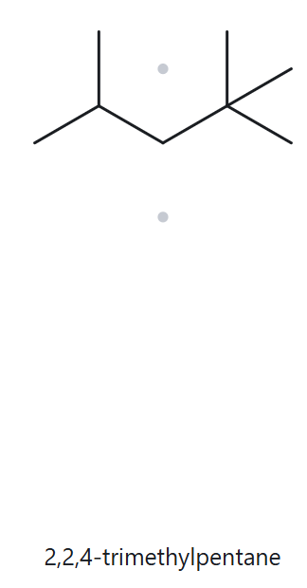
A05-developing C8H18
Parent: longest chain = 5 C → pentane.
Numbering: right → left gives 2,2,4; left → right gives 2,4,4. First point of difference: the second locant, 2 < 4, so number from the right.
Substituents: three methyl groups on C2, C2 and C4 → 2,2,4-trimethyl.
4
2
5
3
1
2,2,4-trimethylpentane
Returned Name: 2,2,4-trimethylpentane
Match ✓
✓ longest chain/ring ✓ lowest locants ✓ alphabetical order ✓ punctuation ✓ formula counted

Slide 6
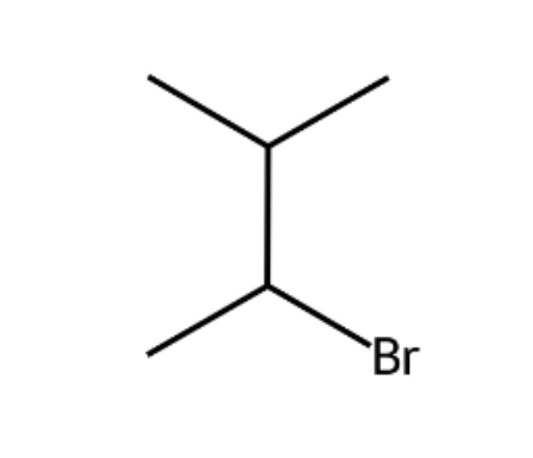
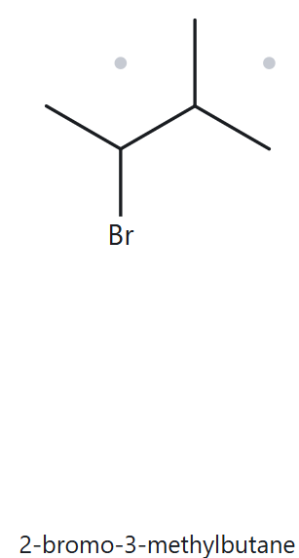
A06-DEVELOPING C5H11Br
Parent: longest chain = 4 C → butane.
Numbering: bottom → top gives 2,3 (Br on C2, methyl on C3); top → bottom also gives 2,3. The locant sets tie, so the alphabetical tie-break applies: bromo comes before methyl, so Br gets the lower number.
Substituents (A→Z): bromo on C2, methyl on C3 → 2-bromo-3-methyl.
4
3
2
1
2-bromo-3-methylbutane
Returned Name: 2-bromo-3-methylbutane
Match ✓
✓ longest chain/ring ✓ lowest locants ✓ alphabetical order ✓ punctuation ✓ formula counted

Slide 7
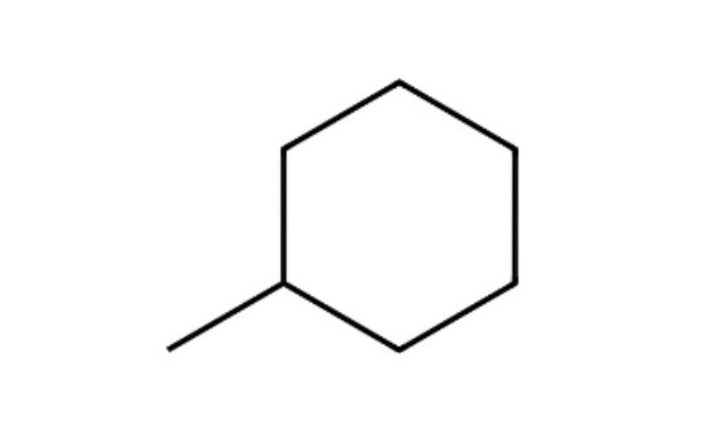
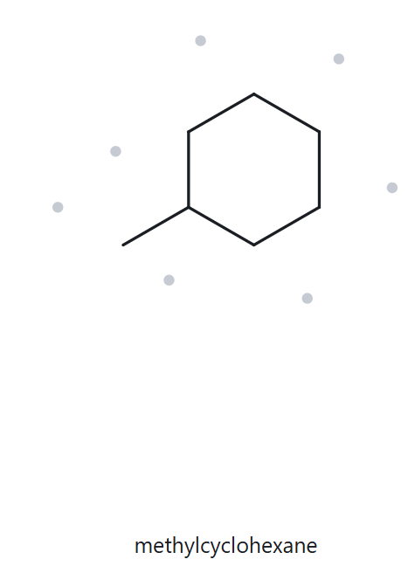
A07-developing C7H14
Parent: ring of 6 C → cyclohexane (the ring is the parent).
Numbering: with one substituent, the ring carbon bearing the methyl is C1 and the locant is not written.
Substituents: methyl → methylcyclohexane.
5
6
4
1
3
2
methylcyclohexane
Returned Name: methylcyclohexane
Match ✓
✓ longest chain/ring ✓ lowest locants ✓ alphabetical order ✓ punctuation ✓ formula counted

Slide 8
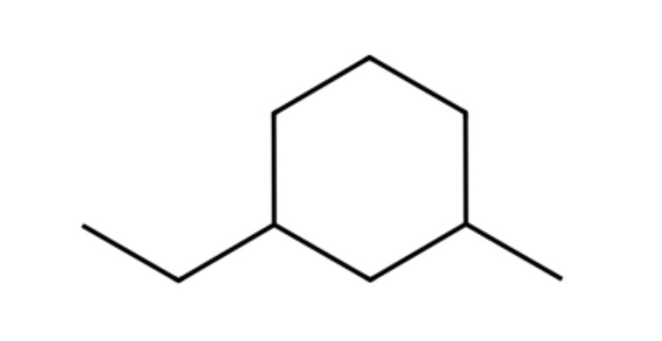
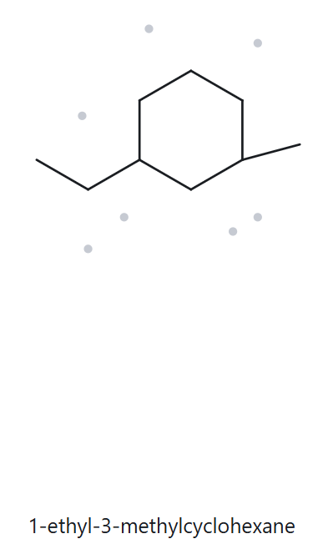
A08-challenge C9H18
Parent: ring of 6 C → cyclohexane.
Numbering: either direction (the short way round) gives 1,3, so the locant sets tie. Alphabetical tie-break: ethyl comes before methyl, so ethyl is C1.
Substituents (A→Z): ethyl on C1, methyl on C3 → 1-ethyl-3-methyl.
5
6
4
3
1
2
1-ethyl-3-methylcyclohexane
Returned Name: 1-ethyl-3-methylcyclohexane
Match ✓
✓ longest chain/ring ✓ lowest locants ✓ alphabetical order ✓ punctuation ✓ formula counted

Slide 9
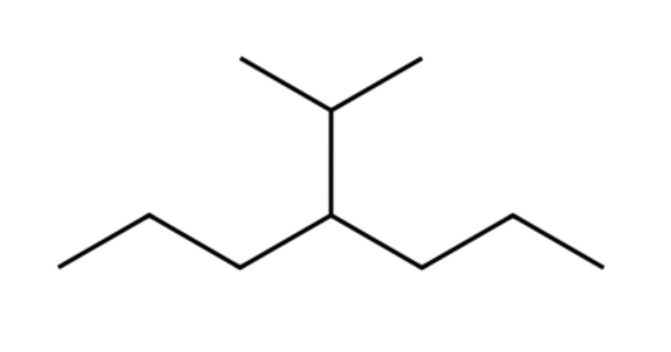
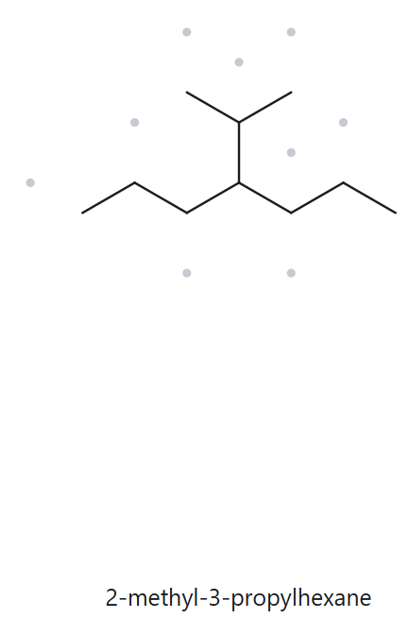
A09-challenge C10H22
Parent: longest chain = 7 C, traced through the branch point (a path through the branch gives only 6 C) → heptane.
Numbering: either end gives 4, since the branch is on the central carbon.
Substituents: isopropyl, written (1-methylethyl), on C4 → 4-isopropyl.
2
6
4
1
3
5
7
Correct name: 4-isopropylheptane; rule that decides: longest chain is 7 C, not the 6-C parent the tool gave.
4-isopropylheptane
Returned Name: 2-methyl-3-propylhexan
Match ✗
✓ longest chain/ring ✓ lowest locants ✓ alphabetical order ✓ punctuation ✓ formula counted

Slide 10
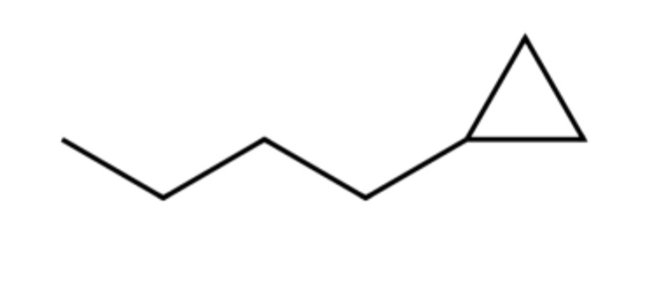
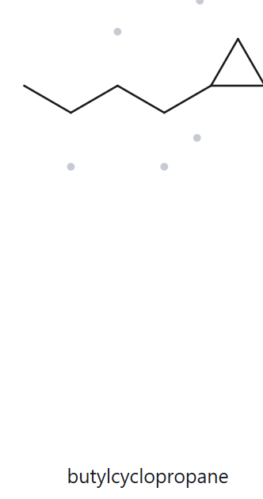
A10-challenge C7H14
3
Parent: the ring is the parent in this activity (current IUPAC rule), even though the chain has 4 C and the ring 3 C → cyclopropane.
Numbering: C1 is the ring carbon bonded to the chain; with one substituent the locant is not written.
Substituents: butyl (the 4-carbon chain) → butylcyclopropane.
2
1
butylcyclopropane
Returned Name: butylcyclopropane
Match ✓
✓ longest chain/ring ✓ lowest locants ✓ alphabetical order ✓ punctuation ✓ formula counted

Slide 11
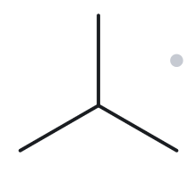
b01-foundation
Given Name: 2-methylpropane
NAME DECODED
BOND-LINE STRUCTURE
Parent: Propane → Three (3) single-bonded C; chain
Substituents: methyl on C2
Expected formula: worked out from the name before drawing: C4H10
formula check
BACK-CHECK
C4H10
General formula: CnH2n+2 (open chain) = C4H10
Agrees? Yes
Returned name: 2-methylpropane
Verdict: same as given
parent length ✓ substituent positions ✓ formula agrees ✓ back-check recorded ✓

Slide 12
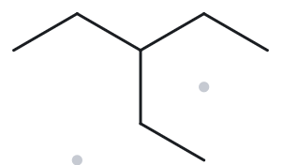
b02-foundation
Given name: 3-ethylpentane
NAME DECODED
BOND-LINE STRUCTURE
Parent: Pentane → Five (5) single-bonded C; chain
Substituents: Ethyl on C3
Expected formula: worked out from the name before drawing: C7H16
formula check
BACK-CHECK
C7H16
General formula: CnH2n+2 (open chain) = C7H16
Agrees? yes
Returned name: 3-ethylpentane
Verdict: same as given
parent length ✓ substituent positions ✓ formula agrees ✓ back-check recorded ✓

Slide 13
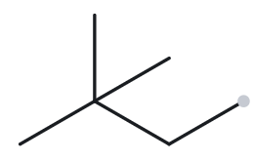
b03-foundation
Given name: 2,2-dimethylbutane
NAME DECODED
BOND-LINE STRUCTURE
Parent: Butane → Four (4) single-bonded C; chain
Substituents: methyl on C2 ; methyl on C2
Expected formula: worked out from the name before drawing: C6H14
formula check
BACK-CHECK
C6H14
General formula: CnH2n+2 (open chain) = C6H14
Agrees? yes
Returned name: 2,2-dimethylbutane
Verdict: same as given
parent length ✓ substituent positions ✓ formula agrees ✓ back-check recorded ✓

Slide 14
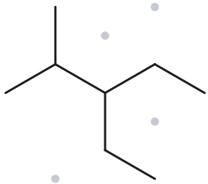
b04-developing
Given name: 3-ethyl-2-methylpentane
NAME DECODED
BOND-LINE STRUCTURE
Parent: Pentane → Five (5) single-bonded C; chain
Substituents: Ethyl on C3 ; methyl on C2
Expected formula: worked out from the name before drawing: C8H18
formula check
BACK-CHECK
C8H18
General formula: CnH2n+2 (open chain) = C8H18
Agrees? yes
Returned name: 3-ethyl-2-methylpentane
Verdict: same as given
parent length ✓ substituent positions ✓ formula agrees ✓ back-check recorded ✓

Slide 15
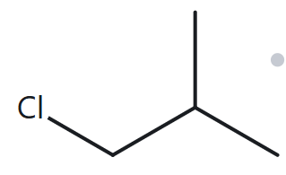
b05-developing
Given name: 1-chloro-2-methylpropane
NAME DECODED
BOND-LINE STRUCTURE
Parent: Propane → Three (3) single-bonded C; chain
Substituents: Chloro on C1 ; methyl on C2
Expected formula: worked out from the name before drawing: C4H9Cl
formula check
BACK-CHECK
C4H9Cl
General formula: CnH2n+2 (open chain) = C4H10; each halogen replaces one H = C4H9Cl
Agrees? yes
Returned name: 1-chloro-2-methylpropane
Verdict: same as given
parent length ✓ substituent positions ✓ formula agrees ✓ back-check recorded ✓

Slide 16
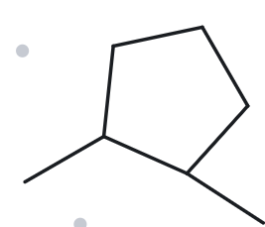
b06-developing
Given name: 1,2-dimethylcyclopentane
NAME DECODED
BOND-LINE STRUCTURE
Parent: Cyclopentane→ Five (5) single-bonded C; ring
Substituents: Methyl on C1 and C2
Expected formula: worked out from the name before drawing: C7H14
formula check
BACK-CHECK
C7H14
General formula: CnH2n (one ring) = C7H14
Agrees? yes
Returned name: 1,2-dimethylcyclopentane
Verdict: same as given
parent length ✓ substituent positions ✓ formula agrees ✓ back-check recorded ✓

Slide 17
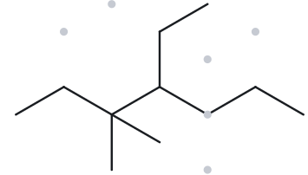
b07- developing
Given name: 4-ethyl-3,3-dimethylheptane
NAME DECODED
BOND-LINE STRUCTURE
Parent: Heptane → Seven (7) single-bonded C; chain
Substituents: Ethyl on C4 ; methyl on C3 (two)
Expected formula: worked out from the name before drawing: C11H24
formula check
BACK-CHECK
C11H24
General formula: CnH2n+2 (open chain) = C11H24
Agrees? yes
Returned name: 4-ethyl-3,3-dimethylheptane
Verdict: same as given
parent length ✓ substituent positions ✓ formula agrees ✓ back-check recorded ✓

Slide 18
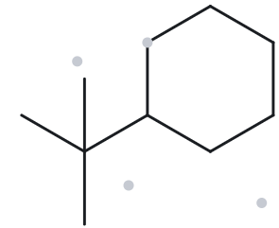
b08-challenge
Given name: tert-butylcyclohexane
NAME DECODED
BOND-LINE STRUCTURE
Parent: Cyclohexane→ Six (6) single-bonded C; ring
Substituents: tert-butyl on C1
Expected formula: worked out from the name before drawing: C10H20
formula check
BACK-CHECK
C10H20
General formula: CnH2n (one ring) = C10H20
Agrees? yes
Returned name: (1,1-dimethylethyl)cyclohexane
Verdict: differs
Explanation: same compound written with a different accepted substituent name. No drawing error.
parent length ✓ substituent positions ✓ formula agrees ✓ back-check recorded ✓

Slide 19
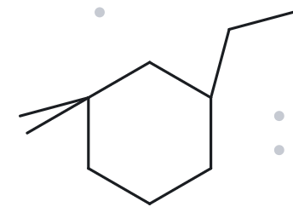
b09-challenge
Given name: 3-ethyl-1,1-dimethylcyclohexane
NAME DECODED
BOND-LINE STRUCTURE
Parent: Cyclohexane → Six (6) single-bonded C; ring
Substituents: Ethyl on C3 ; dimethyl on C1
Expected formula: worked out from the name before drawing: C10H20
formula check
BACK-CHECK
C10H20
General formula: CnH2n (one ring) = C10H20
Agrees? yes
Returned name: 3-ethyl-1,1-dimethylcyclohexane
Verdict: same as given
parent length ✓ substituent positions ✓ formula agrees ✓ back-check recorded ✓

Slide 20
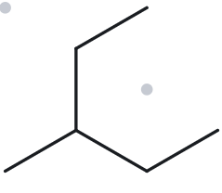
b10-challenge
Given name: 2-ethylbutane
NAME DECODED
BOND-LINE STRUCTURE
Parent: Butane → Four (4) single-bonded C; chain
Substituents: Ethyl on C2
Expected formula: worked out from the name before drawing: C6H14
formula check
BACK-CHECK
C6H14
General formula: CnH2n+2 (open chain) = C6H14
Agrees? yes
Returned name: 3-methylpentane
Verdict: same as given
Explanation: This given name incorrect.
Correct name: 3-methylpentane;
rule broken: the parent chain must be the longest continuous chain.
parent length ✓ substituent positions ✓ formula agrees ✓ back-check recorded ✓

