Slide 1
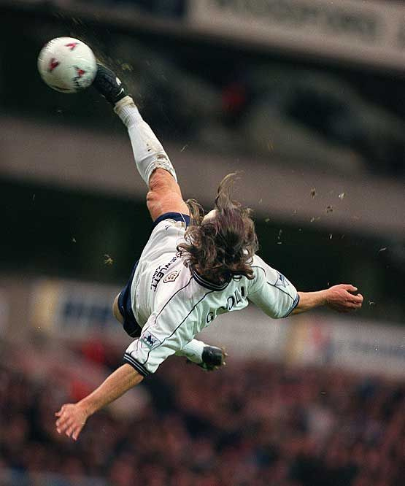
LOOP
STRATGEN
The AI Coordinator for Football Teams
SportsTech · SaaS · Generative AI
Built For: Coaches, Academies, Clubs
Design winning set-pieces before the match starts
TEAM MEMBERS
SHIVANSH (TEAM LEADER)
RITIJ RAJ
PRIYANSHU
VENU PRIYA
loop
-
stratgen
-

Slide 2



LOOP
Market Problem
  Manual method :
    Design tactics manually
    Can’t simulate outcomes
    Rely on intuition, not data
  Other existing tools :
    Analyze past games
    Do not generate new tactics
No SaaS exists that designs tactics automatically

Slide 3


LOOP
Solution
What is StratGen?
StratGen is a cloud-based AI platform that:
  Takes a set-piece scenario
  Understands player positioning
  Generates optimized attacking tactics
  Visualizes improvements instantly
SaaS MVP Features
Interactive pitch board, AI-generated attacking movements, Shot probability improvement score, Before vs After comparison, Save & export tactics

Slide 4
LOOP
HOME
ABOUT
CONTENT
OTHERS
How the STRATGEN AI Works
  Player Relationships Modeling (GNN):
  StratGen represents players as connected points on the pitch and uses a Graph Neural Network (GNN) to understand spacing, marking, and pressure between players.
  Tactical Evaluation:
  The GNN analyzes these relationships to estimate how likely a set-piece is to create a scoring opportunity.
  Tactic Generation (CVAE):
  A generative model (Conditional Variational Autoencoder) then adjusts attacking player positions to explore better tactical setups.
  Validation Loop:
  Each generated tactic is re-evaluated by the GNN to ensure it improves the scoring probability.
Output:
AI-generated player movements with a clear improvement metric for coaches.

Slide 5
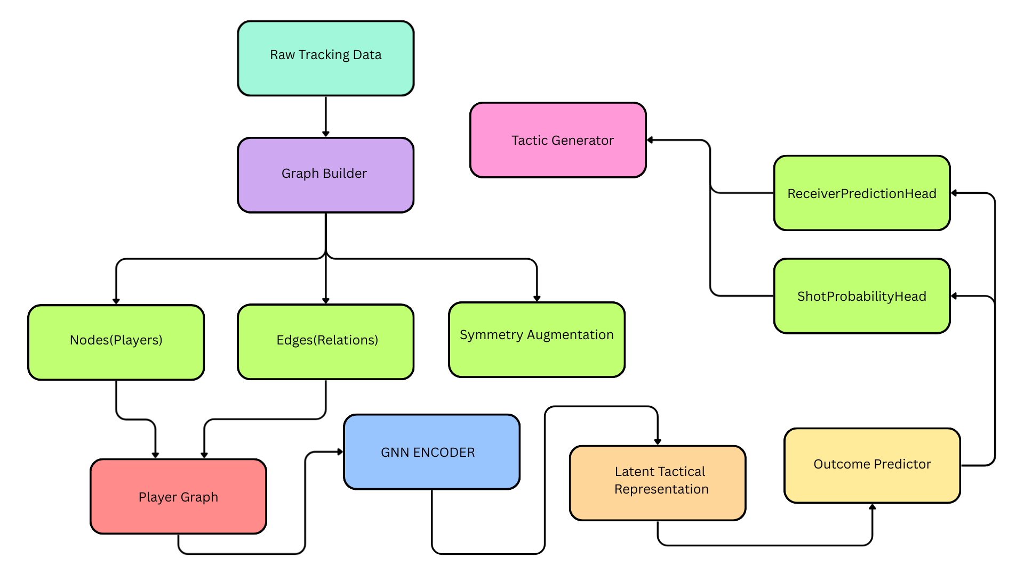
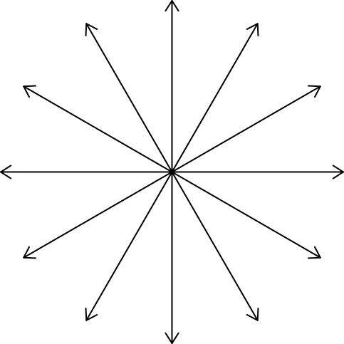
LOOP
AI CORE WORKING

Slide 6
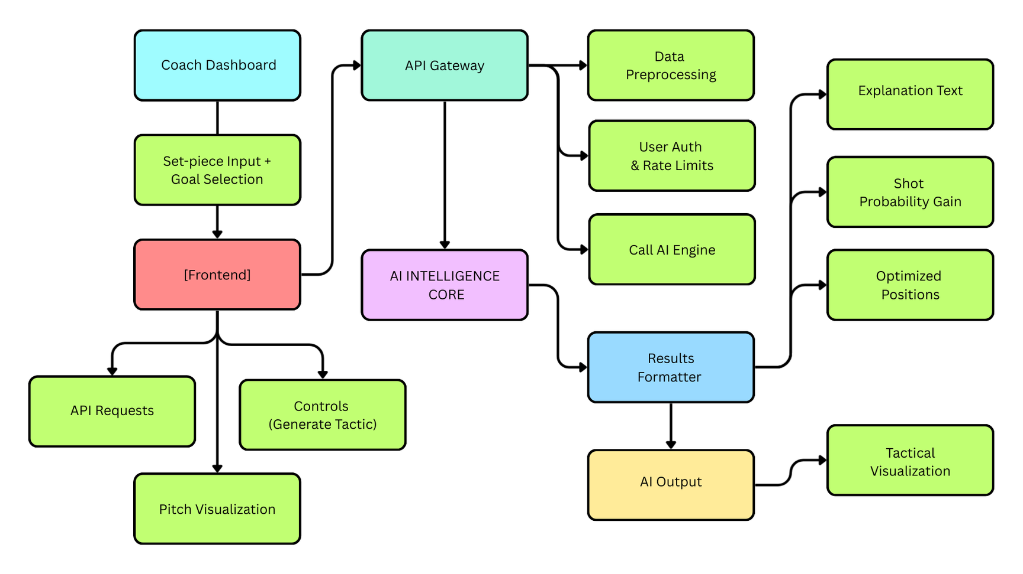
LOOP
PRODUCT WORKING

Slide 7


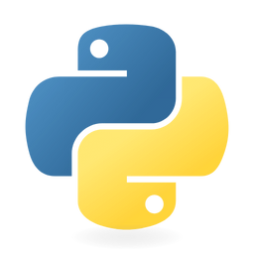


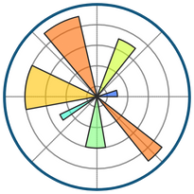






LOOP
Tech Stack
PYTORCH
STREAMLIT
PYTHON
FASTAPI
TECH STACK SUMMARY
POSTRES
StratGen is a SaaS-based AI coaching platform that uses graph neural networks and generative models to analyze set-piece situations and automatically design optimized attacking tactics, helping coaches improve scoring chances through data-driven decision making.
MATPLOTLIB
REACT
PANDAS
JAVASCRIPT
AWS
NEXT.JS
DOCKER

Slide 8
LOOP
Feasibility & Viability
Technical Feasibility
Business Viability
StratGen is technically feasible using existing open football tracking datasets and mature AI frameworks such as graph neural networks and generative models. The system can be developed as a modular pipeline and deployed on standard cloud infrastructure, making it achievable within current technical and computational limits.
StratGen addresses a real and high-value problem in football coaching—set-piece optimization—where teams are already willing to invest in analytics tools. A subscription-based SaaS model provides predictable recurring revenue and allows easy expansion from academies to professional clubs.
Market Viability
The sports analytics market is rapidly adopting AI-driven decision tools, yet most existing solutions focus on post-match analysis rather than tactical generation. StratGen fills this gap by offering a unique generative approach, giving it strong differentiation and growth potential.

Slide 9
LOOP
OTHER
Target Customers
Scalability & Vision
Initial Market:
  Football academies
  College teams
  Semi-professional clubs
  Independent coaches
Future:
  Professional clubs
  Sports analytics firms
  Broadcasters
Long-Term Vision
“StratGen becomes the standard AI assistant for tactical preparation.”
  Used before matches
  Integrated into training
  Data-driven coaching decisions

Slide 10
LOOP
THANK YOU
-
STATGEN
-

