Slide 1

Pick- a -Poop
Daria
Henri
Linnea

Slide 2

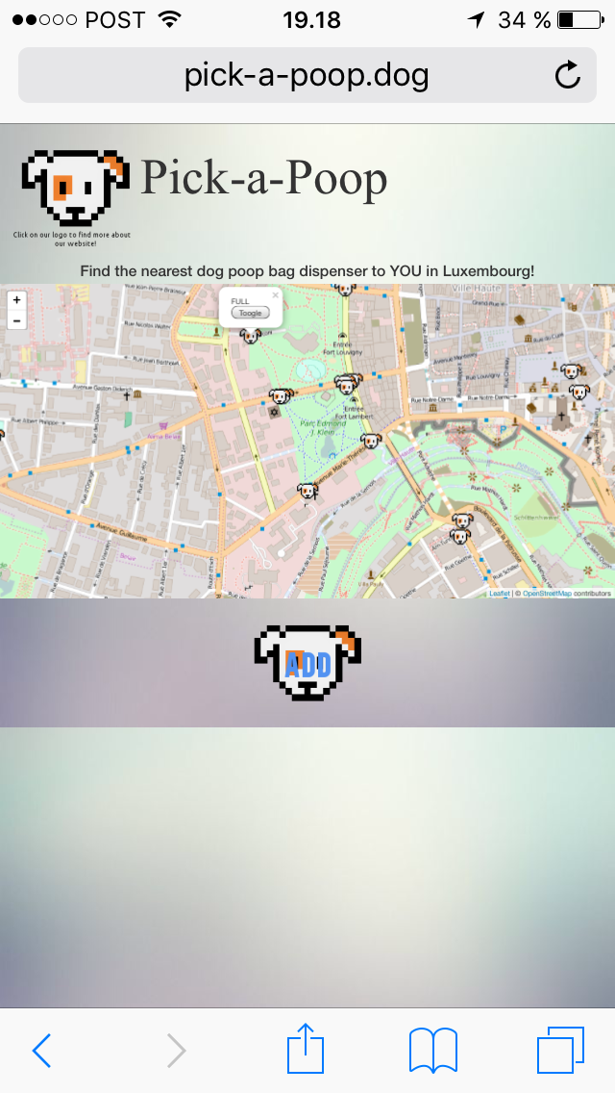

Slide 3
www.pick-a-poop.dog
Challenges
&
FUTURE

