Slide 1
SimpleDB Overview
9/18/2008

Slide 2
What is SimpleDB?
A basic database system
What is has
  Heapfiles
  Basic Operators (Scan, Filter, JOIN, Aggregate)‏
  Buffer Pool
  Transactions
  SQL Front-end
Things it doesn't have
  Query optimizer
  Fancy relational operators (UNION, etc)‏
  Recovery
  Indices

Slide 3
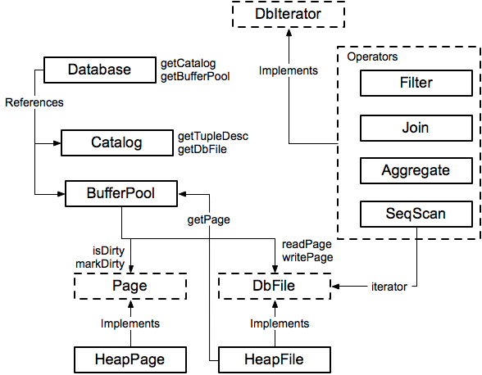
Module Diagram

Slide 4
Catalog
Catalog stores a list of available tables, TupleDesc
  void addTable(DbFile d, TupleDesc d)‏
  DbFile getTable(int tableid)‏
  TupleDesc getTupleDesc(int tableid)‏
Not persisted to disk

Slide 5
DbIterator.java
Iterator class implemented by all operators
  open()‏
  close()‏
  getTupleDesc()‏
  getNext()‏
  rewind()‏
Iterator model: chain iterators together

Slide 6
// construct a 3-column table schema
Type types[] = new Type[]{ Type.INT_TYPE, Type.INT_TYPE, Type.INT_TYPE };
String names[] = new String[]{ "field0", "field1", "field2" };
TupleDesc descriptor = new TupleDesc(types, names);
// create the table, associate it with some_data_file.dat
// and tell the catalog about the schema of this table.
HeapFile table1 = new HeapFile(new File("some_data_file.dat"));
Database.getCatalog().addTable(table1, descriptor);
// construct the query: we use a simple SeqScan, which spoonfeeds
// tuples via its iterator.
TransactionId tid = new TransactionId();
SeqScan f = new SeqScan(tid, table1.id());
// and run it
f.open();
while (f.hasNext()) {
Tuple tup = f.next();
System.out.println(tup);
}
f.close();
Database.getBufferPool().transactionComplete

Slide 7
HeapFile.java
An array of HeapPages on disk
Javadoc is your friend!
Implement everything except addTuple and removeTuple

Slide 8
HeapPage.java
Format
  Header is a bitmap
  Page contents are an array of fixed-length Tuples
Full page size =
header size + BufferPool.PAGE_SIZE

Slide 9
HeapFileEncoder.java
Because you haven’t implemented insertTuple, you have no way to create data files
HeapFileEncoder converts CSV files to HeapFiles
Usage:
  java -jar dist/simpledb.jar convert csv-file.txt numFields
Produces a file csv-file.dat, that can be passed to HeapFile constructor.

Slide 10
BufferPool.java
Manages cache of pages
  Evicts pages when cache is full [not lab 1]
All page accesses should use getPage
  Even from inside DbFile!
You will eventually implement
  locking for transactions
  Flushing of pages for recovery

Slide 11
Compiling, Testing, and Running
Compilation done through the ant tool
  Works a lot like make
Two kinds of tests:
  Unit tests
  System Tests

