Slide 1
A Crystal Ball for Data-Intensive Processing
CONTROL group
Joe Hellerstein, Ron Avnur, Christian Hidber, Bruce Lo, Chris Olston, Vijayshankar Raman, Tali Roth, Kirk Wylie, UC Berkeley
Peter Haas, IBM Almaden

Slide 2
Context (wild assertions)
Value from information
  The pressing problem in CS (?) (!!)
  (in 1998, is CS about computation, or information? If the latter, what are the hard problems?)
“Point” querying and data management is a solved problem
  at least for traditional data (business data, documents)
“Big picture” analysis still hard

Slide 3
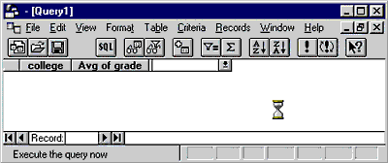
Data Analysis c. 1998
Complex: people using many tools
  SQL Aggregation (Decision Support Sys, OLAP)
  AI-style WYGIWIGY systems (e.g. “Data Mining”)
Both are Black Boxes
  Users must iterate to get what they want
  batch processing (big picture = big wait)
We are failing important users!
  Decision support is for decision-makers!
  Black box is the world’s worst UI

Slide 4
Black Box Begone!
Black boxes are bad
  cannot be observed while running
  cannot be controlled while running
These tools can be very slow
  exacerbates previous problems
Thesis:
  there will always be slow computer programs, usually data-intensive
  fundamental issue: looking into the box...

Slide 5

Crystal Balls
Allow users to observe processing
  as opposed to “lucite watches”
Allow users to predict future
Ideally, allow users to change future
  online control of processing
The CONTROL Project:
  online delivery, estimation, and control for data-intensive processes

Slide 6
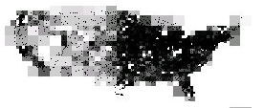
CONTROL @ berkeley
Online Aggregation
  in collaboration with Informix & IBM
  DBMS emphasis, but insights for other contexts
Online Data Visualization
  in Tioga Datasplash
Online Data Mining
UI widgets for large data sets
estimate

Slide 7
Decision-Support in DBMSs
Aggregation queries
  compute a set of qualifying records
  partition the set into groups
  compute aggregation functions on the groups
  e.g.:
Select college, AVG(grade)
From ENROLL
Group By college;

Slide 8
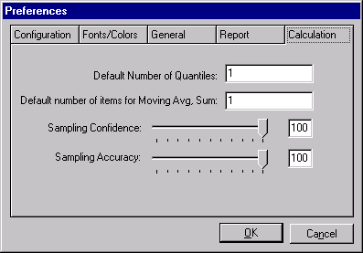
Interactive Decision Support?
Precomputation
  the typical OLAP approach (think Essbase, Stanford)
  doesn’t scale, no ad hoc analysis
  blindingly fast when it works
Sampling
  makes real people nervous?
  no ad hoc precision
    sample in advance
    can’t vary stats requirements
  per-query granularity only

Slide 9
Online Aggregation
Think “progressive” sampling
  a la images in a web browser
  good estimates quickly, improve over time
Shift in performance goals
  traditional “performance”: time to completion
  our performance: time to “acceptable” accuracy
Shift in the science
  UI emphasis drives system design
  leads to different data delivery, result estimation
  motivates online control

Slide 10
Not everything can be CONTROLed
“needle in haystack” scenarios
  the nemesis of any sampling approach
  e.g. highly selective queries, MIN, MAX, MEDIAN
not useless, though
  unlike presampling, users can get some info (e.g. max-so-far)
we advocate a mixed approach
  explore the big picture with online processing
  when you drill down to the needles, or want full precision, go batch-style
  can do both in parallel

Slide 11
Things I Do
CONTROL
  Continuous feedback and control for long jobs
    online aggregation (OLAP)
    data visualization
    data mining
    GUI widgets
  database + UI + stats
GiST: Generalized Search Tree
  extensible index for objects & methods
  concurrency/recovery
  indexability theory (w/Papadimitriou, etc.)
  analysis/debugging toolkit (amdb)
  selectivity estimation for new types

Slide 12
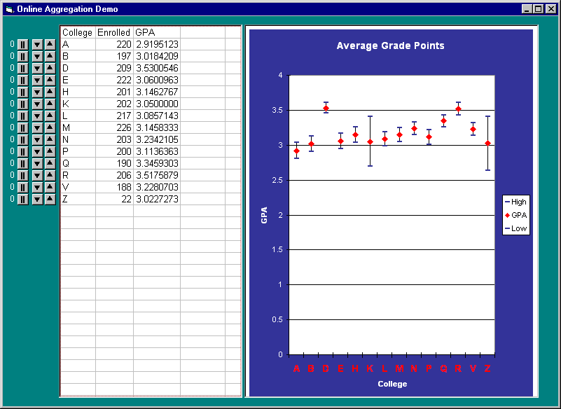
Online Aggregation Demo

Slide 13

New technologies
Online Reordering
  gives control of group delivery rates
  applicable outside the RDBMS setting
Ripple Join family of join algorithms
  comes in naïve, block & hash
Statistical estimators & confidence intervals
  for single-table & multi-table queries
  for AVG, SUM, COUNT, STDEV
  Leave it to Peter
Visual estimators & analysis

Slide 14
Reordering For Online Aggregation
Fairness across groups?
  want random tuple from Group 1, random tuple from Group 2, …
Speed-up, Slow-down, Stop
  opposite of fairness: partiality
Idea: only deliver interesting data
  client specifies a weighting on groups
  maps to a
  we should deliver items to

Slide 15
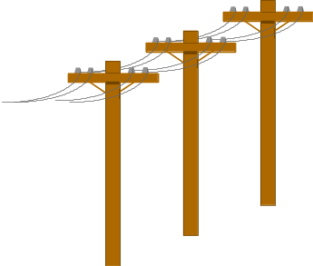
Online Reordering
ABCDABCDABCD...
AABABCADCA...
ABCD
Produce
Process
Consume
Reorder
Performance:
  Effective when Process or Consume > Produce
  Zero-overhead, responsive to user changes
  Index-assisted version too
Other applications
  Scaleable spreadsheets
    scroll, jump
  Batch processing!
    sloppy ordering

Slide 16
Ripple Joins
Progressively Refining join:
  (k_{n} rows of R) × (l_{n} rows of S), increasing n
    ever-larger rectangles in R × S
  comes in naive, block, and hash flavors
R
R
S
S
Traditional
Ripple
Benefits:
  sample from both relations simultaneously
  sample from higher-variance relation faster (auto-tune)
  intimate relationship between delivery and estimation

Slide 17
CLOUDS
Online visualization
  the big picture as a picture!
  plot points as they arrive
  layer “clouds” to compensate for expected error
  how to segment picture?
    v1: grid into squares (quad tree)
    v2: image segmentation techniques?
Tie-ins w/previous algorithms
  delivery techniques for online agg appear beneficial for online viz. Proof?

Slide 18
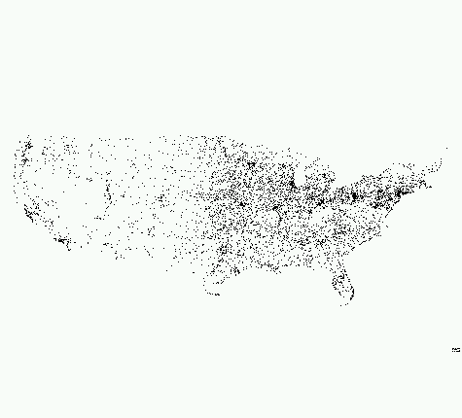
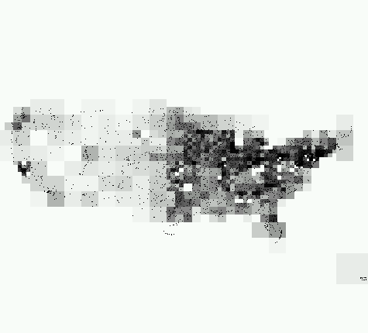
CLOUDS demo

Slide 19
Future CONTROL research
push the online query processing work
  e.g. query optimization, parallelism, middleware
push the online viz work
  empirical or mathematical assessments of goodness, both in delivery and estimation
widget toolkit for massive datasets
  Java toolkit (GADGETS) → spreadsheet
data mining
  online association rules (CARMA)
  what is CONTROL data “mining”?

Slide 20
CONTROL is cheap!
Traditional benchmarks (e.g. TPC):
  cost/speed
Automobile analogy
  Ford vs. Mercedes
  better: f(cost,speed,quality)
Performance wakeup call!
100%
quality
$

Slide 21
Lessons
Dream about UIs, work on systems
Systems, UIs and statistics intertwine
“what unlike things must meet and mate”
  Art, Herman Melville

Slide 22
Status
Things will soon be under CONTROL
  online agg in Postgres, Informix/MetaCube
  joint work with IBM Almaden, possible integration into DB2
  In-house: CLOUDS, CARMA, Spreadsheets
More?
  IEEE Computer ‘99, Database Programming & Design 8/98, DE Bulletin 9/97
  Ripple Join: SIGMOD 99, Juggle: VLDB 99
  SIGMOD ‘97, SSDBM ‘97
  http://control.cs.berkeley.edu

Slide 23
Backup slides
The following slides may be used to answer questions...

Slide 24
Sampling
Much is known here
  Olken’s thesis
  DB Sampling literature
  more recent work by Peter Haas
Progressive random sampling
  can use a randomized access method (watch dups!)
  can maintain file in random order
  can verify statistically that values are independent of order as stored

Slide 25
Estimators & Confidence Intervals
Conservative Confidence Intervals
  Extensions of Hoeffding’s inequality
  Appropriate early on, give wide intervals
Large-Sample Confidence Intervals
  Use Central Limit Theorem
  Appropriate after “a while” (~dozens of tuples)
  linear memory consumption
  tight bounds
Deterministic Intervals
  only useful in “the endgame”

