Slide 1
IGN Code foo challenge
How many ping-pong balls can fit in an average size school bus ?

Slide 2
How to solve
We can solve this mathematically or by counting

Slide 3


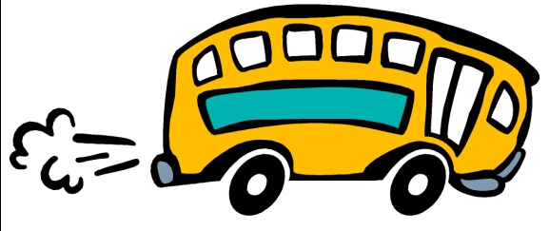
By counting !!!
We need :
A school bus
A massive amount of ping pong balls

Slide 4

How to solve !!
1- we fill the school bus with ping pong balls
2- we count the balls one by one
(…….. I don’t think that’s what your looking for)

Slide 5
By mathematics
We need :
The dimensions of a school bus
The radius of a ping pong ball
11ft = 132 inch
40ft = 480 inch
8ft = 96 inch
1.5 inch

Slide 6
How to solve
1- we divide the width of the school bus by the radius of the ping pong ball so we can get the number of balls that can fit in that width.
96 / 1.5 = 64 balls
Now we have a row of balls across the width of the bus.

Slide 7
How to solve
2- now divide the height of the bus by the radios of the ball to get the number of rows needed to fill the height.
132 / 1.5 = 88 balls
And multiply them with the number of balls across the width to get a slide of balls the fit in the bus.
64 x 88 = 5632 balls

Slide 8
How to solve
3- do the same thing to the length of the bus to get the number of slides needed to fill the bus with balls.
480 / 1.5 = 320 balls
Now just multiply the results to get the number of ping pong balls needed to fill a school bus.
320 x 5632 = 1802240 balls

Slide 9
Complicated ?
If you see this solution complicated then you can always go for the counting way !!

